Slide 1
NSTX-U OH Coil
Lead Area and Embedded G10: Brief Analysis Results
25 May 2011
M. Mardenfeld, PPPL

Slide 2
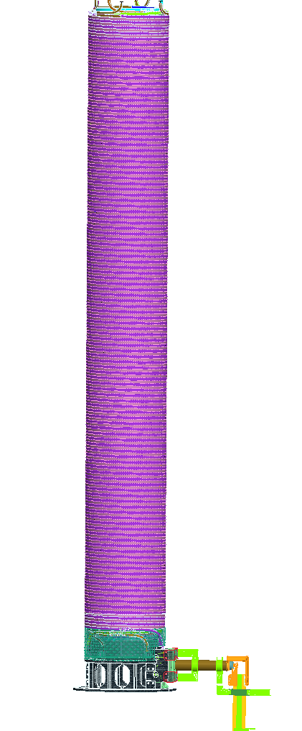
Differential Thermal Expansion
Causes Stresses
Immediately After Pulse
Copper is at ~ 100 C
z
r
Shear along RZ Plane along Interface
G10 Support Annulus
remains “cold”
Bending , Hoop Tension, Shear, Compression
Along Electrical Leads/ Water Feeds

Slide 3
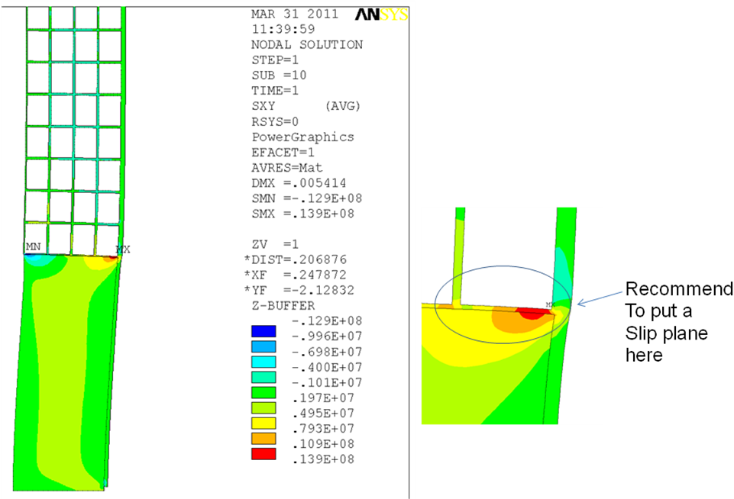
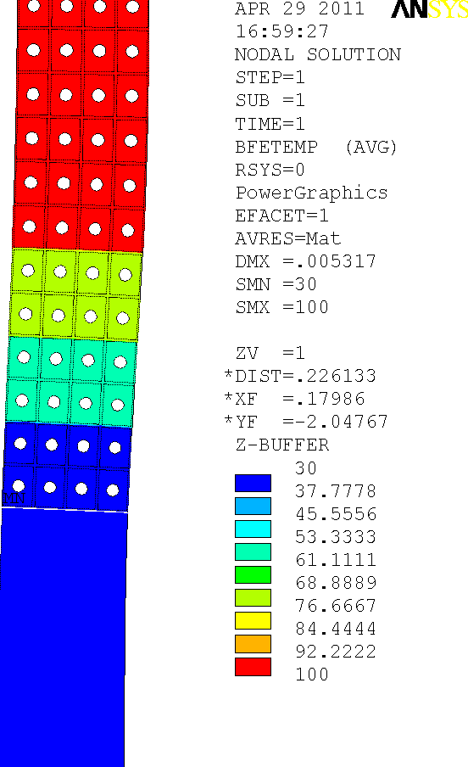
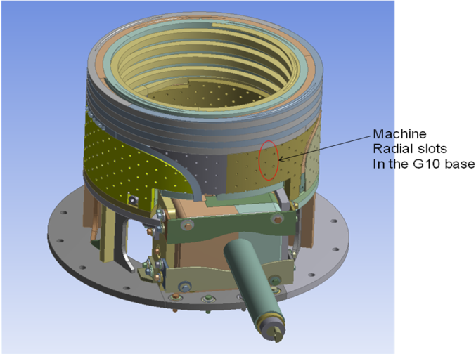
Temp Distribution, C
(Wave has travel several turns)
Shear ( In Plane of Viewing), Pa
Zolfaghari, in his axisymmetric coil model, calculates this effect,
assuming slots have been cut into the G10 to induce flexibility
(slots parallel to tangential plane)

Slide 4
Temp Distribution, C
(Wave has travel several turns)
Deflection ~ 0.3 mm
Shear ( In Plane of Viewing), Pa
Zolfaghari, in his axisymmetric coil model, calculates this effect,
assuming slots have been cut into the G10 to induce flexibility
(slots parallel to tangential plane)

Slide 5
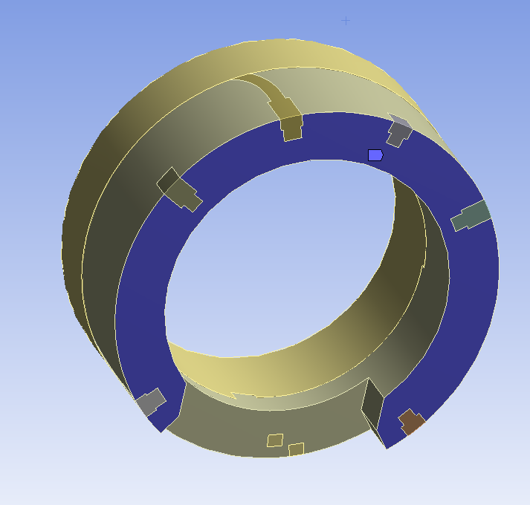
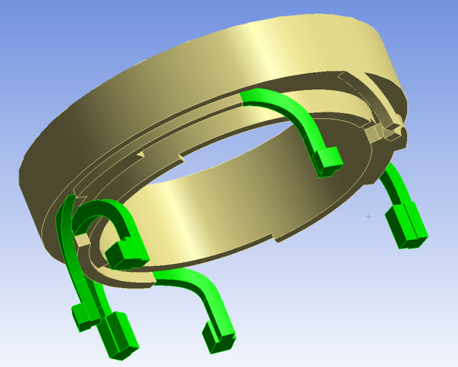
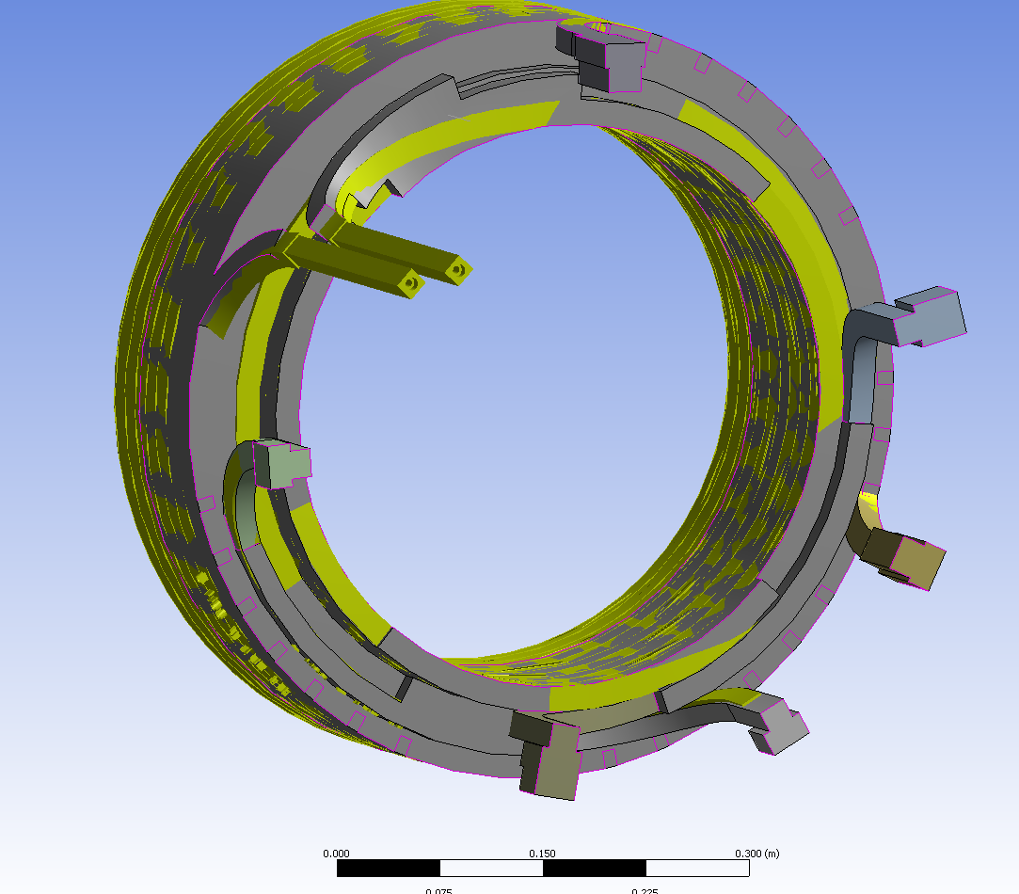
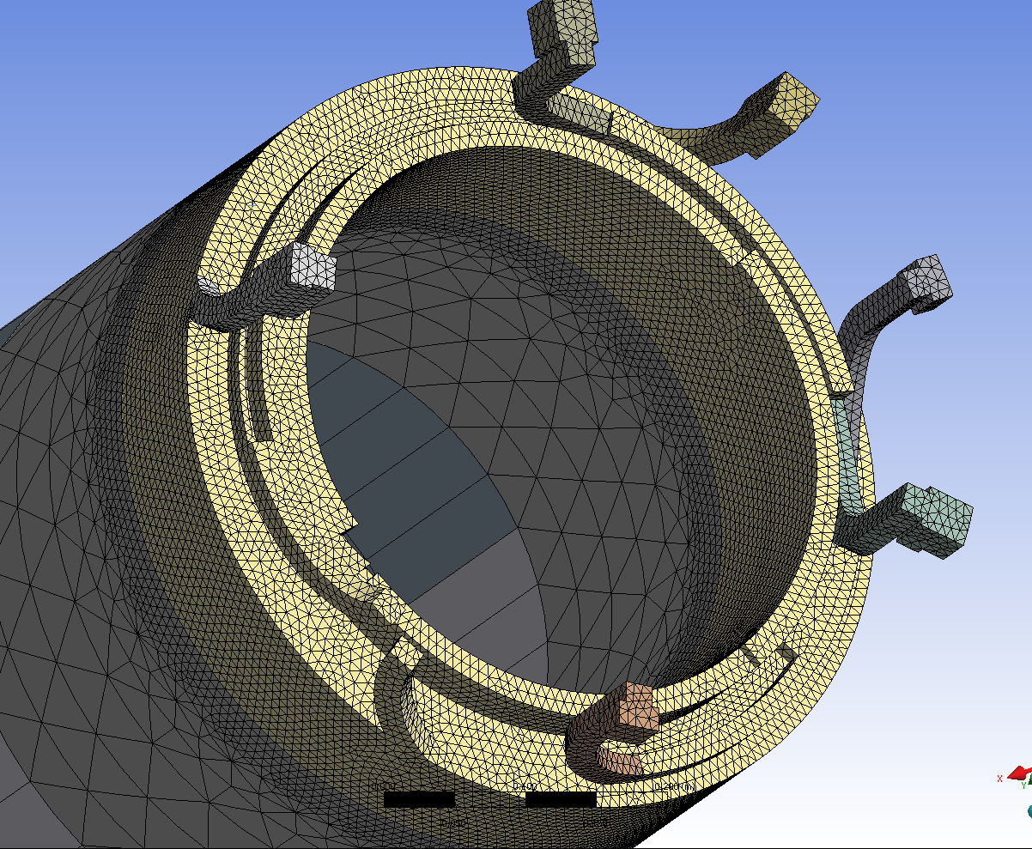
3D Model Developed to Check this Effect
Solid Copper Modeled @ 100 C
to provide Thermal Expansion
Bottom of G10 Fixed
(representing bolts to Support Pedestal)
Water Feeds and G10 remain Cold
True Conductor Geometry, Yellow
overlaid on
FEA approximation
Detail of Conductors in Lead Area

Slide 6
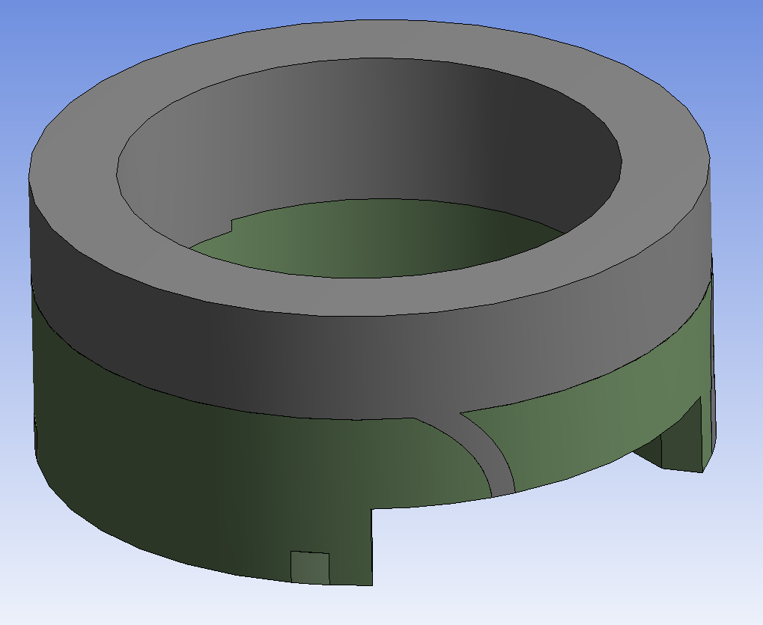
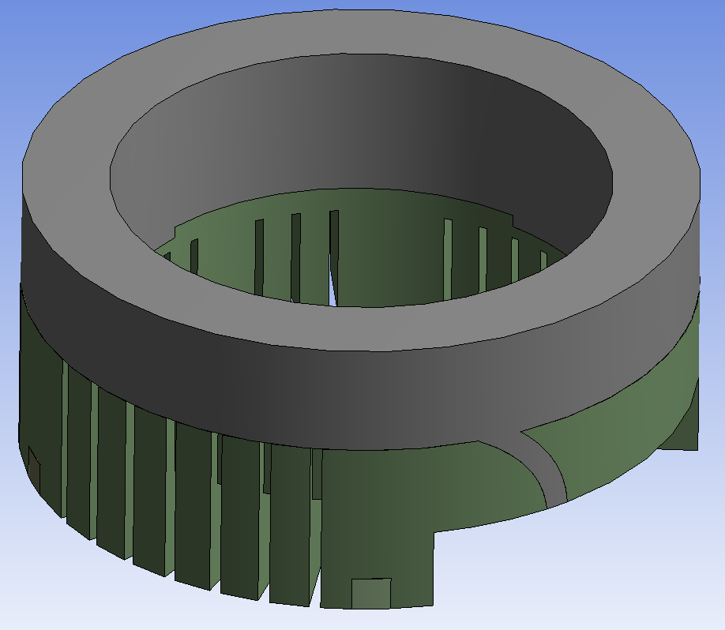
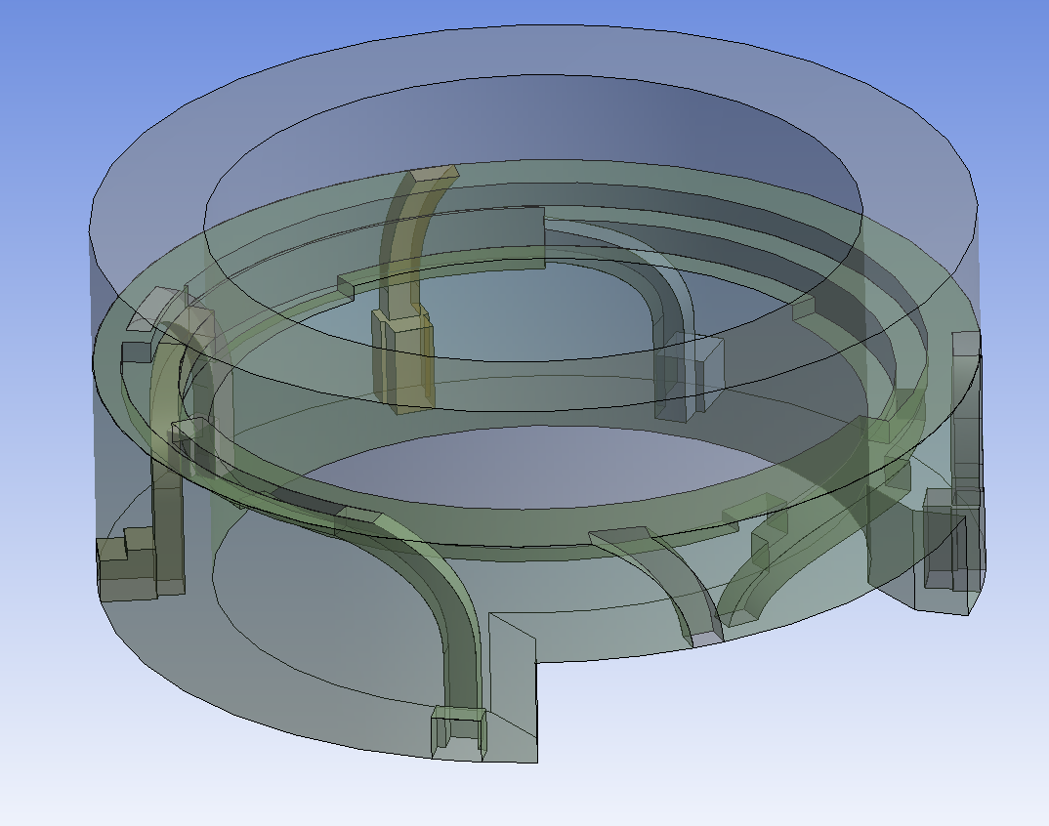
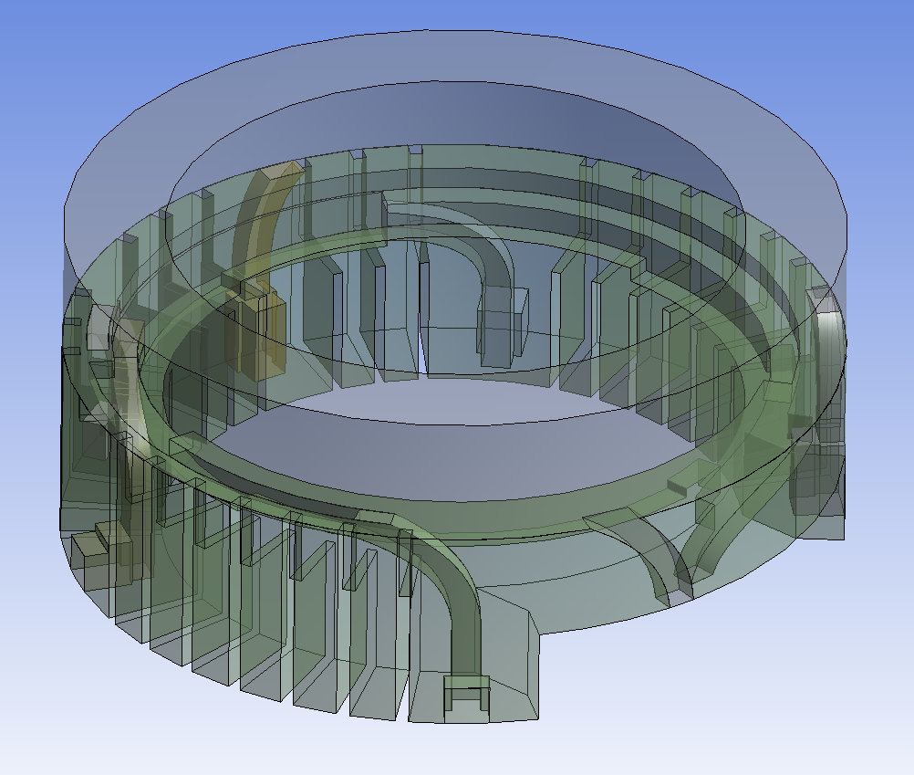
No Slots
Vs
With Slots

Slide 7
No Slots
Vs
With Slots

Slide 8
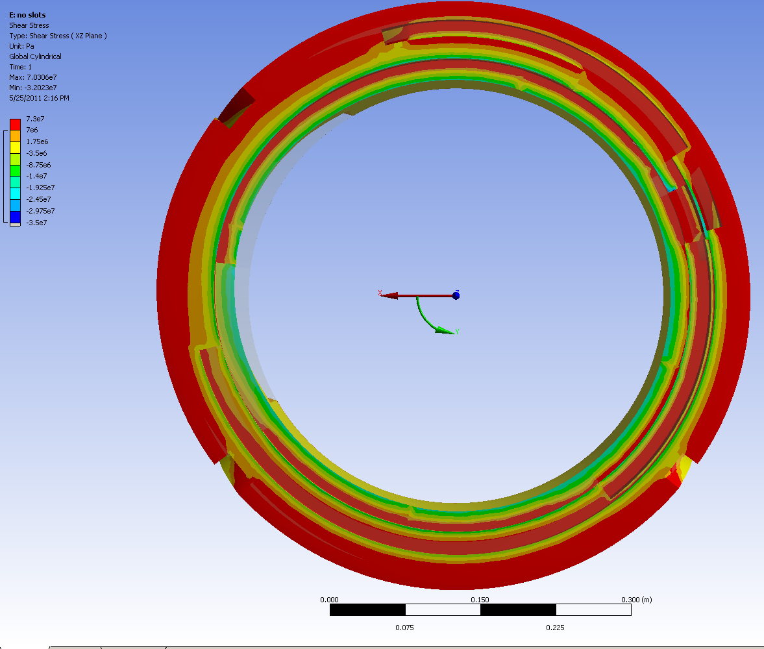
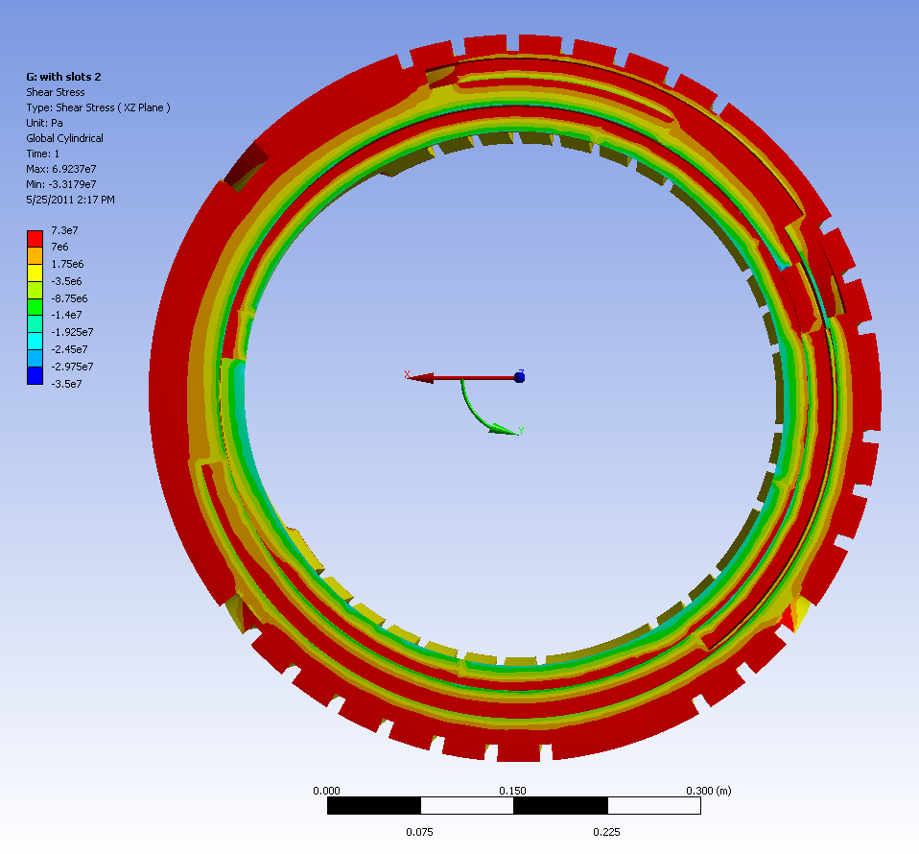
XZ Shear (Pa)
No Slots
With Slots
Red Contour are stresses above 7 Mpa
( Shear Strength between CTD101K and Cu)

Slide 9
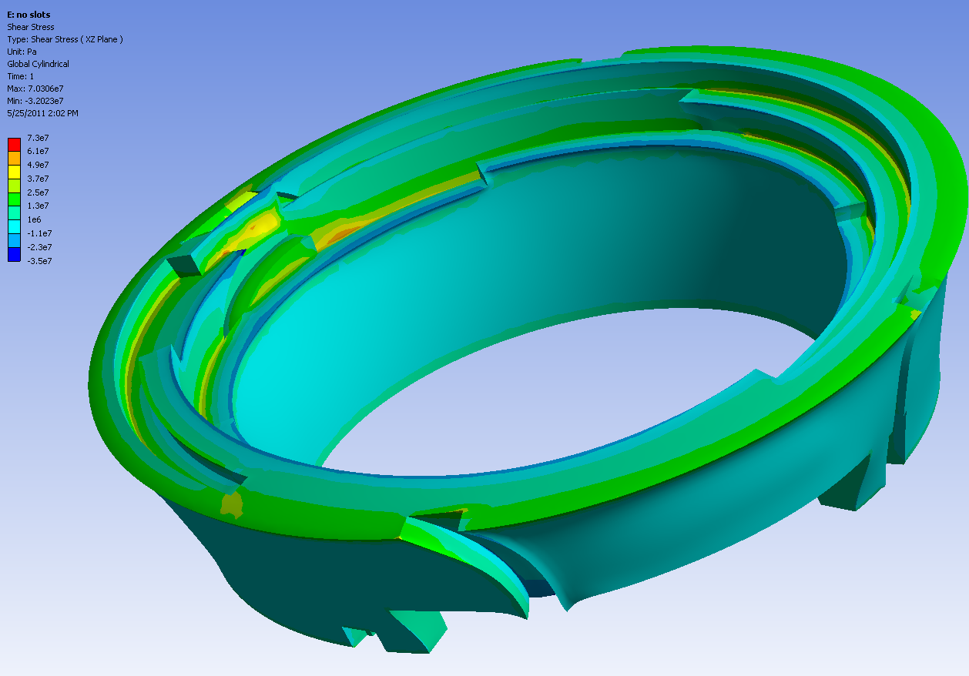
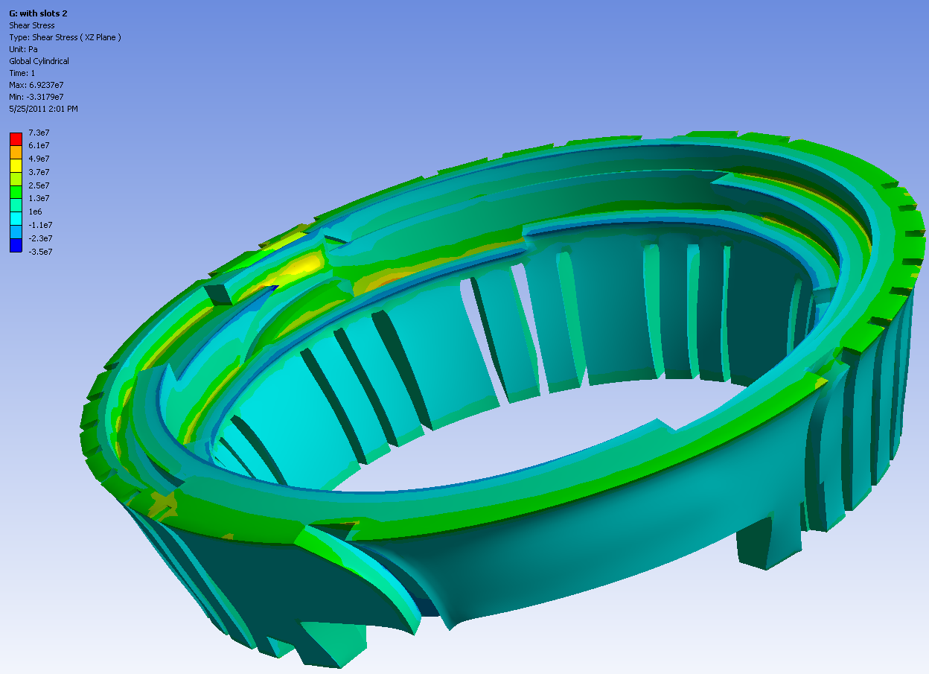
XZ Shear (Pa)

Slide 10
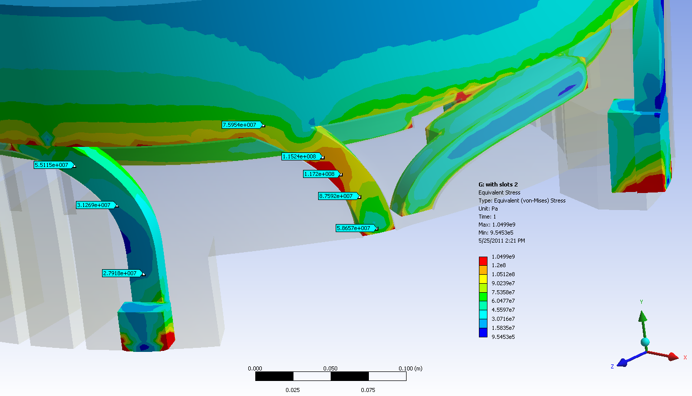
Von Mises Stress in Copper (Pa)
Red Contour is 120 Mpa ~ Fatigue Allowable)
(With Slots, slightly higher than w/o slots)
(Copper Cross Section in model is too big: needs to be refined)
1. Demonstrative of Distribution
2. Slots slightly increase stresses in leads

Slide 11
Possible Solution:
Add stepped rubber grommet?

