Slide 1
NSTX CSU Progect
Testing
New Test Results
23-March-2011

Slide 2
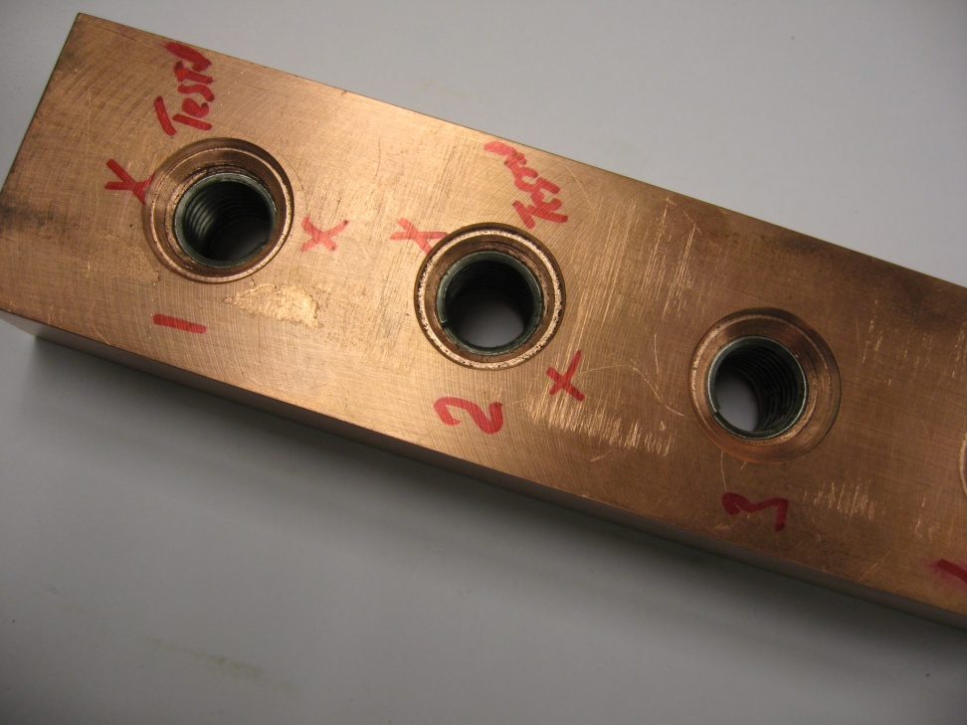
TF Flag Connection Heli-Coil Insert
Pull-Out Test
Insert loaded along axis to 42746 lbf maximum.
Maximum load had NO measurable or observable effect on insert structure.

Slide 3
NSTX TF Coil Flag Connecting Bolt Tensile Strength

Slide 4
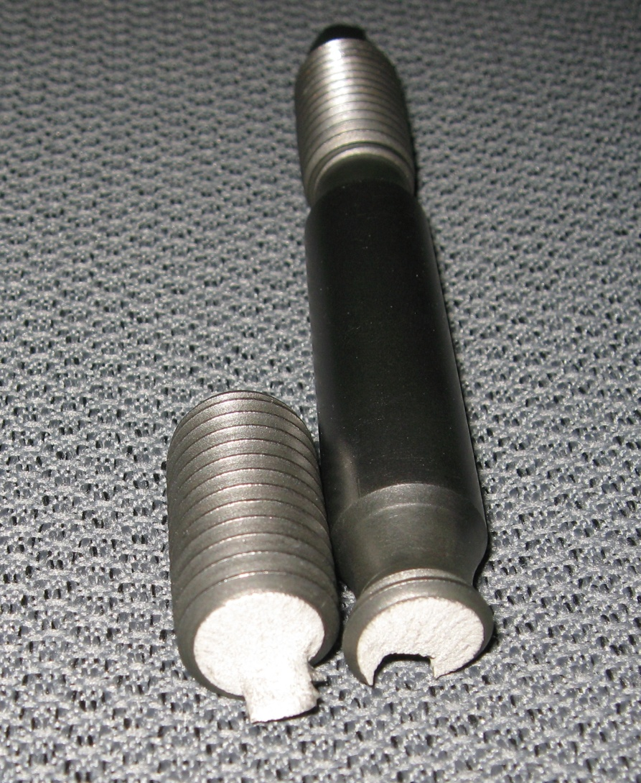
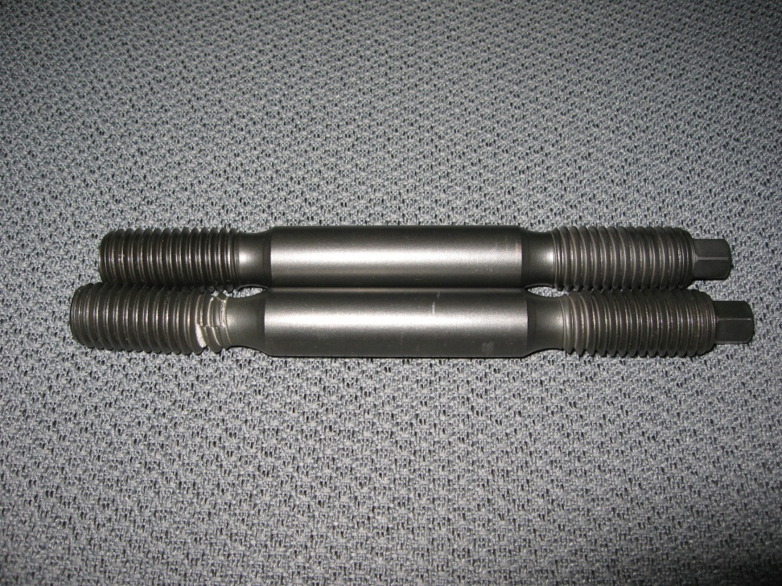
NSTX TF Coil Flag Connecting Bolt Tensile Strength

Slide 5
Bellville Washer Stack

Slide 6
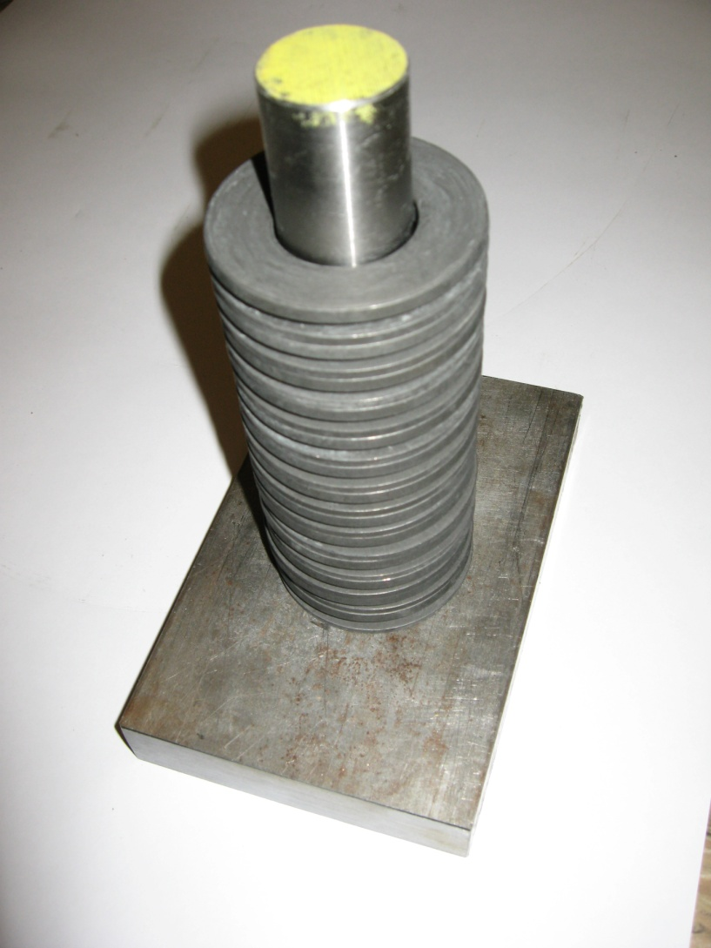
Bellville Washer Stack

Slide 7
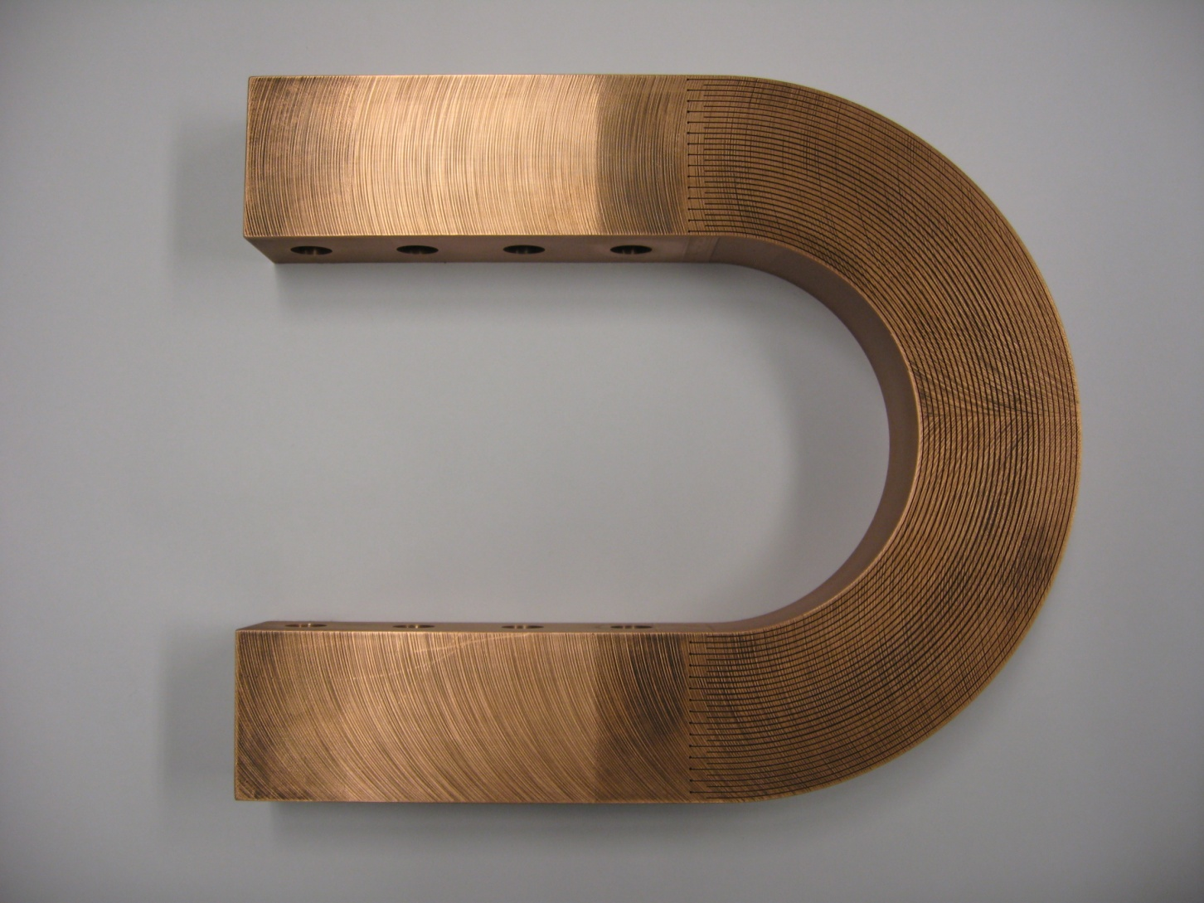
New Wire EDM Flex Conductor

Slide 8
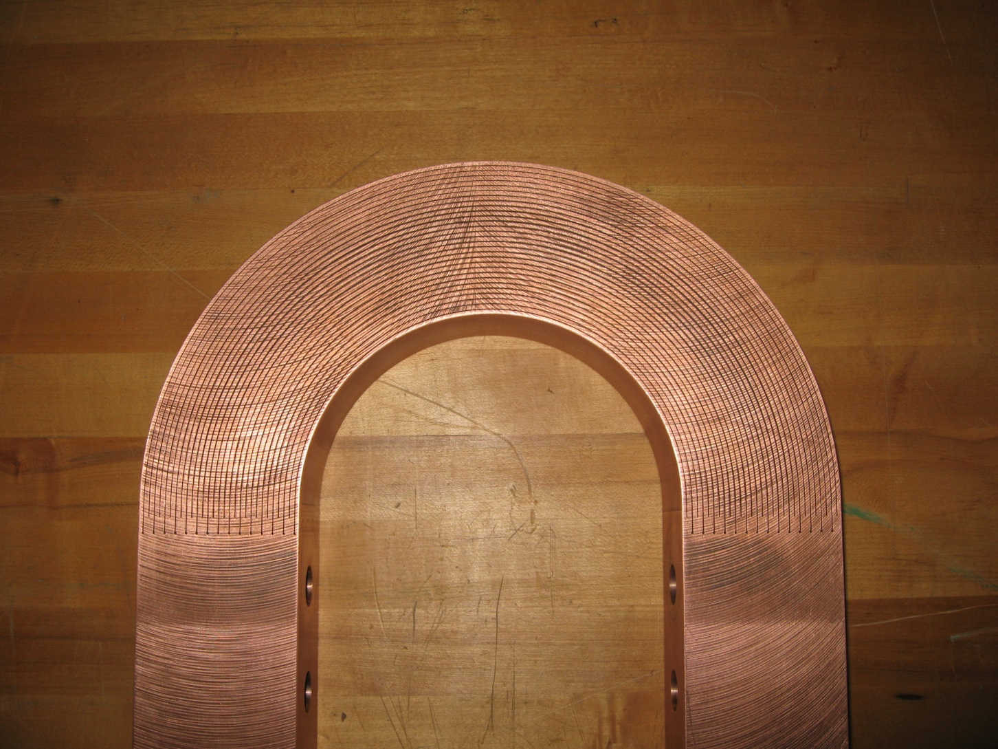
New Wire EDM Flex Conductor

Slide 9
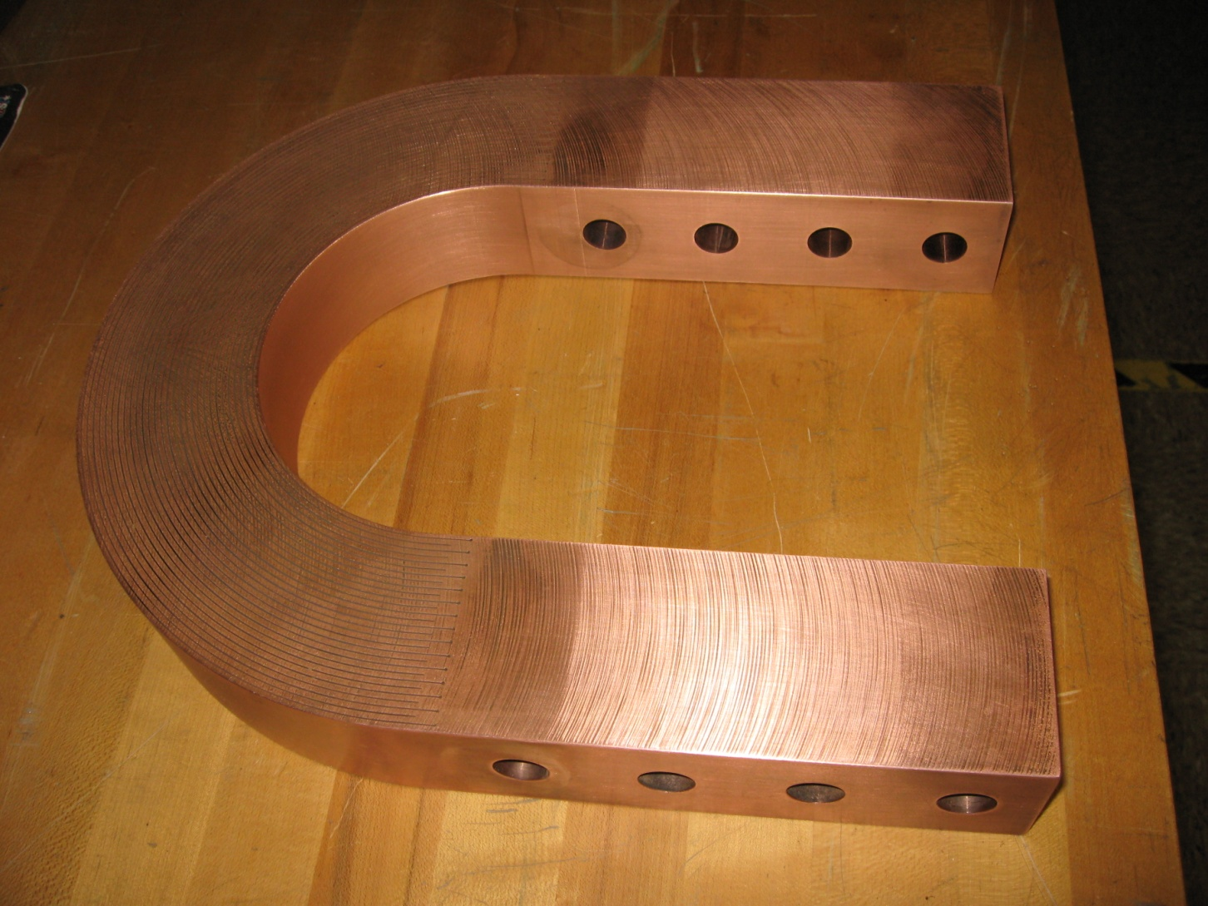
New Wire EDM Flex Conductor

Slide 10
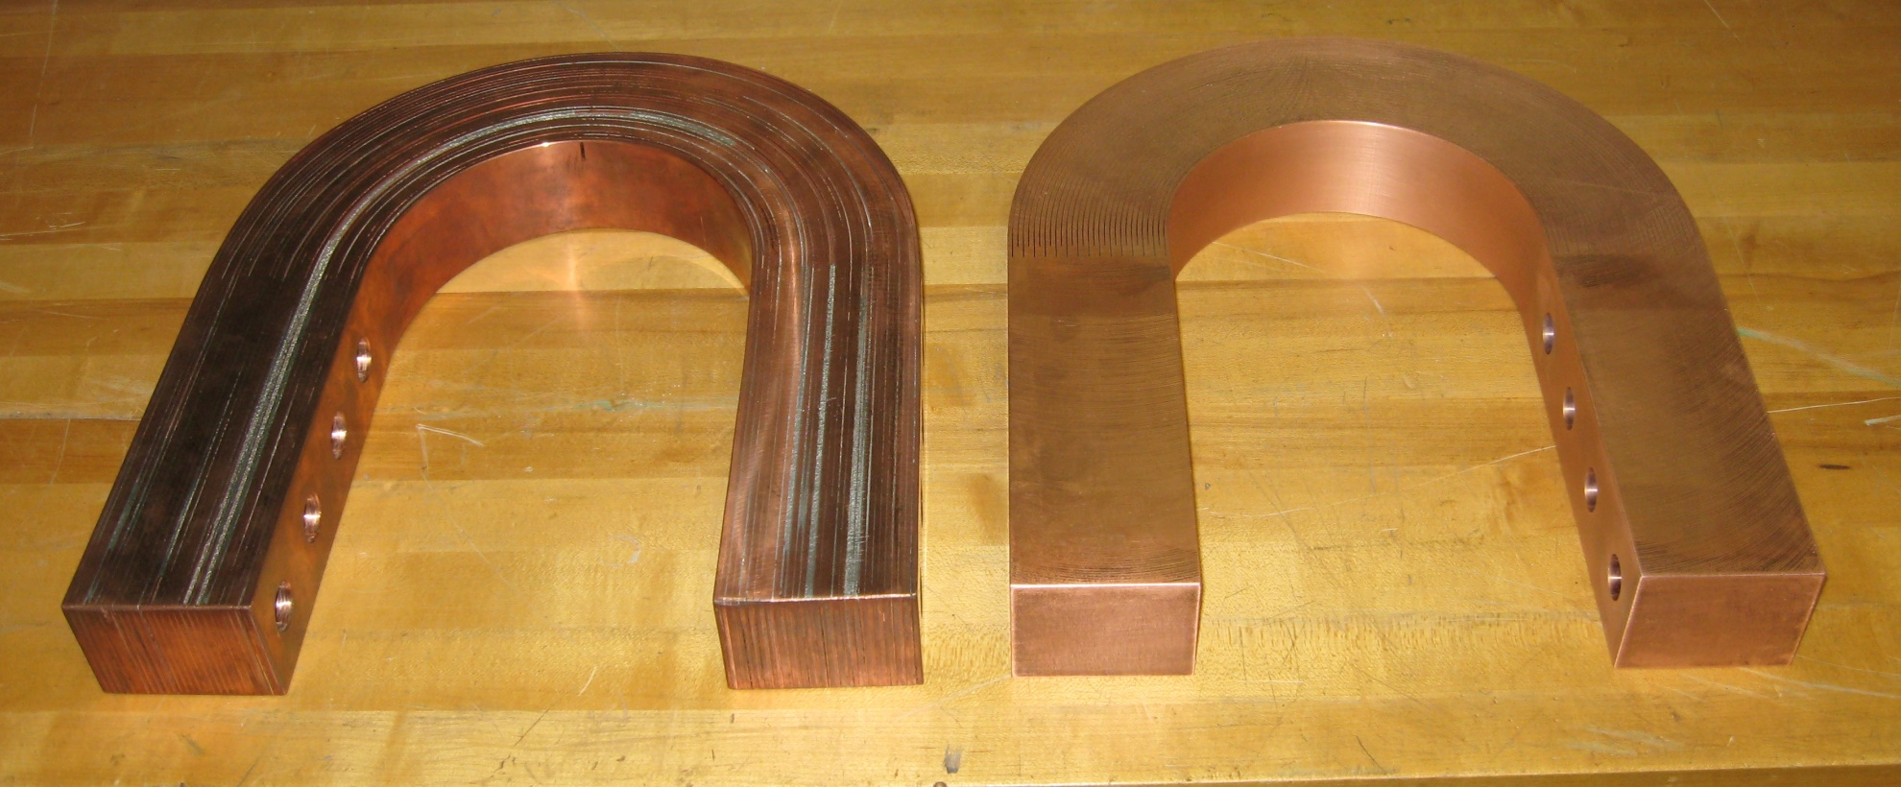
Solder vs. Wire EDM

Slide 11
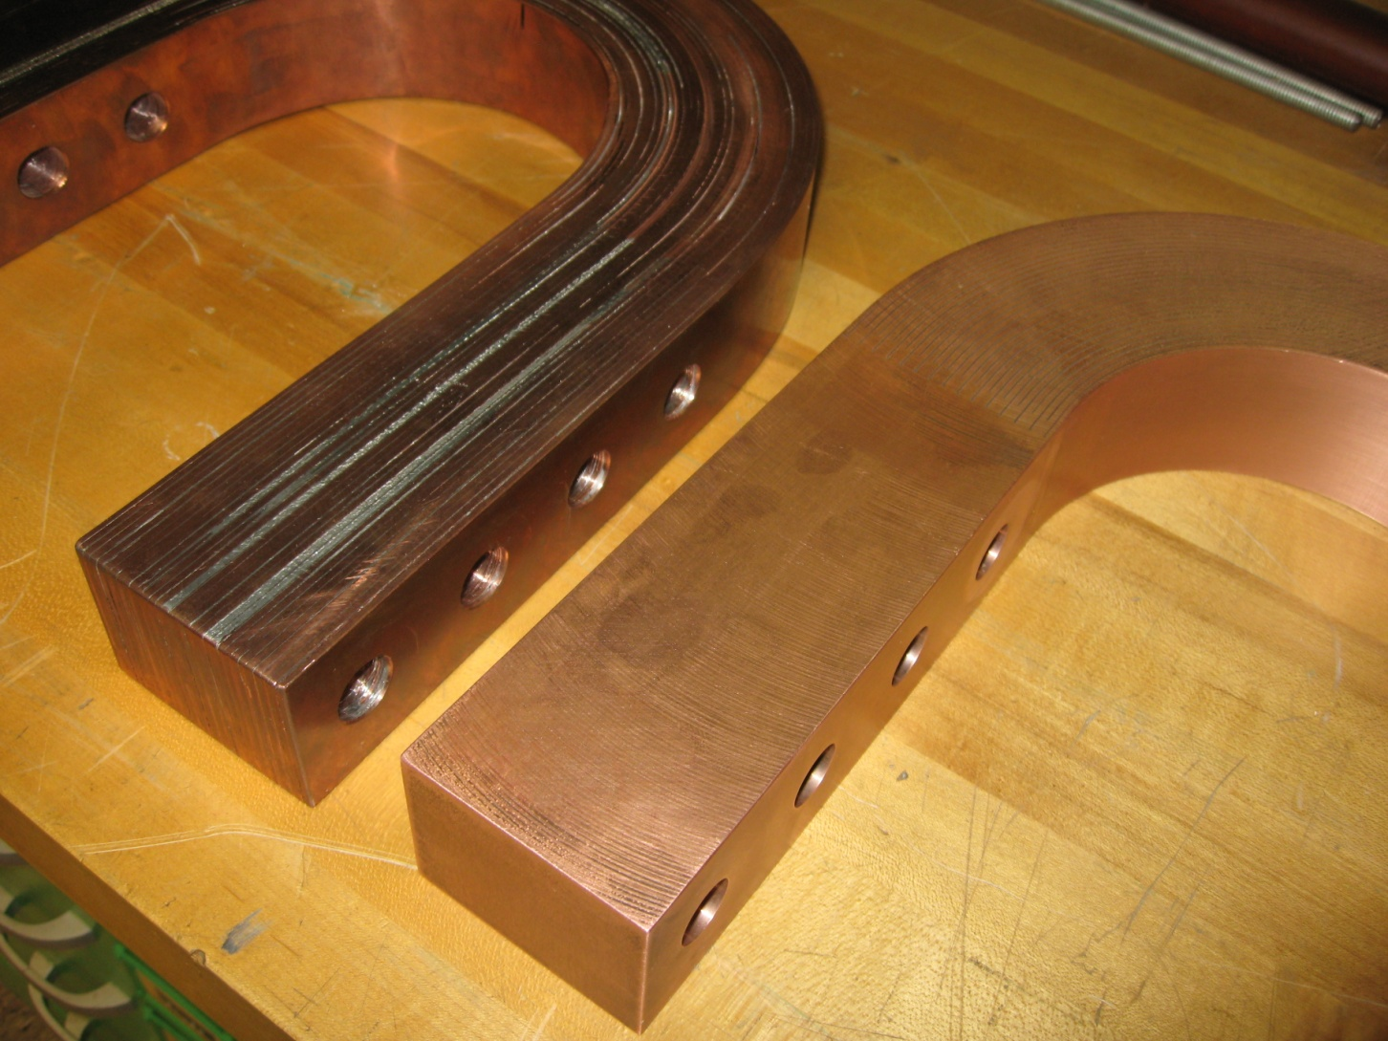
Solder vs. Wire EDM

