Slide 1
NSTX Upgrade Testing
TF Coil Flexible Connector Prototype In-Plane Deflection Test
2011-01-28

Slide 2
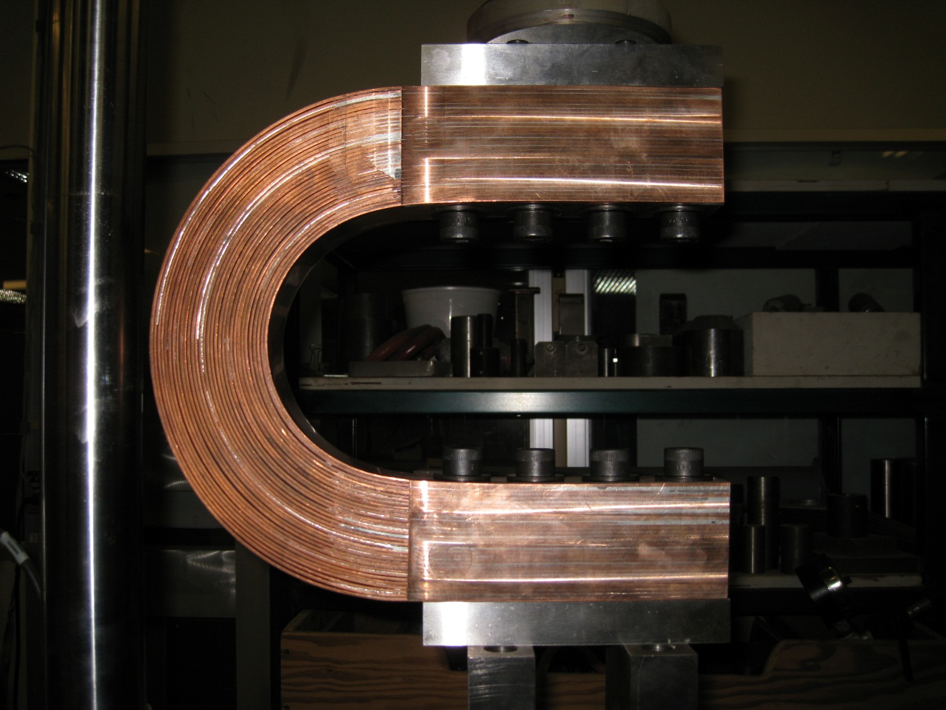
Second Prototype TF Flex Connector in Test Fixture

Slide 3
Flex Connector Prototype #2
Construction: Leaves soldered together with spacers
Prototype Sample Issues:
  Bolt holes misaligned both vertically and horizontally
  Bolt holes required reaming to install bolts
  Solder migration into flex section
  Captivated graphite-foil spacers trapped by solder
  One contact face copper strip only partially soldered
  Terminal portion thickness varies by up to 0.1”
  Free standing unit width is 11.695” (Design = 11.38”)

Slide 4
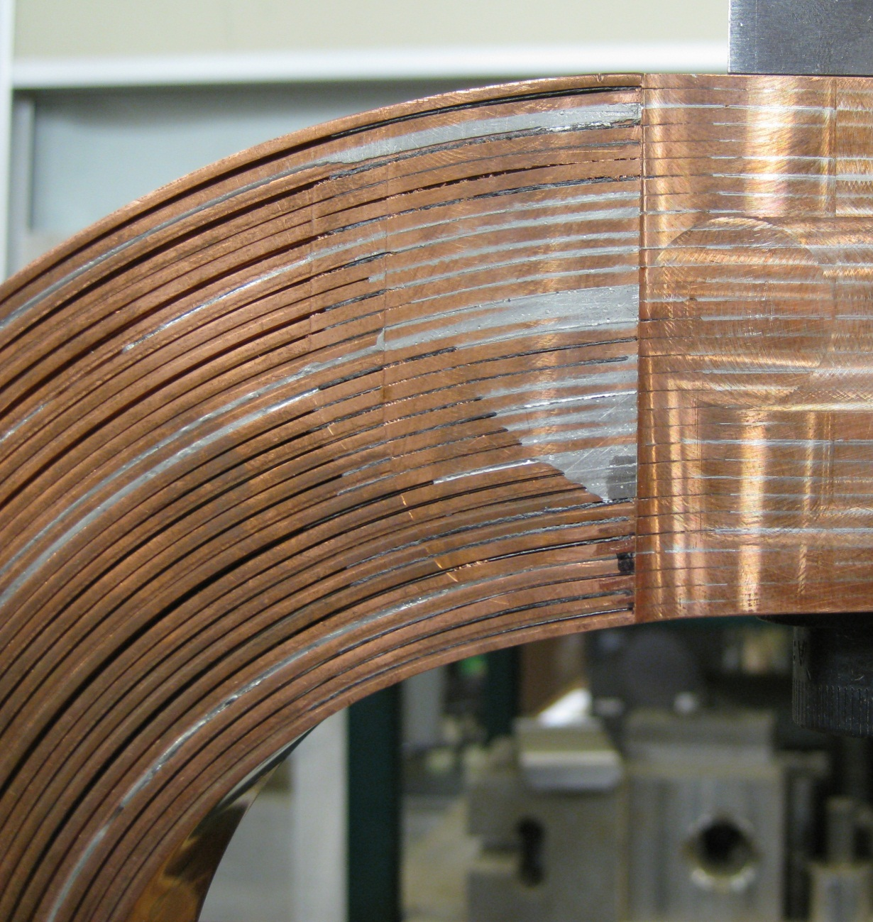
Solder and Graphite in Flex Section

Slide 5
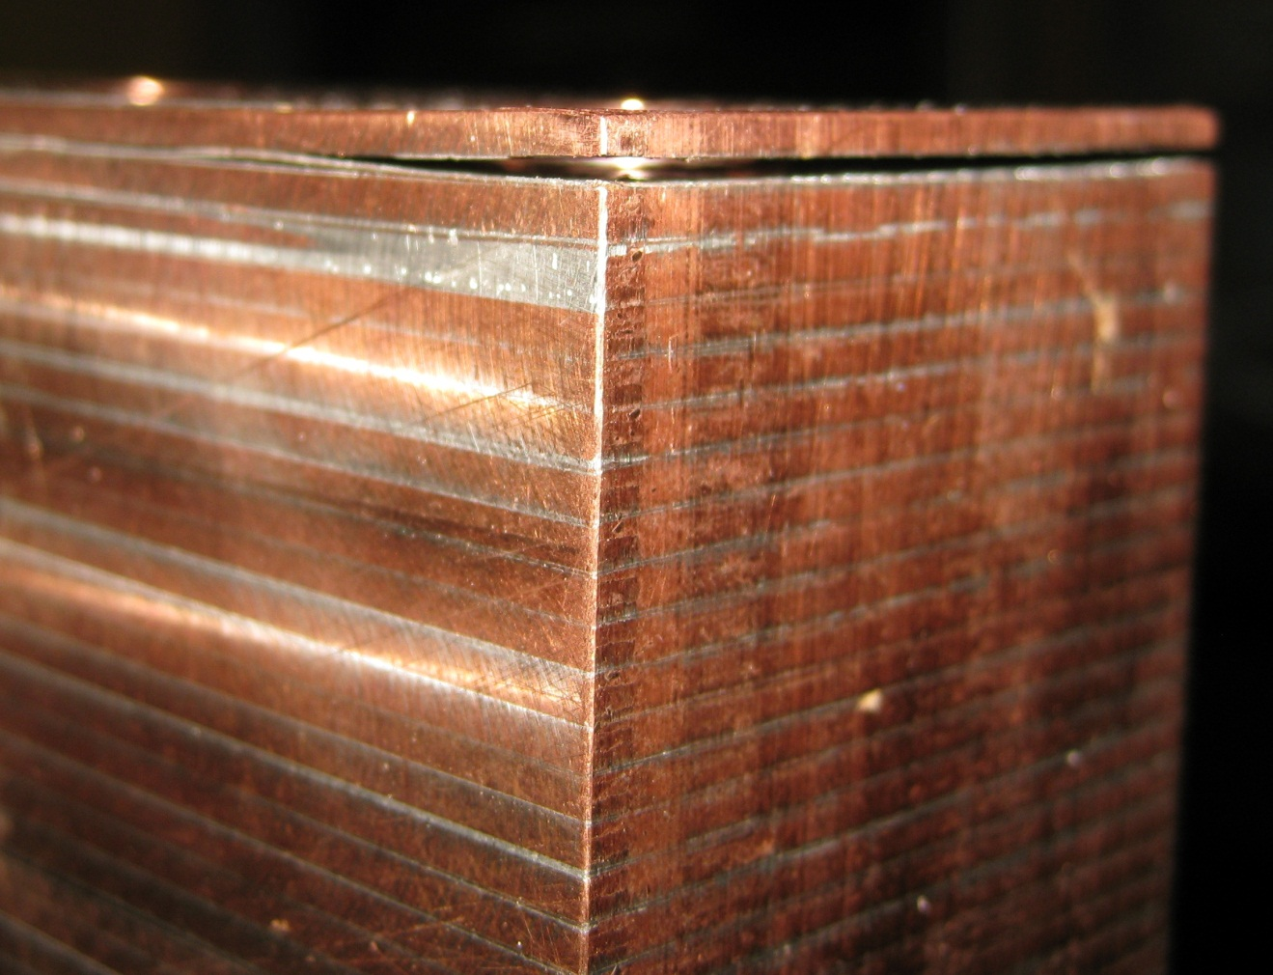
Outer Contact Layer Not Properly Soldered
This may not be an issue if clamping provides good internal contact with low resistance. This could be an issue if eventual corrosion occurs in the gap and reduces resistance

Slide 6
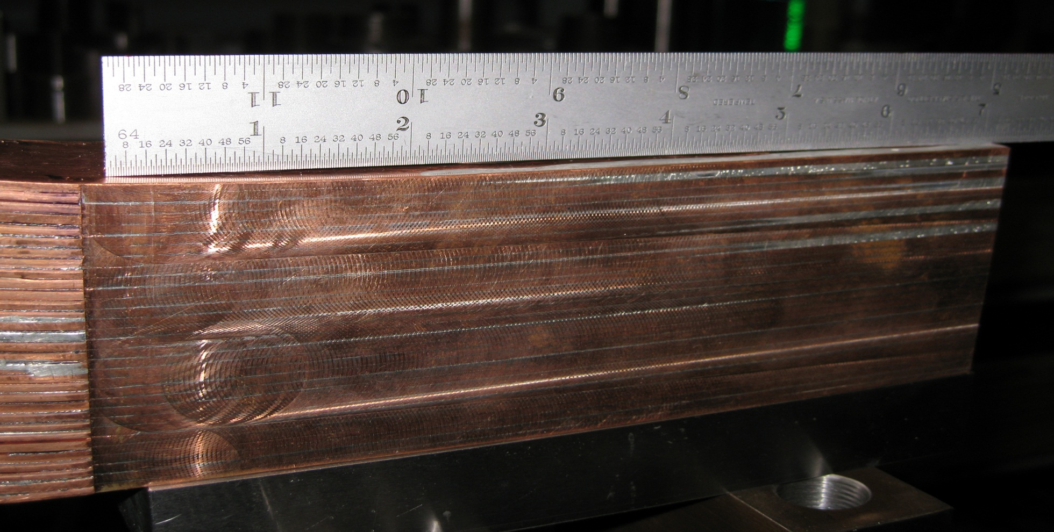
Variation in Terminal Section Thickness
Recommend not using any backing plate which could shift contact face pressure to the ends and produce an unevenly distributed contact resistance.

Slide 7
Variation in Terminal Thickness
Terminal | Flex End Thickness | Free End Thickness | Difference
A | 2.778 in | 2.708 in | 0.07 in
B | 2.755 in | 2.653 in | 0.102 in

Slide 8
Testing Process
The Sample was inspected and measured in a free state without any load
The sample was mounted in the 10K MTS test machine, adjusted to its free state width and the machine zeroed.
The overall width of the sample was displaced +/- 0.5” from its neutral width in increments of 0.02”
This cycle was performed three times with load measurements recorded for both increasing and decreasing increments

Slide 9
Test measurements plotted for all three cycles – Second and third cycles are very close, indicating sample is conditioned for these displacements. The apparent hysteresis is probably due to some small motion in the test fixture.

Slide 10
Loading plots for displacement cycles 2 and 3 show that the results are repeatable and no significant yielding is occurring. The vertical gold line illustrates the design and installation width of 11.38”. A preload of ~650 lb is required to compress the unit to the proper width for installation.

Slide 11
Conclusions
The sample demonstrates some fabrication issues.
Fabrication tolerances are only loosely met.
Terminal thickness varies by ~0.1”, avoid using a bolt backing plate to maintain uniform contact pressure.
Loading plot indicates two distinct regions of response with two separate effective mechanical mechanisms.
Deflection rate is about 1800 lb./in.
Sample would require about 650 lb. of compression in order to be installed.
Total preload on a single TF coil could be about 2000 lb.

