Slide 4
Using SCHNORR Part# 015900
De = 60. mm
Di = 30.5 mm
t = 3.5 mm
lo = 5.004 mm
ho = 1.5 mm
Max permitted s = .96 mm, limit for sigma ll = 1,250. N/mm^2
BAUER Item # 92018401 is exactly the same

Slide 5
 | Calculations in (N and mm) units
 | Calcs Based on the SCHNORR data formulas.
 | Note: These calculations are for SCHNORR #15900
 | De - Ouside diameter | 60 | mm
 | Di - Inside diameter | 30.5 | mm
 | pi | 3.14
 | 1/pi | 0.3185
 | 3/pi | 0.9554
 | 6/pi | 1.9108
 | del=De/Di Schnorr Formula #2 | 1.9672
 | lndel=ln(De/Di) | 0.6766
 | del-1 | 0.9672
 | del+1 | 2.9672
 | (del-1/del)^2 | 0.2417
 | (del+1)/(del-1) | 3.0678
 | (2/lndel) | 2.9559
 | K1 =1/pi(((del-1/del)^2))/((del+1)/((del-1)-(2/lndel))) Formula #3 | 0.6879
 | K2=6/pi(((del-1)/(lndel))-1)))/(lndel) Formula #4 | 1.2129
 | K3=3/pi(del-1/lndel) Formula #5 | 1.3657
 | K4=1 since thikness is less than 6 mm Formula #6 (see chapter 1.3) | 1
 | FORCE and STRESS Calculations
 | lo= total height | 5.004 | mm
 | ho= lo-t | 1.499 | mm
 | t=average spring thickness | 3.505 | mm

Slide 6
 | s= deflection of the single spring (from 75% of ho)) | 0.918 | mm
 | E= modulus for steel | 206000 | N/mm^2
 | mu= Poisson's ratio | 0.3
 | 1-mu^2 | 0.91
 | 4E/(1-mu^2) | 905494.505
 | t^4/(K1*de^2) | 0.06094519
 | s/t | 0.26191155
 | ho/t | 0.42767475
 | s/2t | 0.13095578
 | Formula #8a | 15164.64 | N
 | Formula #9 Stresses at the center of rotation (point OM) | -1124.08 | N/mm^2
 | ( should be less then -1600N/mm^2)
 | t^2/(K1*de^2) | 0.00496093
 | formula #10 Stress at point (l) | -2030.27 | N/mm^2
 | formula #11 Stress at point (ll) | 1183.42482 | N/mm^2
 | formula #12 Stress at point (lll) | 1086.30 | N/mm^2
 | 1/del | 0.50833333
 | (K2-2K3) | -1.5185995
 | (ho/t-s/2t) | 0.29671897
 | Formula #13 Stress at point (lV) | -547.32 | N/mm^2
 | t^3/(K1*de^2) | 0.01738807
 | Formula #14 Spring Rate (dF/ds) | 14953.84 | N/mm
 | Formula #15 Spring Work (Integral from 0 to s, of F*ds) | 7218.36 | N-mm
 | 2E/(1-mu^2) | 452747.253
 | t^5/(K1*de^2) | 0.2136129
 | Basic requirements for a good Disk spring design
 | For the above basic equations to work
 | This Spring is linear because ho/t=.428 (since for ho/t<0.4 are linear) | slightly non-LINEAR
 | del=De/Di=2.3923 and it should be between 1.75 and 2.5 | O.K.
 | Outside diameter De, Inside diameter Di

Slide 7
 | ho/t=(lo-t)/t=.428 and it should be between 0.4 to 1.3 | O.K.
 | ho=lo-t cone height, t=disk thickness
 | De/t=17.12 and it should be between 16. and 40. | O.K.
 | Conclusion: This spring under the constant load of 3790.0 N is O.K.
 | Basic machine operation requirements:
 | 1) TF coil inner leg maximum thermal expansion was calculated at 8.4mm
 | 2) OH coil requires a preload of 20,000.0 lbs total or 6,428.5 N (14 St) per stack. Must
 | calculate the required deflection (s) for the preload force?
 | 3) OH coil thermal expansion was calculated at 6.0mm
 | So, the total each spring stack travel is = 8.4+6.0+calculated from minimum preload ?
 | For Fatigue predictions, using fatigue life diagrams for disk springs, one requires
 | the Pre and Maximum loads stresses at points ll or lll (depending on del and ho/t).

Slide 8
 | For SCHNORR Part # 15900 and 12 Stacks with 26 disks |  |  |  |  | Force=20,000.0lbs
 |  |  | disp. mm | tot disp. | Force N | sigma ll
 |  |  |  |  |  | N/mm^2
 |  |  | 26*0.425 | 11.05 | 7,413.0 | 501.4
 |  | Preload | 11.05+8.4 | 19.45 | 12,587.1 | 936.1
 |  |  | 19.45+6. | 25.45 | 16,100.0 | 1,300.0 | FAIL
 | Prmt. Limt. |  | 26*.96 | 24.96 | 15,790.0 | 1,250.0
 | Total Space required |  | 26*lo is 26*.197 = 5.122 in |  |  | 8.0 inch available
 | For SCHNORR Part # 15900 and 14 Stacks with 26 disks
 |  |  | disp. mm | tot disp. | Force N | sigma ll
 |  |  |  |  |  | N/mm^2
 |  |  | 26*0.364 | 9.47 | 6,428.5 | 424.5
 |  | Preload | 9.47+8.4 | 17.87 | 11,642.8 | 850.5
 |  |  | 17.87+6. | 23.87 | 15,164.6 | 1,183.4 | O.K.
 | Prmt. Limt. |  | 26*.96 | 24.96 | 15,790.0 | 1,250.0
 | Total Space required |  | 26*lo is 26*.197 = 5.122 in "no change"

Slide 10
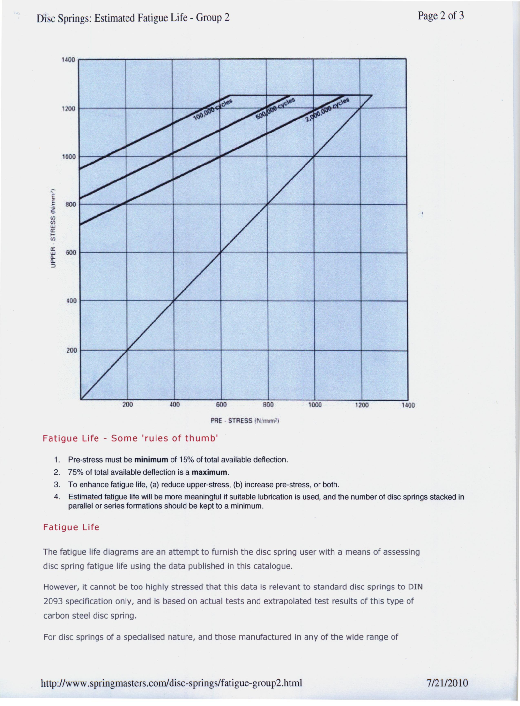
12 Stacks
14 Stacks

Slide 16
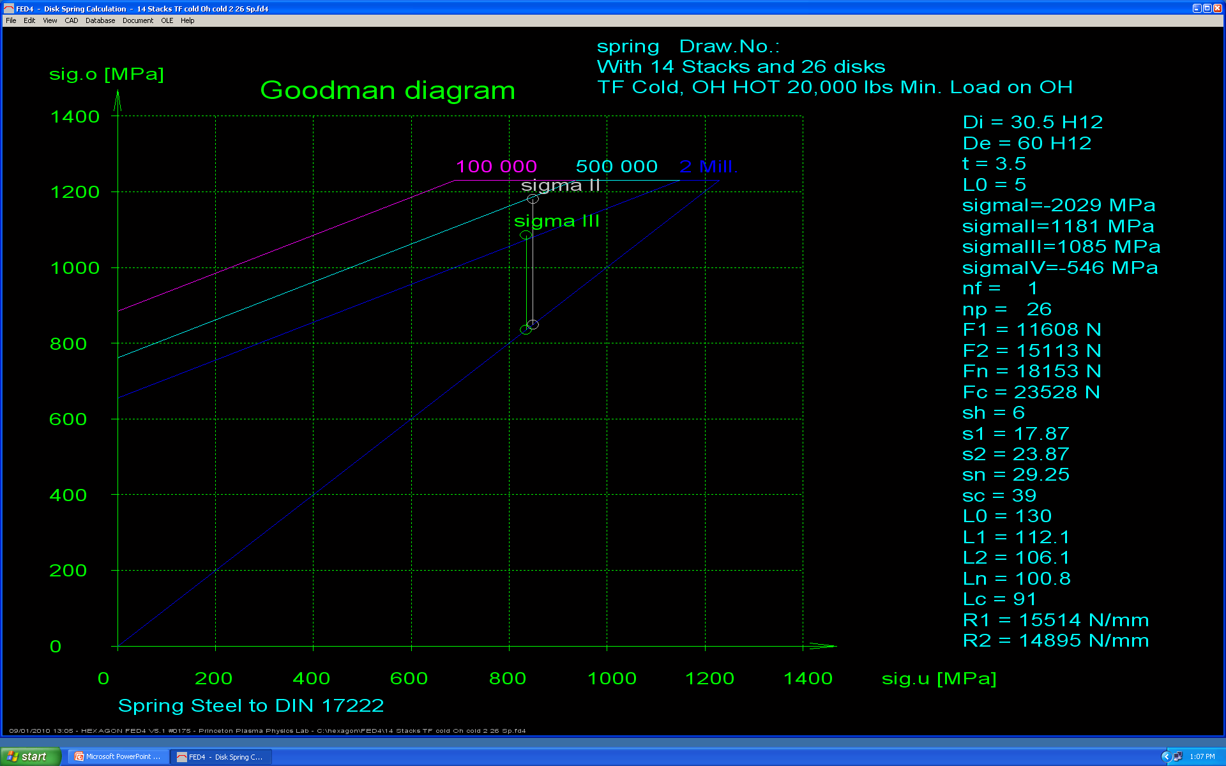

Slide 18
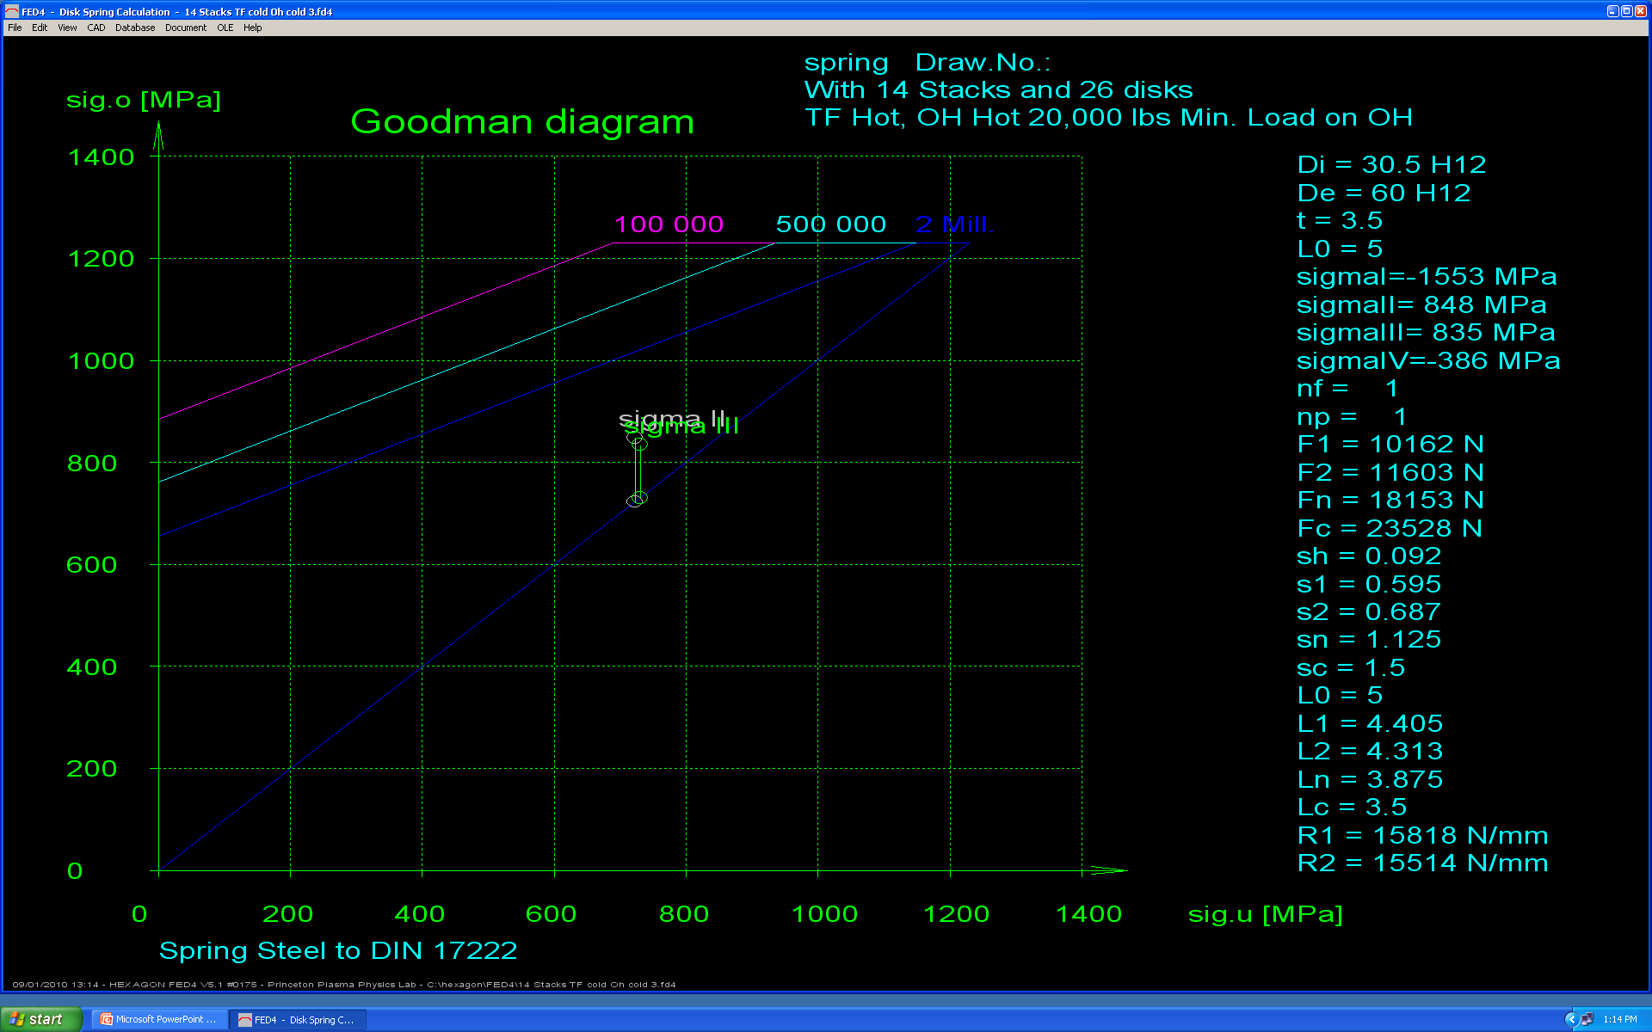

Slide 19
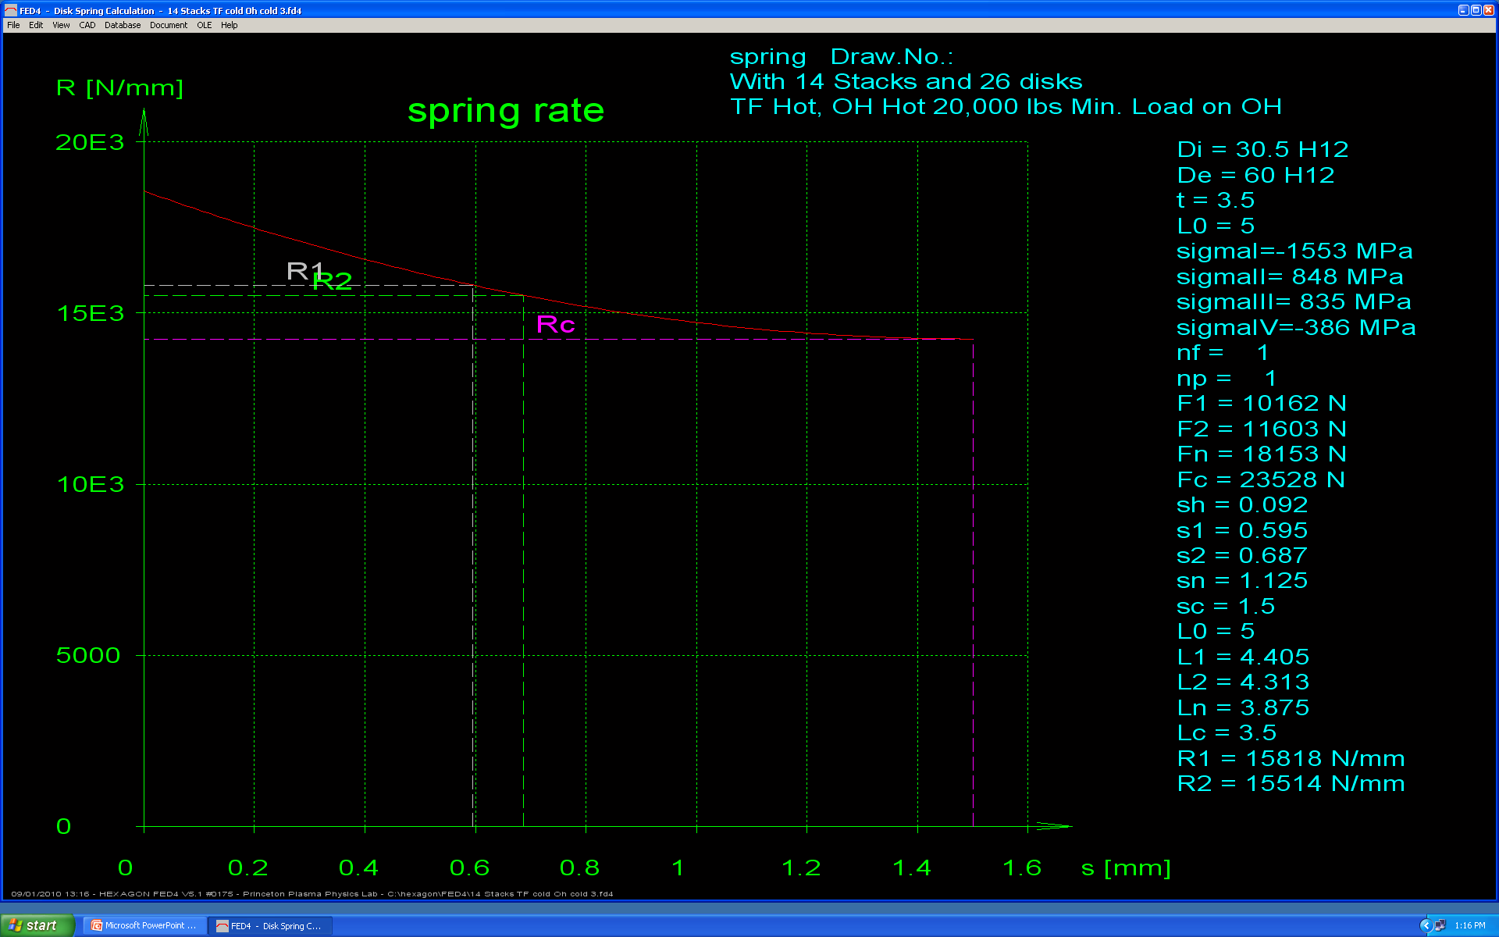

Slide 20
