Slide 1
Upper PF Bus Bar Simulations

Slide 2
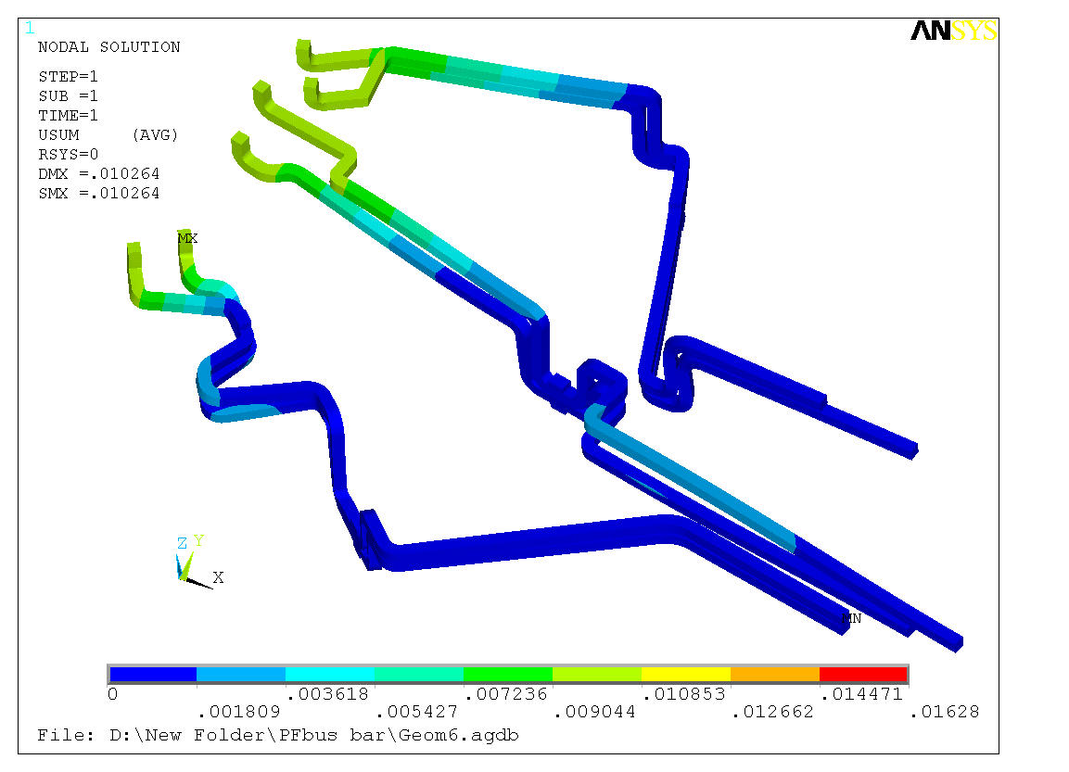
Simulations were performed assuming 1 cm displacement of the center stack due to thermal expansion Bas bars are fixed at the opposite end
PFB
PFA
PFC

Slide 3
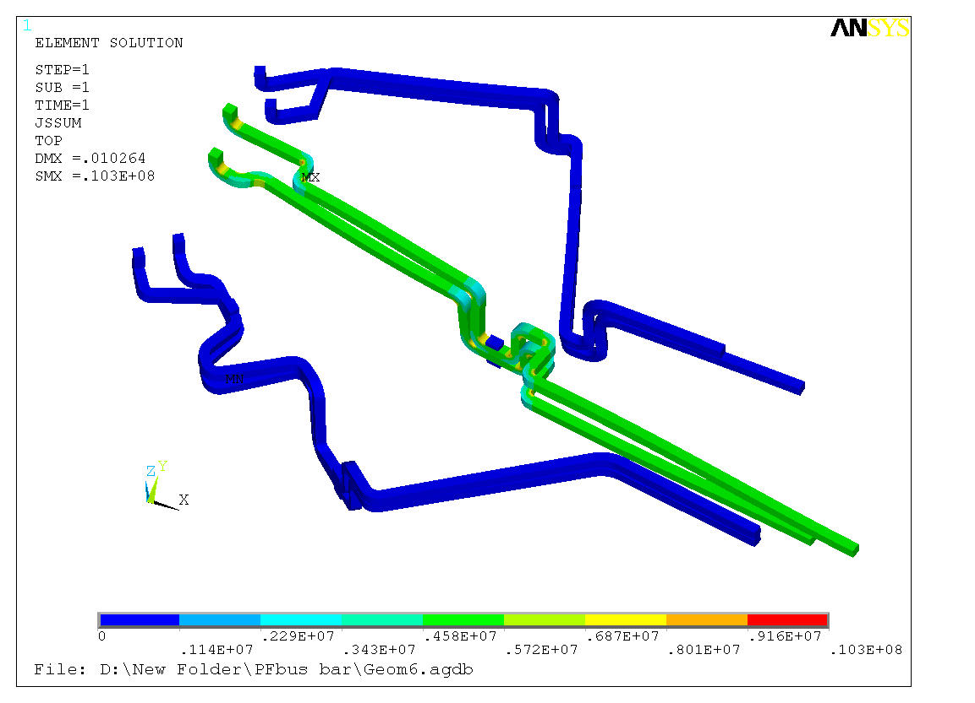
Compliant bracket attachment were modeled as elastic bricks 2 cm height with elastic modulus of 1E6 and 1E9 Pa Scenario #79 is considered with 6.2 kA in PFA
PFB
PFA
PFC

Slide 4
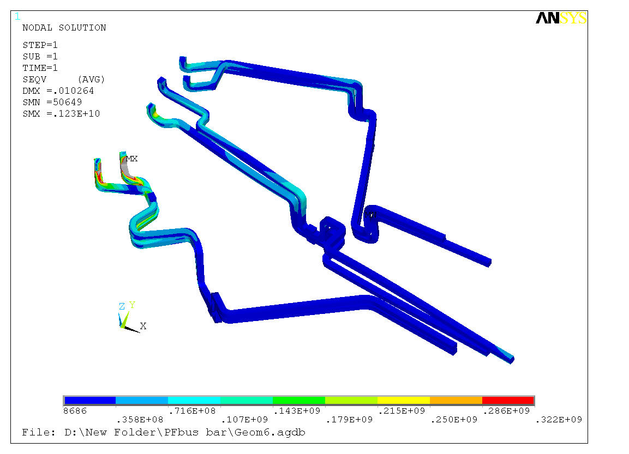
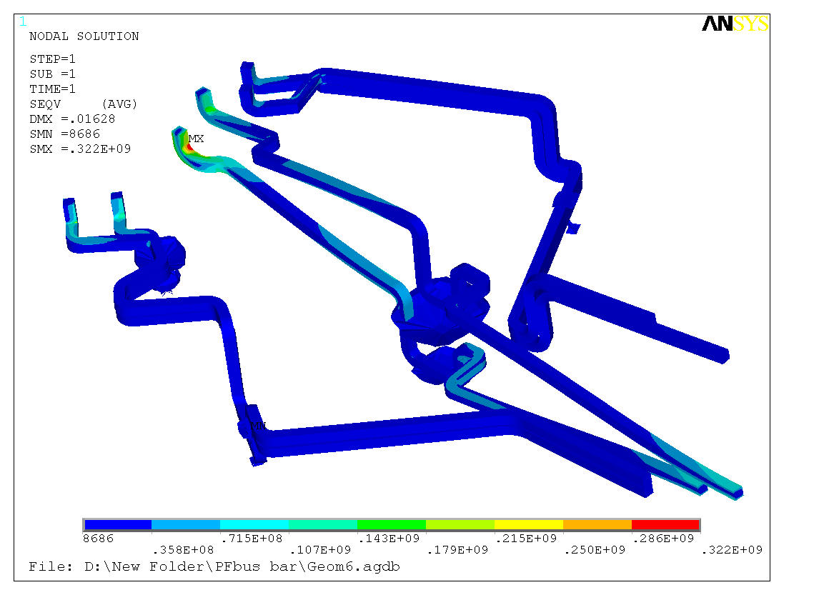
Elastic Modulus 1E9 Pa
Von Mises Stress
Deformation exaggerated 10 times
Elastic Modulus 1E6 Pa

Slide 5
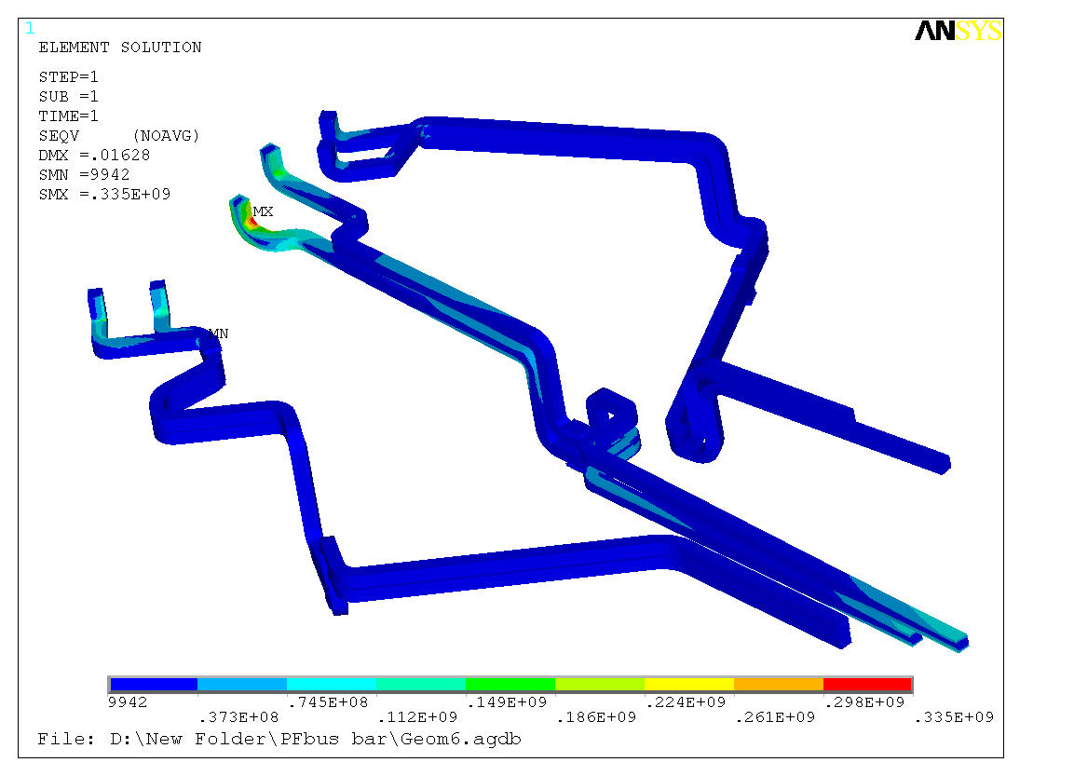
Elastic Modulus 1E9 Pa
Von Mises Stress
True scale
Elastic Modulus 1E6 Pa

Slide 6
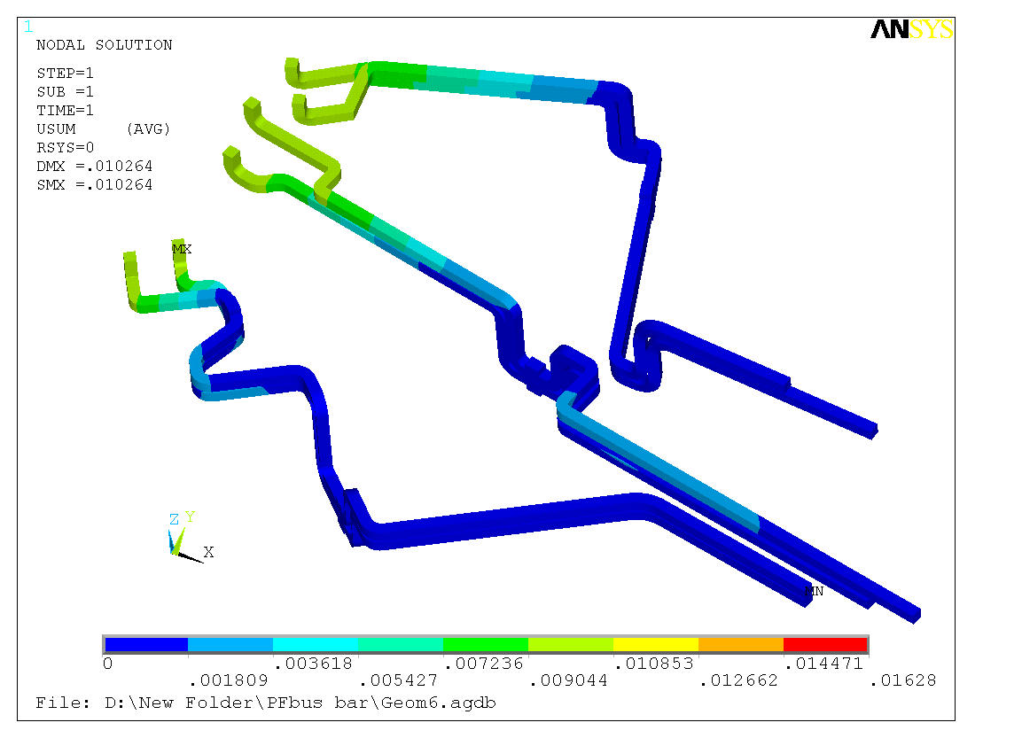
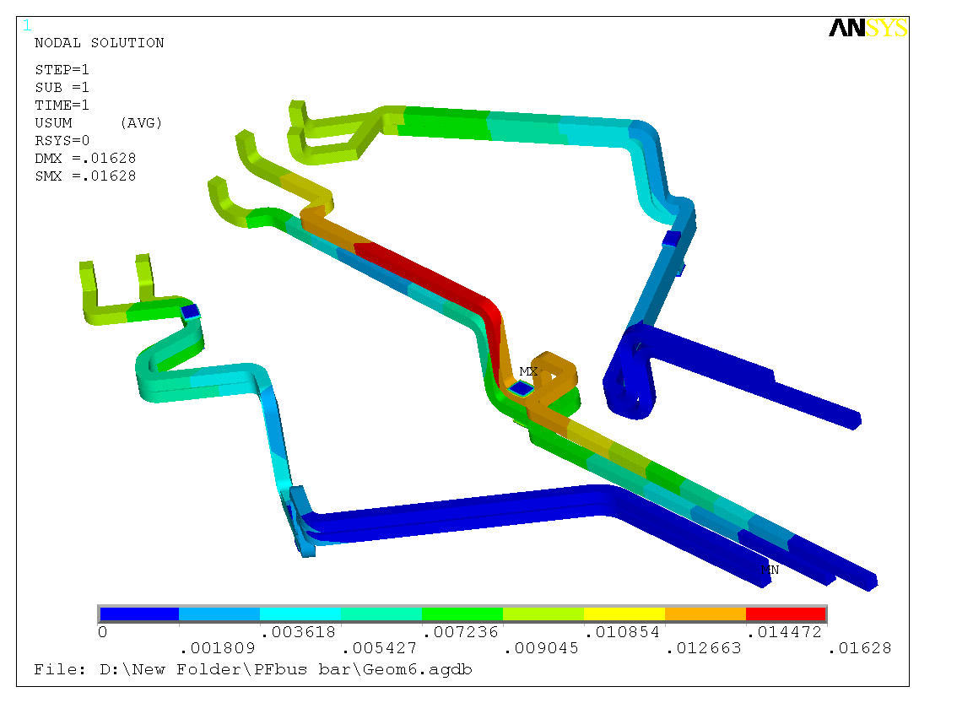
Elastic Modulus 1E9 Pa
Deformation
True scale
Elastic Modulus 1E6 Pa

Slide 7
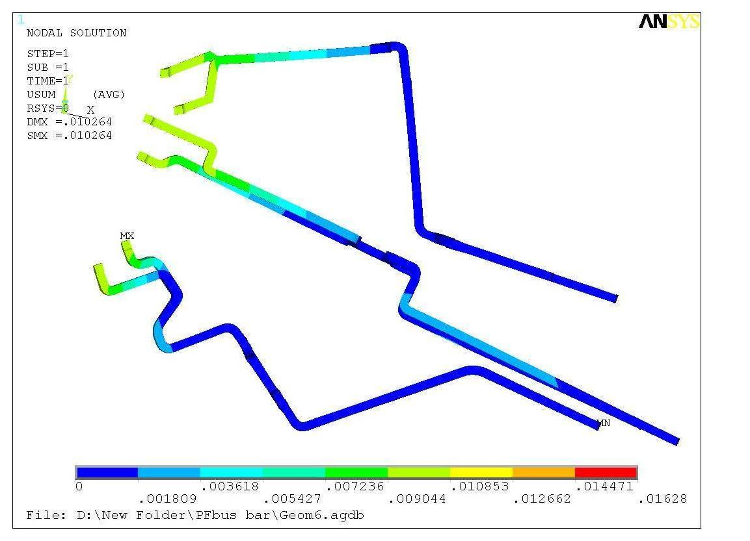
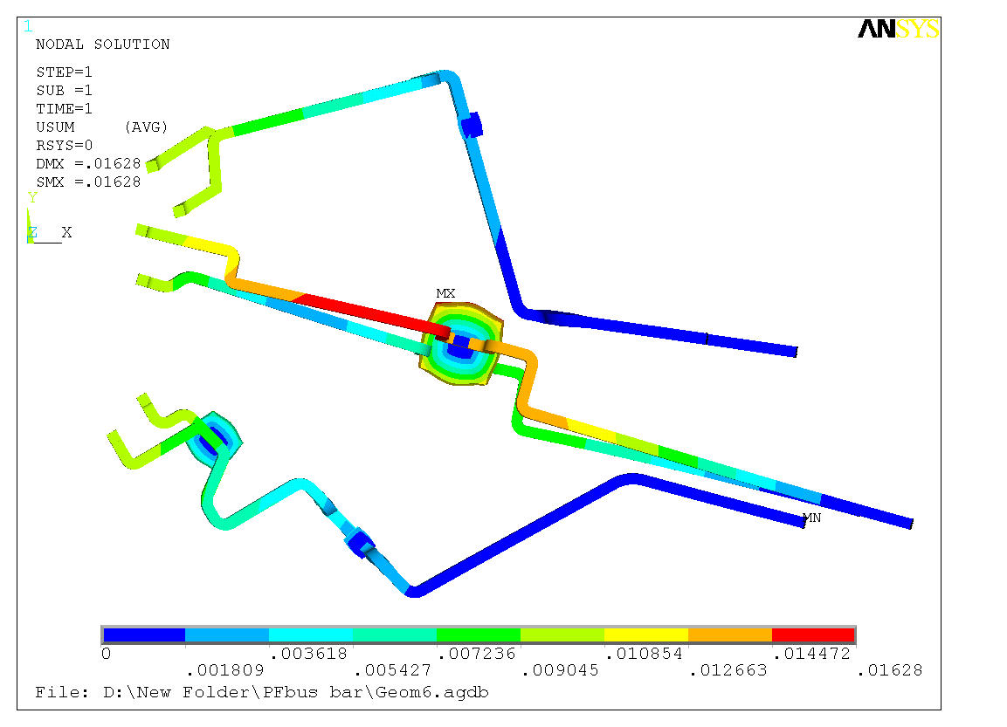
Elastic Modulus 1E9 Pa
Deformation
True scale
Elastic Modulus 1E6 Pa

Slide 8
Elastic Modulus 1E6 Pa

Slide 9
Elastic Modulus 1E9 Pa

