Slide 1
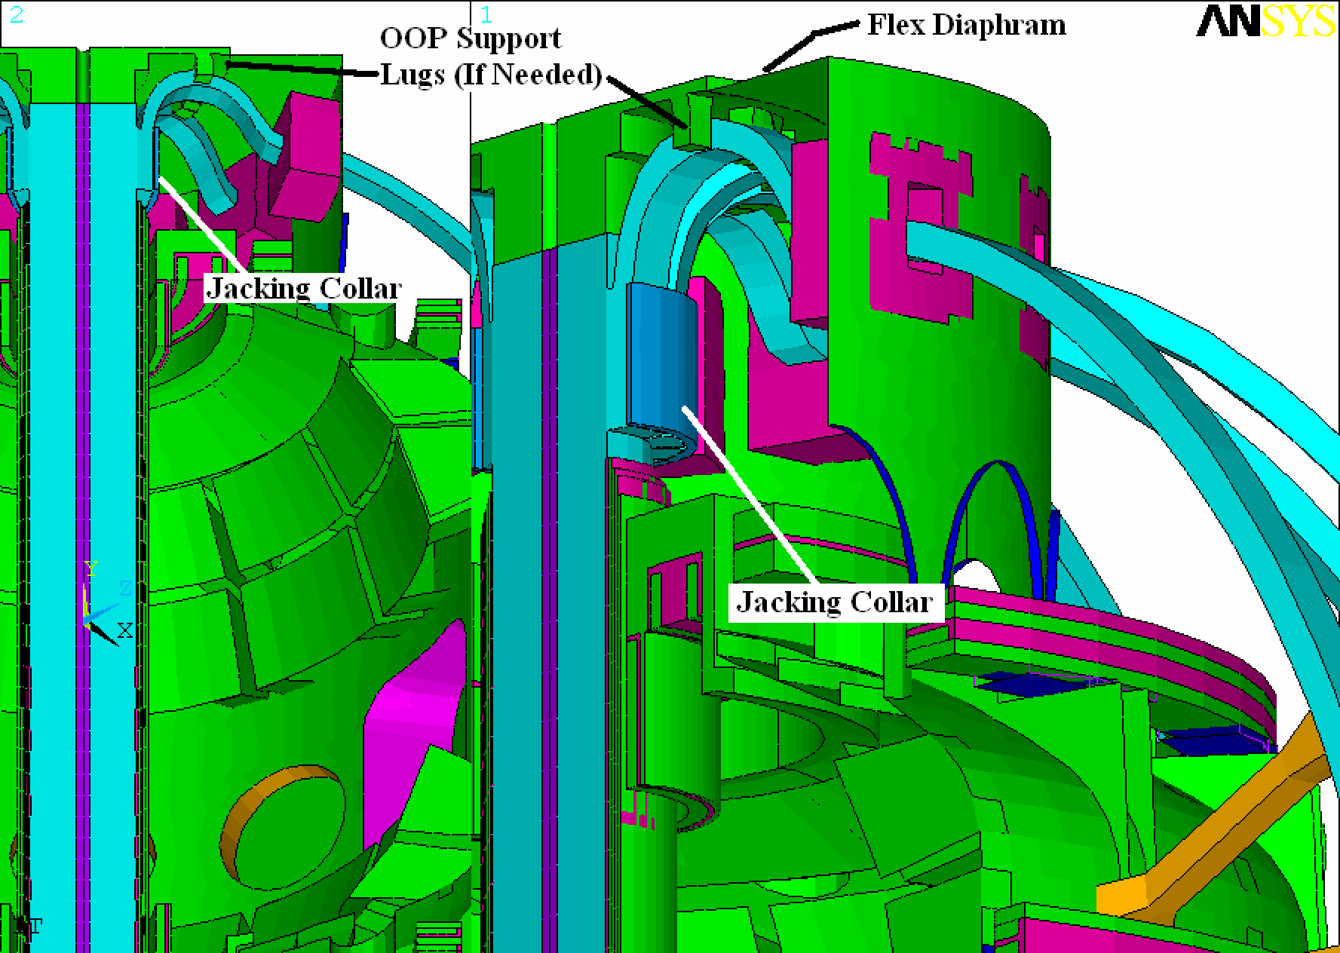

Slide 2
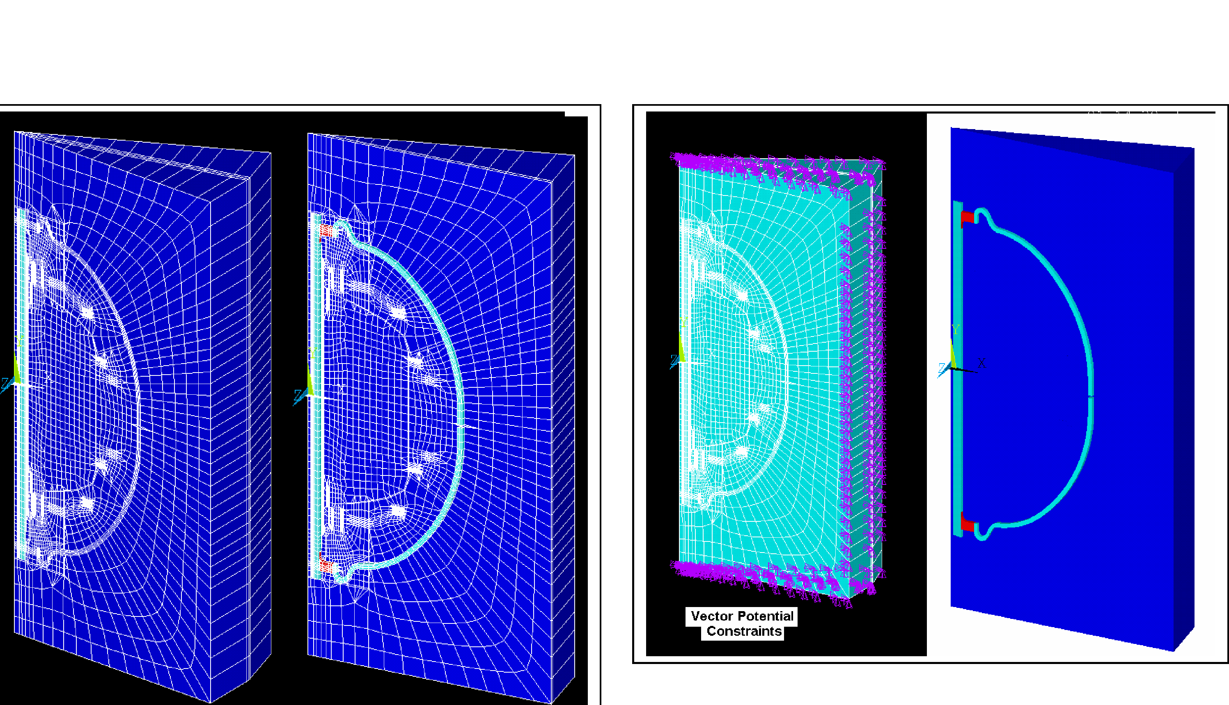

Slide 3
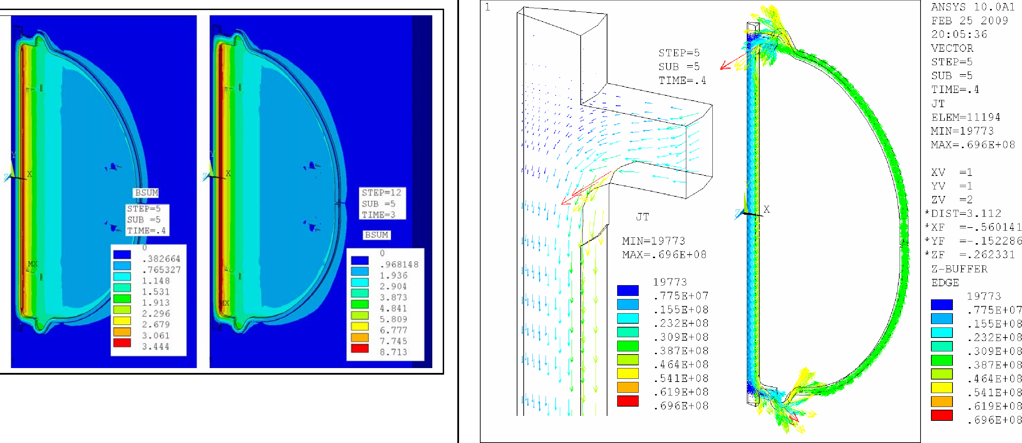

Slide 4
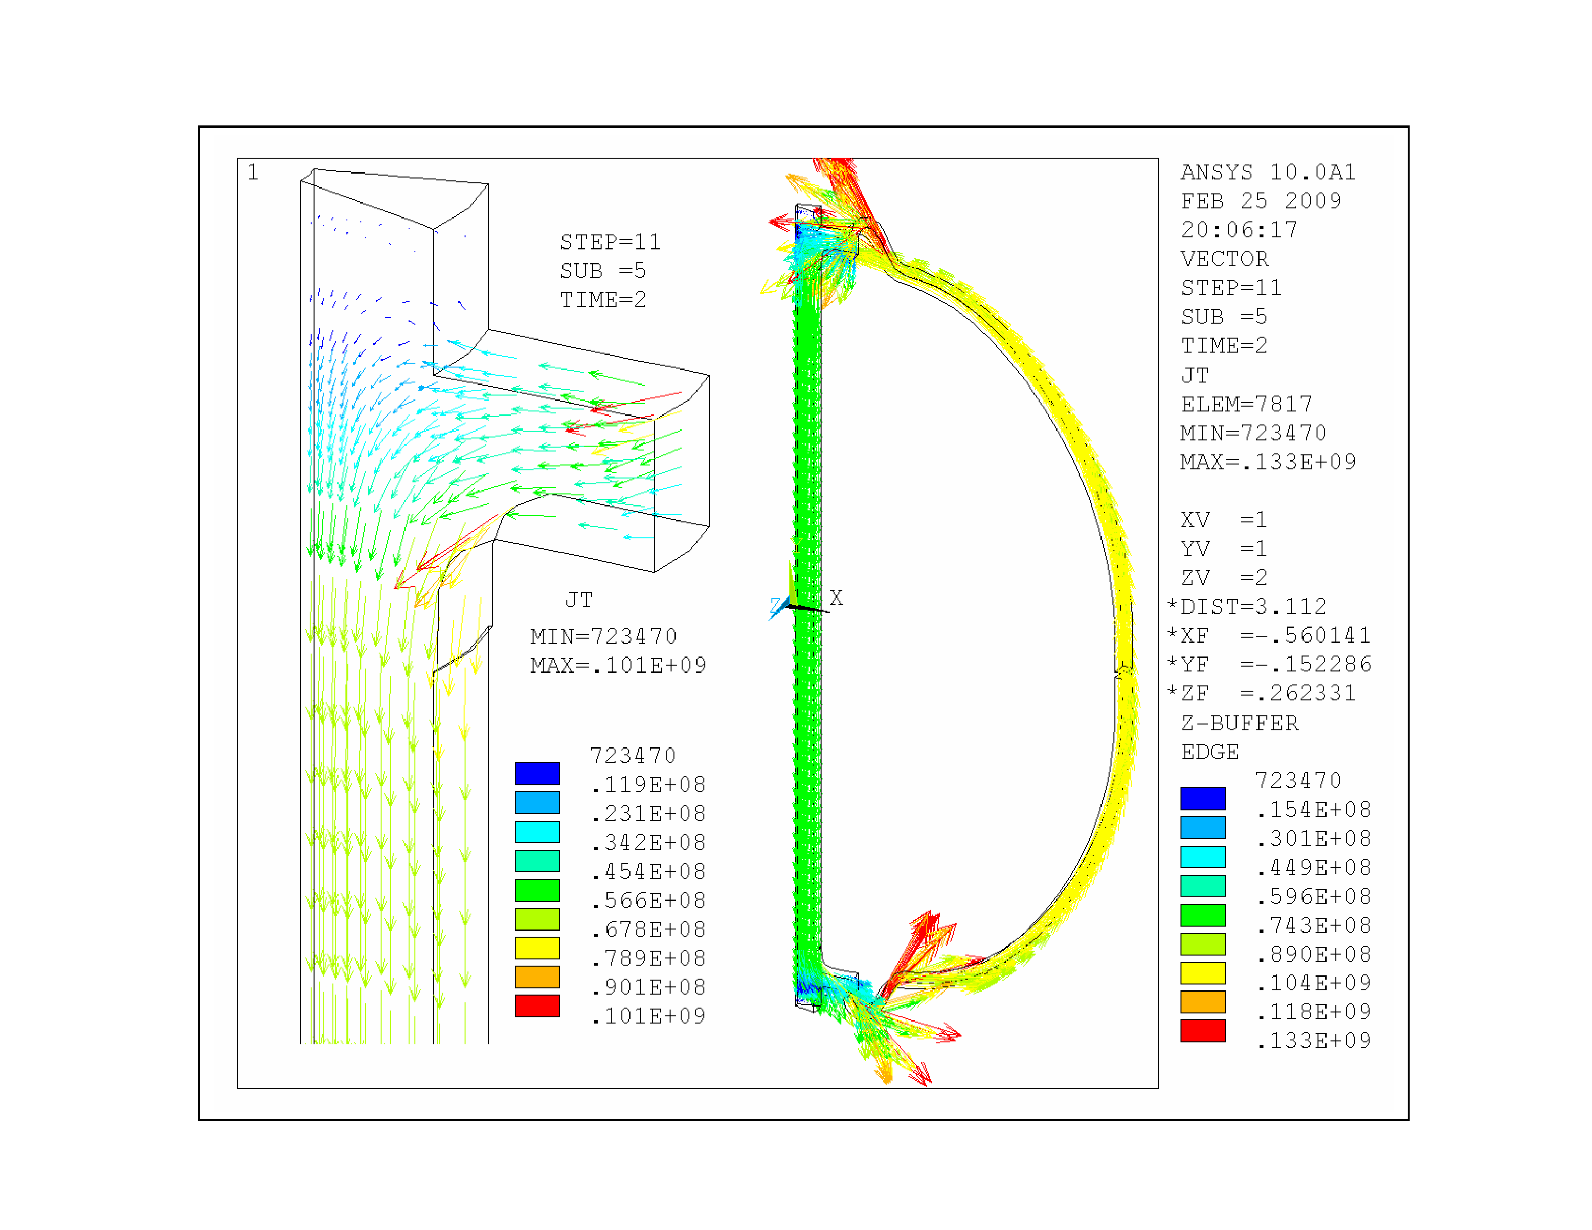

Slide 5
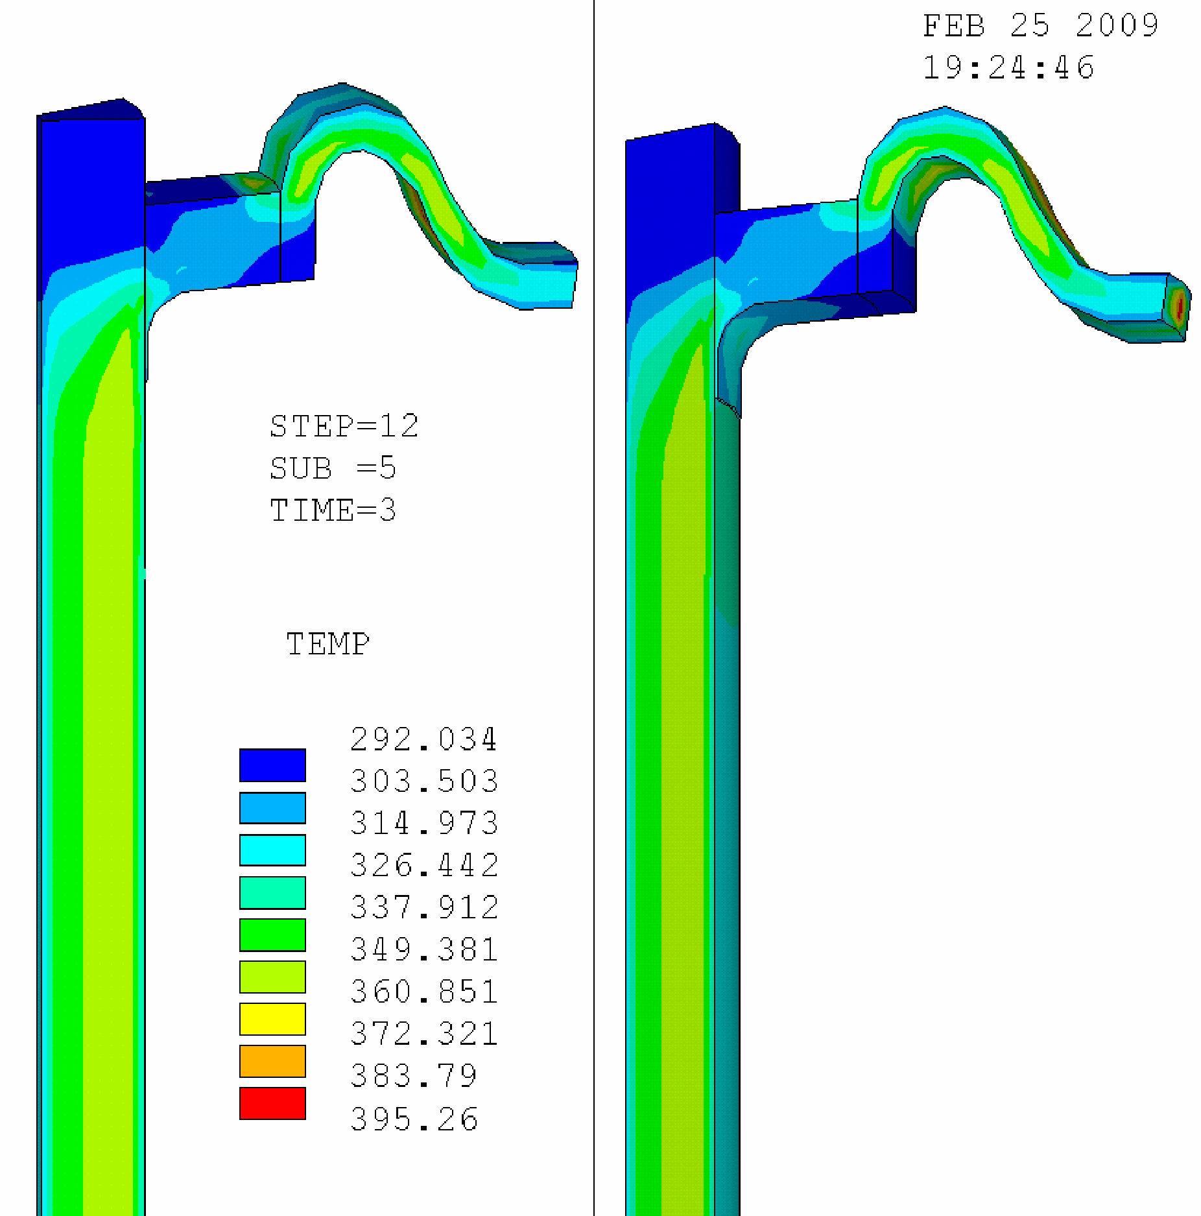

Slide 7
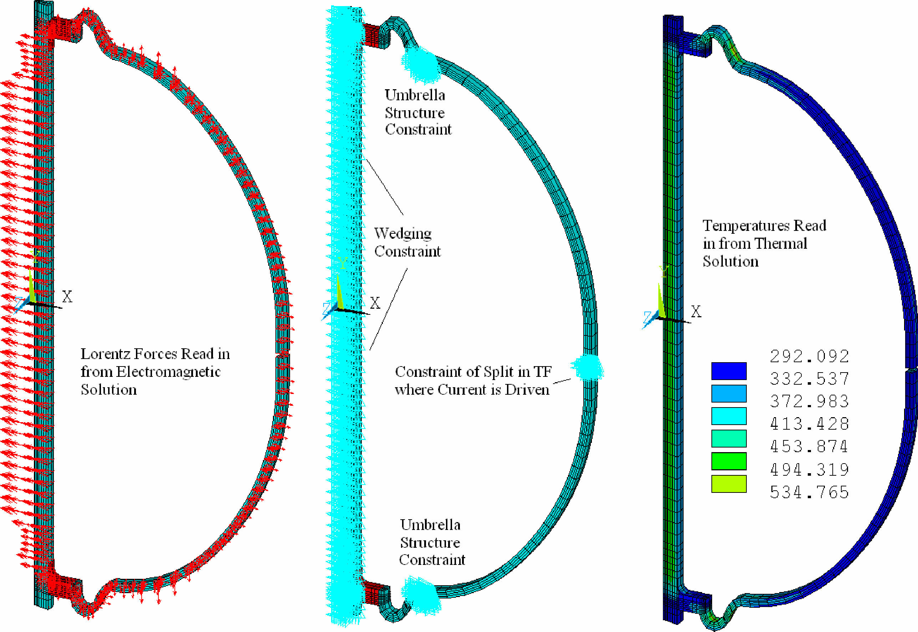

Slide 8
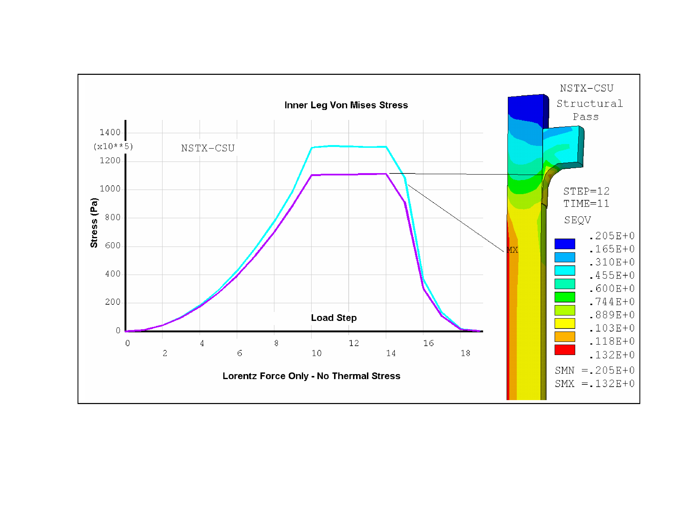

Slide 9
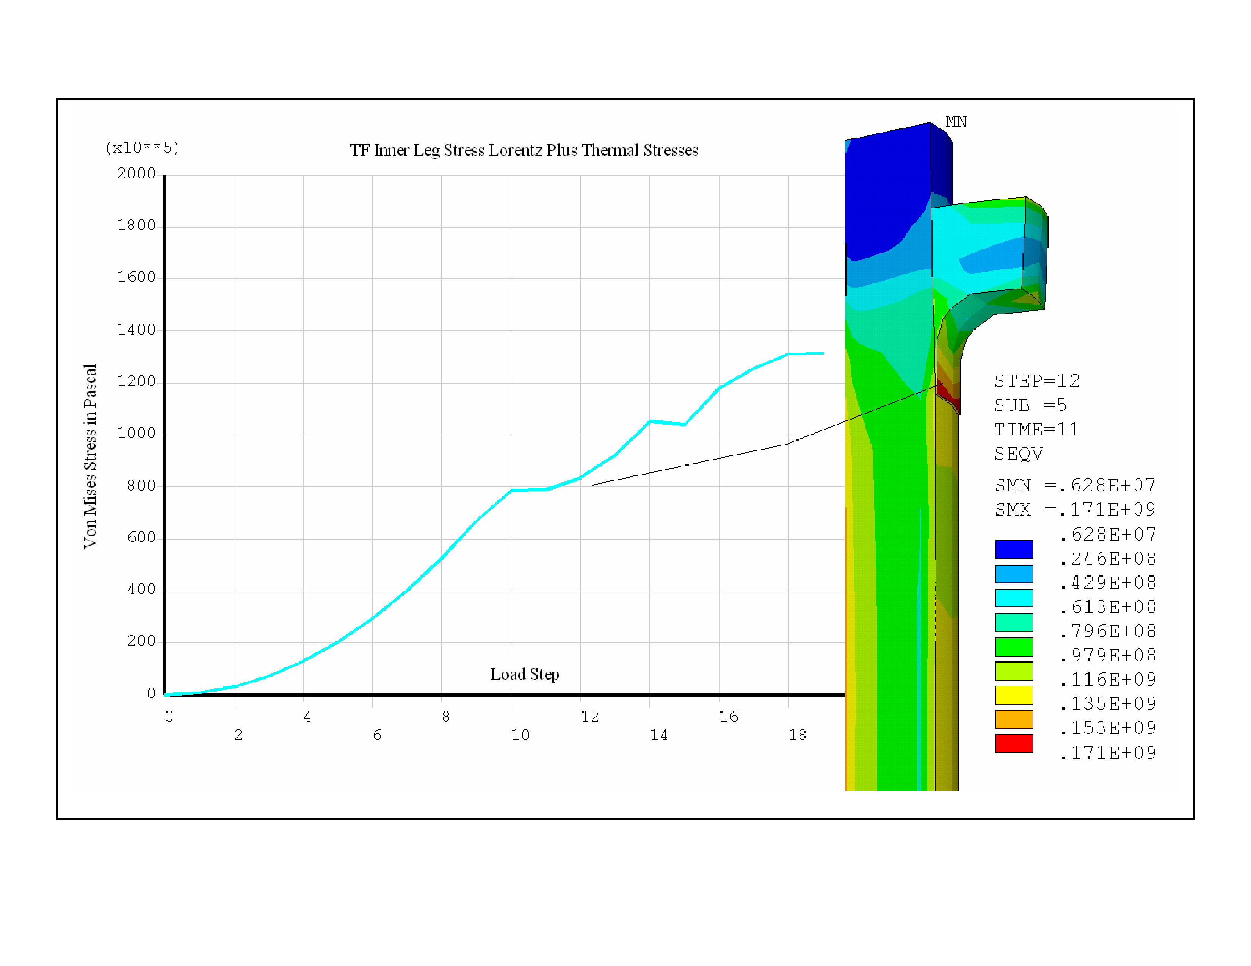

Slide 10
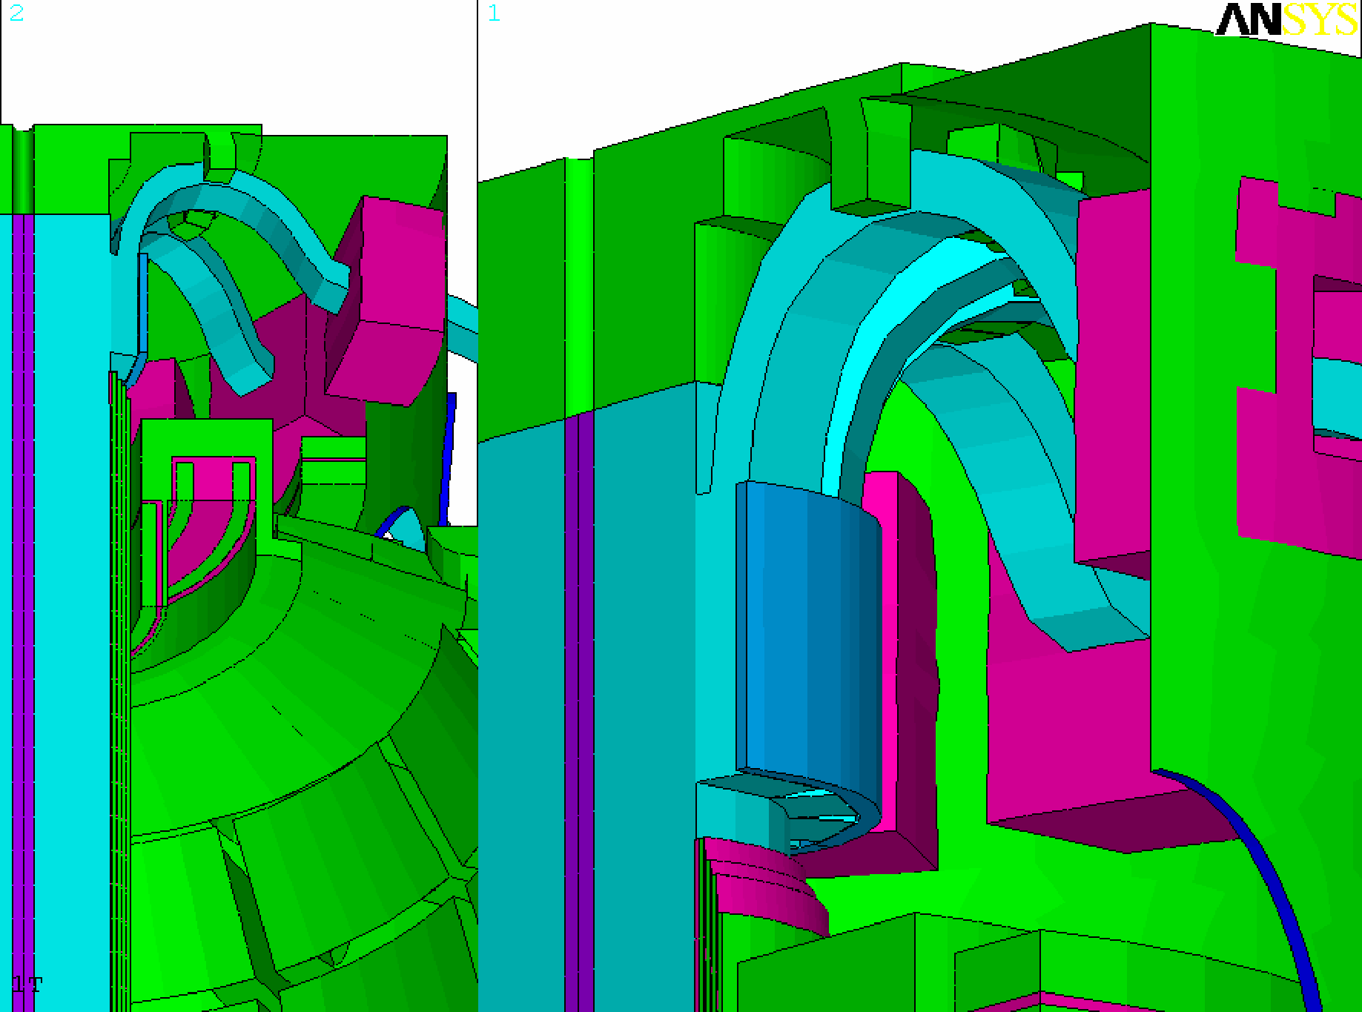
•
•

Slide 11
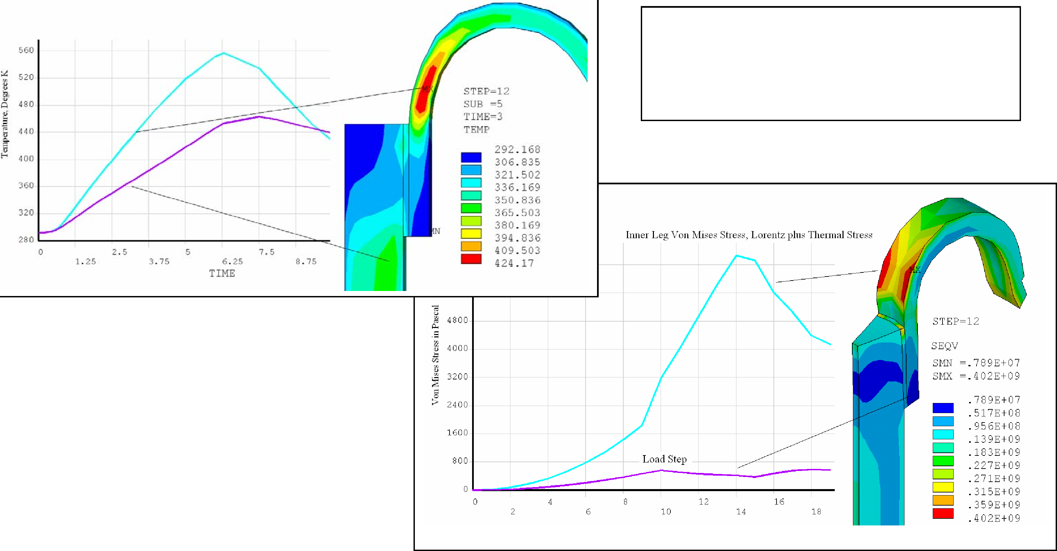
Much of the stress in the loop appears to be a result

Slide 12
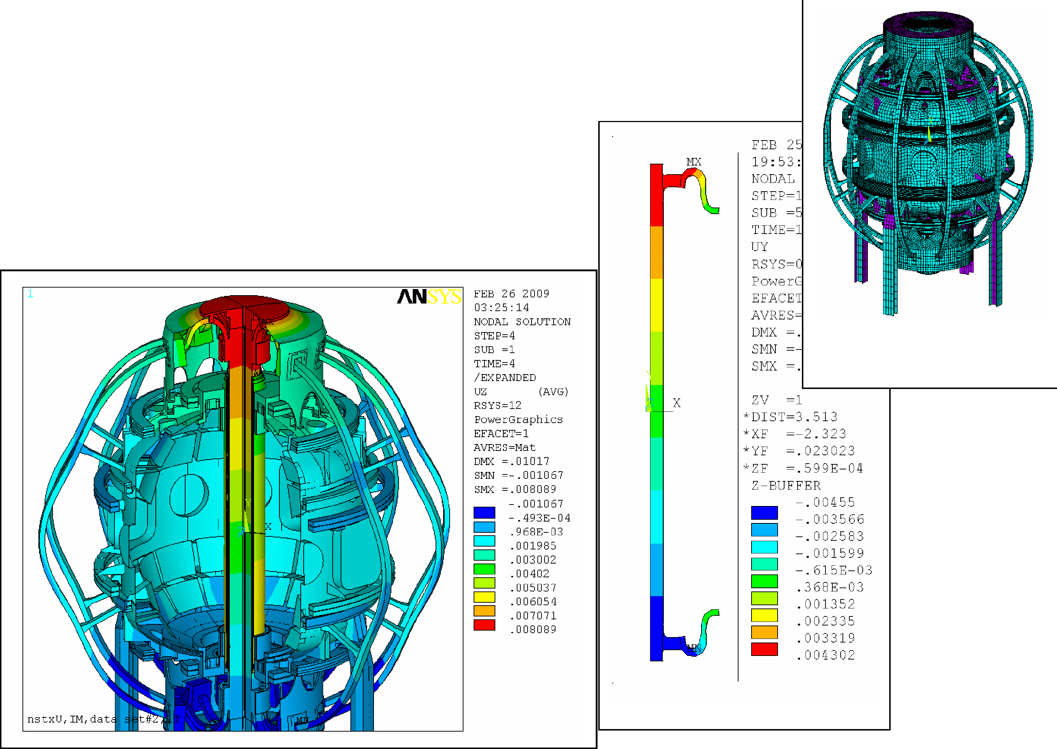
This time the inner leg is at 100C temp and the outer leg is at 50C
Integrated central column expansion is close to the electromagnetic thermal diffusion model
Four Fold Symmetry Expansion. HM Provided the

Slide 13
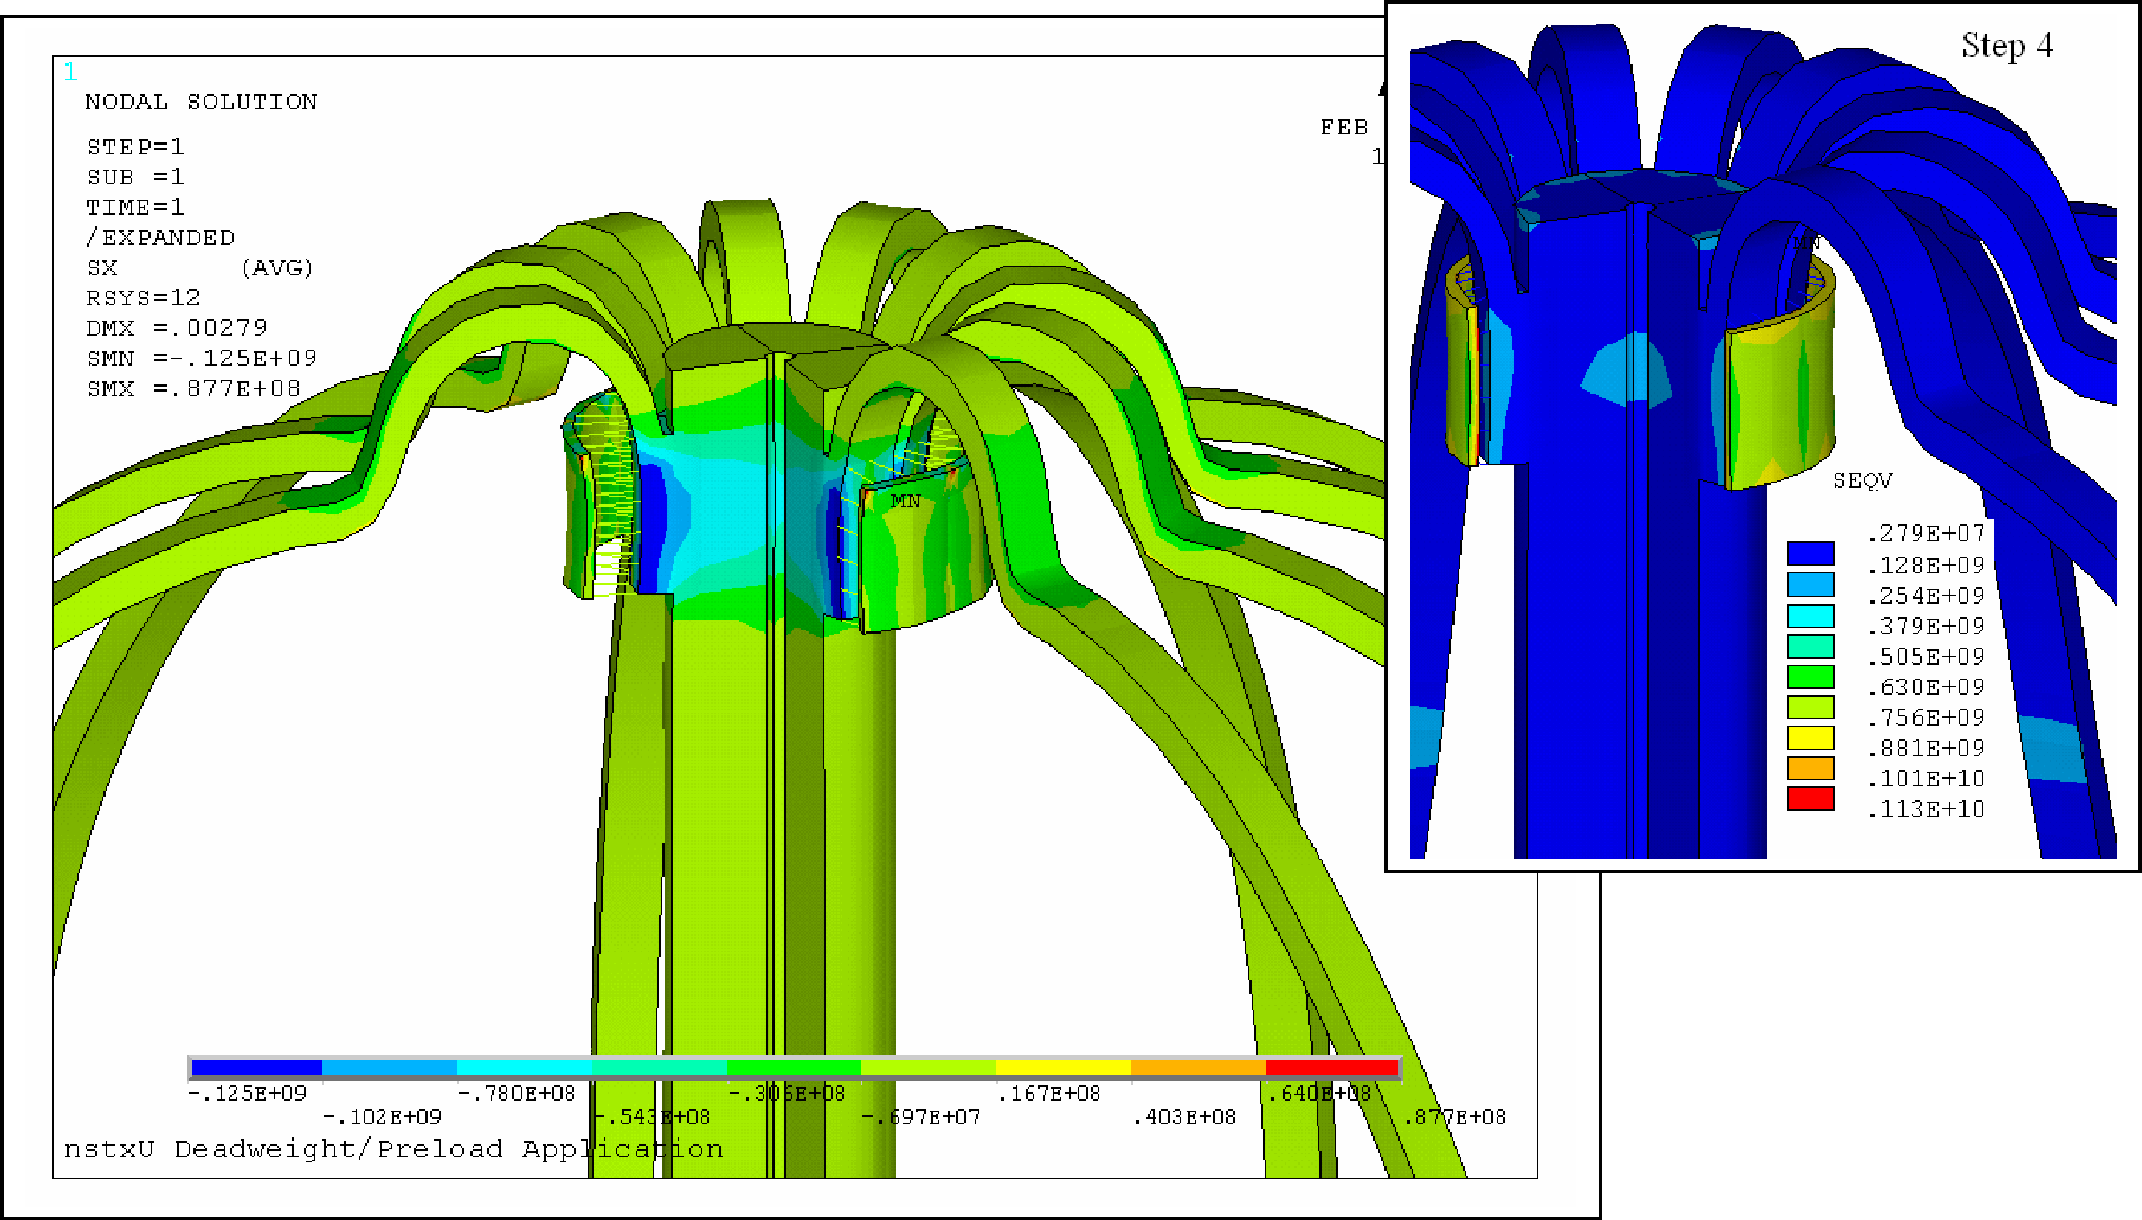

Slide 14
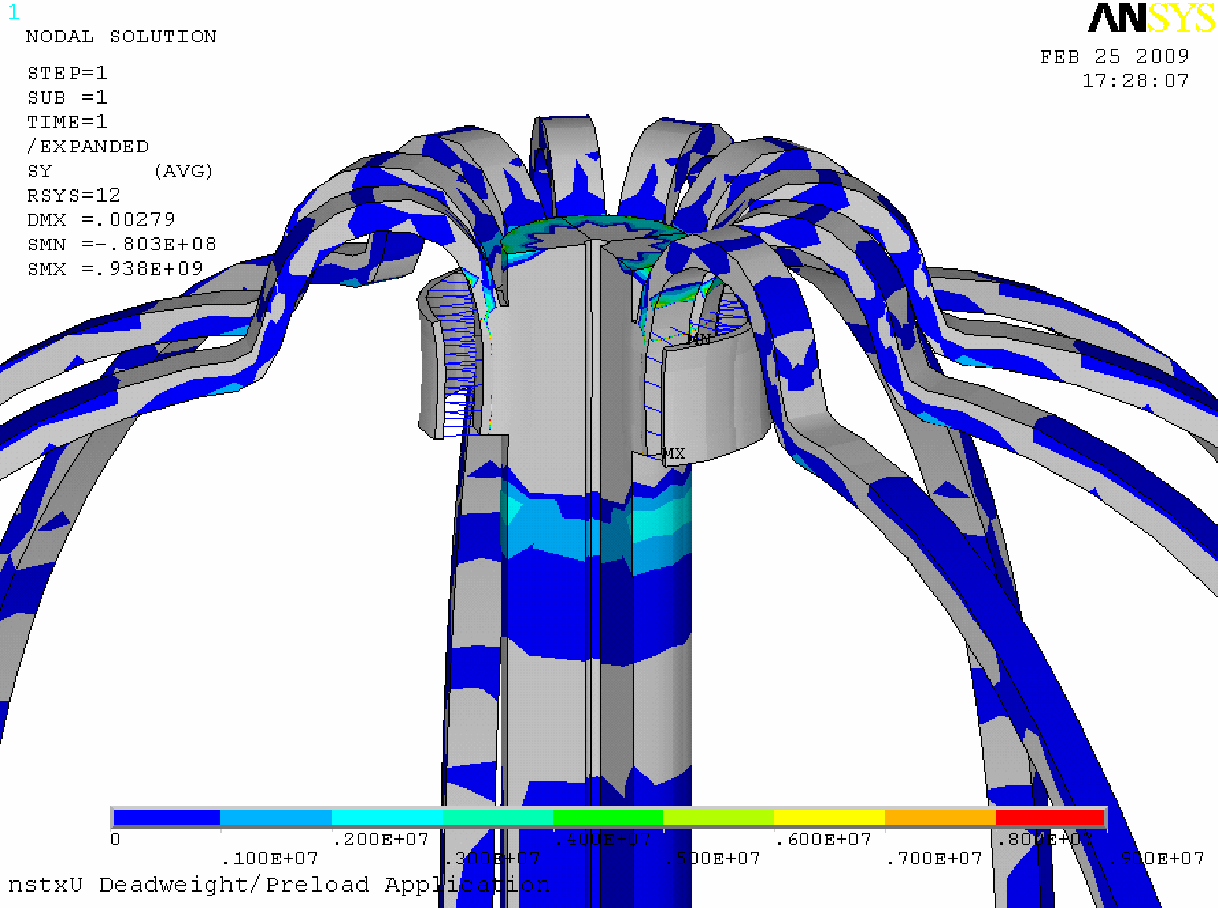

Slide 16
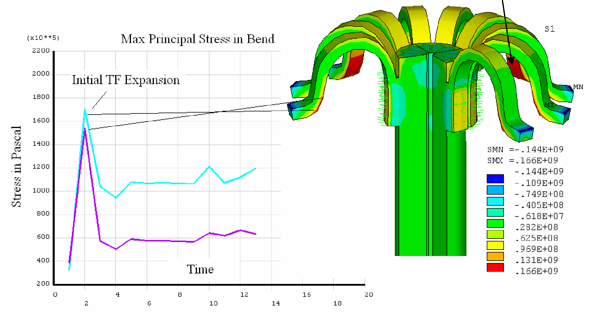
 | Max Principal Stress In Bend. –No Internal

Slide 17
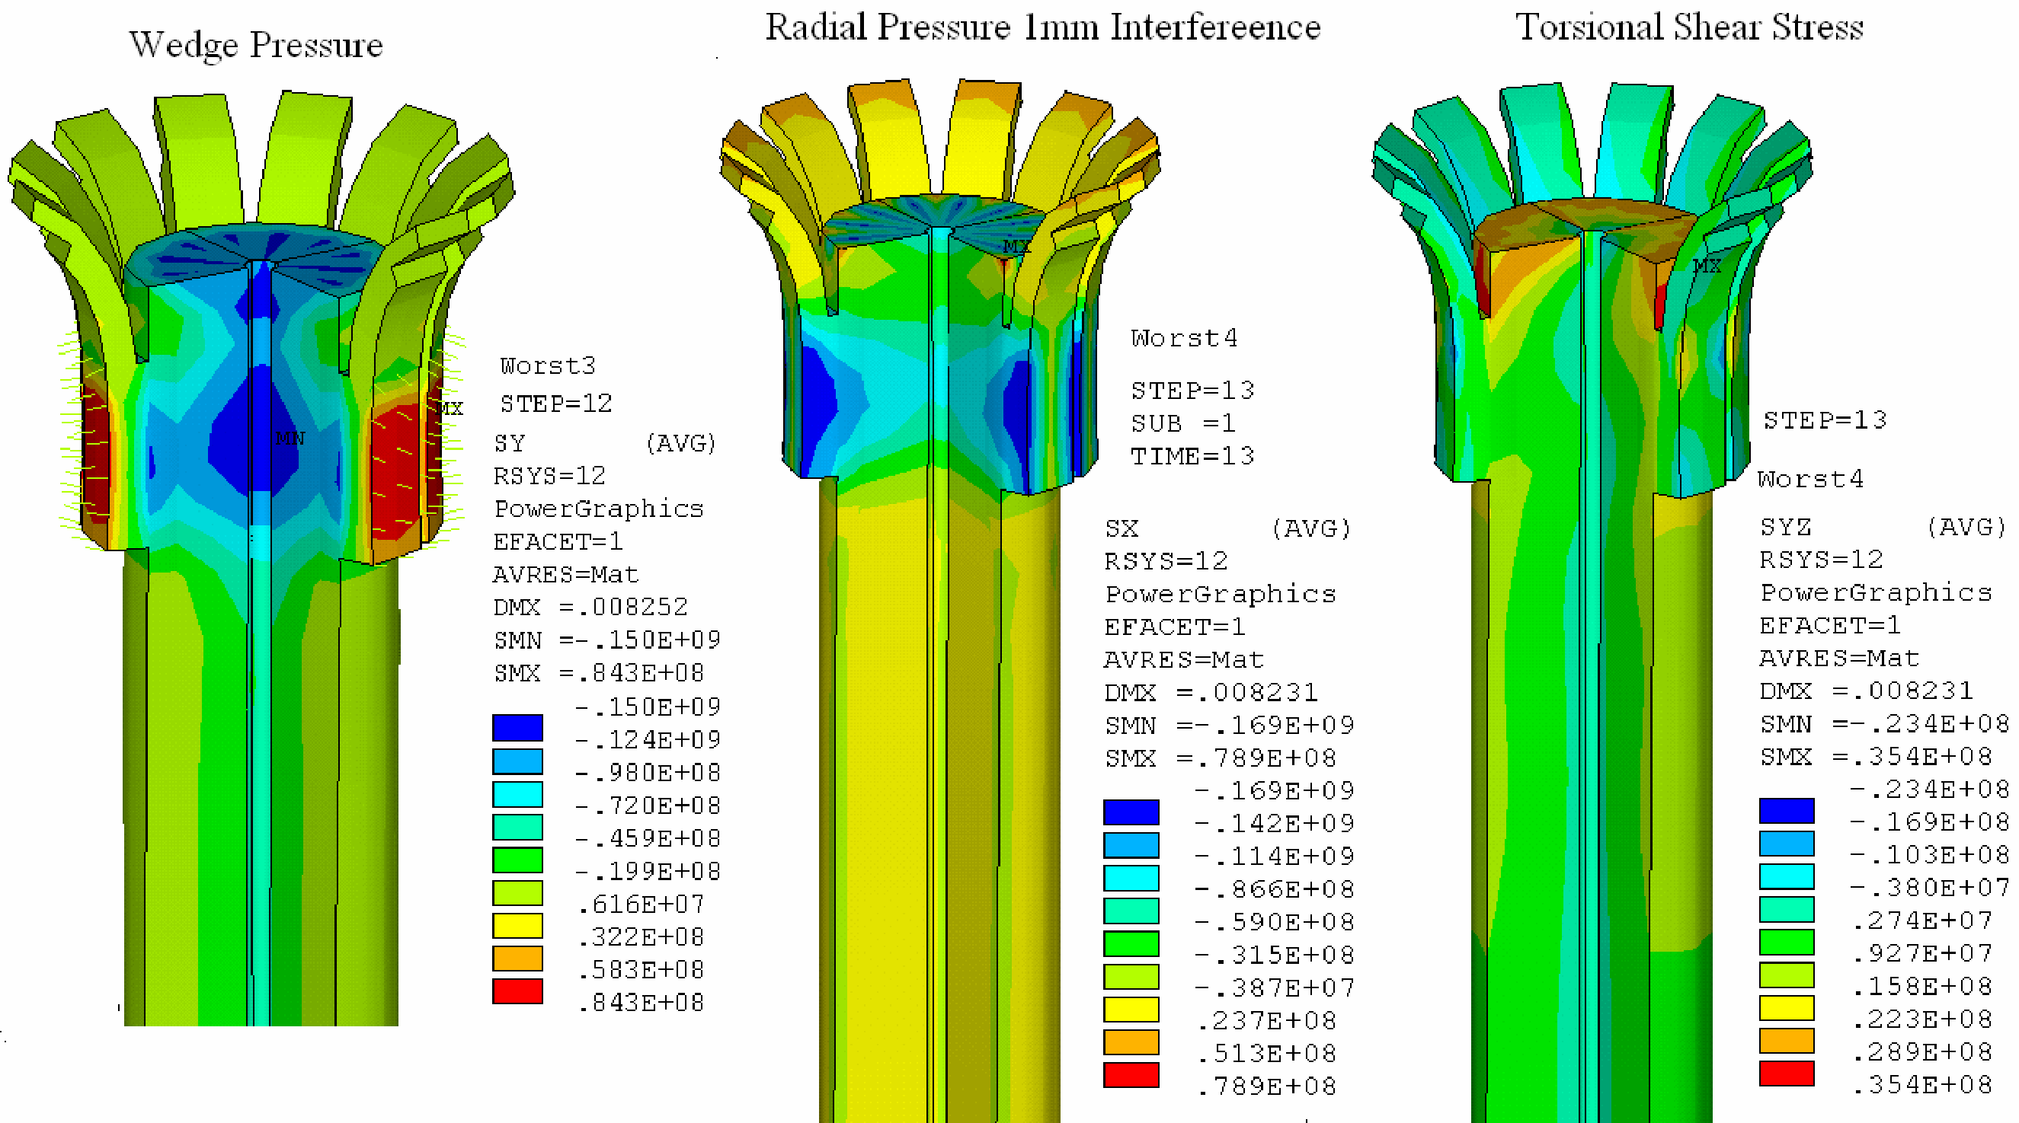
Ring height might be increased to improve torsional carrying capacity of the extension that connects with the umbrella structure hub

Slide 18
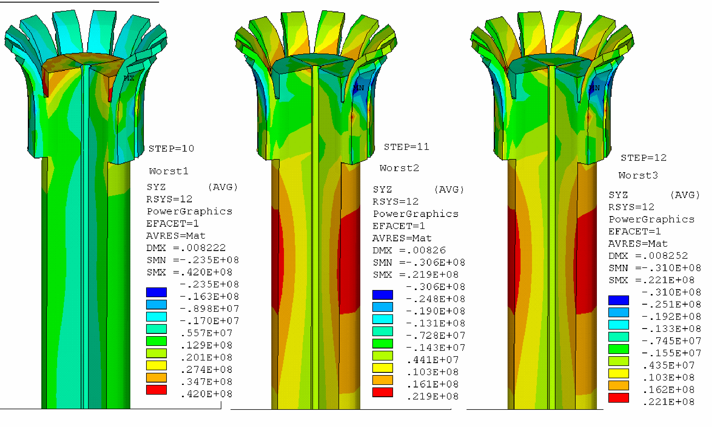

Slide 19
Can Develop Needed Contact Pressures
Expansion Loop Can Absorb Central Column Vertical Motion With
Jacking Ring Compression Aids Torsional Shear Carrying Capacity
No Mechanical Connections Penetrating the TF Inner Leg
Jacking Ring Compression Supports in-Plane Shear Carrying Capacity
OOP Support Lugs D Not Appear to be Needed

