Slide 1
The NSTX-U Electric Arc
Introductory comments on the process of recovery
Stewart Prager
May, 2015

Slide 2
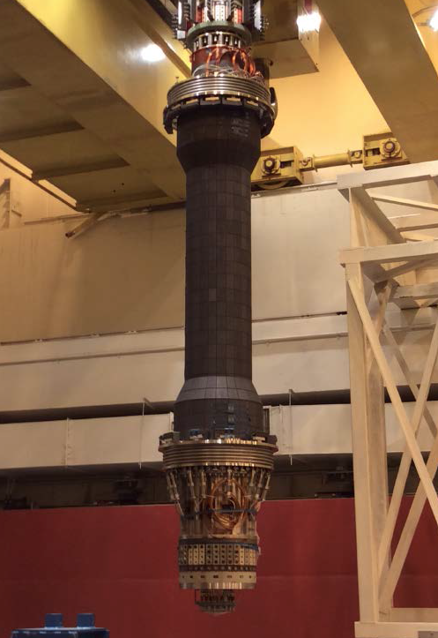
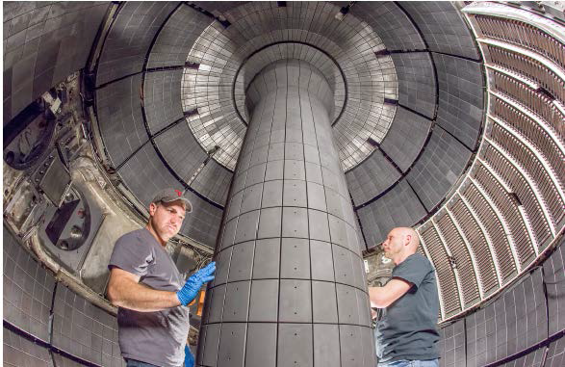
NSTX-U construction project
By April 23
All construction complete (2.5 year project),
External readiness review for operations complete
Majority of electrical commissioning complete for CD-4

Slide 3
NSTX-U construction project
By April 23
All construction complete (2.5 year project),
External readiness review for operations complete
Majority of electrical commissioning complete for CD-4
April 24
Ready for “CD-4 plasma shot”
Electrical arc occurred in OH coil circuit
(external to center stack magnet)

Slide 4
Disassembly, detailed assessment, clean-up began immediately
Three internal reviews have been commissioned – internal to PPPL, but external to NSTX-U
Two reviews are complete, one is longer term
Detailed design for reassembly underway
Expect to restart machine commisioning in about 6 weeks (exact schedule TBD)

Slide 5
Internal reviews
On causes: technical, procedural, process
Appointed April 30
Completed May 13
On technical extent of condition
Appointed May 13
Completed May 22
Root cause analysis
In-depth investigation of human, organizational, technical factors
Appointed May 4
In progress, report expected in about one month

Slide 6
Chronology
PPPL
Review
Extent
cond
PPPL
Review
causes
arc
4/24
May
June
PPPL
Advisory
committee
External
review
Root cause analysis
(for long-term improvements)
Assessment, design, reassembly
restart

Slide 7
Review committee memberships
On causes: technical, procedural, process
R. Ellis (chair, ME) ,J. Delooper (best practices), J. Hosea (phys.),
C. Neumeyer (EE), M. Bell (phys.)
On technical extent of condition
J. Hosea (chair, phys), R. Ellis (ME), N. Greenough (EE),
D. Mueller (phys)
Root cause analysis
I. Zatz (chair, ME), J. Lacenere (EE), J. Malsbury (QA),
M. Mardenfeld (ME)

Slide 8
Charge to internal review committee
Root technical cause: Is the cause for the arc correctly identified and understood? Are there any other likely causes that should be more carefully considered? Are there contributing causes that also need to be addressed prior to implementing any repair or re-design work?
Root procedural and process causes: Are there any procedural or process lapses that contributed to the fault – either in design/installation or in machine operations/interlocks? Are there any procedural or process improvements that should be implemented?
Extent of condition: Are there any other areas of NSTX-U, not yet identified, that might have been compromised by the fault, or be subject to similar defects? Are there any other similar weaknesses in the NSTX-U design, procedures, or processes that could lead to future difficulties?
Repair and design solution: Are the conceptual designs, repairs, and corrections identified by the NSTX-U team highly likely to avoid a recurrence of a similar fault? Are there other approaches that would be superior?

Slide 9
Internal review committee report
Root technical cause
Understood
Root procedural and process causes
Many findings and recommendations
(for pre- and post- startup)
Extent of condition
Recommended a follow-on “task force” to answer this charge
Repair and design solution
Early in the design, will need to follow PPPL design review procedures
Corrective action
plan underway
Appointed, and work completed
Well underway
A substantive, appropriately “hard-hitting” report with many recommendations

Slide 10
Internal review committee report
Root technical cause
Understood
Root procedural and process causes
Many findings and recommendations
(for pre- and post- startup)
Extent of condition
Recommend a follow-on “task force” to answer this charge
Repair and design solution
Early in the design, will need to follow PPPL design review procedures
Technical cause discussed by Stefan Gerhardt
Corrective action
plan underway
Committee report discussed by Bob Ellis
Appointed, and work completed
Well underway
Design issues discussed by Larry Dudek, Steve Raftopoulos
A substantive, appropriately “hard-hitting” report with many recommendations

Slide 11
Technical extent of Condition Report
Careful assessment of other technical risks,
some to be remedied before re-start, some after
Committee report discussed by Joel Hosea
Mitigation of risks covered by L. Dudek, S. Raftopoulos

Slide 12
Root cause analysis
In-depth investigation of contributing organizational, technical, and human factors
Roughly a two-month study
Aimed for longer-term (post re-start) improvements
Goals and process described by Irv Zatz

Slide 13
The charges are addressed in presentations
1. Technical cause: Larry Dudek, Stefan Gerhardt
2. Procedural and process causes: Bob Ellis
3. Extent of condition: Joel Hosea, Irv Zatz
4. Repair and design solution: Steve Raftopoulos
5. Overall recovery plan: All the above, Stewart Prager

