Slide 1



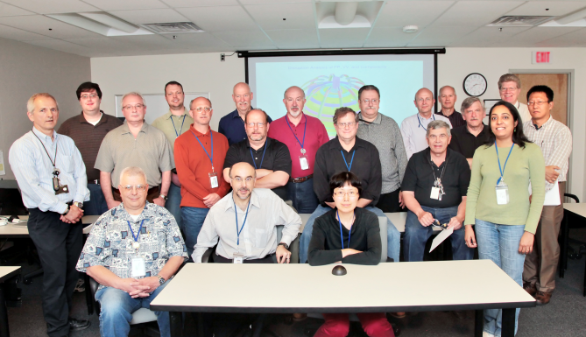
NSTX
Supported by
NSTX-U Centerstack Plasma Facing Components
Kelsey Tresemer
Ankita Jariwala, Art Brooks,
and the NSTX Upgrade Team
Columbia U
CompX
General Atomics
FIU
INL
Johns Hopkins U
LANL
LLNL
Lodestar
MIT
Nova Photonics
New York U
ORNL
PPPL
Princeton U
Purdue U
SNL
Think Tank, Inc.
UC Davis
UC Irvine
UCLA
UCSD
U Colorado
U Illinois
U Maryland
U Rochester
U Washington
U Wisconsin
Culham Sci Ctr
U St. Andrews
York U
Chubu U
Fukui U
Hiroshima U
Hyogo U
Kyoto U
Kyushu U
Kyushu Tokai U
NIFS
Niigata U
U Tokyo
JAEA
Hebrew U
Ioffe Inst
RRC Kurchatov Inst
TRINITI
NFRI
KAIST
POSTECH
ASIPP
ENEA, Frascati
CEA, Cadarache
IPP, Jülich
IPP, Garching
ASCR, Czech Rep
NSTX Center Stack Upgrade Peer Review
LSB B318
May 18, 2011

Slide 2
Slide title
Outline
  Overview
  Design Specs
    GRD
    Chits
  Tile Design
    Layout
      Diagnostic layout/wireways
      Gas Injection
    Loading
      Materials
      Analysis Results
      Fastening Scheme
  Summary

Slide 3
Design Specifications
This job covers the replacement, upgrade, and reinstallation of the carbon Plasma-Facing Components on the Centerstack Upgrade.
  In accordance to the NSTX Centerstack Upgrade General Design Requirements (GRD) document.
      Tiles shall be radially curved, with overlapping edges, ATJ Graphite, and designed for the upgrade heat loading and increased magnetic fields
      Heat Flux Loading on the tiles shall be mitigated via advanced divertor operations and held to material (ATJ) allowables
      Pulse length: 1 to 5 seconds, rep rate 1200 sec
      350 °C bakeout temp
    Other (non GRD) considerations:
      Tiles will have diagnostic slotting and appropriate wire channels
        Passages for Gas Injection System
      Tile thicknesses increase to .75”, 1” and 2” for the CSVS, IBD AS and VS, and the IBDHS, respectively.
      Effort to reduce installation/re-installation problems
        Re-usability, anti-galling

Slide 4
Design Specifications
Review-based Chits: All closed
201004-03 | April 2010 Peer Rvw | Peer-03 | Make sure surface area of contact between tiles and backing surface is sufficient for disruption current and heat loads | Completed. Disruption current analyses was completed. All forces are inward. Grafoil is being reintroduced. Analysis confirms heat transfer is adequate and stresses are within limits.
201006-06 | June 2010 PDR | Chit-06 | Consider using graphite tiles for centre tub even if it needs increasing the centre column radius by a few mm to save cost (and time) | Concur. Will be using ATJ graphite on the CS column at GRD specified thicknesses.
201006-11 | June 2010 PDR | Chit-11 | At each review, a new tile connection scheme is shown. This latest one has not been used in other fusion machines. May present some R&D. Perhaps going with another fusion experiment's method should be considered. | The design is being changed to welded studs and threaded caps. (the proven existing NSTX design) Only exception is the use of Spiralock threads to prevent galling and allow reuse.
201006-19 | June 2010 PDR | Chit-19 | The definition of the CFC linked to requirements. Density, weave, graphitization temperature all need to be fed back to the design. | All tiles are now ATJ graphite. CFCs are not required.
201008-04 | Lehman Aug 2010 CD-2 | 2.1-4 | MAGNETS & CORE(Brad Nelson): Refrain from placing contracts for the PFC tiles until after the prototyping of the tiles and mechanical testing of the fastening scheme is completed. | CFC’s were eliminated. ATJ graphite properties are well known. Loading is much lower and stresses are no longer a concern. Most stresses in the divertor tiles are thermally (internally) induced.

Slide 5
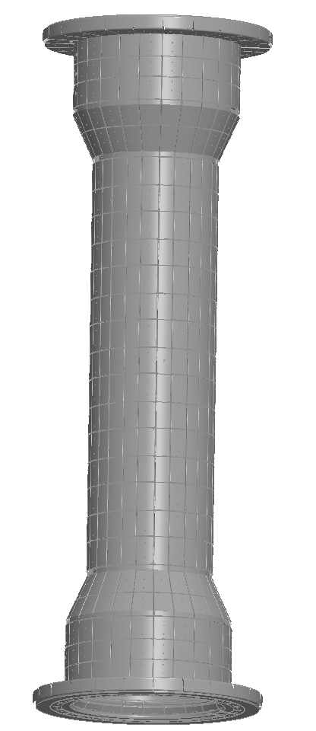
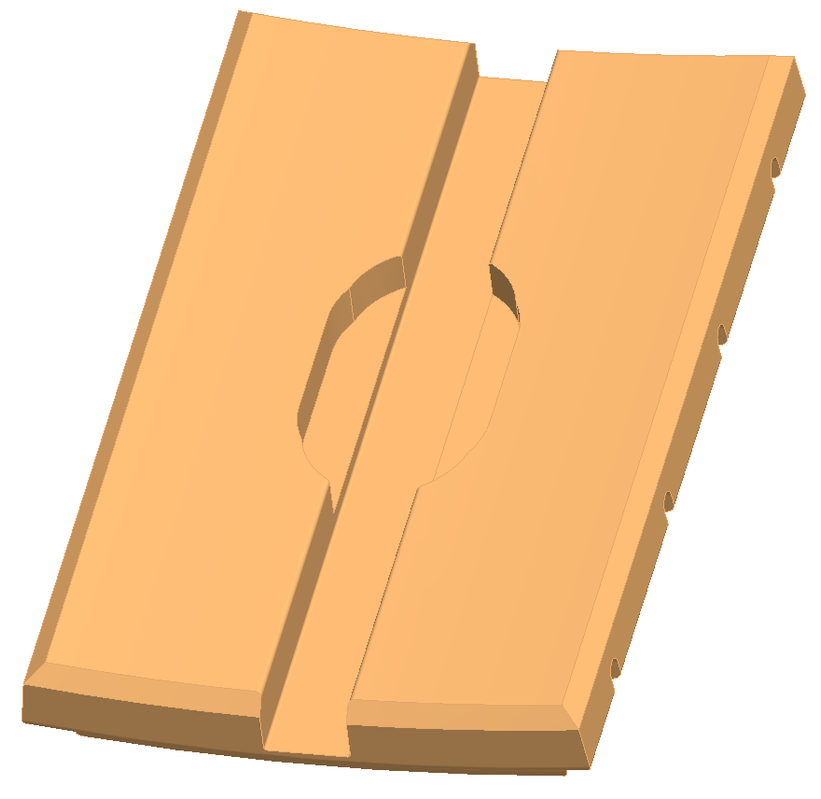
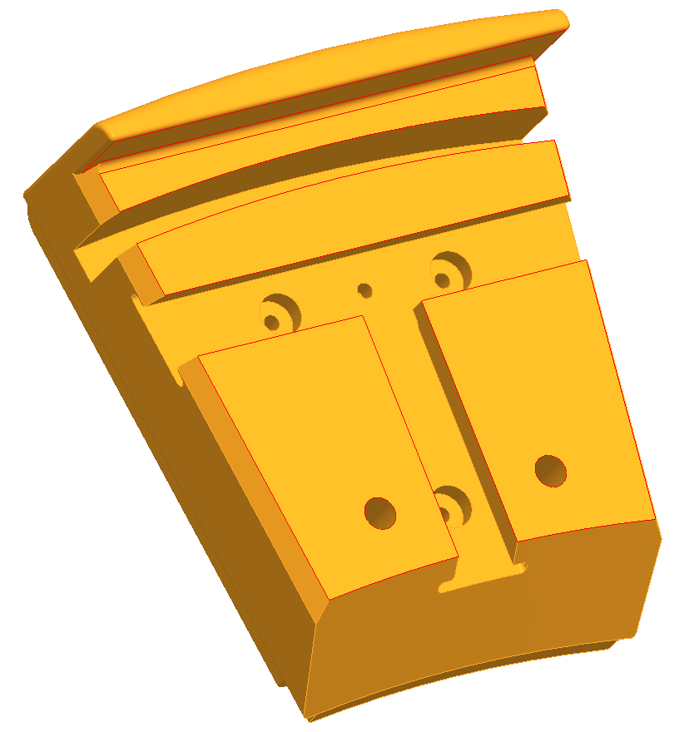
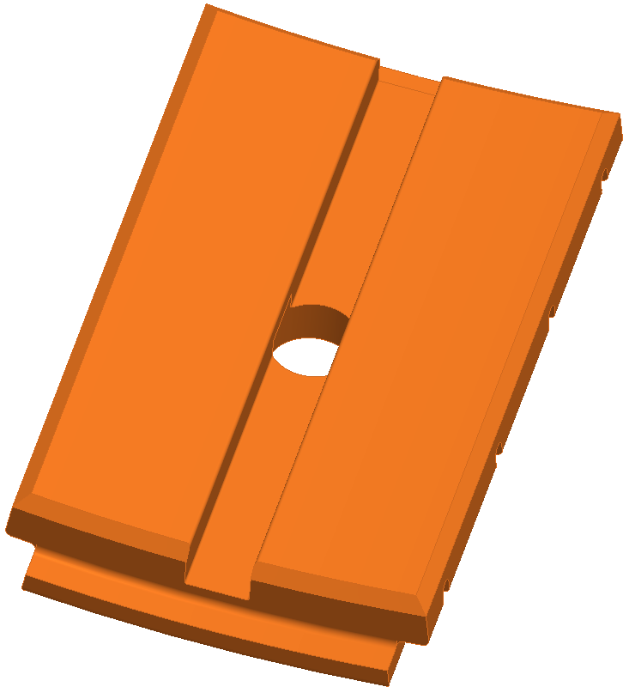
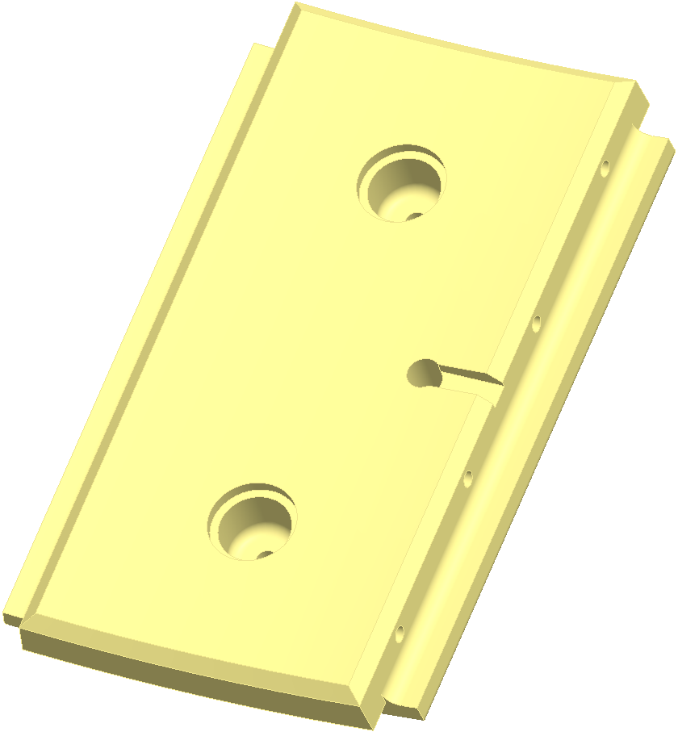
Tile Design
IBD HS (U)
IBD VS (U)
IBD AS (U)
CS VS
IBD AS (L)
IBD VS (L)
IBD HS (L)
Tile layout
Tile layout
  Reduced overall tile number, increased size where possible
    ~900 → ~700 tiles
      IBD HS Tiles the same size due to thermal constraints
  Designed diagnostic slots and wire channels
    Mirnov, Rogowski, Langmuir, Thermocouple

Slide 6
Tile Design

Slide 7
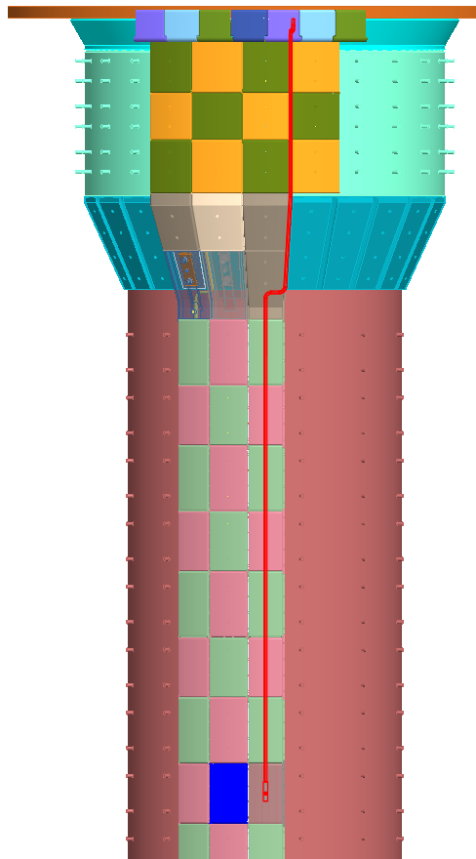
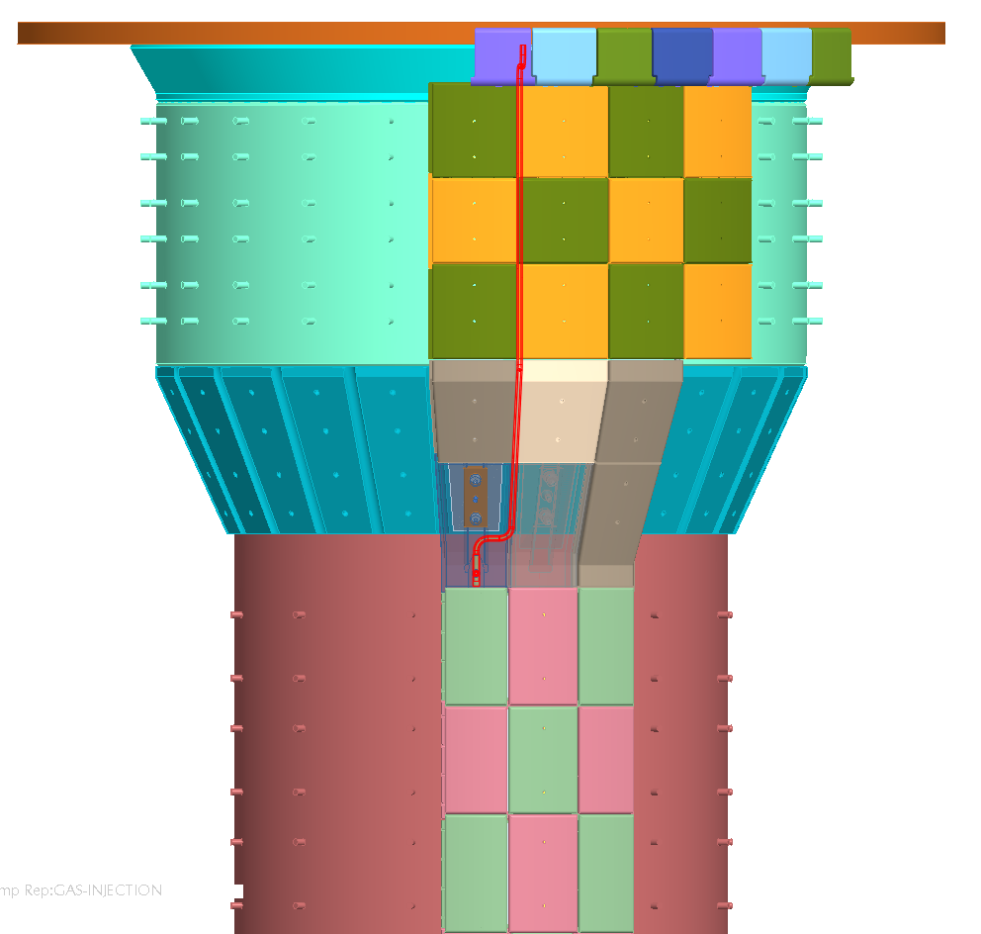
Tile Design
Tile layout
  Collaborated to include Gas Injection System passages
    Shoulder and Mid-plane

Slide 8
Tile Loading: Thermal
GRD constraint: Use ATJ Graphite and
    The thermal analysis is done using the average heat fluxes associated with a 14 MW plasma of 5 second duration pulse with 1200 second rep rate. (DN loading)
      Heat Flux applied to Plasma Facing Surface of Tiles. For IBDhs this includes vertical surface

Slide 9
Tile Loading: Thermal
Results
  1D results show that SN (15 MW/m2) will probably be limited to 1s if heat flux magnitude is not reduced via operations

Slide 10
Tile Loading: Thermal
Results
  2D analysis, with Grafoil, with water flow
    Water lowers temp ratcheting while not exceeding own limits

Slide 11
Tile Loading: Thermal
Max: 202°C
Max: 327°C
Max: 425°C
Max: 1062°C

Slide 12
Tile Loading: Thermal
Results
  2D analysis, with Grafoil, with water flow
    Water eliminates tile-temp ratcheting while not exceeding 100 °C

Slide 13
Tile Loading: Thermal

Slide 14
Tile Loading: Thermal Stress
Results
  All thermal stresses are well within limits of ATJ
    Exception on edge of IBDHS tile, where heating could be on two faces, but not likely…

Slide 15
Tile Loading: Thermal Stress
IBDHS

Slide 16
Tile Loading: E-Mag
The halo currents and associated Lorentz forces & directions are based on the following:
  Halo Currents are resistively distributed & predominantly poloidal
    Studies show this to be true even with large toroidal peaking (TPF) with in and out strike points at different toroidal angles
    The exception is near the strike points where current quickly redistributes
  The tiles are assumed shorted to each other (at least locally) by plasma filling the gaps
    It is estimated that at a temperature of 10ev, the plasma electrical resistivity is very close to ATJ graphite (thou it may not penetrate very deep into the gap)
  As a result of the above, there is current sharing between the tiles and CS casing based on the relative resistance
Per Stefan Gerhardt, the interaction of the halo currents with the TF is always such as to press tiles toward VV wall or CS Casing
  This is this is true even when the TF direction is opposite the plasma current.

Slide 17
Tile Loading: E-Mag

Slide 18
Fastening Scheme
Due to design flaws in previous proposals, reverting to present NSTX configuration
  Weld Studs and nut caps in CSVS and IBDVS
    With Spiralock threads
  Bellevilles and socket cap screws in IBDAS and IBDHS
  Grafoil!
Redesign for steel to steel connections
  ATJ tiles are passively held, allowed thermal freedom
    Grafoil is minimally compressed via installation
    Socket cap screws have low preload (112 lbs)
    Spiralock tiles need high tolerances to maintain higher preloads w/o compressing ATJ or Grafoil

Slide 19
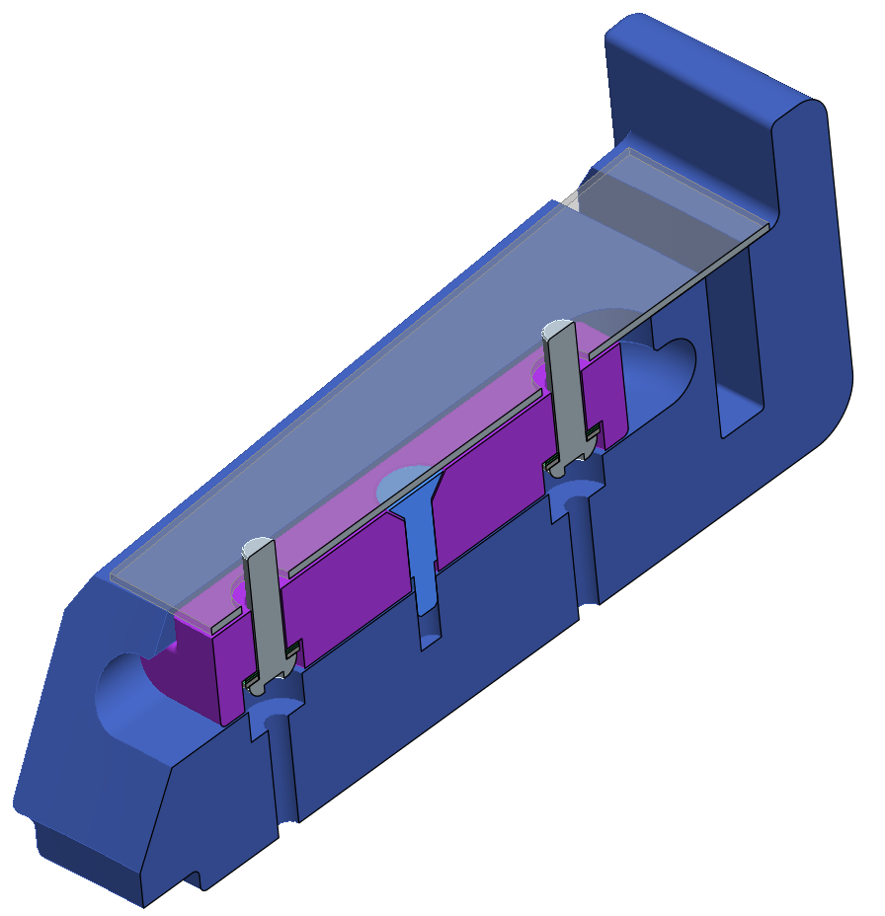
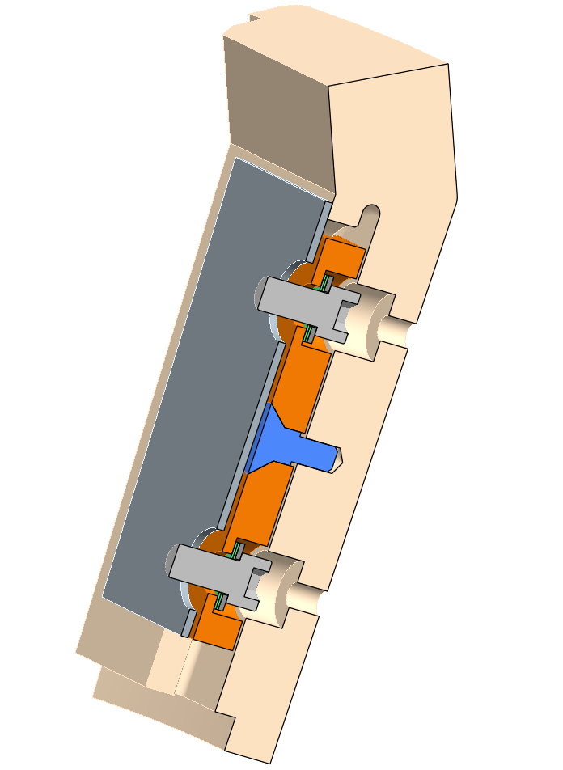
Fastening Scheme
IBD HS and IBD AS

Slide 20
Fastening Scheme
IBD HS and IBD AS
T-bar and cap screws
  Light preload (112 lbs)
  Bellevilles
  Grafoil is lightly compressed by T-bar
  Locating pin

Slide 21
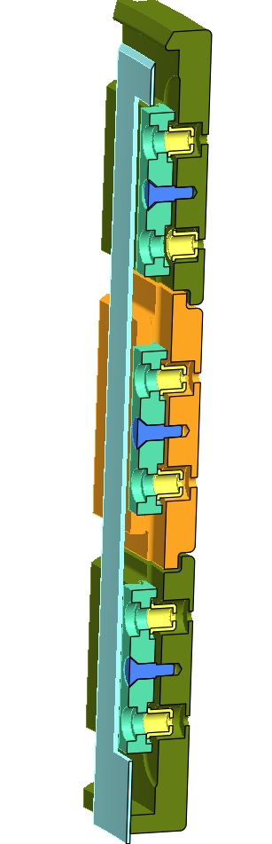
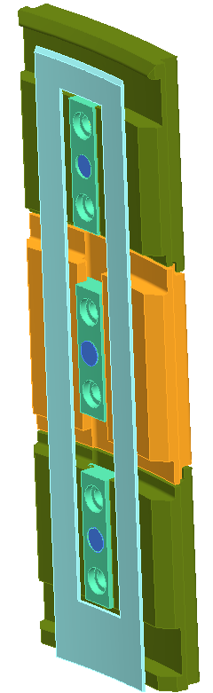
Fastening Scheme
IBD VS
T-bar and Spiralock nutcaps
  Large pre-load (75% of Sp)
  Hard joint, steel to steel, high tolerances
  Grafoil is BARELY compressed by tile, only to provide compliant surface for tile’s thermal expansion.
  Locating pin

Slide 22
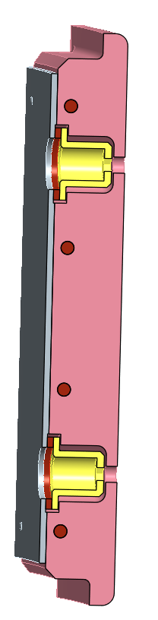
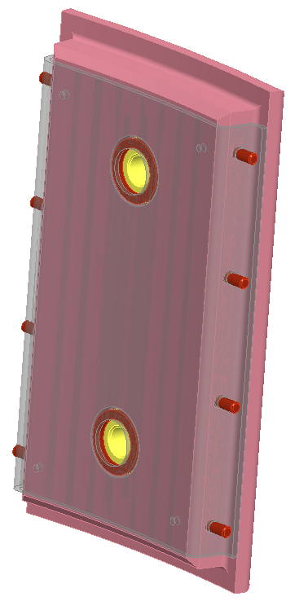
Fastening Scheme
IBD VS and CS VS
Inconel Rail and Spiralock nutcaps
  Large pre-load (75% of Sp)
  Hard joint, steel to steel
  Fastening columns hold adjacent tiles for economy.
  Grafoil not needed, forces within limits, thermal heating almost none

Slide 23
Summary
Design is adequate to handle GRD loading (thermal and E-Mag), provided certain assumptions hold:
    Heat Flux for a SN CAN be controlled by operations (Strike point sweeping and Snowflake) to lower the magnitude
      Will extend the pulse length
    The directionality of the Halo force is ALWAYS away from plasma despite the direction of current flow
    Heating to the IBD HS is NOT on both the tile’s top surface AND the CHI gap surface at the same time.
Other design components have been integrated into design without major issues
  Design is solid, mature, and meets NSTX-U requirements
  Analysis has been documented and checked
  Chits have been addressed and closed

Slide 24
Summary Continued
Left to do…
  Cost and Scheduling needs to be updated in light of recent analysis
    WAF need updating
  Risks need to be updated
    No “show stoppers” as of now
  Final design needs prototyping (in progress)
  Documentation
    Procedures
    Update SRD
    Drawings
FDR

