Slide 1



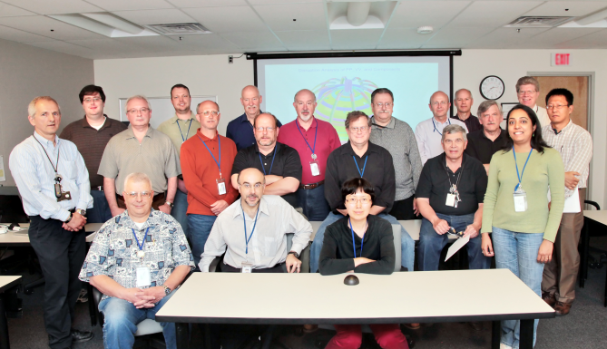
NSTX
Supported by
Vacuum Vessel & Support Structure
WBS 1.1.2
Mark Smith
and the NSTX Upgrade Team
Columbia U
CompX
General Atomics
FIU
INL
Johns Hopkins U
LANL
LLNL
Lodestar
MIT
Nova Photonics
New York U
ORNL
PPPL
Princeton U
Purdue U
SNL
Think Tank, Inc.
UC Davis
UC Irvine
UCLA
UCSD
U Colorado
U Illinois
U Maryland
U Rochester
U Washington
U Wisconsin
Culham Sci Ctr
U St. Andrews
York U
Chubu U
Fukui U
Hiroshima U
Hyogo U
Kyoto U
Kyushu U
Kyushu Tokai U
NIFS
Niigata U
U Tokyo
JAEA
Hebrew U
Ioffe Inst
RRC Kurchatov Inst
TRINITI
NFRI
KAIST
POSTECH
ASIPP
ENEA, Frascati
CEA, Cadarache
IPP, Jülich
IPP, Garching
ASCR, Czech Rep
NSTX Center Stack Upgrade Peer Review
LSB B318
May 18, 2011

Slide 2
Outline
Charge Questions
CHITs
Design Overview
Vessel Leg Reinforcement
Pedestal Upgrade
Umbrella Upgrades
PF2/3 Support Upgrades
PF4/5 Support Upgrades
TF Outer Leg Support Upgrades
Interconnections
Cost & Schedule
Open Items

Slide 3
Charge Questions
Has ES&H been properly addressed?
Does the final design meet the GRD?
Does the FDR satisfy PPPL Procedure ENG‐033 Design Verification?
  Attachment 4: Design Review Objectives and Input Documentation
  Attachment 6: Human Performance Improvement/Factors Considerations.
Have the CHITS & previous recommendations been addressed?
Have risks been appropriately identified and mitigated?
Are the cost and schedule estimates updated and reasonable?

Slide 4
CHITs
CHIT log line item 215: CHIT-07 PDR June 2010
  TF Outer Leg Support Bolted Joint:
    Are dielectric breaks (insulated joints) required?
    No.
    How is a shear load carried?
    Design has been modified to accommodate shear load.
CHIT is closed.

Slide 5
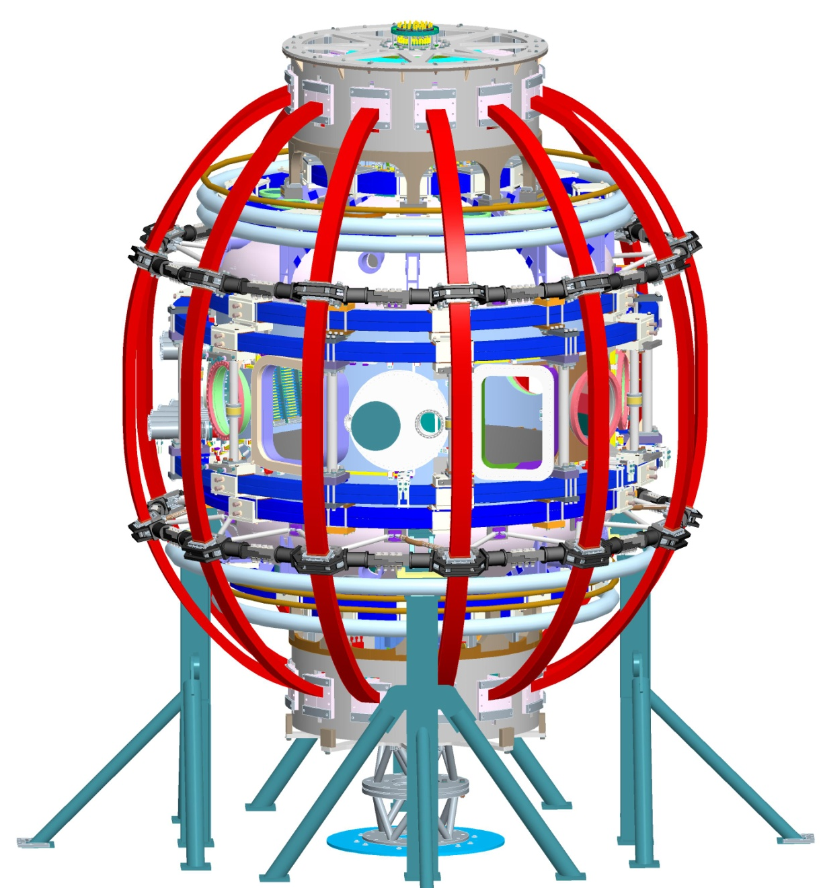
Design Overview
New Umbrella Upper Lid
Upper & Lower Umbrella Reinforcements
Upper & Lower Umbrella Reinforcements
New TFO Leg Support Ring
Additional PF2 Clamp,
PF2/3 Support Upgrades
Existing PF4/5 Supports Upgraded
New (additional) PF4/5 Supports
New Clevis & Connecting Rods
New Umbrella Lower Lid
VV Foot Reinforcement
New Pedestal

Slide 6
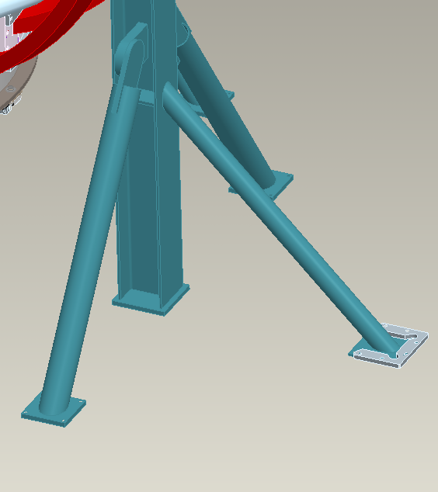
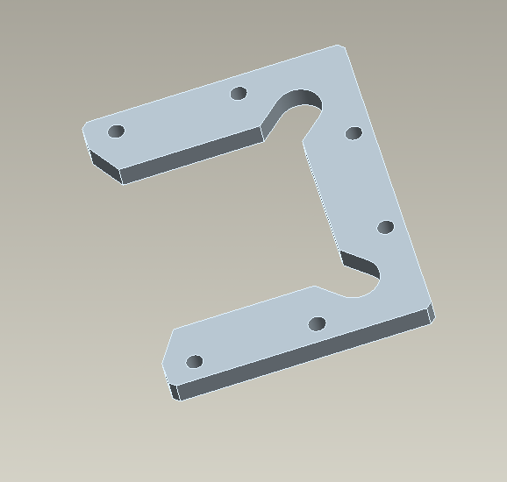
Vessel Leg Reinforcement
Horseshoe shaped foot reinforcement
Epoxy anchor bolts attach to the concrete.
1 reinforcement per set of VV supports.

Slide 7
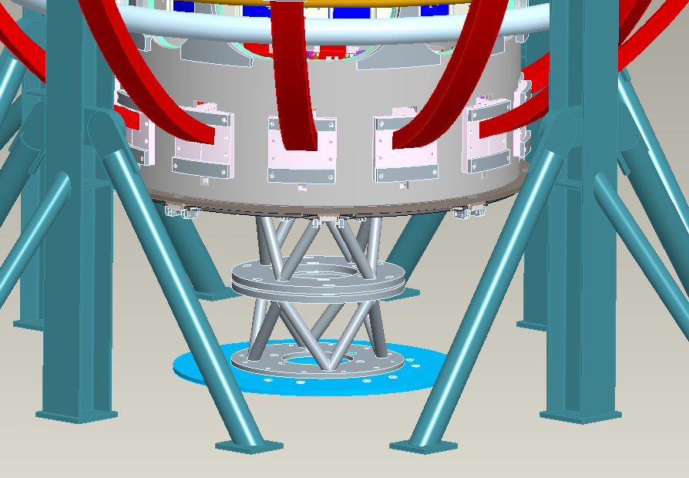
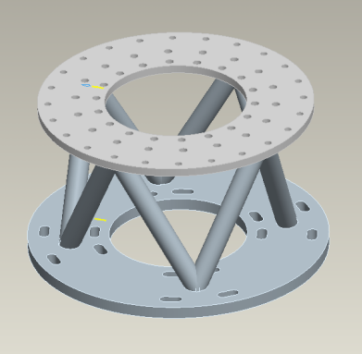
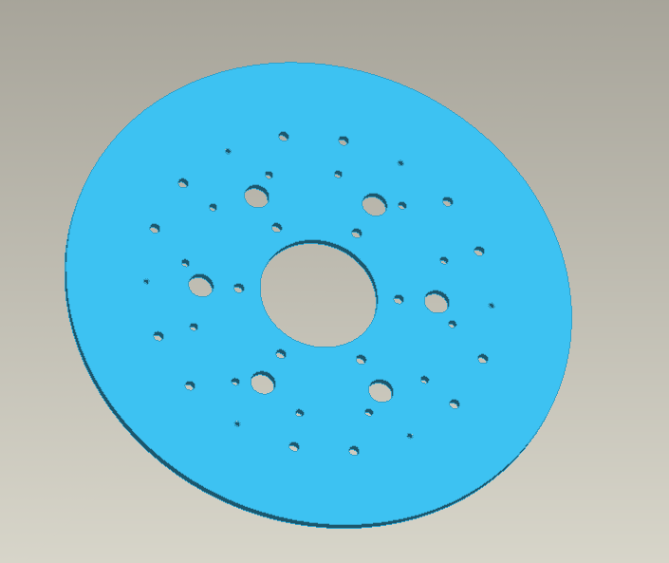
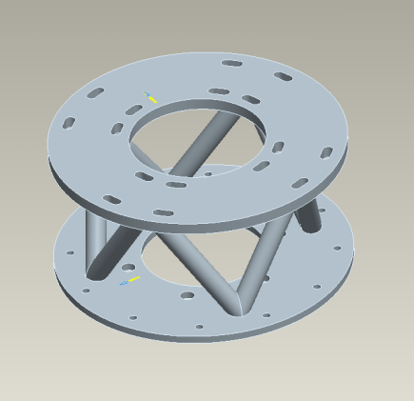
Pedestal Upgrade
Upper Pedestal Section
New Pedestal
Base Plate
Lower Pedestal Section

Slide 8
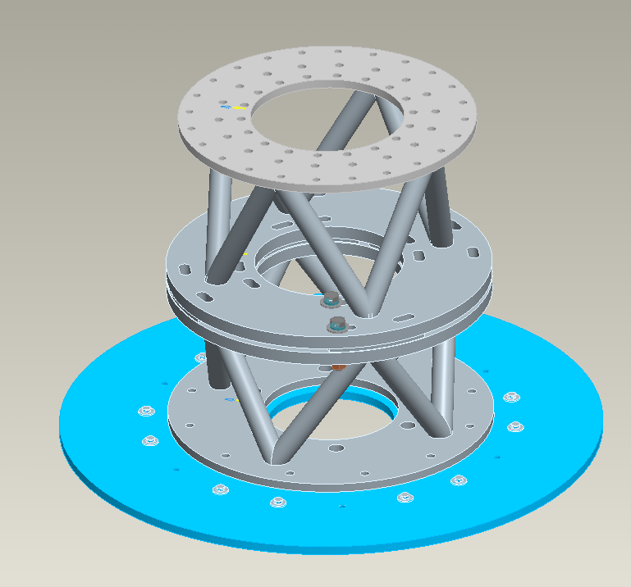
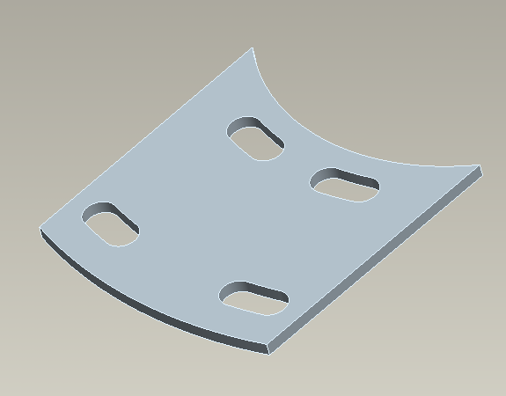
Pedestal Upgrade
Design provides access / clearance for equipment.
Attachments for lower crown bolt plate and umbrella lower lid.
Bolt slots provide for alignment.
Gap allows for height adjustment via shims.
Epoxy anchor bolts attach to the concrete.
Grouted base allows for leveling.
Base Plate distributes load and provides attachment point for equipment.
Fiducials provided for alignment.

Slide 9
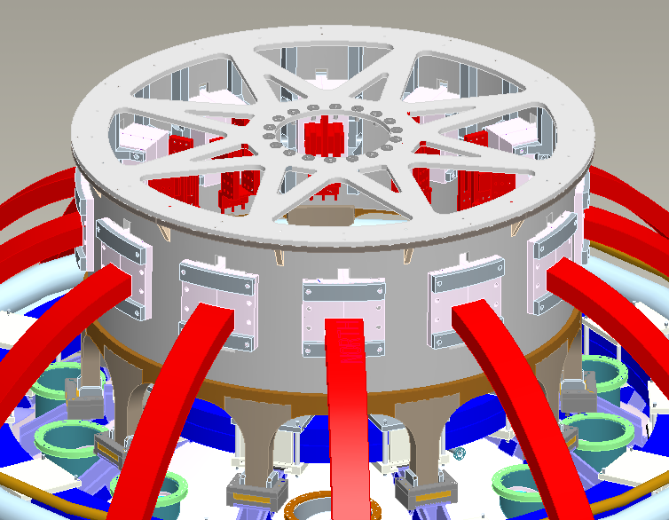
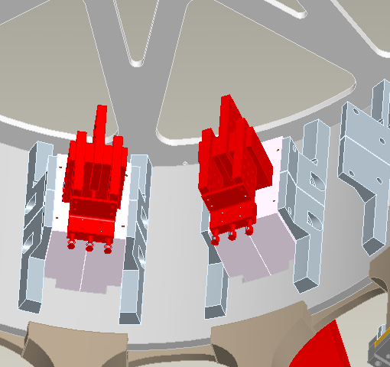
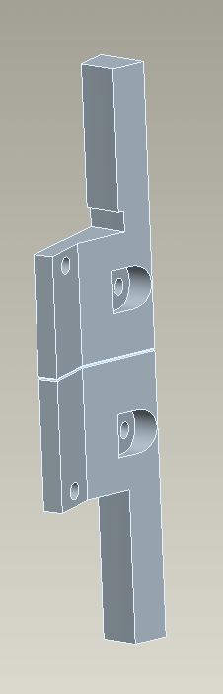
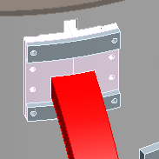
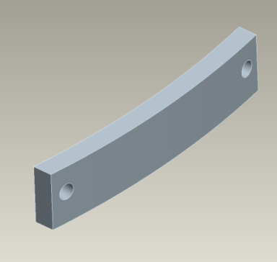
Umbrella Upgrades
Upper & Lower Umbrellas
Internal Reinforcement adjacent to Al Blocks
(2 part & welded).
Block threaded rods replaced.
Upper & Lower Umbrellas
External Reinforcement on Al Blocks (bolted). Corner bolts replaced.

Slide 10
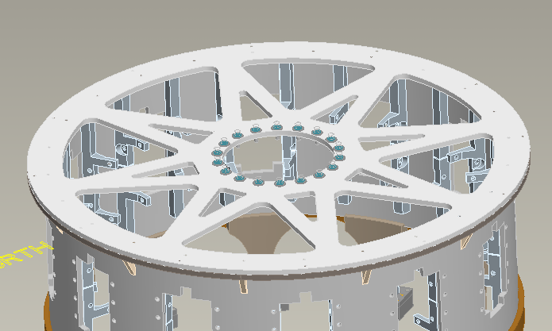
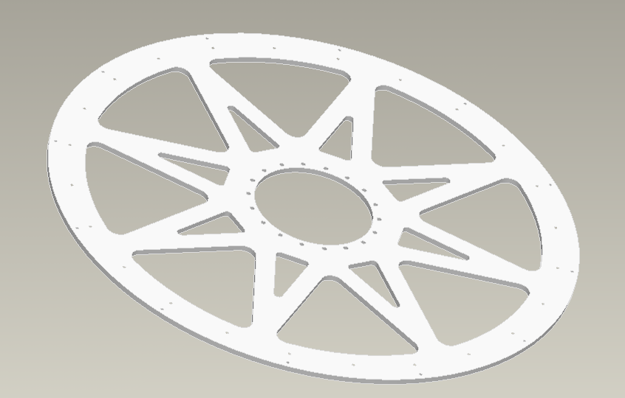
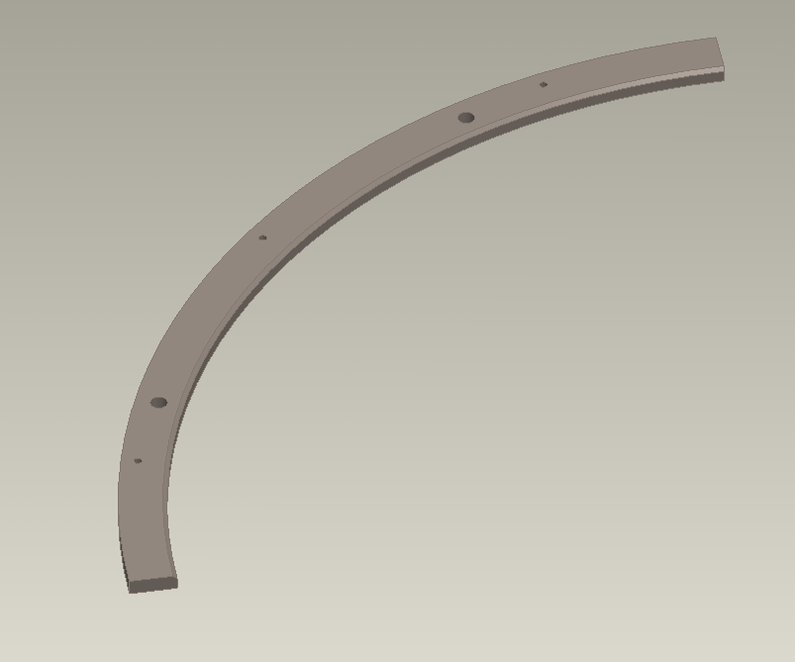
Umbrella Upgrades
Upper lid and crown bolt plate attachment (bolted)
New Upper Lid
(1 water jet part)
Upper Lid bolts to ring.
Upper Lid Reinforcement Ring and Gussets (welded )
For installation, Upper Lid Reinforcement Ring is sectional.

Slide 11
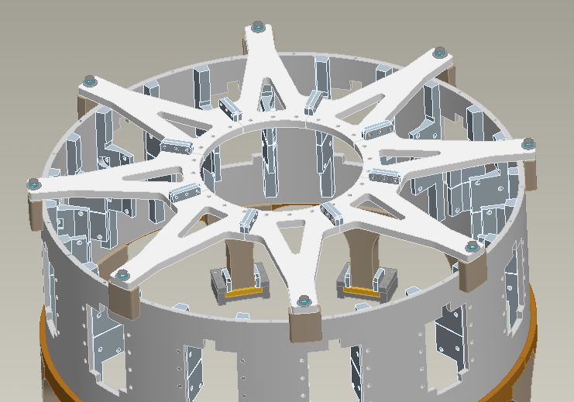
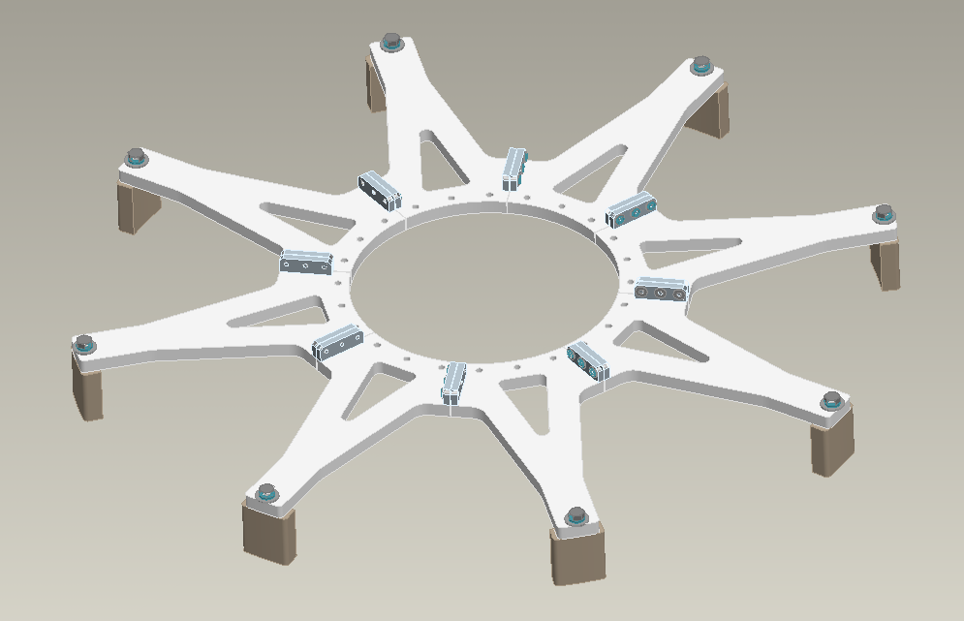
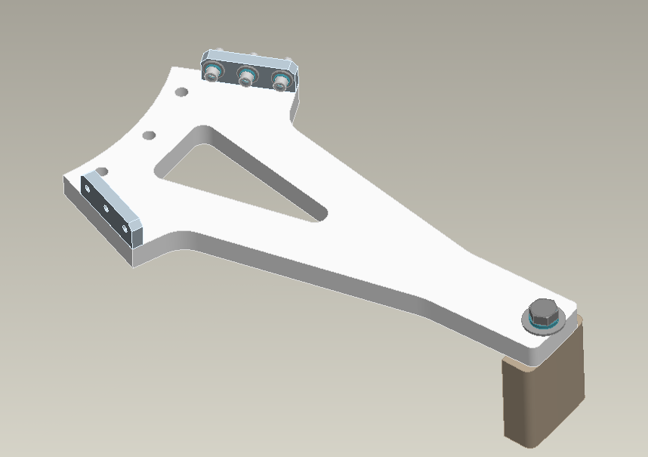
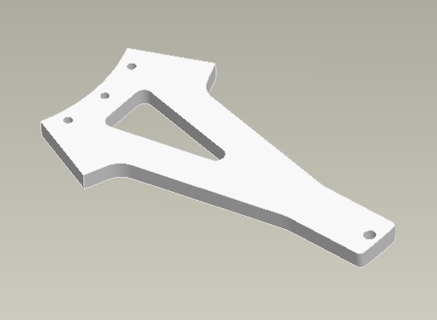
Umbrella Upgrades
Lower lid and Pedestal attachment (bolted)
New Lower Lid (sectional & bolted)
welded
bolted
welded
1 water jet part

Slide 12
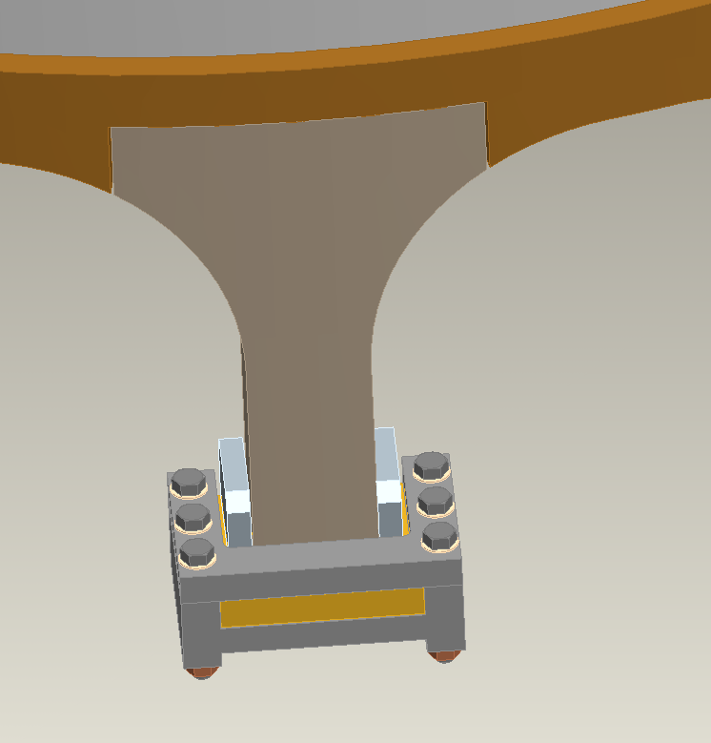
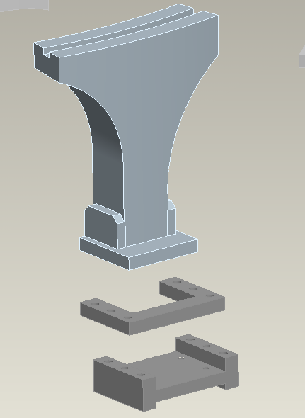
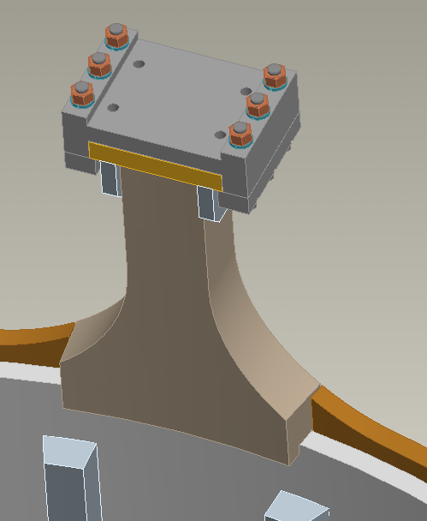
Umbrella Upgrades
Arch Reinforcement Ring (sectional & welded)
Replacement Leg
(1 machined part)
Upper & Lower Umbrella Legs removed and replaced (welded).
Replace foot hardware, capture and slide with Inconel parts.

Slide 13
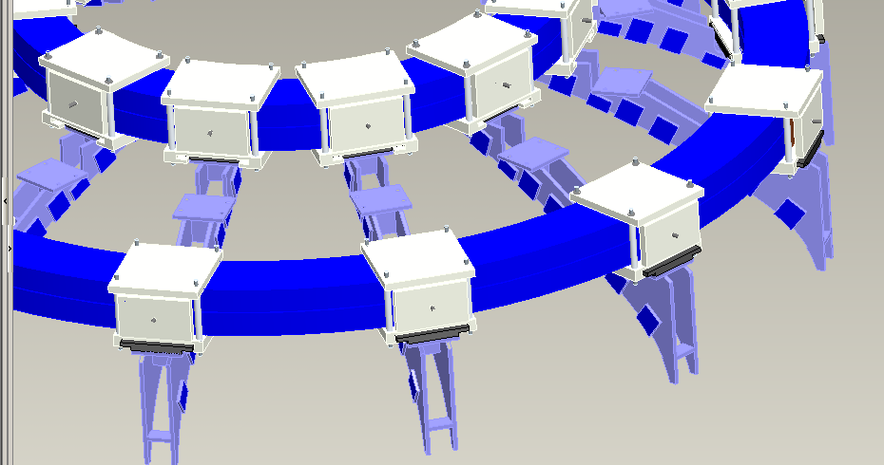
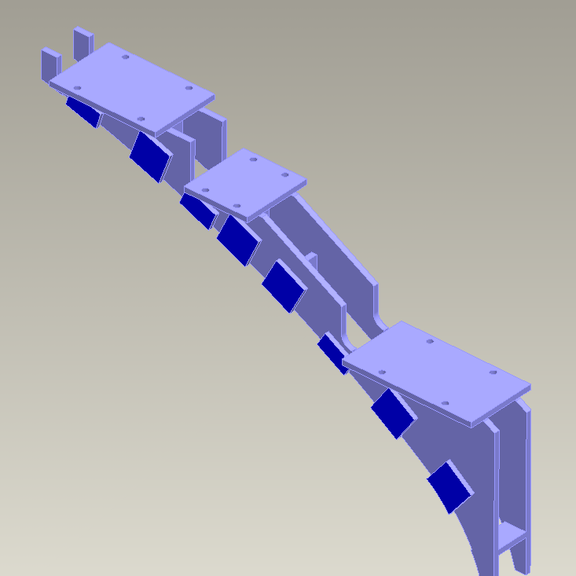
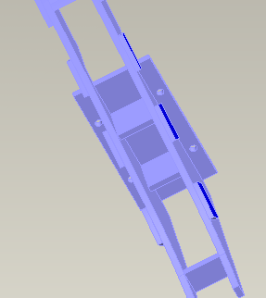
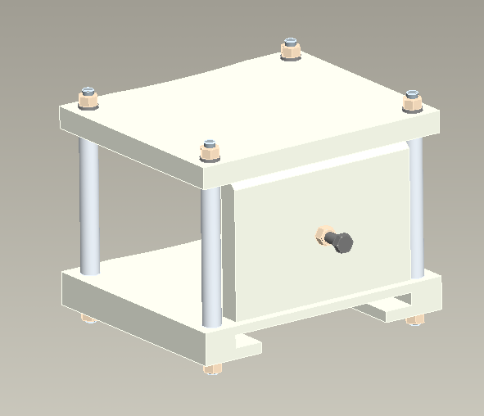
PF2/3 Support Upgrades
PF2 mount
PF3 mount
PF3 Clamp
Additional PF2 Clamp
Weld reinforcement on PF3 mount.
Remove PF2/3 hardware and replace with ASTM A193 B8M Class2 Material.

Slide 14
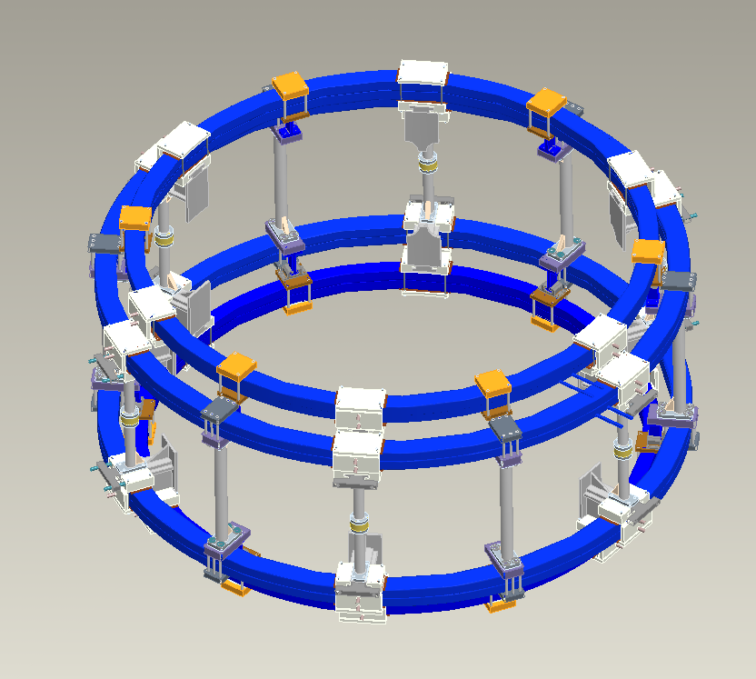
PF4/5 Support Upgrades
4 of 6 existing PF4/5 supports free to slide radially for thermal expansion.
2 of 6 existing PF4/5 supports (180˚ apart) fixed radially.
6 New (additional) PF4/5 Supports
Modifications to existing PF4/5 supports.

Slide 15
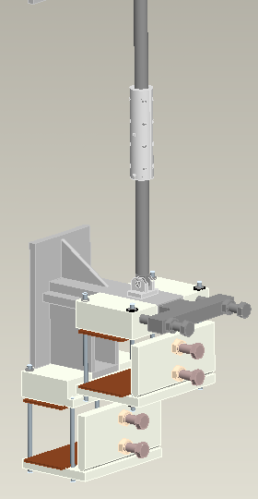
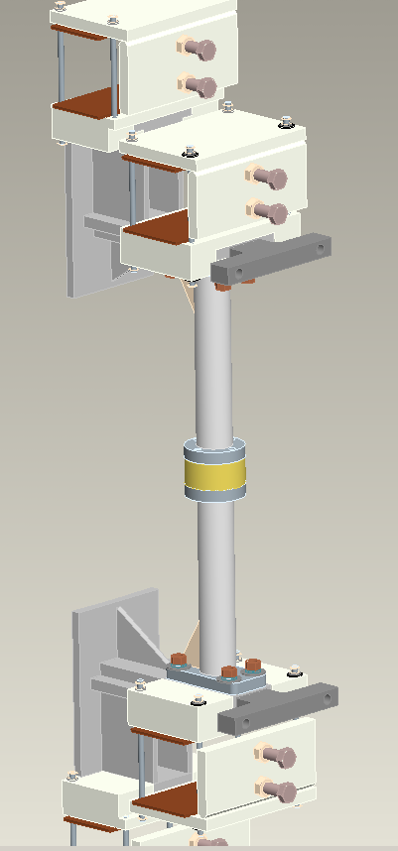
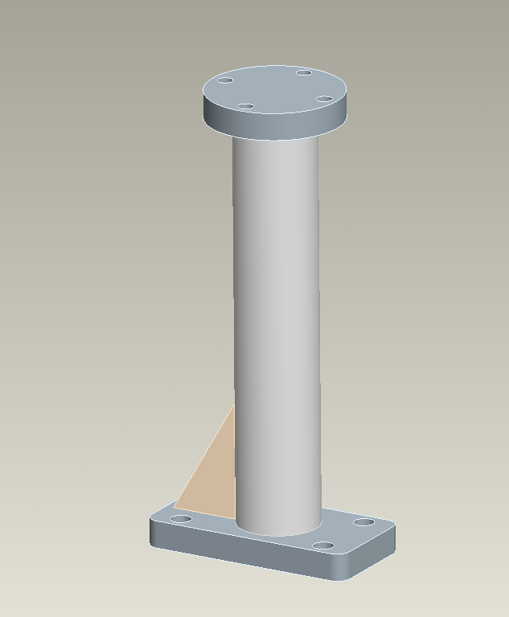
PF4/5 Support Upgrades
Replace column.
2 part column with spacer for installation.
Remove clevis.
Replace hardware with ASTM A193 B8M Class2 Material.
Studs used for installation.

Slide 16
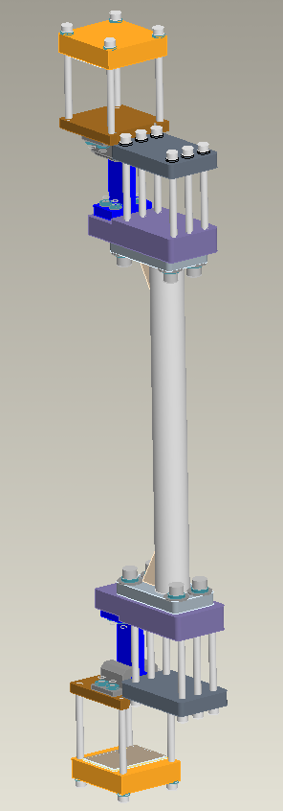
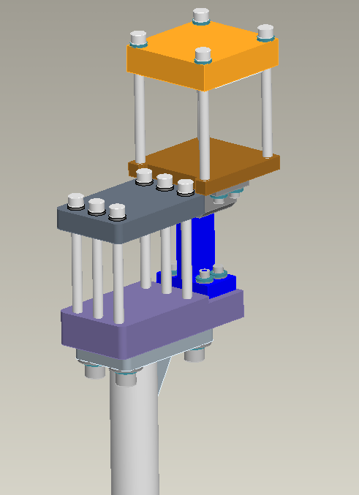
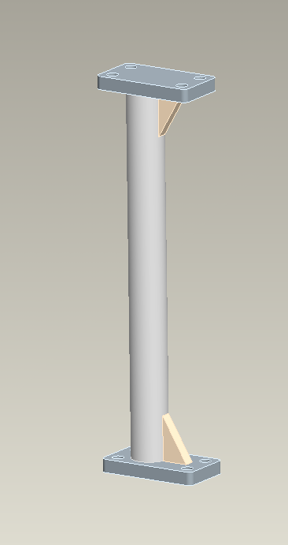
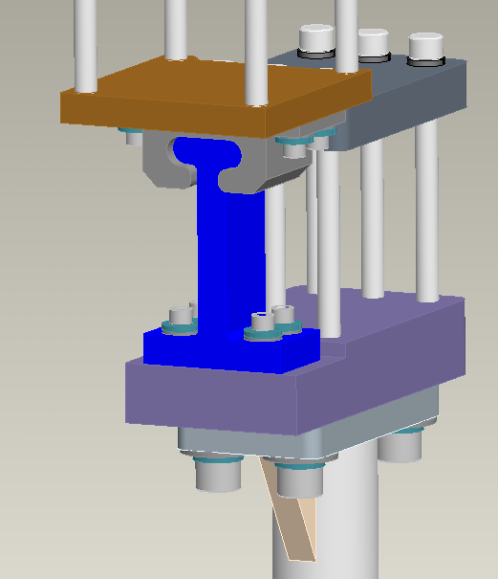
PF4/5 Support Upgrades
New (additional) PF4/5 Support
T-slot allows for relative motion between PF4 and PF5.

Slide 17
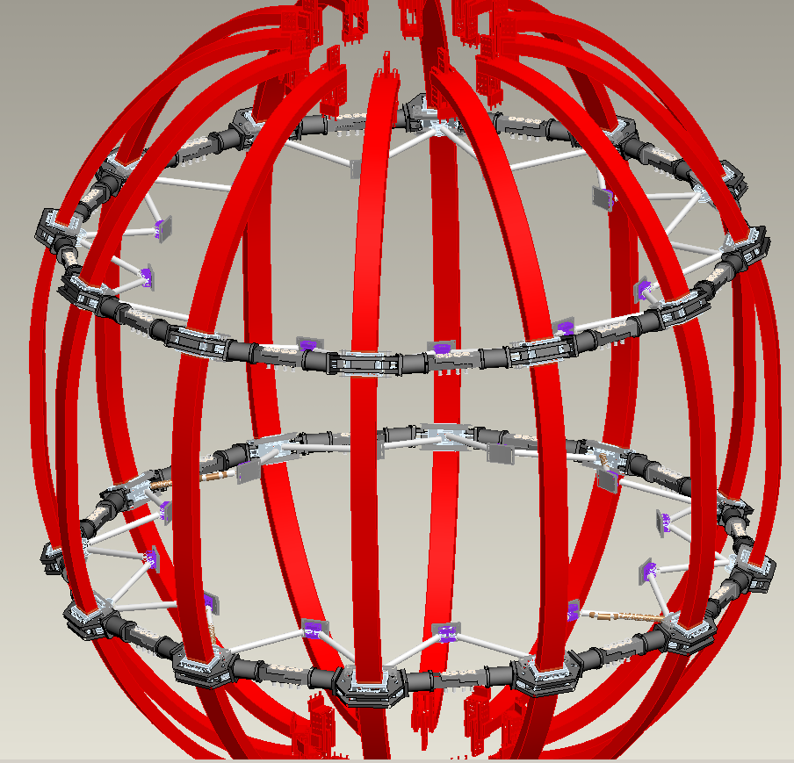
TF Outer Leg Support Upgrades

Slide 18
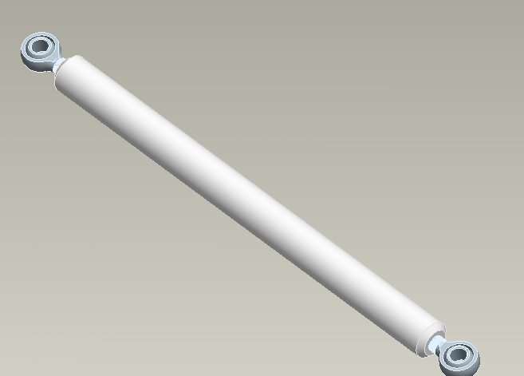
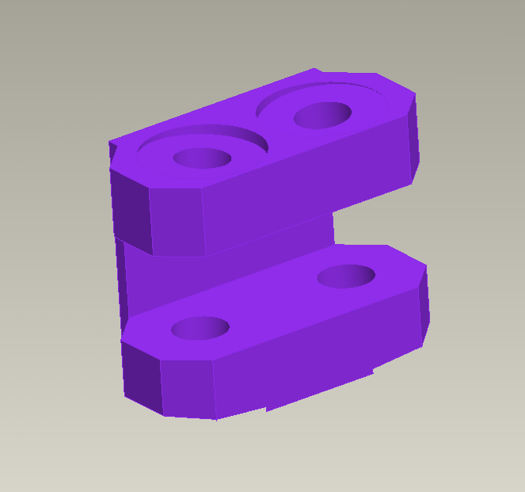
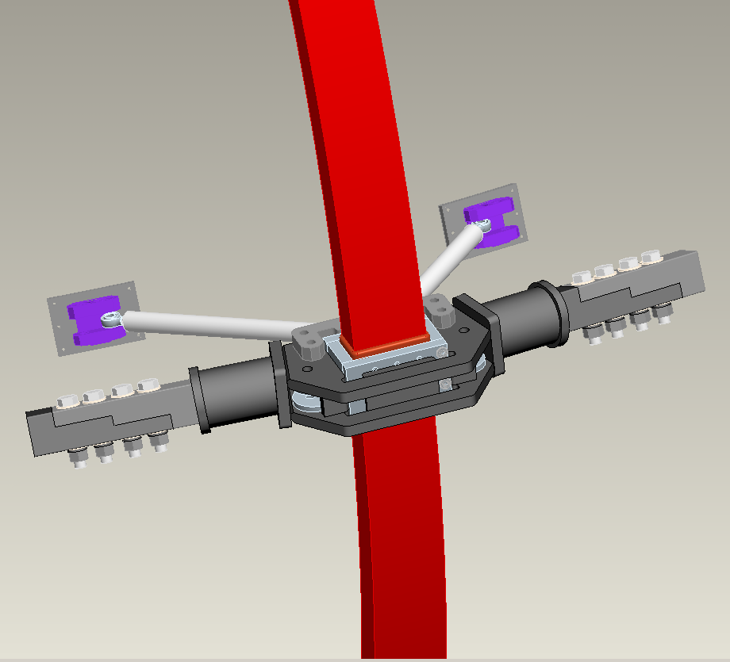
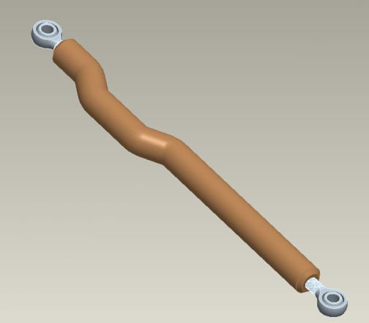
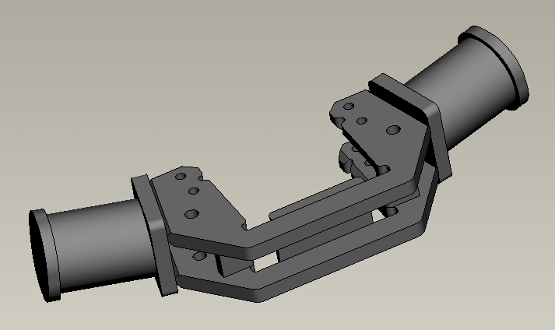
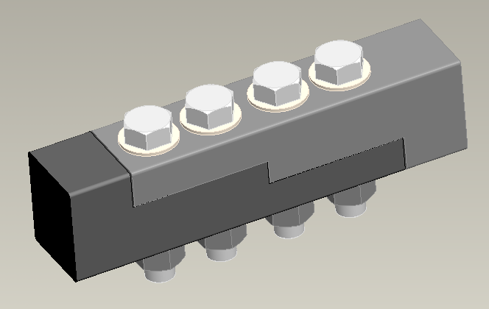
TF Outer Leg Support Upgrades
Remove and replace clevis.
Remove and replace connecting rods.
Shimmed around existing TFO leg clamp.
Remove and replace existing TFO Leg support turnbuckles.
welded

Slide 19
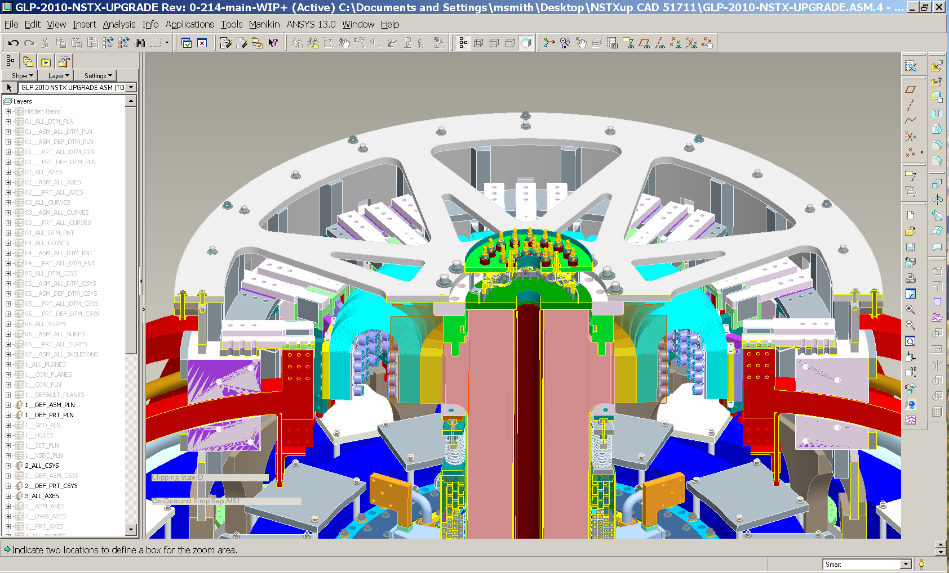
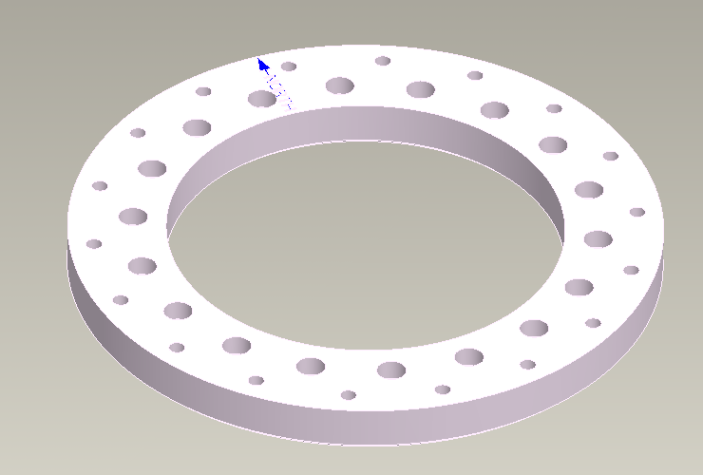
Interconnections
Upper Crown-Lid Bolt Plate

Slide 20
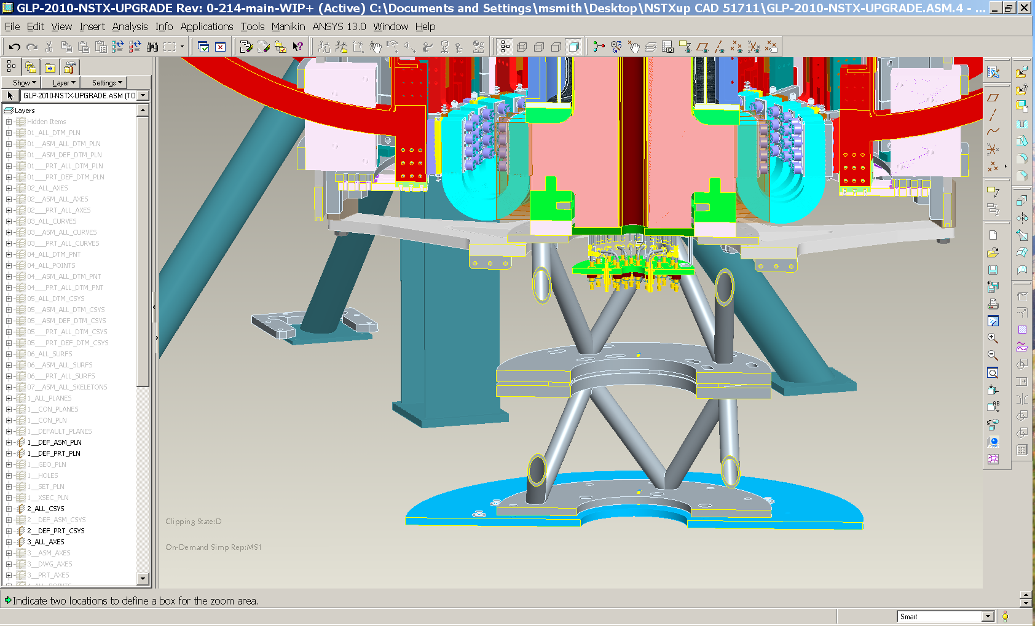
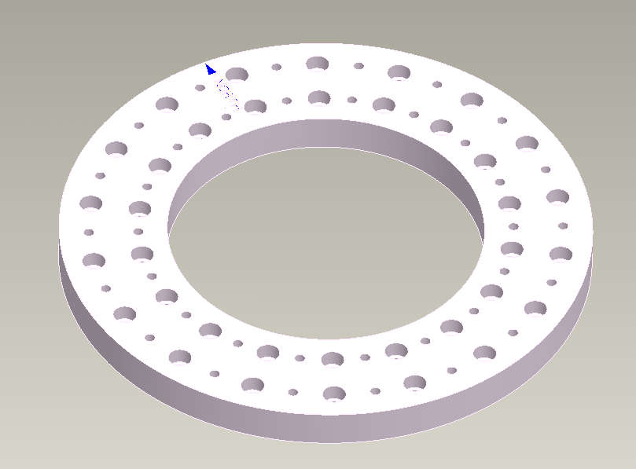
Interconnections
Lower Crown-Lid-Pedestal Bolt Plate

Slide 21
Cost & Schedule
ETC updated for FDR effort and M&S.
  Additional EAEM man-hours required: ≈ 830 man-hours.
  Assembly and detailed drawings mostly completed.
  Design finalization pending calculation completion.
  M&S reduced ≈ $200k.
    This requires validation.
Will need to update ETC upon completion of the calculations.

Slide 22
Open Items
Anchor spacing & Concrete Loading
Pedestal bolted details.
Lower Lid Assembly bolted details.
Upper/Lower Lid to Crown Bolt Plate details.
PF4/5 New Support FEA details.
TFO Leg Weldment bolted details.
ETC Cost & Schedule.

Slide 23
NSTX
Supported by
Bus Bars & Supports
WBS 1.5.5
Mark Smith
and the NSTX Upgrade Team
Columbia U
CompX
General Atomics
FIU
INL
Johns Hopkins U
LANL
LLNL
Lodestar
MIT
Nova Photonics
New York U
ORNL
PPPL
Princeton U
Purdue U
SNL
Think Tank, Inc.
UC Davis
UC Irvine
UCLA
UCSD
U Colorado
U Illinois
U Maryland
U Rochester
U Washington
U Wisconsin
Culham Sci Ctr
U St. Andrews
York U
Chubu U
Fukui U
Hiroshima U
Hyogo U
Kyoto U
Kyushu U
Kyushu Tokai U
NIFS
Niigata U
U Tokyo
JAEA
Hebrew U
Ioffe Inst
RRC Kurchatov Inst
TRINITI
NFRI
KAIST
POSTECH
ASIPP
ENEA, Frascati
CEA, Cadarache
IPP, Jülich
IPP, Garching
ASCR, Czech Rep
NSTX Center Stack Upgrade Peer Review
LSB B318
May 18, 2011

Slide 24
Outline
Charge Questions & CHITs
Installation Layout
CHI Ring Bus
PF 1a, b, c Bus
OH Coaxial Bus
TF Bus
Cost & Schedule

Slide 25
Charge Questions & CHITs
Has ES&H been properly addressed?
Does the final design meet the GRD?
Does the FDR satisfy PPPL Procedure ENG‐033 Design Verification?
  Attachment 4: Design Review Objectives and Input Documentation
  Attachment 6: Human Performance Improvement/Factors Considerations.
Have the CHITS & previous recommendations been addressed?
Have risks been appropriately identified and mitigated?
Are the cost and schedule estimates updated and reasonable?
There are no open CHITs.

Slide 26
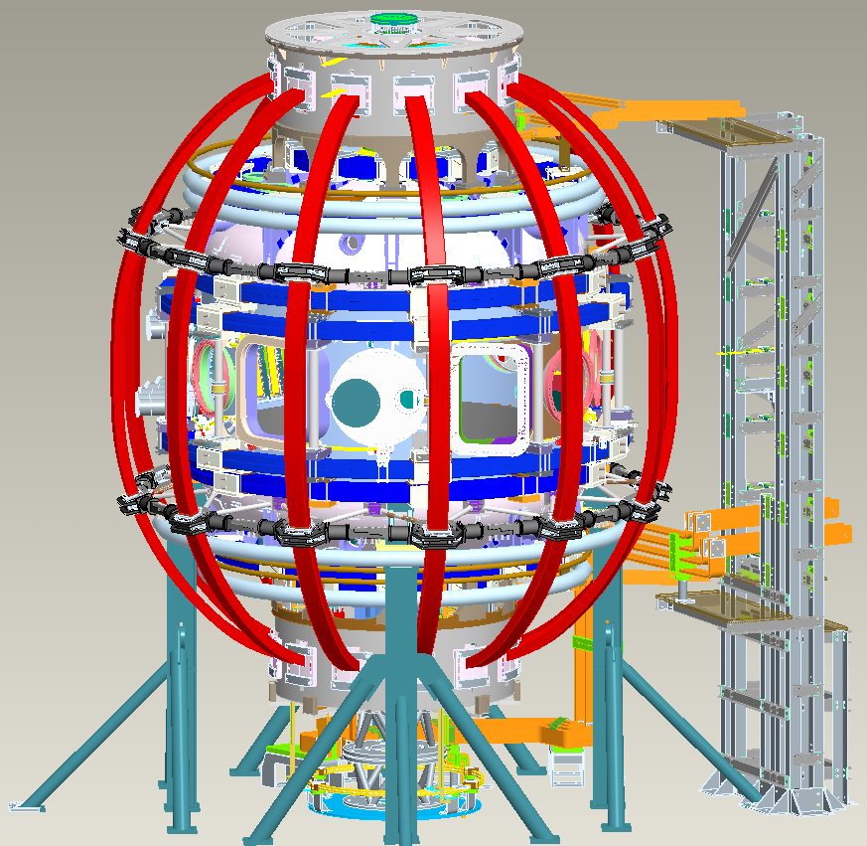
Installation Layout
Upper PF1 Bus
Bus Tower
TF Bus
CHI Ring Bus

Slide 27
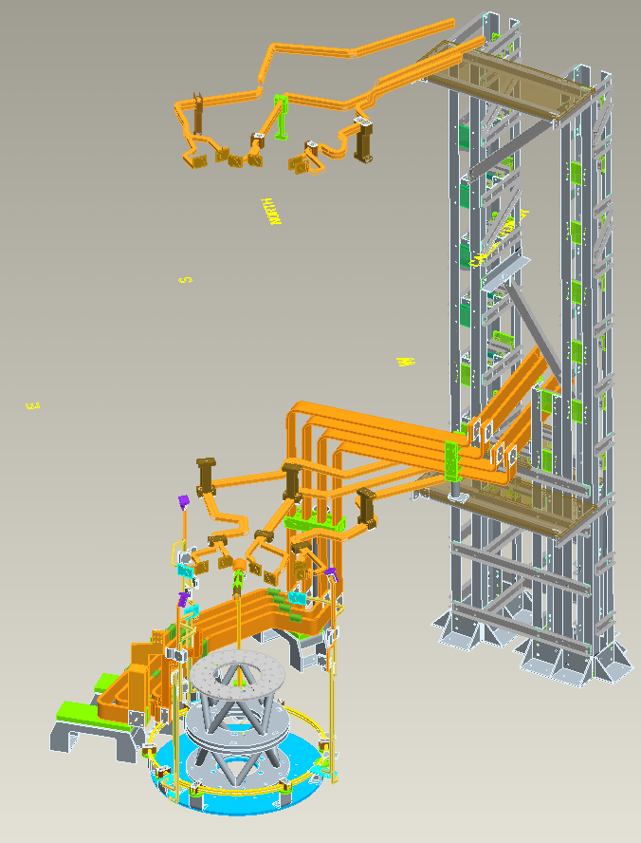
Installation Layout
Upper PF1 Bus
Bus Tower
TF Bus
Lower PF1 Bus
OH Bus
Pedestal
CHI Ring Bus

Slide 28

CHI Ring Bus
Water cooled .
Clamp
G10 spacer
Support/mount

Slide 29

PF 1a, b, c Bus
Bus Tower
Clamp
Support/mount
Upper PF1 Bus Runs

Slide 30

PF 1a, b, c Bus
Bus Tower
Clamp
Lower PF1 Bus Runs

Slide 31



OH Coaxial Bus
Connection to OH coil.
Water cooled rectangular bus section.
Air cooled Coaxial Bus section.
G10 spacer
Support/mount

Slide 32

TF Bus
Bus Tower
Support/mount
Water cooled section.
G10 spacer
G10 spacer
Support/mount
Support/mount

Slide 33

TF Bus
G10 spacer
Support/mount
Water cooled section.
Bus Tower
G10 spacer
Support/mount

Slide 34
Cost & Schedule
ETC required for FDR.
  Note: Since bus runs are field fit, design is frozen until installation.
  1st pass analysis is completed.
  Assembly and detailed drawings mostly completed.
  Design modifications (per analysis) implemented prior to installation.
  ETC to include designer man-hours.
  ETC to include EMEM man-hours.
  ETC to include additional EAEM (analysis) man-hours.

