Slide 1




NSTX
Supported by
Power System
Columbia U
CompX
General Atomics
FIU
INL
Johns Hopkins U
LANL
LLNL
Lodestar
MIT
Nova Photonics
New York U
ORNL
PPPL
Princeton U
Purdue U
SNL
Think Tank, Inc.
UC Davis
UC Irvine
UCLA
UCSD
U Colorado
U Illinois
U Maryland
U Rochester
U Washington
U Wisconsin
Raki Ramakrishnan (WBS5 Manager)
Weiguo Que: Cog Engineer (Analysis)
Xin Zhao: Cog Engineer (Controls)
Culham Sci Ctr
U St. Andrews
York U
Chubu U
Fukui U
Hiroshima U
Hyogo U
Kyoto U
Kyushu U
Kyushu Tokai U
NIFS
Niigata U
U Tokyo
JAEA
Hebrew U
Ioffe Inst
RRC Kurchatov Inst
TRINITI
NFRI
KAIST
POSTECH
ASIPP
ENEA, Frascati
CEA, Cadarache
IPP, Jülich
IPP, Garching
ASCR, Czech Rep
NSTX Center Stack Upgrade Peer Review
LSB B318
May 18, 2011

Slide 2
PWR SYSTEM UPGRADE FOR NEW CENTER STACK
REQUIREMENTS
TF : 129.8 kA, 1kV, ESW 7.08 sec every 2400 sec (7.05kA rms) ;
OH : 24kA, ESW 1.474 sec every 2400 sec ; 6kV
PF1a: Eliminate Ripple reduction reactors
Other PF : Existing config. meets requirements for other PF
CONSTRAINTS:
Constraints analyzed to project realistic estimate
  NSTX machine is located in NTC - is small in area.
  Constrained space in the basement of NTC
  FCPC Building has limited space & equipment is virtually crammed inside. No basement in this building.
  Thus real estate availability is very limited and design of upgrades has to meet these limitations
  TF has now four parallels. Thus short circuit current about 250kA. Upgrade dictates doubling parallels - short circuit current also gets doubled – the forces are four times more. Hence power loop components require appropriate upgrade. Also additional protective measures are required.

Slide 3
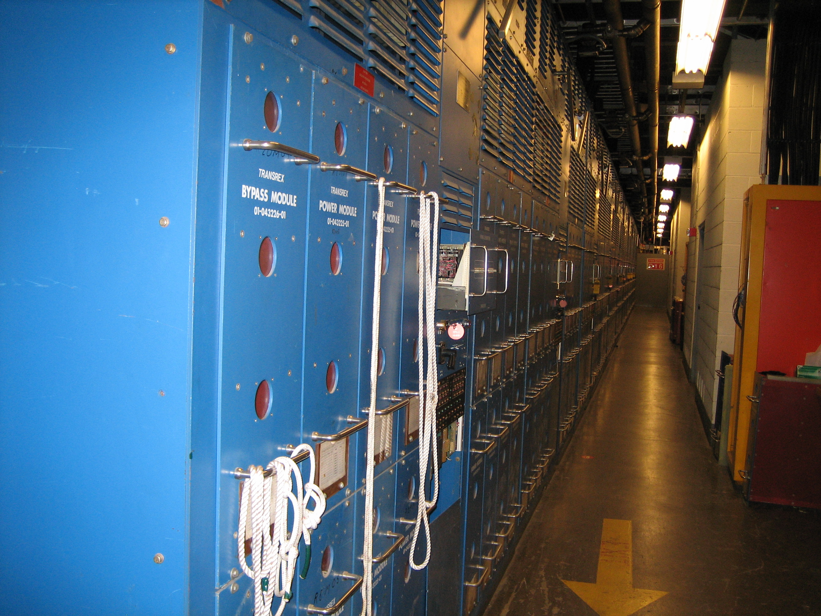
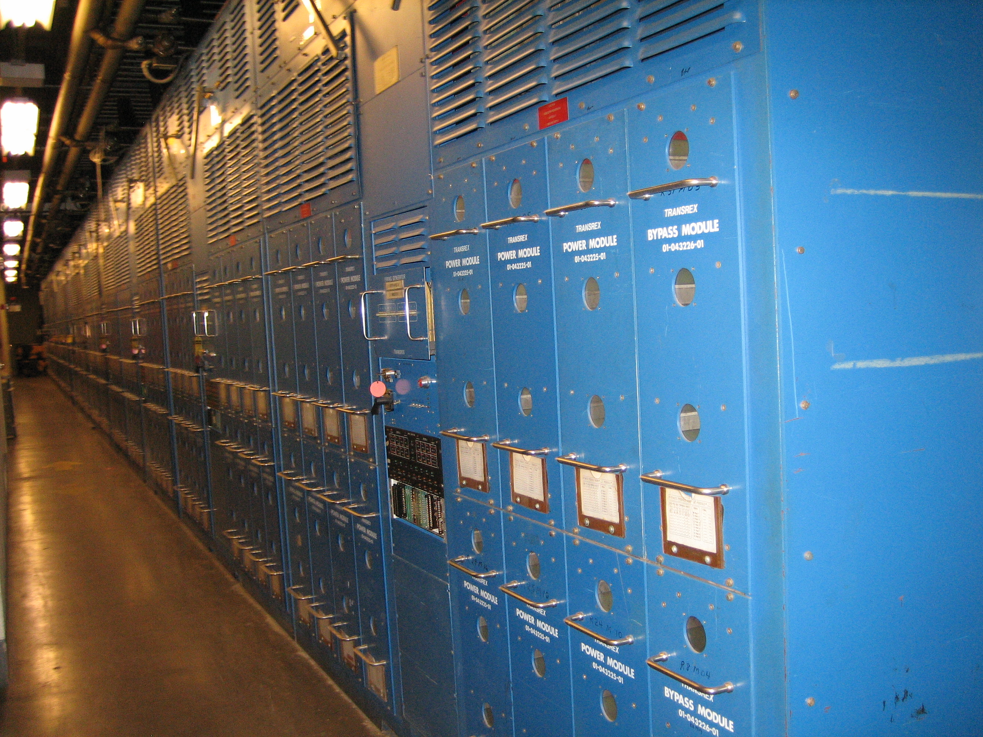
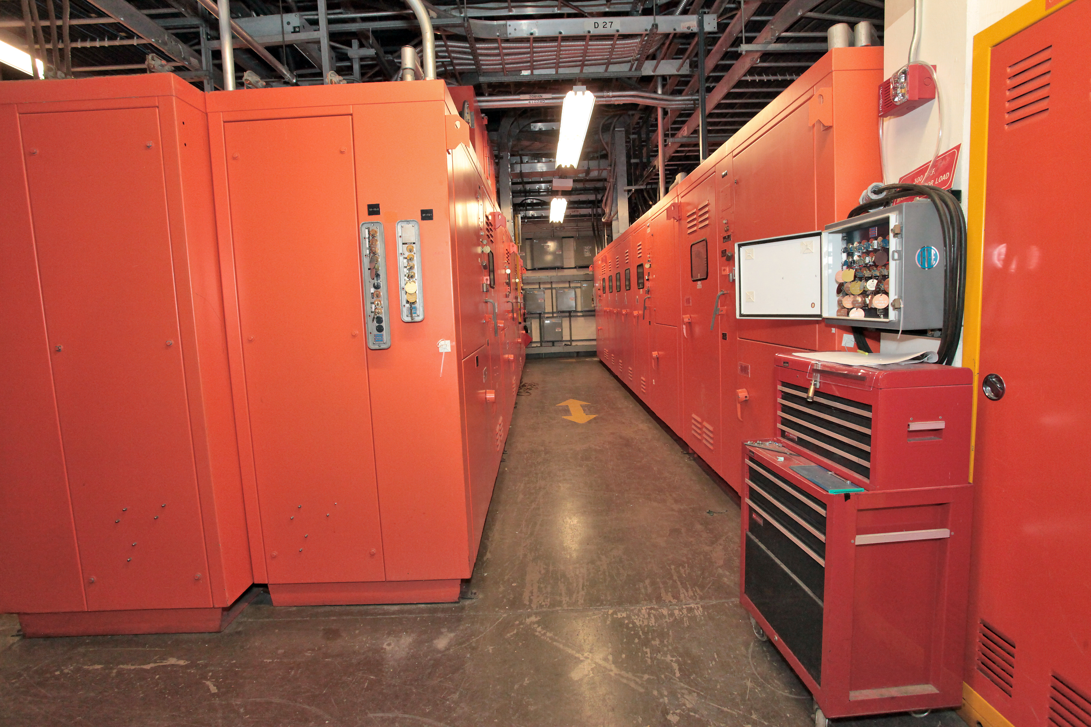
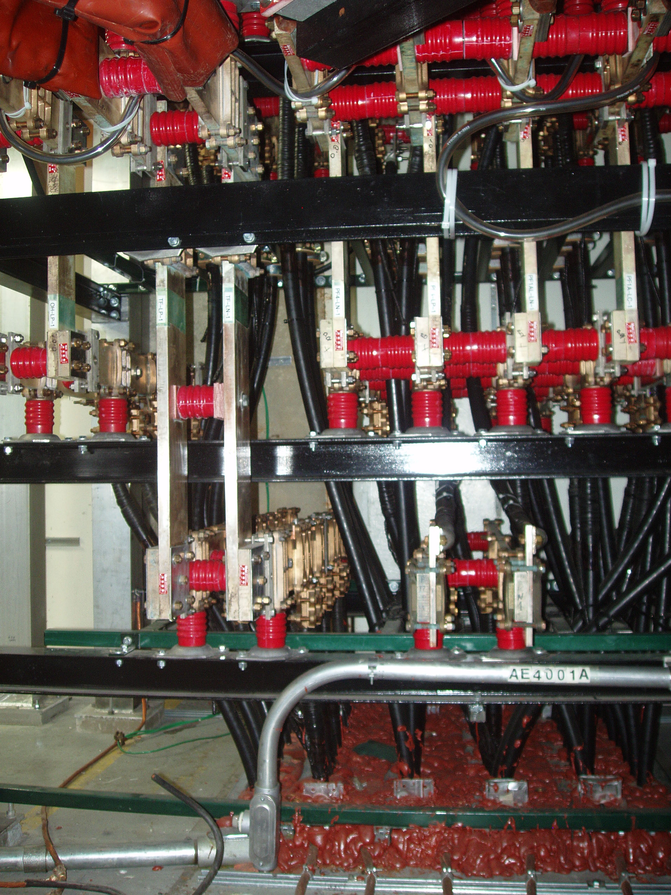
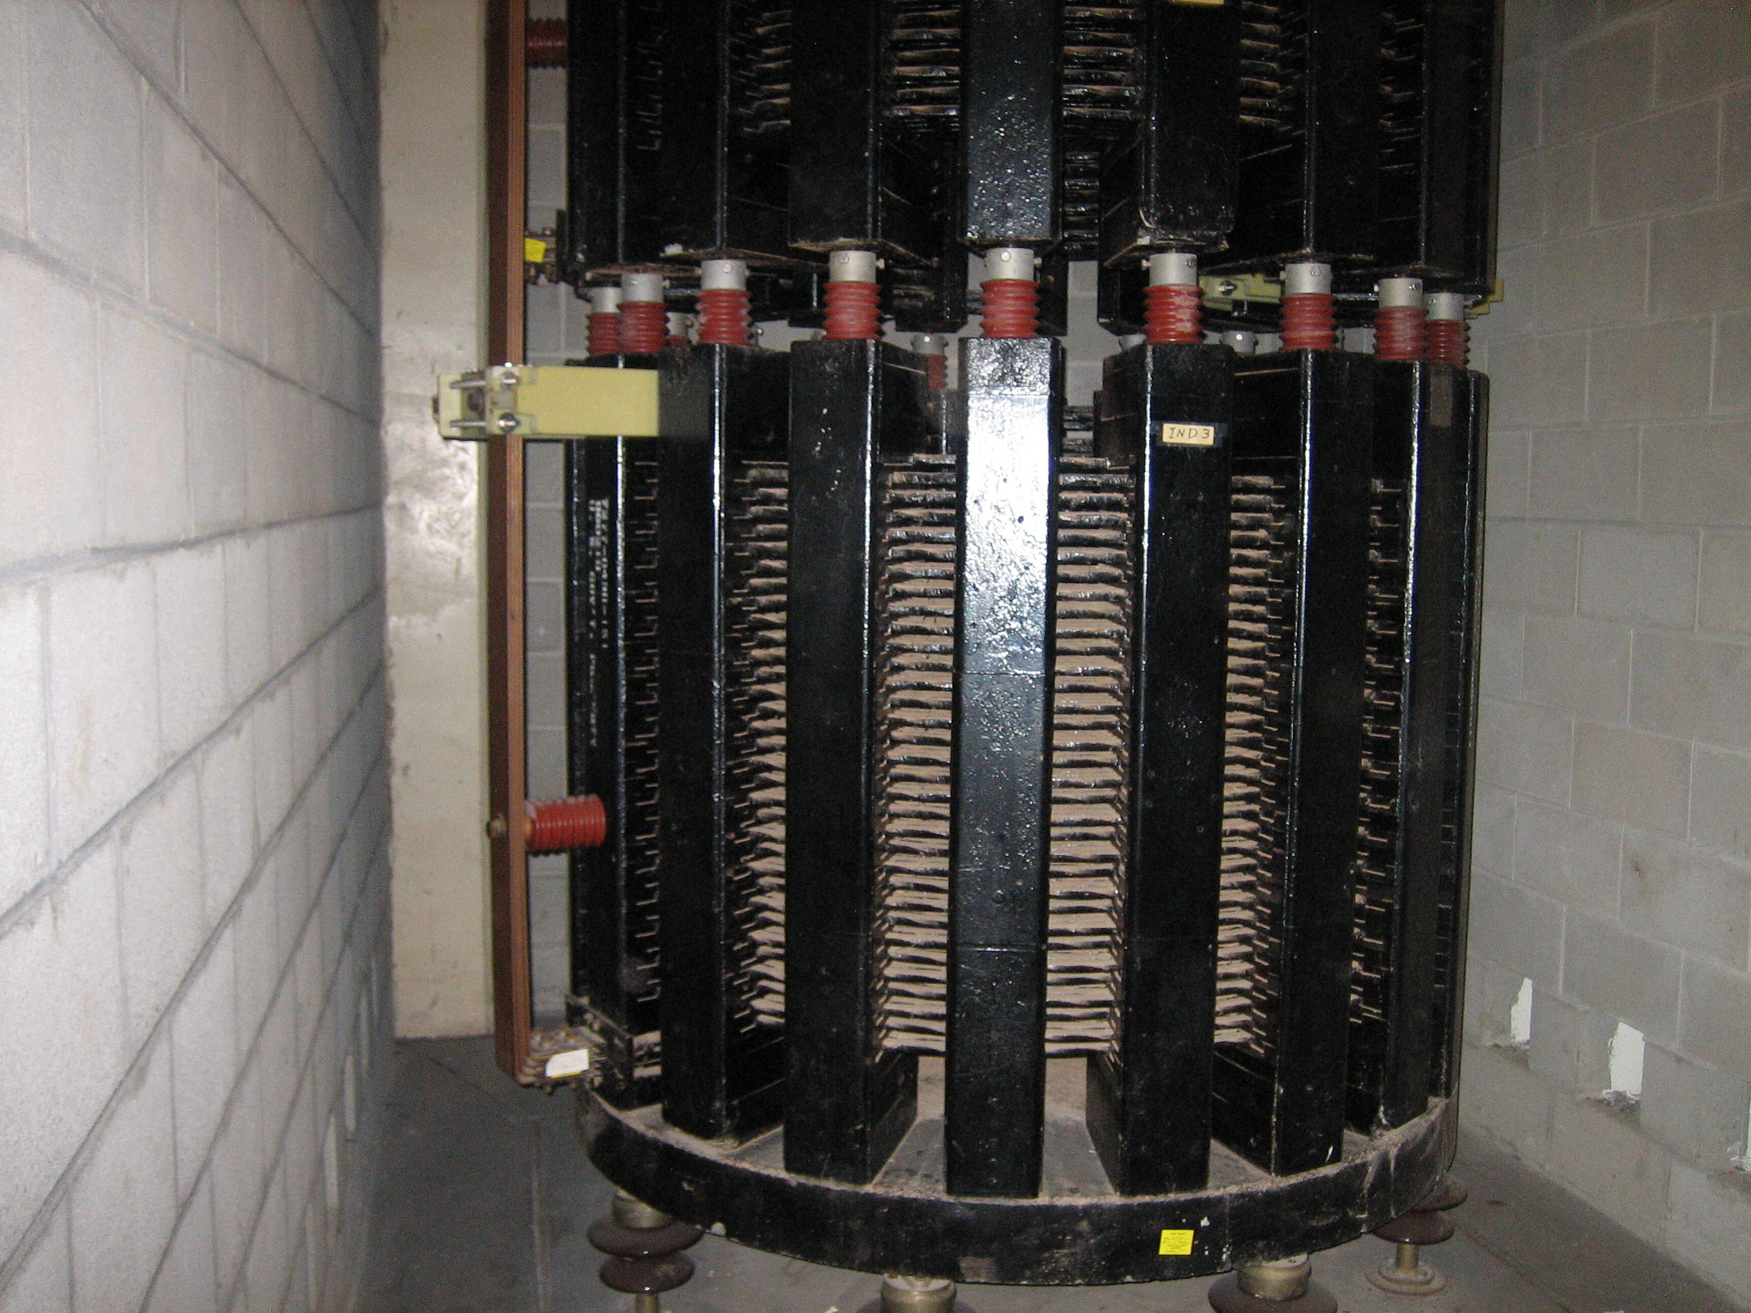
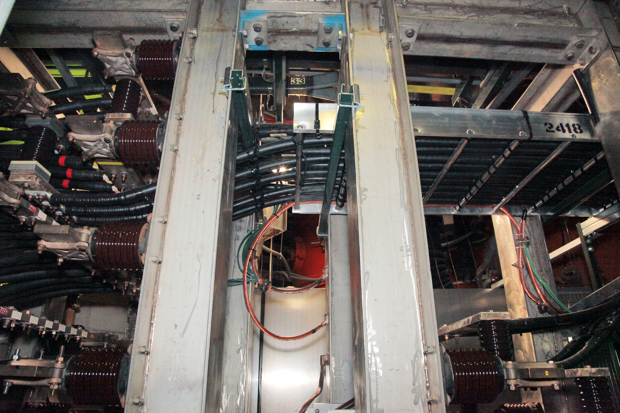
Pwr. System Equipment

Slide 4
NSTX Upgrade Coil Ckt. Summary

Slide 5
TF POWER LOOP DESIGN
Four additional PARALLELS of Transrex power supplies to be provided to existing four parallels
Each parallel - two 1 kV Transrex power supply sections in series.
  CLRs will be connected between the supplies
  One section of the supply will be used as a Diode
Existing four SDS of TF with additional parallel supplies will be used.
  two parallels to be fed via each switch.
Four more DC reactors (270uH) to be used in the additional 4 parallels.
  Since upgraded OH circuit needs reactors of higher inductance,
  the existing 270uH OH CLRs will be reconnected in the TF Circuit.
To install reactors in TF wing
  (1) Remove PF1a Ripple reduction Reactors & store; and
  (2) Remove four CICADA Racks in the middle of isle.

Slide 6
TF POWER LOOP DESIGN – Contd.
DCCTs
  Existing eight DCCTs will be repositioned to detect current in each of the eight parallels
  Eight additional DCCTs will be purchased and installed
  Two new DCCTs to detect total TF Coil Current
  The Vacuum Control Room presently empty will be used for housing the electronics boxes
CABLING
  Reconnect existing cabling as needed.
  Install additional power cabling within FCPC - nearly 7000 feet of 1000mcm 5kV power cables. Limited space makes bus installation difficult
  Reconnect existing power cabling in Transition Area (TA) - in TFTR Test Cell Basement- to NSTX Test Cell for TF use.
  Provide Control Cabling as needed
Modify Power Cable Termination Structure (PCTS) for TF to handle fault currents & to accept 3 more power cables/pole.

Slide 7
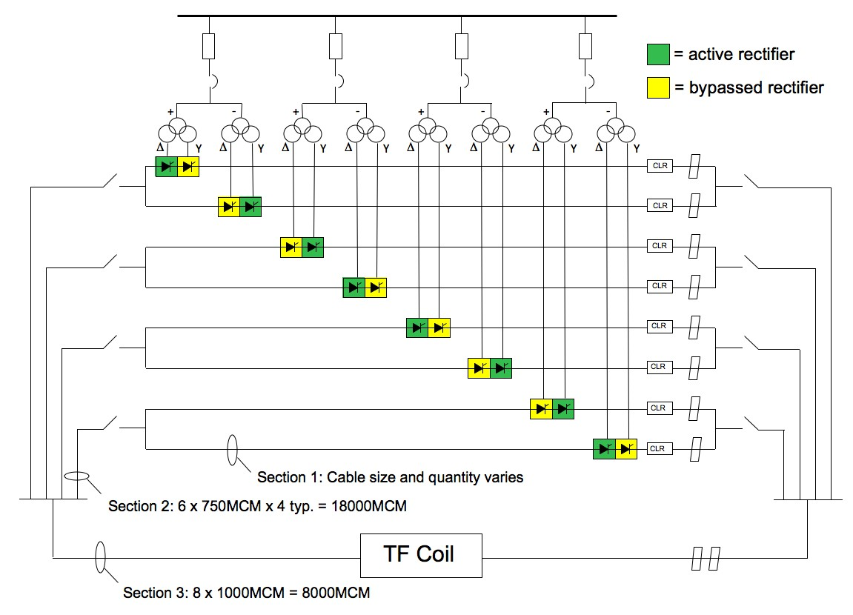
TF Feed – One line diagram
13.8kV Bus 60-87.5Hz
AC CLR

Slide 8
PSCAD ANALYSIS Simulation Model
(Weiguo Que)
Eight power supply branches are used and the control algorithm will control the converter firing angle alpha such that the current in each branch is 1/8 of the total TF coil current. Each power supply has its own PI current controller.
PI Current Controller :
Proportional gain: K=0.21
Integrator Time Constant: 3 second applied when I error falls below 6.5 kA.
Over Current Trip: 22 kA, block and bypass with 10 msec delay.

Slide 9
PSCAD ANALYSIS Simulation Results
(Weiguo Que)
TF Coil Inner Leg Temperature
TF Coil Outer Leg Temperature
TF Coil Inner Leg Temperature:
Rise From 12 degree C To 94.9 degree C
TF Coil Outer Leg Temperature:
Rise From 12 degree C To 56.4 degree C
I²t: Simulation: 1.2007E+5 (kA*kA*Sec)
Theory: 1.1965E+5 (kA*kA*Sec)
I²t Calculation

Slide 10
PSCAD ANALYSIS Normal Work Condition
(Weiguo Que)
TF coil current 130 kA, 6.5 second
Power Supply Branch current 16.25 kA
Alpha angle control and alpha limits calculation
Motor-Generator Speed

Slide 11
PSCAD ANALYSIS TF coil and Disconnect Switch Short Circuit Condition
(Weiguo Que)
Case 1: TF Coil Short Circuit
Time (sec) | TF Coil Short Branch Max. Current(kA) | TF Coil Short Circuit Current (kA)
1.2 | 28.1 | 219.4
1.4 | 33.9 | 262.4
1.5 | 33.7 | 262.9
1.6 | 34.4 | 263.1
1.7 | 33.8 | 263.4
1.8 | 33.6 | 262.2
1.9 | 31.3 | 242.7
2 | 28.8 | 225.8
3 | 25.4 | 199.9
8 | 26.9 | 211.5
8.6 | 16.4 | 126.1
TF coil short circuit current 1.7 sec
Branch short circuit current 1.7 sec
Case 2: Disconnect Switch Short Circuit
Time (sec) | Disconnect Switch Short Branch Max. Current(kA)
1.2 | 30.6
1.4 | 35.5
1.5 | 35.5
1.6 | 35.6
1.7 | 35.9
1.8 | 35.9
1.9 | 33.1
2 | 31.6
3 | 27.8
8 | 29.1
8.6 | 17.4
TF coil short circuit current 1.7 sec
Branch short circuit current 1.7 sec

Slide 12
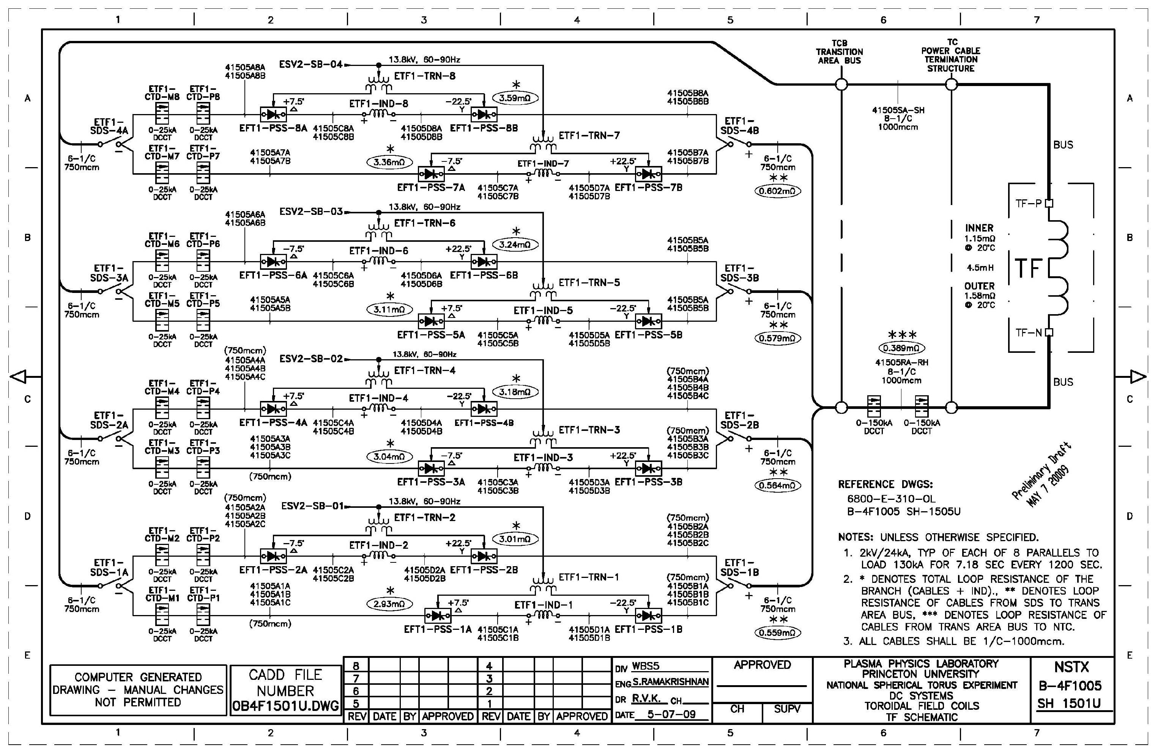
TF CIRCUIT – 129.8kA, 1kV (8 parallels)

Slide 13
OH PWR. LOOP DESIGN & PF PWR. LOOP DESIGN BASIS
EXISTING OH PWR LOOP DESIGN:
  6kV Anti-parallel configuration
  24kA for 0.4 seconds every 600 seconds
UPGRADE - OH PWR LOOP DESIGN:
  6kV Anti-parallel configuration
  24kA for 1.474 sec every 2400 seconds
  Work Required
  The DC CLR values have been optimized to the new requirement based on PSCAD analysis. These new reactors of the required values will be purchased and installed.
  All the other equipment and cabling in the power loop will be used AS IS

Slide 14
PF COILS
PF DESIGN:
  Existing circuits for PF1b, PF2, PF3, PF4,and PF5 will be used AS IS for the upgrade.
  PF1a Changes
    The ripple reduction reactors in the PF1aU & PF1aL circuits will be eliminated based on the newly designed PF1a Coils
    Associated power cabling changes will be made.

Slide 15
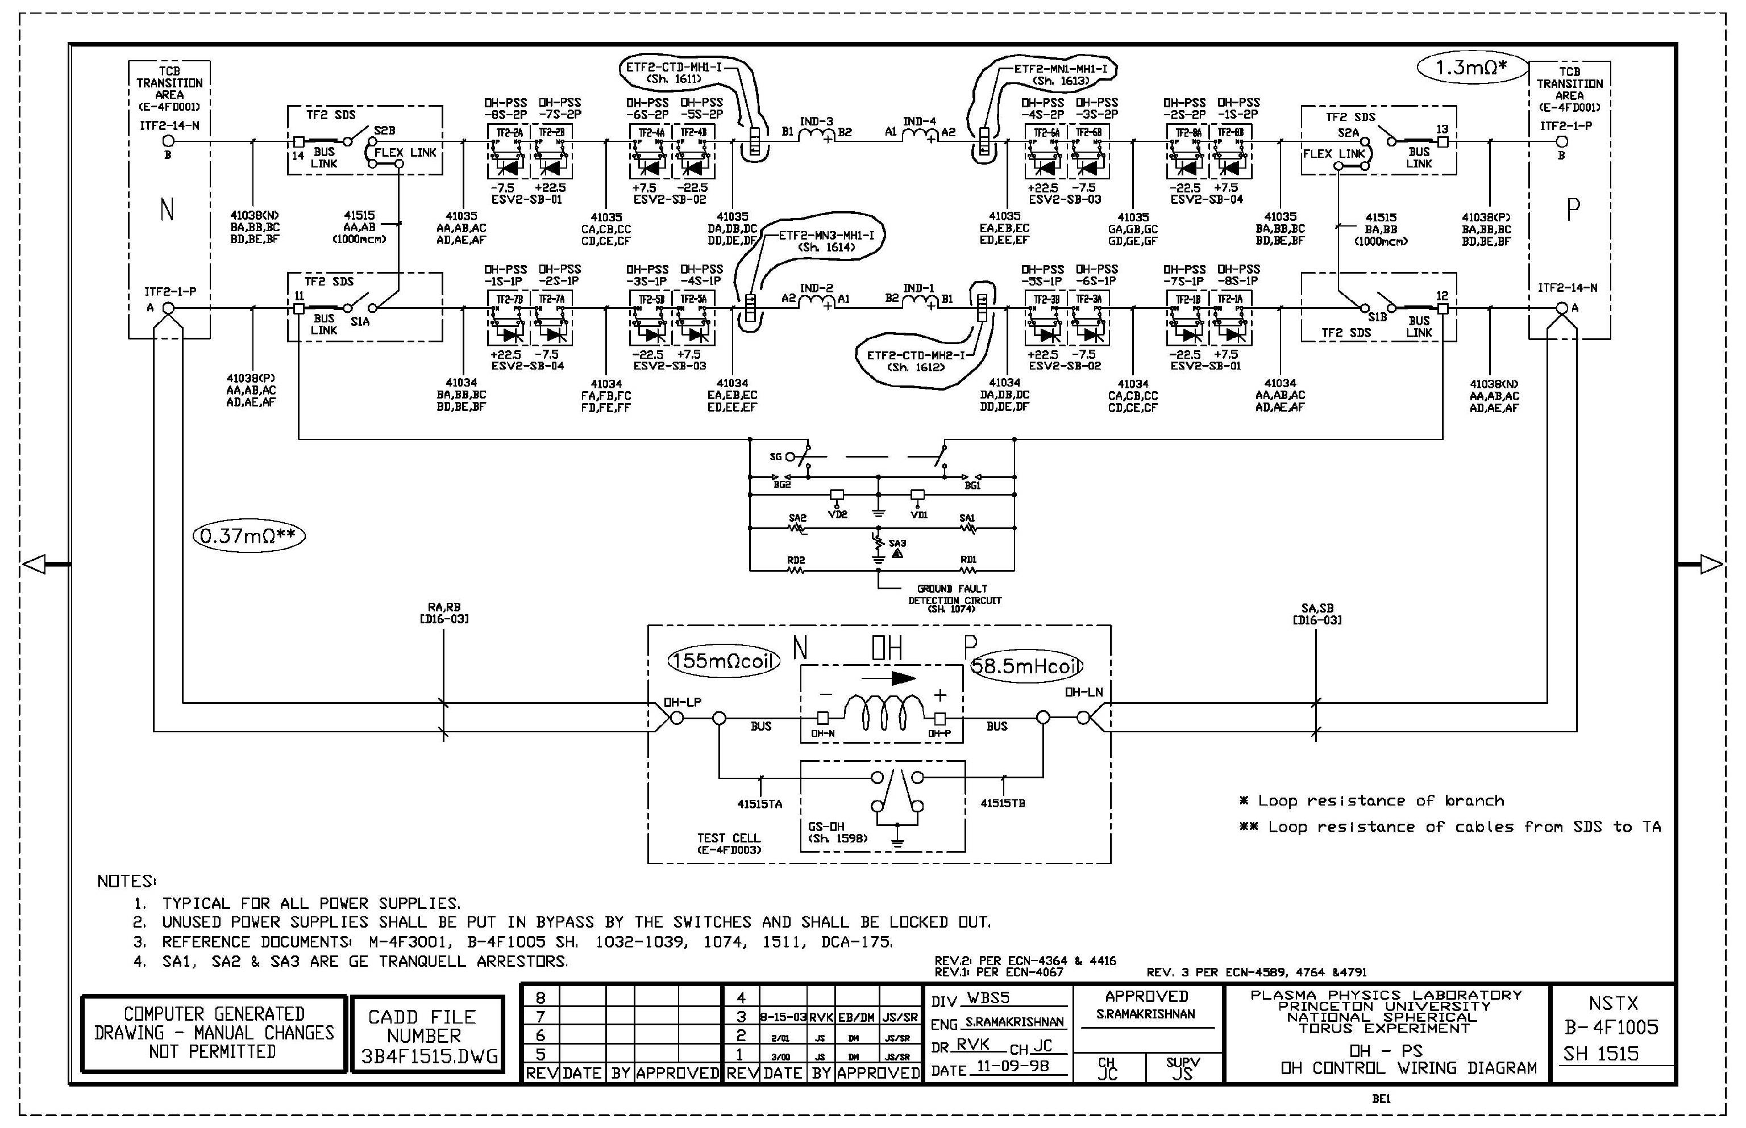
OH CIRCUIT – ANTI-PARALLEL 6kV;+/-24kA

Slide 16
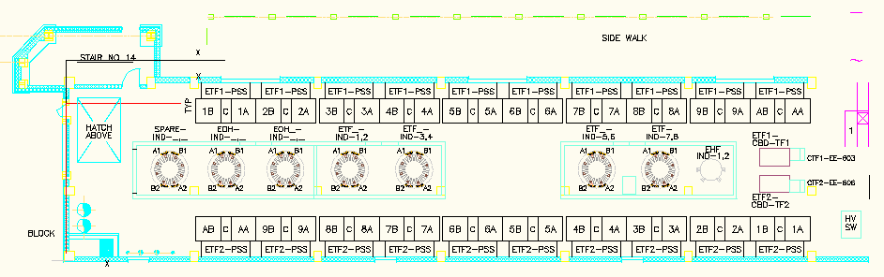
FCPC BLDG. TF WING - REACTOR LAYOUT

Slide 17
CONTROL & PROTECTION
CONTROLS
  Hardwired Controls will be upgraded
CIRCUIT PROTECTION
  Analog Coil Protection Units (ACPs) will be modified as needed
RECTIFIER PROTECTION
  ACCT, DCCT & PT signals along with other interlocks will be processed in the FD. See Block diagram.
  Fault Detector (FD) in Rectifiers
    Overcurrent
    Pulse duration
  FD will generate Level 1, 2, 3 faults to trip.

Slide 18
CONTROL & PROTECTION Contd.
  Digital Coil Protection (DCP):
    DCP is designed for protecting the machine support system.
DCP design will be presented in detail by R. Hatcher

Slide 19
COST BASIS
Basis for Cost and Schedule Estimates
  Input from Vendors
  Prior Experience
  Similar tasks previously executed
  Engineering Judgment
Other aspects
  Costs are essentially center -of-the-error bars
  Areas of risk judged ; constraints noted
  Contingency in the spreadsheet based on analysis of risks, general spread in quotes
Cost & Schedule
  Discussed in another area

Slide 20
SUMMARY
TF, OH, PF1aU, PF1aL Power Loops redesigned to meet NSTX Upgrade requirements. Other circuits remain the same.
System designed around space constraints in the facility.
In TF loop, four additional branches added to meet the higher current of 130kA for 7.08 sec every 2400 sec. Loop designed to withstand the short circuit forces of nearly 4 times the existing level. Additional Power Cabling, and Current Limiting Reactors (CLR) are provided.
OH Power Loop CLR value optimized based on PSCAD analysis.
PF1aU & L ripple reduction reactors eliminated since these are not needed for the new coils having been built with higher inductance.
New accurate fiber optic DCCTs (+/-150kA) provided to measure the TF current.
Protection system upgraded to meet the new needs. Currently each circuit is protected from overcurrent, I^2*t, higher pulse duration and higher than permitted pulse period. In the new scheme force combination of current in coils are computed and protection accorded.
Cost estimate is developed based on prior experience, similar tasks previously executed, vendor quotes, and engineering judgment.

Slide 21
CONCLUSION
FDR for Power System design meets the GRD requirements
Cost & Schedule has been developed based on prior experience, similar tasks previously executed, vendor quotes, and engineering judgment. Design done keeping in view all constraints.
Ready to proceed to Procurement & Installation.

Slide 22
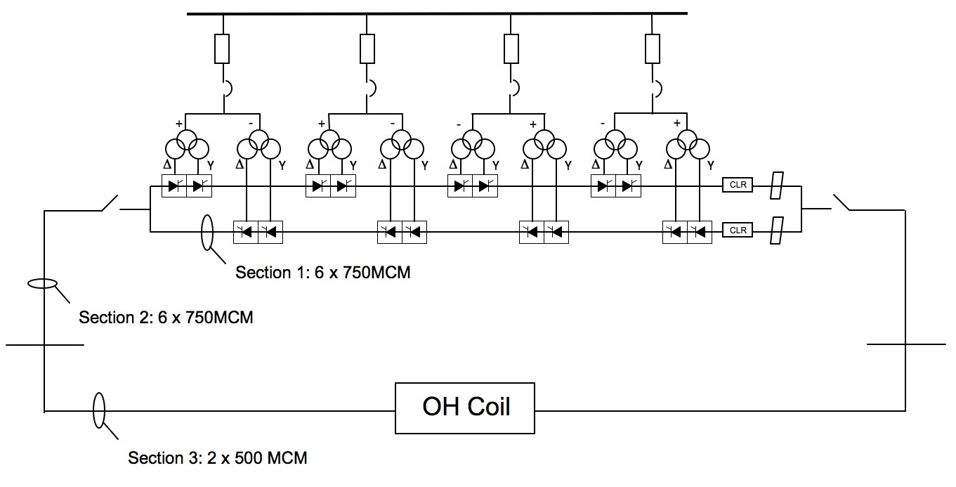
FCPC Rectifiers

