Slide 1



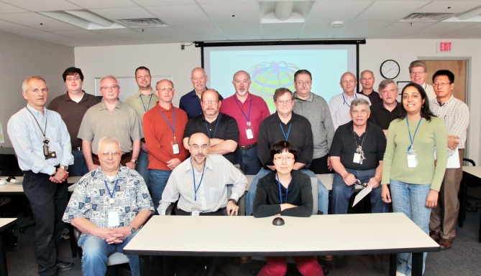
NSTX
Supported by
Digital Coil Protection System
Ronald Hatcher
J. Lawson, R. Mozulay, and R. Woolley
and the NSTX Research Team
Columbia U
CompX
General Atomics
FIU
INL
Johns Hopkins U
LANL
LLNL
Lodestar
MIT
Nova Photonics
New York U
ORNL
PPPL
Princeton U
Purdue U
SNL
Think Tank, Inc.
UC Davis
UC Irvine
UCLA
UCSD
U Colorado
U Illinois
U Maryland
U Rochester
U Washington
U Wisconsin
Culham Sci Ctr
U St. Andrews
York U
Chubu U
Fukui U
Hiroshima U
Hyogo U
Kyoto U
Kyushu U
Kyushu Tokai U
NIFS
Niigata U
U Tokyo
JAEA
Hebrew U
Ioffe Inst
RRC Kurchatov Inst
TRINITI
NFRI
KAIST
POSTECH
ASIPP
ENEA, Frascati
CEA, Cadarache
IPP, Jülich
IPP, Garching
ASCR, Czech Rep
NSTX Center Stack Upgrade Peer Review
LSB B318
May 18, 2011

Slide 2
Background
Operating envelope of NSTX_CSU significantly greater than that of NSTX
Expansion due to increased magnetic field strength (coil currents), changes to device geometry, new coils systems, increased pulse length, and new operating scenarios
Combined range of currents can result in forces, temperatures, and stresses to both coils and structures that significantly exceed NSTX design limits
Access to full operating space would result in compromised structural integrity and in some cases catastrophic failure
Mechanical solution is not feasible (complicated design, cost, schedule, and flexibility)

Slide 3
Background (cont.)
Static methods could result in severe operation limitations (e.g., PF4-PF5 simultaneous operation)
Project is determining critical set of values (forces, stresses, temperatures, combinations) that combined with their derivatives define the machine “state” with respect to machine integrity

Slide 4
Other Experiments
DIII-D
  Immediate “abort” (shutdown all power systems and short the OH coil) and “next shot prevention” protection
  Thermally, the coils should be able to withstand the heat from one shot if cooling is lost during the shot (if the coil has totally cooled down from the previous shot)
  Coil Monitoring
    Ground Fault
    Over current
    Coil coolant flow
    Coil coolant pressure
    Coil outlet coolant temperature
    Coil conductor temperature
    B-coil (TF) bundle deflection
    B-coil center post twist
    B-coil pre-stress monitoring
  Other (undocumented)

Slide 5
Other Experiments (cont.)
C-Mod
  Multiple non-integrated systems
  Coil temperature monitoring
  Real-time I²t calculation and temperature modeling (microcontrollers)
  OH force monitors (analog)
  Over current protection
  RF coupler protection
  RF transmitter protection (in design phase)
  Other (undocumented)

Slide 6
Design Basis
DCPS will provide real-time protection to NSTX_CSU mechanical components
DCPS algorithms will not only provide instantaneous protection but also in the “first derivative” sense
The DCPS will not allow successive plasma attempts at a rate that exceeds the basic duty cycle of the NSTX_CSU (5 s / 1200 s = 0.4 %)
Computing hardware shall be chosen with headroom for expansion
Operation of the DCPS shall be fail safe. It will be impossible to run the machine with the DCPS faulted or in a powered off state
The DCPS will, where reasonable, use “off the shelf” industry standard components

Slide 7
Design Basis (cont.)
The DCPS will use redundancy, to the greatest extent possible, to increase reliability
Any fault or failure on any DCPS unit will be considered genuine and cause a Level 1 fault
Software shall be written in modern, structured programming language
The DCPS software will include data archive and restore functionality
The DCPS will be located indoors within a temperature controlled environment (heating and air conditioning) with a maximum ambient temperature of 24 ºC (FCPC junction area)

Slide 8
Benefits
Easy reconfiguration – the DCPS algorithms and interlock limits can be easily changed in response to changing experimental requirements or changes in the state of the protected hardware
The DCPS is capable of monitoring and interlocking a set intersecting/competing objectives with both unmatched accuracy and redundancy
The DCPS algorithms can be exercised off-line for both post-shot evaluative analysis and for scenario development
DCPS algorithms can provide data to other processes (psc, psrtc, etc.) that can be used to modify process behavior for fault and/or disruption avoidance
Algorithms can be easily added for new hardware

Slide 9
Benefits (cont.)
Self-check algorithms can continuously monitor system health
The DCPS hardware and software will be capable of providing simultaneous protection on multiple timescales (coils-power-supplies control systems, forces, stresses and strains, thermal processes)

Slide 10
Functionality
The set of limiting values and their derivatives define a “safe operating area” for the device. At any instant in time, the job of the DCPS is to ensure the integrity of the NSTX CSU mechanical structures via the following actions
  Determine if any calculated value exceeds operating limit (initiate fault)
  Determine if a power supply fault would result in conditions causing DCPS fault (initiate fault)
  Determine if (given power supply response, present trajectory, etc.) any DCPS limit would be breached prior to next calculation time (initiate fault)
  Predict a future time when it would be possible to attempt a plasma shot with a specified set of coil current envelopes
  Determine a set of coil current envelopes allowable for a plasma attempt “right now
  Compute and archive other quantities that over time can affect machine integrity because of fatigue

Slide 11
Functionality (cont)
  Evaluate acceptability of potential operating scenarios (static and transient) for a given DCPS configuration

Slide 12
Design Requirements
DCPS = real-time machine integrity determination and protection utilizing fast programmable digital system
DCPS design will be fail-safe (redundancy)
State continuously calculated on high-speed digital computer system and compared to pre-defined limits (like ISTP-001)
DCPS will be easily reconfigurable via software (algorithms, state variables, and interlock values)
Basic calculation interval similar to power supply response time (O(ms)) or less
Provides protection via interface to existing Level 1 fault system

Slide 13
Design Requirements (cont.)
The DCPS will include a “post-processor” to assist the operators in fault cause determination
The DCPS shall include a software test suite that can be used to validate DCPS functionality (e.g., regression testing after changes)
Scalable I/O for future expansion
The DCPS will be a “standalone” system with respect to the laboratory network (security)
Computing hardware to include extra capacity for future expansion (DCPS → MPS)

Slide 14
Current Design
Each DCPS unit will support 64 analog and up to 96 digital I/O channels
INPUTS
  Analog signals – currents, coolant flows, temperatures, pressures
  Digital signals – status bits from other systems
  All inputs will have over/under-voltage protection
  All inputs will be electrically isolated from the DCPS (e.g., opto-coupler)
  Digital Inputs: 5 V (TTL) or 10 – 32 V (high noise immunity)
  Analog Inputs: ±10 V
  4 kHz anti-aliasing filter
  cable fault detection
  Reset Input: digital input (local pushbutton or remote electrical signal)
  ACTIVE FAULT HAS PRECEDENCE

Slide 15
Current Design (cont.)
Outputs
  Currently only envision using one latched fault output fault signal per unit
  All outputs will utilize optical isolation to the outside world (e.g., opto-coupler)
Faults
  A protection interlock level is breached or will be breached prior to the next DCPS calculation time
  The combination of coil currents and temperatures are such that a power supply fault would move the system to a state corresponding to a DCPS faulted state
  Internal DCPS system integrity routines determine that there is a problem with the input data
  Internal DCPS self-check routines determine that program or internal data structures are corrupted
  Internal watchdog timer failure
  External watchdog timer failure

Slide 16
Algorithms
PF coil supports
Bus Bar stresses
Outer leg insulation bond shear
PF2 bracket and bolt stress
PF3 bracket and weld stress
Torques and stresses lid and spoke assembly (upper & lower)
Vacuum vessel leg torque
TF outer leg torque
Forces on PF coils (single and combination)
PF Coil moments (torque)
Dome and PF rib stresses
Coil thermal stresses
Lid torque
Leg and brace Hilti’s™ (loads and moments)
Knuckle clevis loads
Ring loads and moments
TF teeth torque
TF joint bolts stresses
Umbrella structure reinforcement (stress)
OOP TF torque
TF joint (forces, torques)
TF coil torsional shear stress
OH fatigue (long term)
TF shear forces between TF turns, insulation, and insulating crown
Coil temperatures (i²t heating)

Slide 17
Algorithms
PF coil supports
Bus Bar stresses
Outer leg insulation bond shear
PF2 bracket and bolt stress
PF3 bracket and weld stress
Torques and stresses lid and spoke assembly (upper & lower)
Vacuum vessel leg torque
TF outer leg torque
Forces on PF coils (single and combination)
PF Coil moments (torque)
Dome and PF rib stresses
Coil thermal stresses
Leg and brace Hilti’s™ (loads and moments)
Knuckle clevis loads
Ring loads and moments
Lid torque
TF teeth torque
TF joint bolts stresses
Umbrella structure reinforcement (stress)
OOP TF torque
TF joint (forces, torques)
TF coil torsional shear stress
OH fatigue (long term)
TF shear forces between TF turns, insulation, and insulating crown
Coil temperatures (i²t heating)

Slide 18
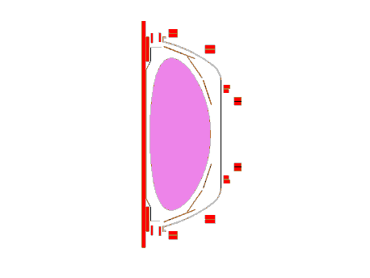
Block Diagram with DCPS
PSRTC
PCS
FCPC
Conditioning
Analog
Data In
CPU01
Signal
Digital
Data In
CPU02
Level 1
FLT
DCPS
NSTX CSU
Plasma Diagnostics

Slide 19
DCPS Hardwaer Block Diagram (1/2)
Eight, 8-channel analog input boards
  Analog inputs with 5-pole, 4 kHz input filter and self-test feature
Digital input board
2 – National Instruments 6259 1.25 MS/s DAQ
I/O Board
8 Channel Analog Input Board with 5-pole, 4 kHz input filter and self-test feature
Dell PowerEdge R910

Slide 20
Schedule
Successful CDR completed 3/2011
  Chit resolution ongoing (most resolved, one meeting to go)
Systems code is under development (Woolley) with beta version expected in June
  Will be used to exercise DCPS algorithms on NSTX and NSTX CSU configurations during next two run periods
System drawings for preliminary design complete and under review
PDR scheduled for June (tentative date 6/17)
  One external reviewer commitment (try for one more)
FDR to follow in 2012

