Slide 1
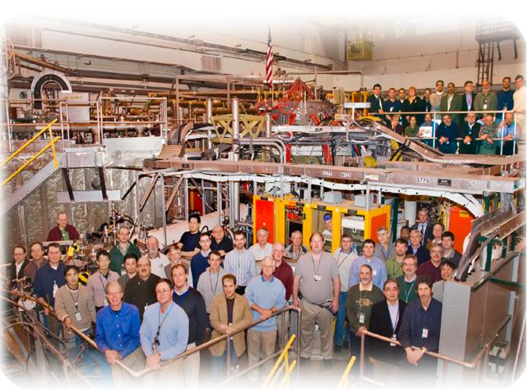
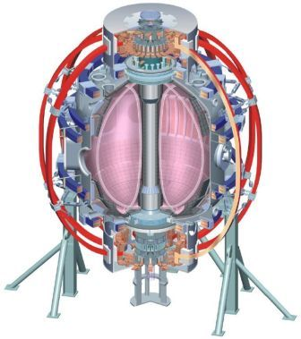
Torus Vacuum Pumping System
NSTX
Supported by
W. Blanchard
C. Priniski, J. Winkelman, Y. Zhai, G. Labik
College W&M
Colorado Sch Mines
Columbia U
CompX
General Atomics
INEL
Johns Hopkins U
LANL
LLNL
Lodestar
MIT
Nova Photonics
New York U
Old Dominion U
ORNL
PPPL
PSI
Princeton U
Purdue U
SNL
Think Tank, Inc.
UC Davis
UC Irvine
UCLA
UCSD
U Colorado
U Illinois
U Maryland
U Rochester
U Washington
U Wisconsin
Culham Sci Ctr
U St. Andrews
York U
Chubu U
Fukui U
Hiroshima U
Hyogo U
Kyoto U
Kyushu U
Kyushu Tokai U
NIFS
Niigata U
U Tokyo
JAEA
Hebrew U
Ioffe Inst
RRC Kurchatov Inst
TRINITI
KBSI
KAIST
POSTECH
ASIPP
ENEA, Frascati
CEA, Cadarache
IPP, Jülich
IPP, Garching
ASCR, Czech Rep
U Quebec
NSTX NB Upgrade Peer Review
April 19, 2011

Slide 2
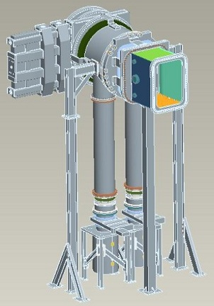
TVPS
TMPs
placed near TC floor to minimize the effects
of the magnetic field
2650 l/s pumping speed
Magnetic shields:
½” thick low carbon steel cylinders
shields extends 6” above/below TMPs
reduce the field to below 50 gauss
Calculated effective pumping speed is
approximately 1900 l/s
14” duct
PDX CB/bellows
assembly
12” gate valve
support stand
TMP and magnetic
shield
NSTX
NSTX NB Upgrade Peer Review
April 19, 2011
2

Slide 3
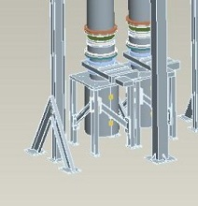
TMP Support Stand
Support stand assembly for various loads:
Approx. 1200 lbs from vacuum
less than 50 lbs from magnetic forces
Approx 5700 ft-lbs torque for worst case TMP failure
Support stand:
3” square aluminum tubing bolted to 24” square SS plate
cross braces with electrical isolation
34”
NSTX
NSTX NB Upgrade Peer Review
April 19, 2011
3

Slide 4
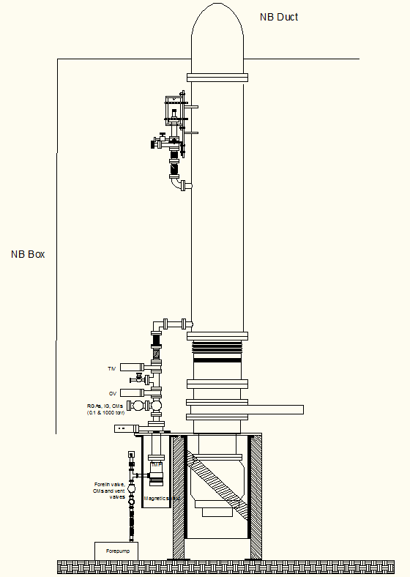
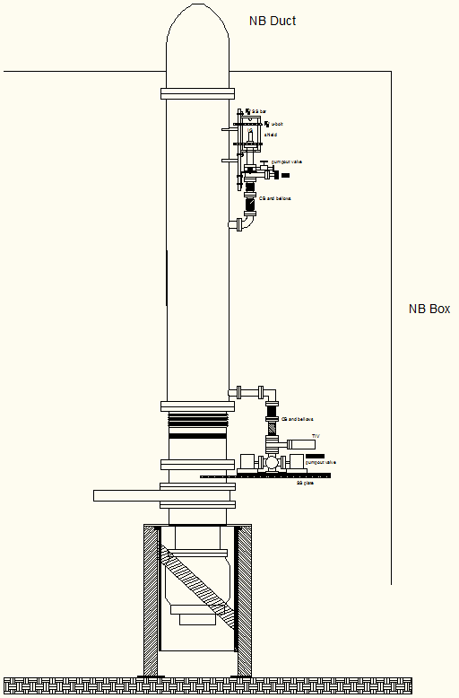
RGA and Gauging Overview
Ion gauge assembly on each pumping duct
RGA system and CM each on separate ducts
All assemblies located between the ducts and the NB box
NSTX
NSTX NB Upgrade Peer Review
April 19, 2011
4

Slide 5
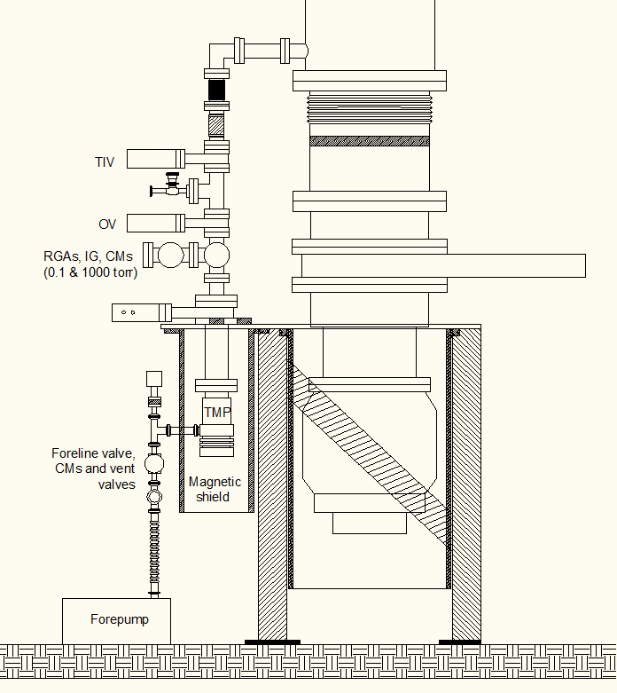
RGA System
Reuse of most of the existing equipment
Same differentially pumped configuration as exiting system on NSTX
RGA assembly :
TMP and forepump
CB and bellows
interface , orifice and TMP isolation valves
ion gauge and CMs
Two RGAs for trend monitoring and after shot outgassing
Small TMP will also be shielded from magnetic fields
Same capabilities for measurements across a wide range of pressures
NSTX
NSTX NB Upgrade Peer Review
April 19, 2011
5

Slide 6
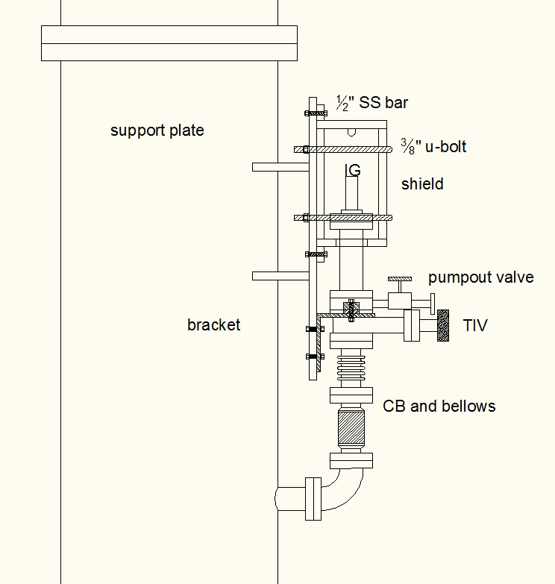
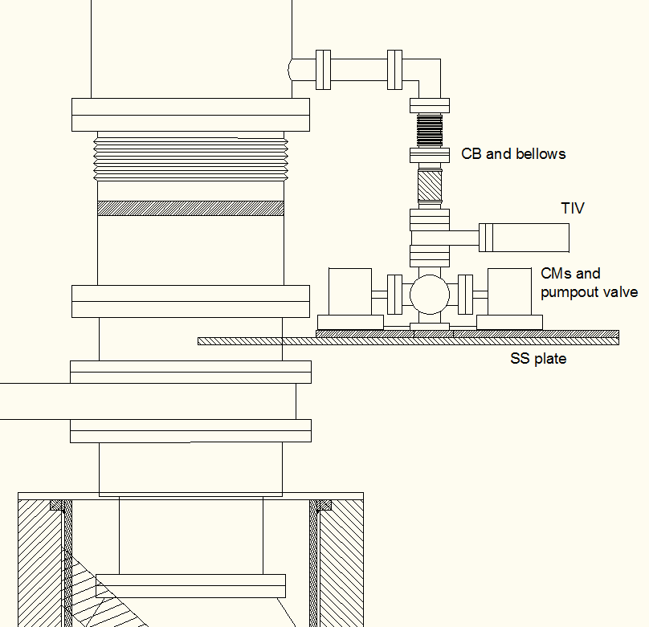
Gauging
Two ion gauge assemblies and one CM assembly
CM assembly :
CMs used for pumpdown, calibrations and GDC
CB/bellows assembly
pumpout and isolation valve
SS support plate
Ion gauge assemblies :
miniature ion gauges
CB/bellows assembly
pumpout and isolation valve
low carbon steel shield cylinder
SS brackets and support plate welded to duct
Shields u-bolted to support plate
Separate bracket to hold and isolate ion gauge
NSTX
NSTX NB Upgrade Peer Review
April 19, 2011
6

Slide 7
Summary
Overall design of TVPS and monitoring systems are complete
Magnetic field reduced to less than 50 gauss
Effective pumping speed ~1900 l/s
RGA system configuration similar to existing system
NSTX
NSTX NB Upgrade Peer Review
April 19, 2011
7

