Slide 1

NSTX
Supported by
NSTX NBIU Power System & Controls
College W&M
Colorado Sch Mines
Columbia U
CompX
General Atomics
INEL
Johns Hopkins U
LANL
LLNL
Lodestar
MIT
Nova Photonics
New York U
Old Dominion U
ORNL
PPPL
PSI
Princeton U
Purdue U
SNL
Think Tank, Inc.
UC Davis
UC Irvine
UCLA
UCSD
U Colorado
U Illinois
U Maryland
U Rochester
U Washington
U Wisconsin
J. Edwards/ M. Cropper
S. Ramakrishnan/ Timothy N. Stevenson
Culham Sci Ctr
U St. Andrews
York U
Chubu U
Fukui U
Hiroshima U
Hyogo U
Kyoto U
Kyushu U
Kyushu Tokai U
NIFS
Niigata U
U Tokyo
JAEA
Hebrew U
Ioffe Inst
RRC Kurchatov Inst
TRINITI
KBSI
KAIST
POSTECH
ASIPP
ENEA, Frascati
CEA, Cadarache
IPP, Jülich
IPP, Garching
ASCR, Czech Rep
U Quebec
NSTX Upgrade Project
Final Design Review
LSB B318
June 23, 2011

Slide 2
NSTX NBIU Power & Controls - Introduction
Update on the NBI Power System
Work Scope to connect N4 NBPS ABC to BL2 ion sources
Procurements
Routing and Installation
Grounding
Update on the NBI Controls
Work Scope to control NBI BL2 and inject NBI into NSTX plasma
Conclusion
2

Slide 3
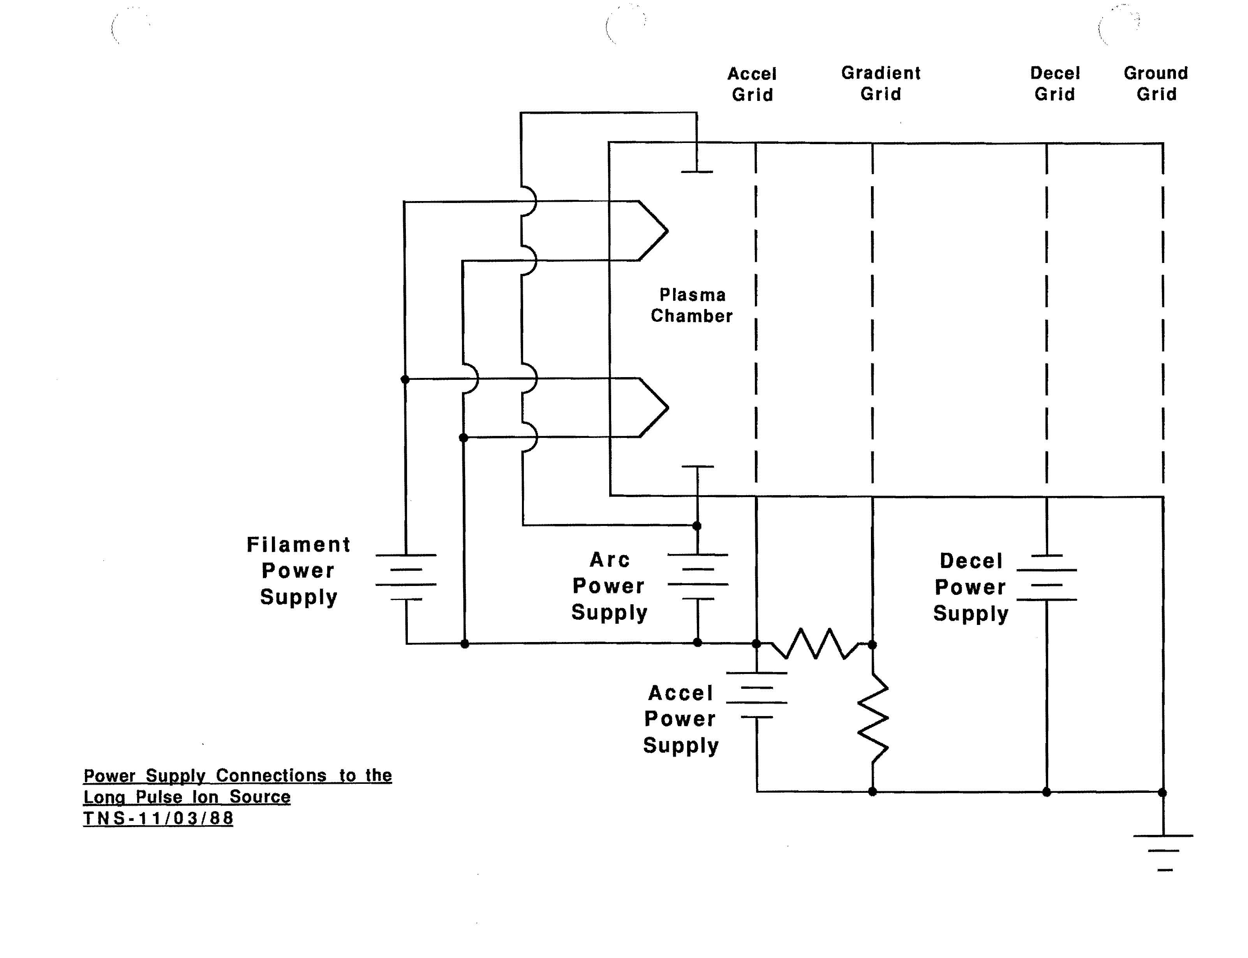
NSTX NBIU Power & Controls - Battery Diagram
NBI Source Battery Diagram
3

Slide 4
NSTX NBIU Power & Controls - NBPS
Neutral Beam Power System Work Scope
Same design as original power systems but updated to present BL1 configuration
Recommission N4 power systems A,B, & C (all still available):
  Accel (with some new electronics in Surge Room & Mod/Reg)
  Grad Grid (build new air cooled resistive dividers per BL1 design)
  Decel (with new tube control and regulator electronics)
  Arc
  Filament
  Bending Magnet
Run both beamlines from MG set for 13.8 kV feed (same as we did on TFTR)
    adding remotely controlled motorized actuation to 13.8 kV switches
Reuse existing N4 Arc and Filament low voltage cabling to TFTR TC Basement as is
Add junction boxes and route new cables from TCB through TC to NTC
Move N4 HVEs from TCB to NTC
Reuse transmission lines with clamshell arrangement in NTC (like BL1)
Reuse existing telemetry and fiber optic cables salvaged from TFTR
Reuse existing NBPS Deionized Water Skids in the pump room (still attached)
4

Slide 5
NSTX NBIU Power & Controls - Road Map
Routing, Penetrations, draft Installation Procedures done
CONFIRMED
&
Layouts completed
Accel
Decel
Fil&Arc
Mag
PLC F/O
PS F/O
NBPC Bldg
138’
TFTR TC
NSTX TC
NB Switchyard
100’
Pumproom
TFTR TC Basement
MER
Dashed means new…
5

Slide 6
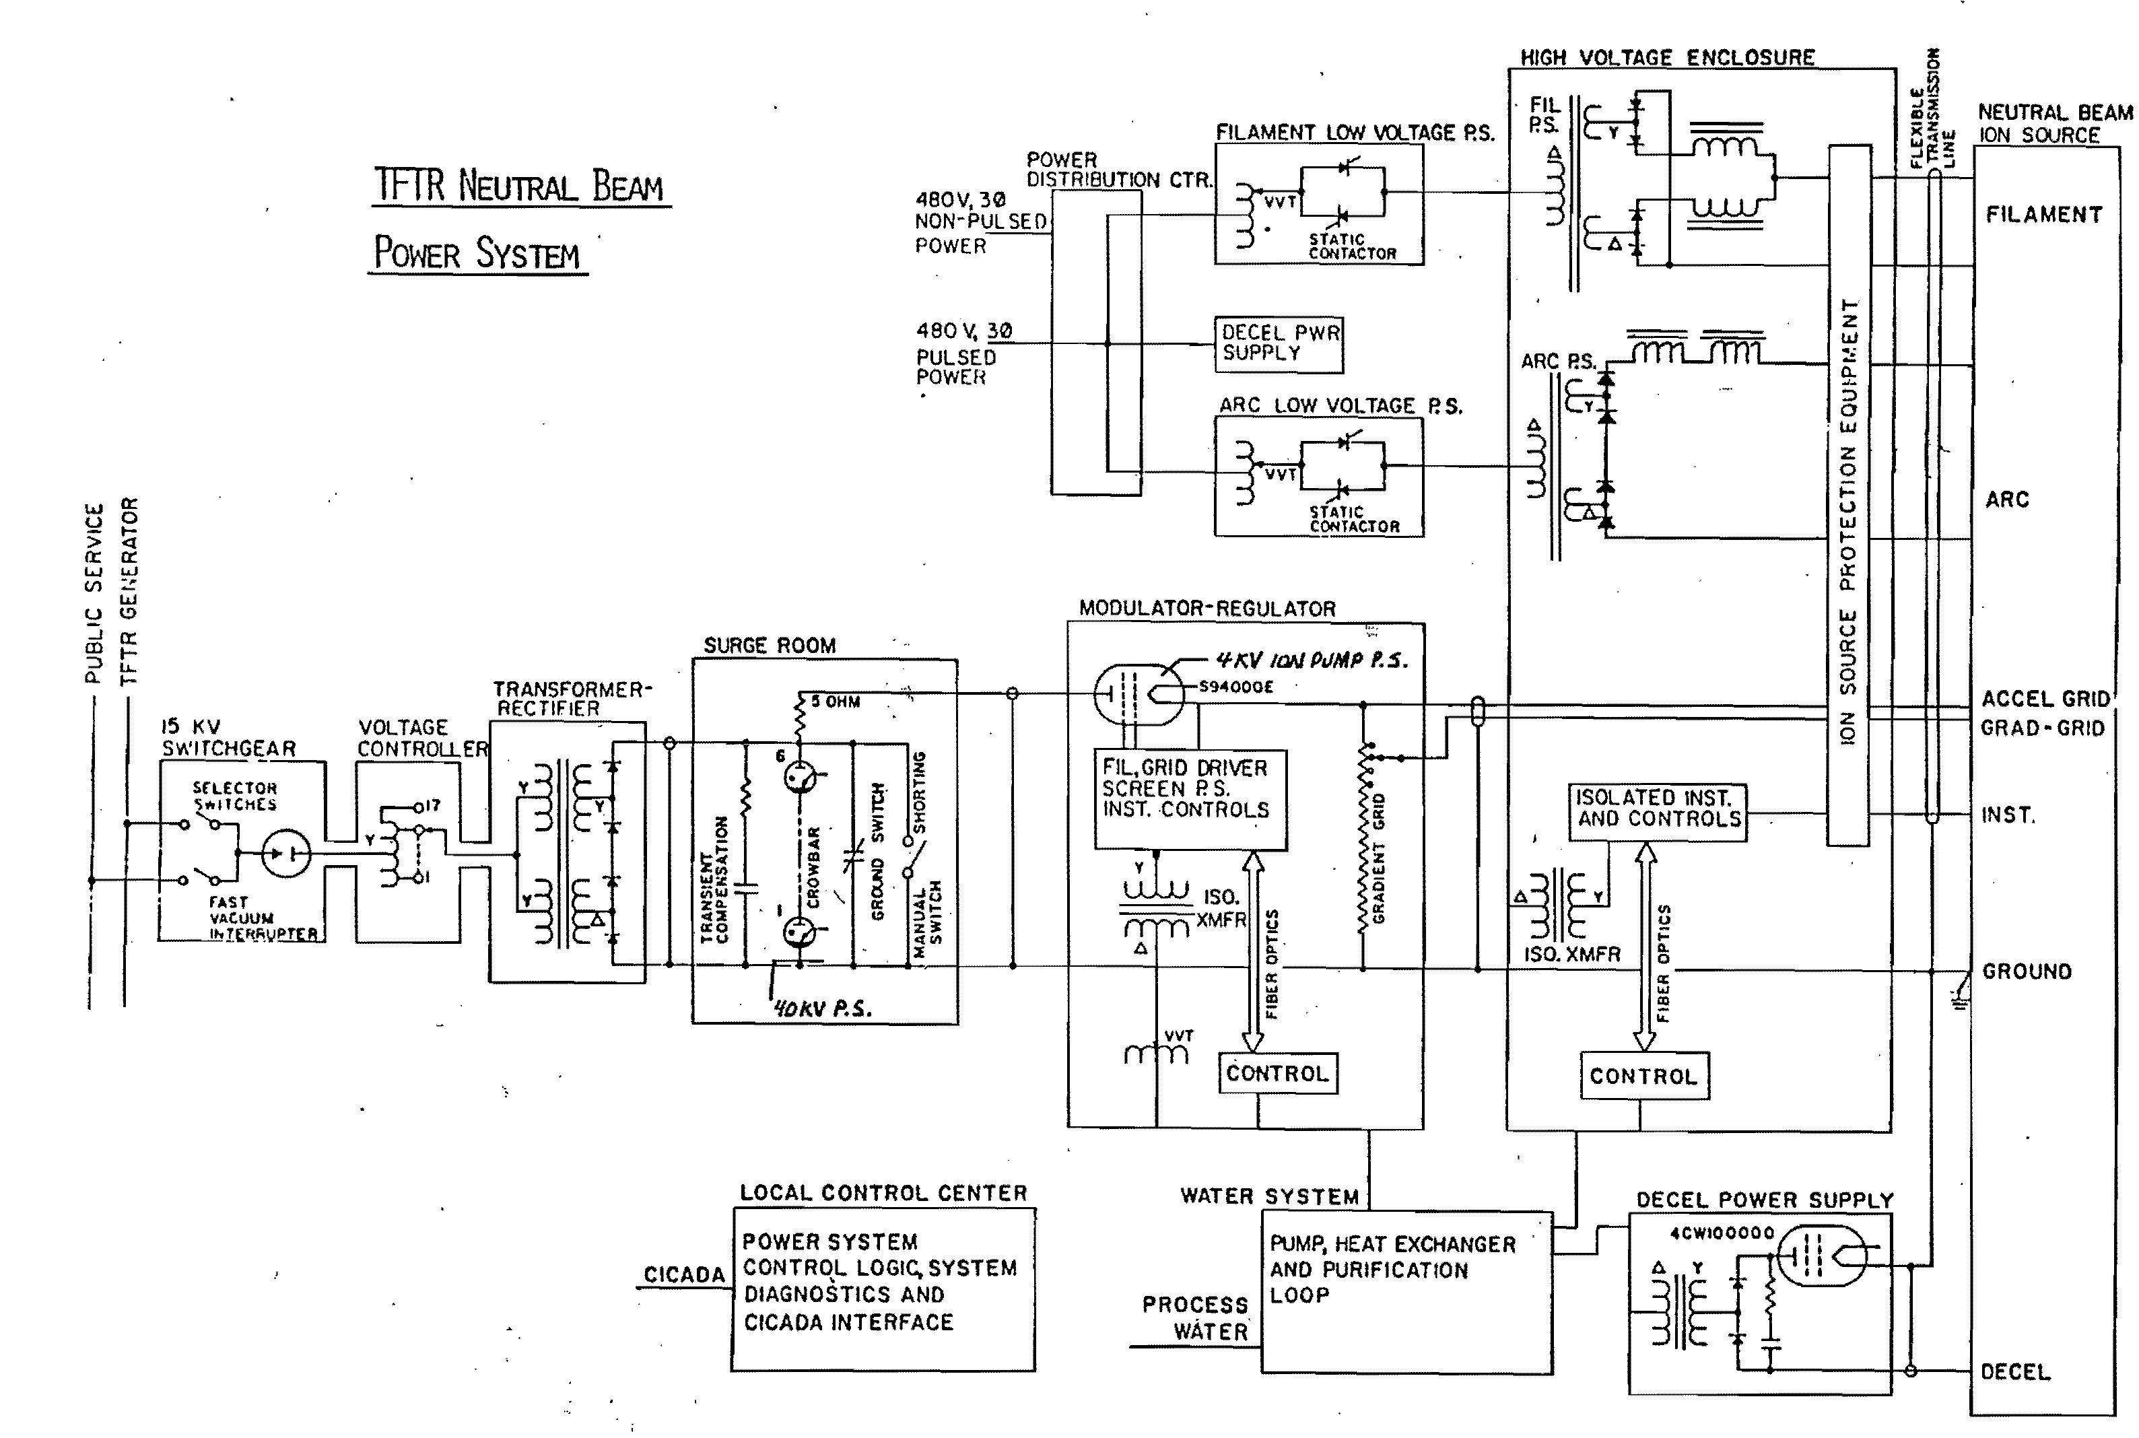
NSTX NBIU Power & Controls - One Line Diagram
Update electronics & control circuits as noted
NBI NBPS One Line Diagram

Slide 7
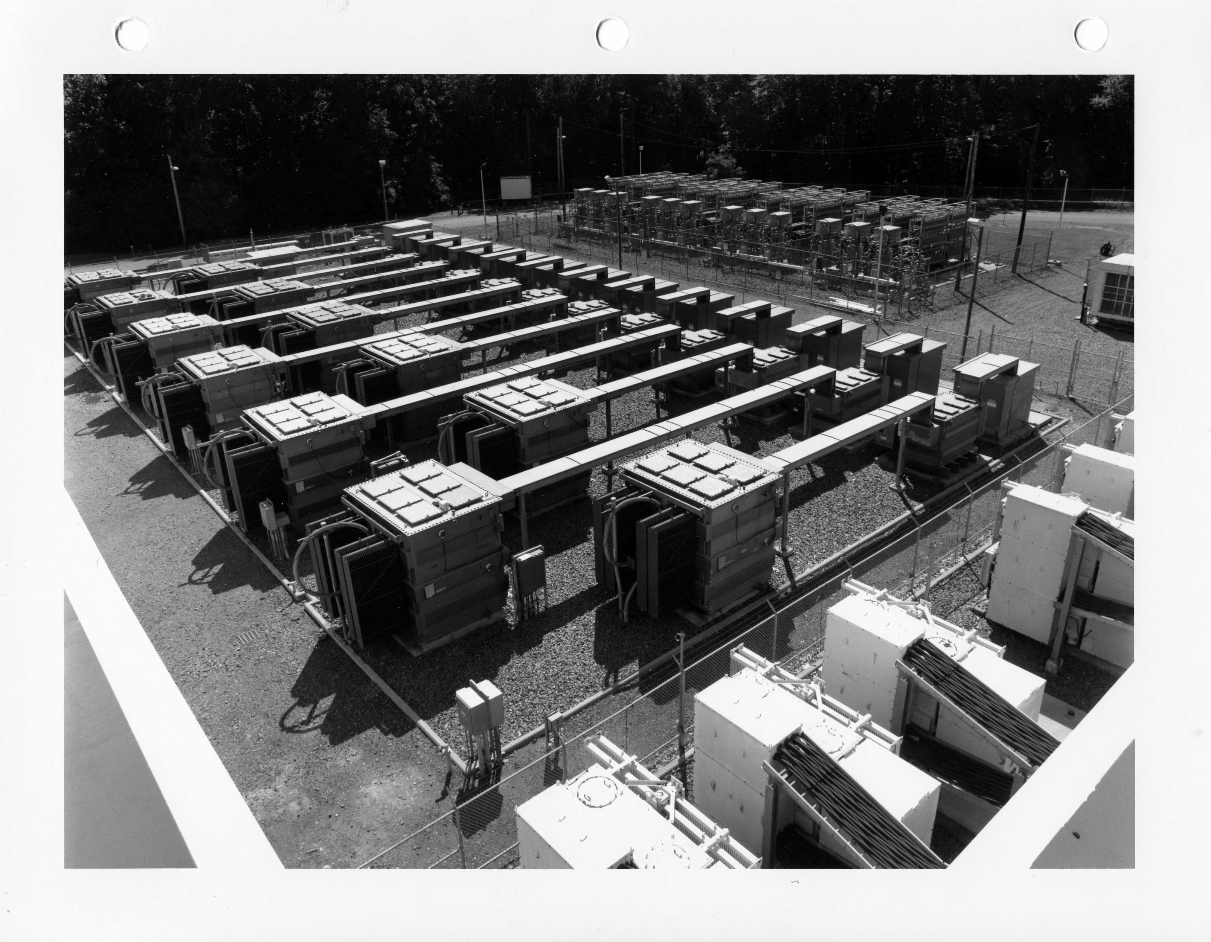
NSTX NBIU Power & Controls - NBPS N4 available
N4
XFMRs
NBI NBPS Switchgear and Transformers
7

Slide 8
NSTX NBIU Power & Controls - Layouts complete
New cable and tray
New cable and tray
New penetration in NTC West wall
Existing penetration in TC floor
NB Upgrade
Tray layout in NSTX Test Cell
8

Slide 9
NSTX NBIU Power & Controls - Layouts complete
Arc, Filament, Bending Magnet conductors
Existing penetration in TC floor
Fiber Optic spice box and tray
Decel conductors
Accel Triax conductors
NB Upgrade
Tray Layout TFTR Test Cell Basement
9

Slide 10
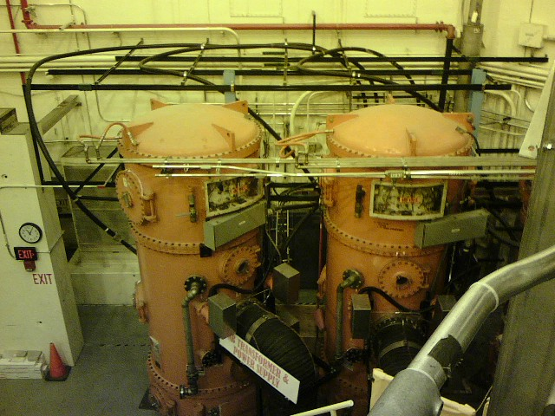
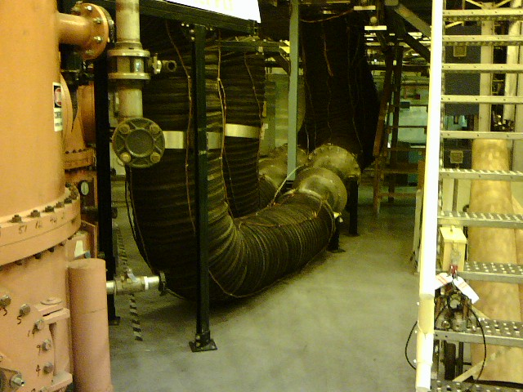
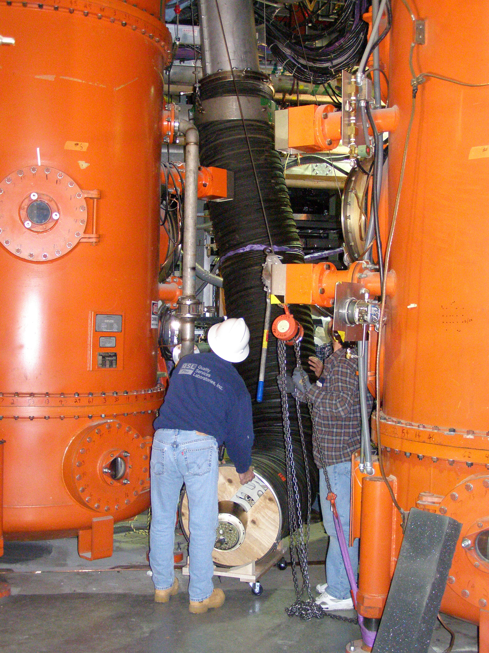
NSTX NBIU Power & Controls - HVEs & Xmsn Lines
BL1 HVEs and Triax
BL1 Xmsn lines
HVE internal circuits disconnected.
Ready for removal from TCB and relocation to NTC.
Saving N4 Xmsn line for reuse
10

Slide 11
NSTX NBIU Power & Controls - New Cable
Procurements required are standard items for NBPS Operations and Maintenance
NEW TRIAX CABLE TO BE PROCURED FOR ACCEL - 20‐26 weeks ARO
  SOW TO BE ISSUED FOR PROCUREMENT
    SUPPLYING THE CABLE
    TERMINATING AND TESTING THE CABLE
NEW 600V 4/C-500 MCM CABLES TO BE PROCURED FOR ARC/FILAMENT/MAGNET
  Cost has nearly doubled since last estimate due to Cu price increase
COAXIAL CABLE RG218U FOR DECEL TO BE PROCURED
PARTS FOR GRADIENT GRID RESISTORS & HARDWARE TO BE ORDERED
CABLE TRAY
Nothing unusual…
11

Slide 12
NSTX NBIU Power & Controls
TOTAL CABLES TO BE INSTALLED
  THREE TRIAX CABLES – PROJECTED LENGTHS 300*3 FEET
  THREE CABLES 600V 4C/500MCM & GRD WIRE - ARC
  THREE CABLES 600V 4C/500MCM & GRD WIRE - FILAMENT
  THREE CABLES 600V 4C/500MCM & GRD WIRE – MAGNET*
      *STANDARDIZE THE CABLES FOR EASE OF PROCUREMENT
  THREE CABLES 600V 4C/#8 & GRD WIRE – 208V FEED
  THREE COAXIAL CABLES RG218U FOR DECEL
  ALL POWER CABLES OF ARMORED CONSTRUCTION
  FIBER-OPTIC CABLES
    6 CABLES WITH 8 FIBERS FOR EACH HVE – TOTAL 18 FOR HVEs
ROUTING PROPOSED
  ROUTE ALL CABLES VIA TFTR TEST CELL BASEMENT, TFTR TEST CELL AND ON TO NSTX TEST CELL VIA PENETRATIONS
INSTALL THE TRANSMISSION LINES
INSTALL AUXILLIARY POWER CIRCUITS
SAME
Routing and Installation well known and ready to go…
12

Slide 13
NSTX NBIU Power & Controls
NBI Grounding scheme will conform to TFTR and NSTX design and operating experience
SAME AS FOR NB1
GROUNDING BASED ON SINGLE POINT PRINCIPLE
PROVIDE 24”X18”X3/8” CU PLATE ON INSULATORS IN WEST WALL NTC
CONNECT THE 500 KCMIL GROUND WIRES (FROM 2 TRAYS) TO PLATE
CONNECT PLATE TO BUILDING STEEL VIA THE EXISTING TFTR TEST CELL GROUND.
BEAMBOX WITH STAND TO BE INSULATED FROM FLOOR – DOUBLE BREAK
TRIAX RETURN (HVE) TO BE CONNECTED TO THE SOURCE BOX PER EXISTING SCHEME
PROVIDE GROUND WIRE AROUND TRANSMISSION LINE – CONNECT THIS TO THE PLATE
CONNECT SOURCE BOX TO GROUND VIA THE GROUND WIRE AROUND THE TRANSMISSION LINE
RUN GROUND WIRE FROM EACH HVE TO THE GROUND PLATE
CONNECT THE ARMOR OF EACH TRIAX TO THE HVE IN NTC
CONNECT THE ARMOR OF EACH TRIAX TO MODREG GROUND IN NBPC
CONNECT HVE SEGMENTS WITH GROUND JUMPERS
FOR TESTING THE GROUND WIRE CAN BE DISCONNECTED FROM GROUND PLATE AND THEN TESTED
13

Slide 14
NSTX NBIU Power System - Status
All electrical design work for installation purposes has been completed
Routing of cables has been optimized to meet the requirements
Penetrations required have been identified and shown in drawings
All installation drawings for raceways and cables have been completed
Draft installation procedures with Bill of Materials have been prepared
14

Slide 15
NSTX NBIU Controls
Neutral Beam Injection Control System
Work Scope very similar to BL1 with updates to current status
Mimic existing NSTX BL1 Control scheme for BL2 but move NTC racks
Reactivate N4 Local Control Centers, CAMAC, Hardwired Interlock System
Turn BL2 Plasma Current Interlocks on (chassis still in use for BL1)
Add additional plasma interlock to prevent long pulse into armor- Ip & IpR
Expand I/O for PLC control of BL and Services but use existing PLC
Expand Thermocouple Scanning System to include BL2 & the ARMOR
Fold BL2 into EPICS & timing pages
Update NBOS LabView Operator interface so existing staff can run 2 BLs
Pyrometer not yet feasible… no sight lines so tile upgrade to take the heat.
  (still under consideration.)
More sources, more buttons… but not more operators
15
15

Slide 16
NSTX NBIU Controls - Handshakes
Neutral Beam Control System & Interfaces to NSTX
NBI Ops Supervisor & Operators
NSTX Ops
LCC - NBPS
EPICS TCs
Chief Operations Engineer
PS F/O Telemetry
EPICS Timing pages
NBI Fault Detector
BL PLC Control
Cryo Control
Gas Control
TVPS PLC
Vacuum System Operator
BL RGA Control
Hardwired Interlock System
BL CAL Camera
Physics Operator
TC Scanner
NBOS (LabView)
Operator Control Sys
(LabView)
Central Computing
NBI data on Scope
NBI Physics Data on NSTX MDS+ tree
CAMAC Beam data
PDM - Ip interlock
& Redundant Ip
Beta Feedback
16

Slide 17
NSTX NBIU Controls - Progress
Block Diagrams of each segment of the control scheme complete
Signal lists have been prepared to determine I/O requirements
Drawing lists have been prepared to determine requirements for new drawings and P&IDs
  53 Drawings identified 52 completed.
  608 CWD’s identified 75 of them are commercial cables and do not need drawings generated, 470 require new drawings, 460 completed.
  Test Cell/Gallery portion complete , 138’ level not started.
Rack contents and layouts have been evaluated to determine new space requirements
NBOS LabView Controls will be updated to current technology like BL1
Interfaces are well understood and can be replicated for BL2 control
Test Cell cable trays lay out has not been started – last major effort for controls
Controls design is on track…
17

Slide 18
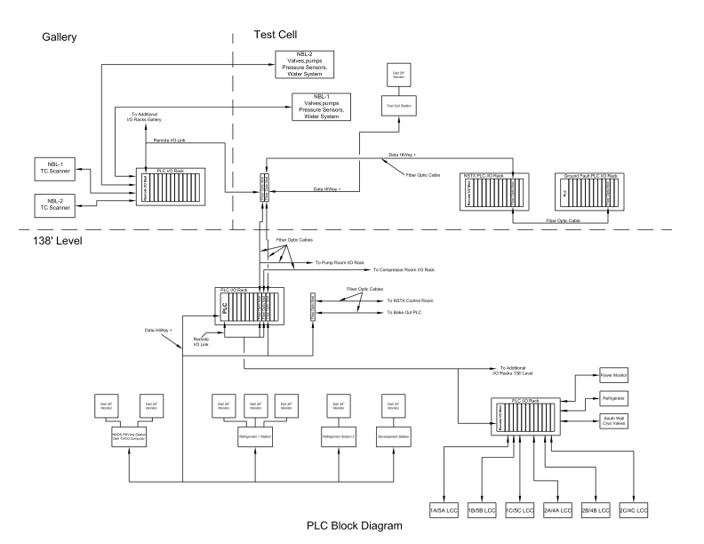
NSTX NBIU Controls - PLC Block Diagram
18

Slide 19
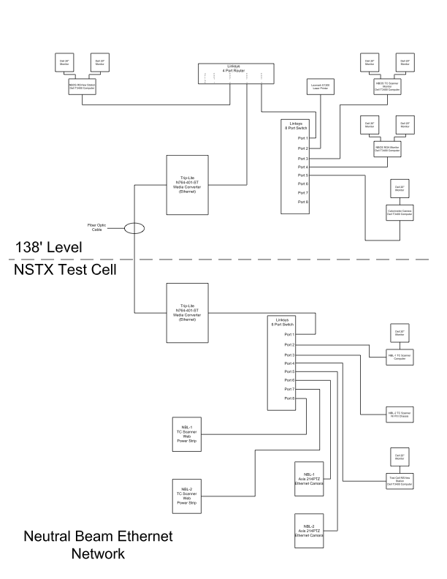
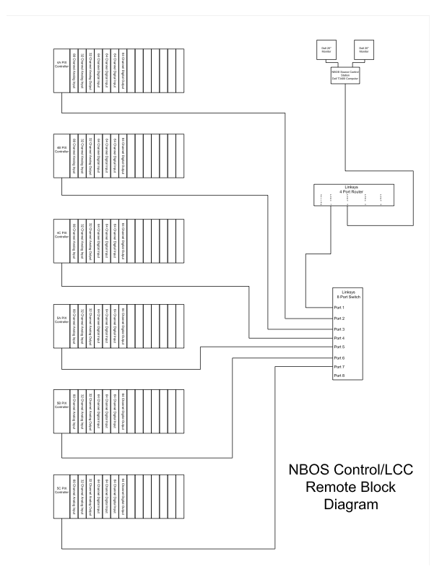
NSTX NBIU Controls - NB Network, Remote LCC System
19

Slide 20
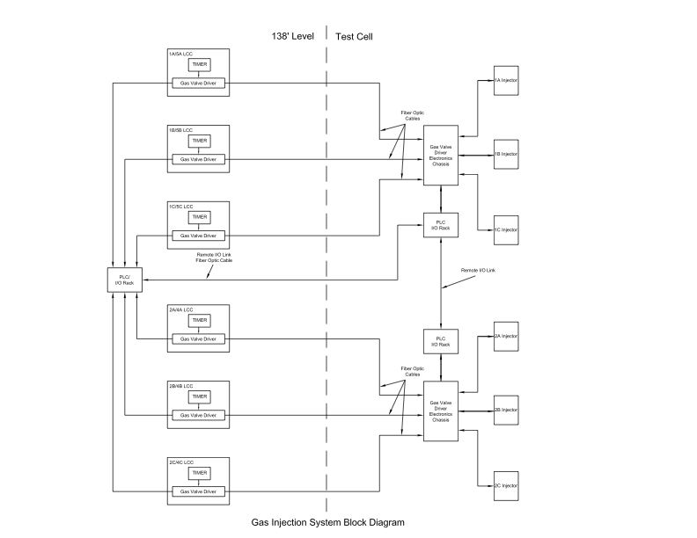
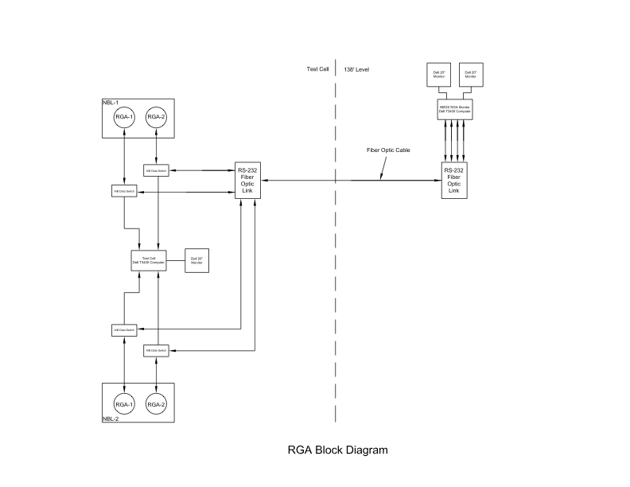
NSTX NBIU Controls - Gas Inj Sys, RGAs
20

Slide 21
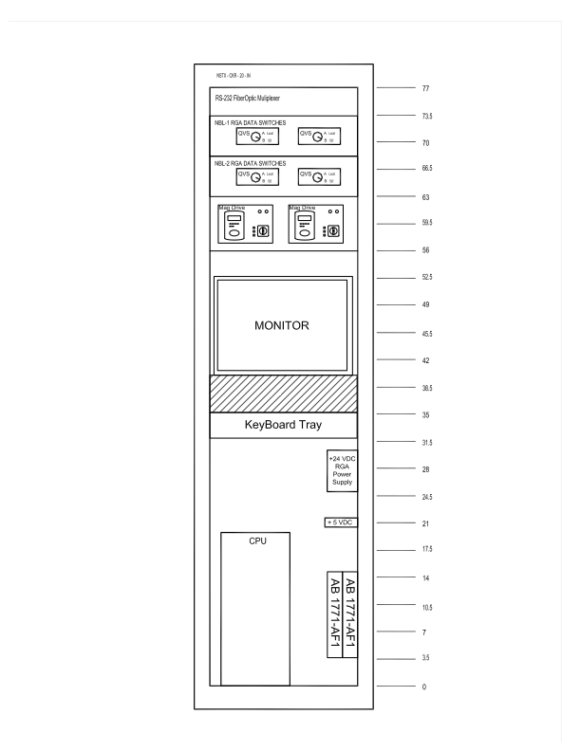
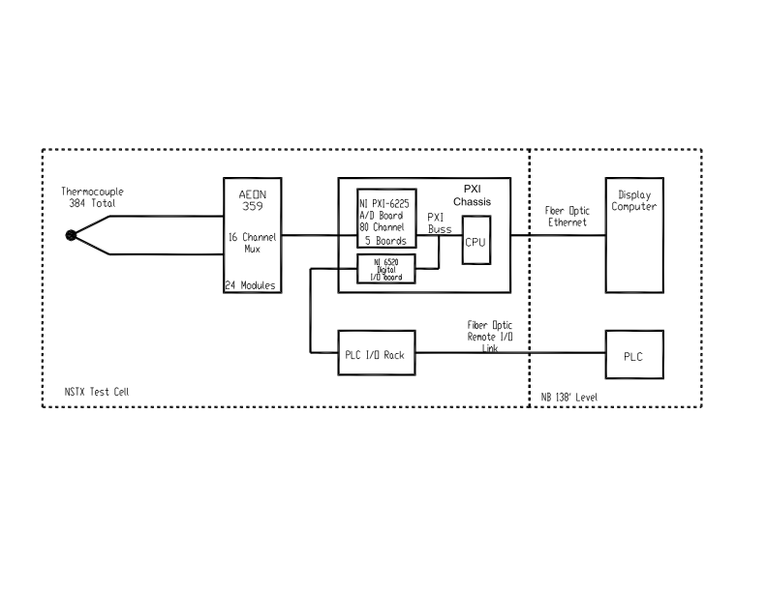
NSTX NBIU Controls - TC Scanner, NTC Racks
21

Slide 22
NSTX NBIU Power & Control - Conclusion
NBI Power System -
  Reuse major portions of N4 power supply with updates
Work Scope to connect N4 NBPS ABC to BL2 ion sources - known
Procurements - similar to TFTR and NSTX BL1
Routing and Installation - a clear path forward identified
Grounding - same or similar
NBI Controls - repeat for BL2
Work Scope to control NBI BL2 - known
Conclusion - BL2 Power and Control design is well known and tested
And ready to run another BL again…
22

Slide 23
NSTX NBIU Power & Controls - Power feeds are OK
Turn some breakers back ON for NBPS N4 A,B, & C systems…
23

