Slide 1
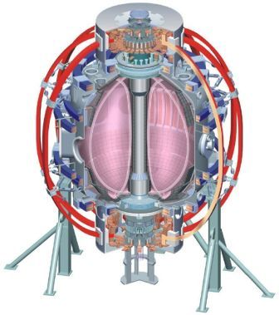
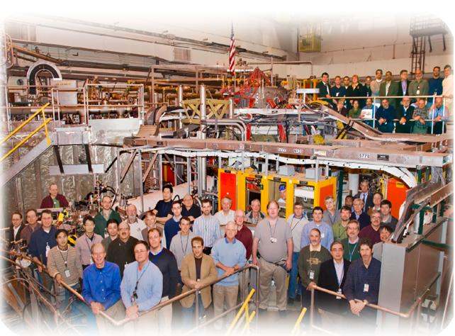
NSTX
Supported by
Neutral Beam Upgrade: NB Armor
College W&M
Colorado Sch Mines
Columbia U
CompX
General Atomics
INEL
Johns Hopkins U
LANL
LLNL
Lodestar
MIT
Nova Photonics
New York U
Old Dominion U
ORNL
PPPL
PSI
Princeton U
Purdue U
SNL
Think Tank, Inc.
UC Davis
UC Irvine
UCLA
UCSD
U Colorado
U Illinois
U Maryland
U Rochester
U Washington
U Wisconsin
K. Tresemer, M. Denault, J. Winkelman, L. Bryant
Culham Sci Ctr
U St. Andrews
York U
Chubu U
Fukui U
Hiroshima U
Hyogo U
Kyoto U
Kyushu U
Kyushu Tokai U
NIFS
Niigata U
U Tokyo
JAEA
Hebrew U
Ioffe Inst
RRC Kurchatov Inst
TRINITI
KBSI
KAIST
POSTECH
ASIPP
ENEA, Frascati
CEA, Cadarache
IPP, Jülich
IPP, Garching
ASCR, Czech Rep
U Quebec
NSTX Upgrade Project
NB Peer Review
LSB, B318
April 19, 2011

Slide 2
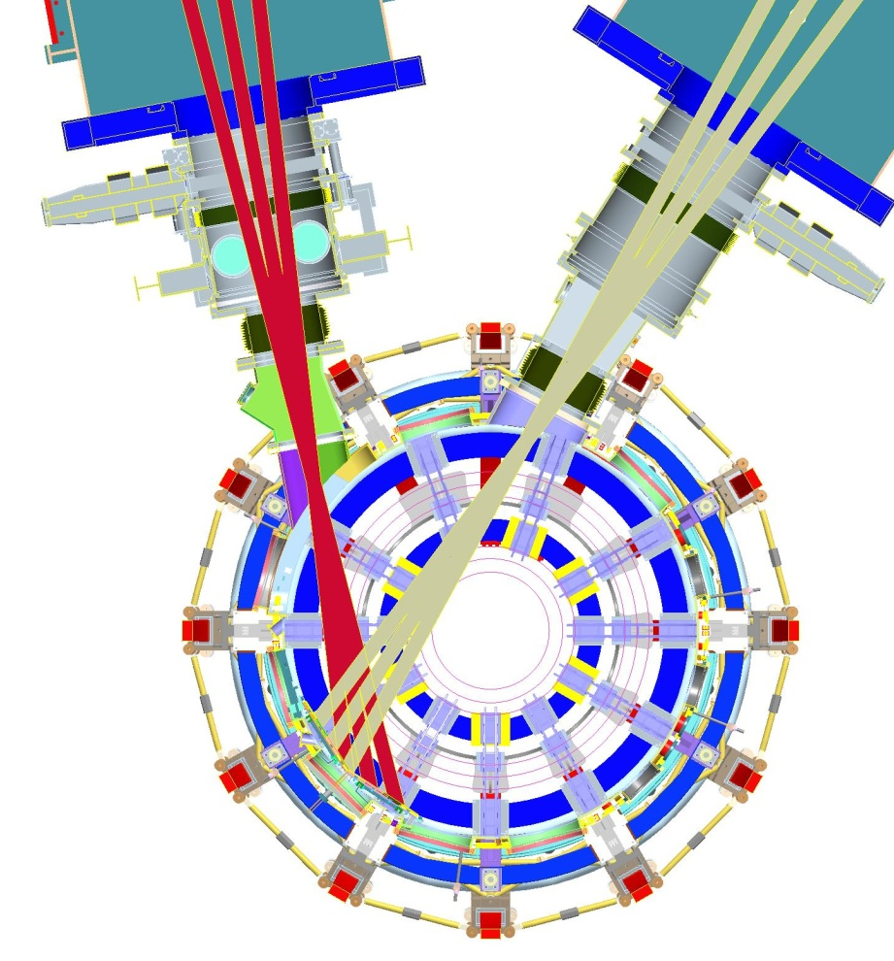
NB Armor: Overview
Armor Relocation:
Shifting armor counterclockwise
To fit both beamlines on surface
Using ATJ graphite in non-crucial areas of armor.
Carbon Fiber Composite (CFC) in areas of intense beam overlap
Upgrading mounting hardware to maximize port functionality and installation/removal
Look at disruption forces and resulting stresses on armor mounts

Slide 3
Armor Move
Current Alignment
Proposed Alignment
BL 1
BL 2
BL 1
Bay I
Bay I
Bay H
Bay H
Bay G

Slide 4
Armor Move: Beamline fit
Used combination of empirical data and analysis to create beam “footprints”
Beam photo shows rough ellipse shape from conditioning shots
Assumed beam dispersion of .5 deg horizontal, 1.5 deg vertical
Used calculated “Smear” areas for beam profiles (incident angle effects)
Taking these areas, built ellipses and applied them to a simple armor shape, showing beam layout and overlaps
C
B
A

Slide 5
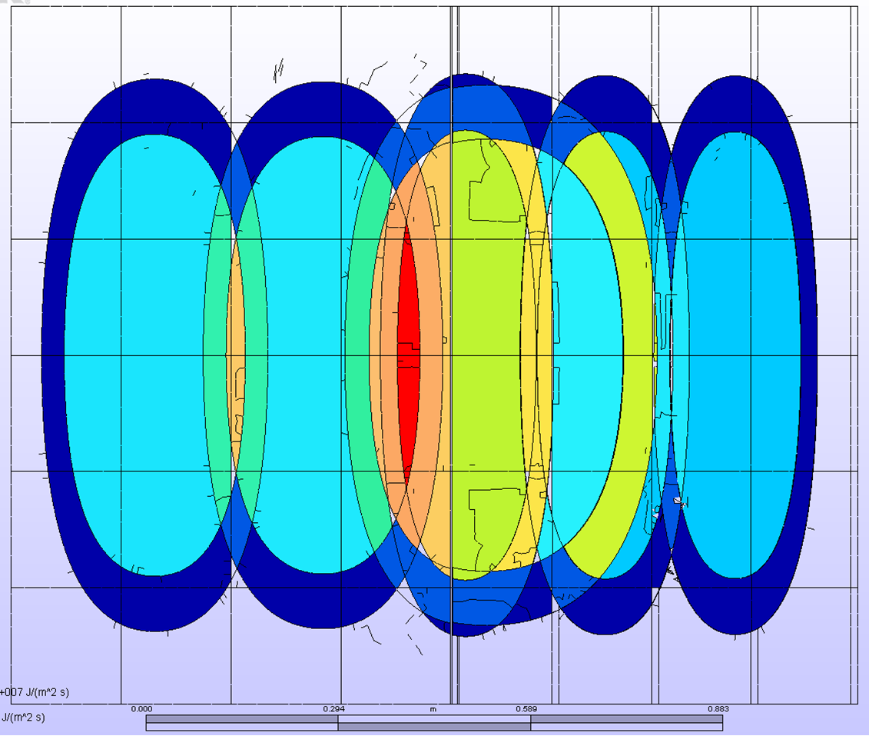
Armor Move: Beamline fit
Resulting Source Profiles on Armor Face Confirms Fit!
Outer ring:
20% total source power
Inner “hotspot”:
80% total source power
Beam overlaps create areas of intense flux
Area of thermal investigation and probable material upgrade to 3D CFC

Slide 6
Armor Tile Thermal Analysis
Model accuracy check
Data from MSE shots
ATJ tiles
90 kv, 19 MW/m^2 source heat flux, 400 ms
50 – 80 C bulk temp change
Confirmed that ALGOR model behaved similarly
1 NB “fault” testing
Temperature and Stress under full power, full length of shot
80 kV, 7.7 MW/m², 5 sec
90 kV, 9.2 MW/m², 3 sec
110 kV, 13.9 MW/m², 1 sec
Baseline Material properties of ATJ Graphite
Max Tensile Stress: 26 Mpa
Max Temp : 2600 °C*
*This is the temperature at which the sublimation rate rapidly accelerates. Sublimation does begin at lower temperatures in vacuum, but the effect is less. Attempting to capture an acceptable maximum temperature.

Slide 7
Armor Tile Thermal Analysis
 | Run # | Run Description | T (deg C) | Time @ T (s) | Tslot Von Mises (MPa) Free exp.
1 Beamline | 1 | MSE, 90 kV, .400 ms, 9.24 MW/m^2 applied
 | 2 | Stress analysis | 544.6 | 0.433 | 8.91
 | 3 | 80 kV, 5 s, 7.70 MW/m^2 applied
 | 4 | Stress analysis | 1893.7 | 5.5 | 16.16
 | 5 | 90 kV, 3 s, 9.23 MW/m^2 applied
 | 6 | Stress analysis | 1611.3 | 3.08 | 16.76
 | 7 | 110 kV, 1 s, 13.86 MW/m^2 applied
 | 8 | Stress analysis | 1220.3 | 1.05 | 16.42
 | 9 | Stress analysis | 956.4 | 1.2 | 17.78

Slide 8
Armor Tile Thermal Analysis
2 NB “fault” testing
Temperature and Stress under full power of two beams
Looking at an overlap tile that sees greatest flux
Finding time limit to max temp and max stress
80, 90, 110 kV
 | Run # | Run Description | T (deg C) | Time @ T (s) | Tslot Von Mises (MPa) Free exp.
2 Beamlines | 11 | 80 kV, max q: 23.9 MW?m^2
 | 12 | Stress analysis, TS 14 | 2693.9 | 1.68 | 36.6
 | 13 | Stress analysis, TS 8 | 1965.2 | 0.96 | 25.6
 | 14 | 90 kV, max q: 35.8 MW/m^2
 | 16 | Stress analysis, TS 18 | 2643.3 | 1.08 | 37.88
 | 15 | Stress analysis, TS 10 | 1905.54 | 0.6 | 26.1
 | 17 | 110 kV, max q: 35.84 MW/m^2
 | 18 | Stress analysis, TS 18 | 2649.4 | 0.675 | 38.68
 | 19 | Stress analysis, TS 10 | 1879.7 | 0.375 | 26.86

Slide 9
Armor Tile Thermal Analysis
Results
Single NBL “fault” is acceptable
Temperatures and stresses within capabilities of ATJ graphite
Possible surface cracks, ablation
If occurs, should attempt to visually inspect surface for damage
Double NBL “fault” is not acceptable with only ATJ
Stresses on surface and in T-slot exceed material limit
Risk critically cracking tile. Need to prevent this.
Use available CFC in needed zones. Tensile strength 3x that of ATJ.
Temperatures will surpass 2600 °C and carbon will rapidly sublimate.
Material mass will be sufficient to protect for length of “fault”. Stainless backing plates added protection.
Armor will be damaged, need visual inspection, but will perform duty as a sacrificial protective surface.
Increased safety:
Additional Plasma interlock
Increasing ss backing plate coverage
Increased administrative caution while using both NLBs

Slide 10
Thermal Analysis for Between-Shot Cooling
Worst case heat load on tile and backing plate
Ran test sample in ALGOR, simple shape
“Back of the envelope” Analysis
3”x1” slice of armor (tile and backing plate), 3/8” cooling tube, 20 minutes between shots
Determined time constant for cooling: ~70 seconds
Preliminary results suggest cooling system adequate for in-between shot cooling
More tests needed to confirm. Numbers will be updated for FDR as analyses are completed

Slide 11
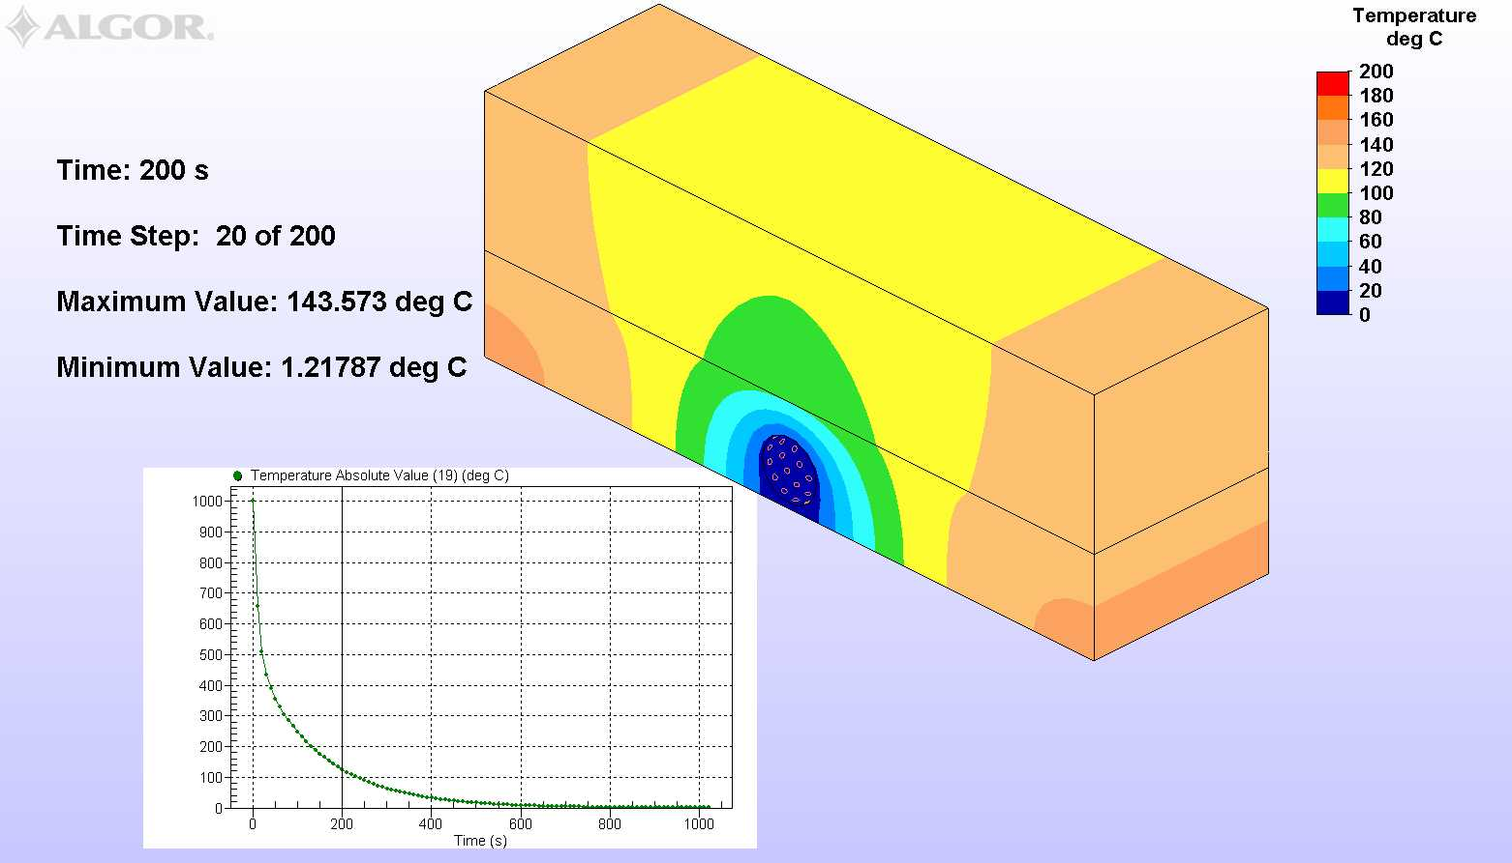
Thermal Analysis for Between-Shot Cooling
Graphite (ATJ)
Stainless Steel

Slide 12
Armor Support System
Front
Weld on studded pads (4 places)
MSE LIF Port
Bay I footprint
Bay G footprint

Slide 13
Armor Support System
Back
Bay I support
Bay G support
Redesigned Bay H supports

Slide 14
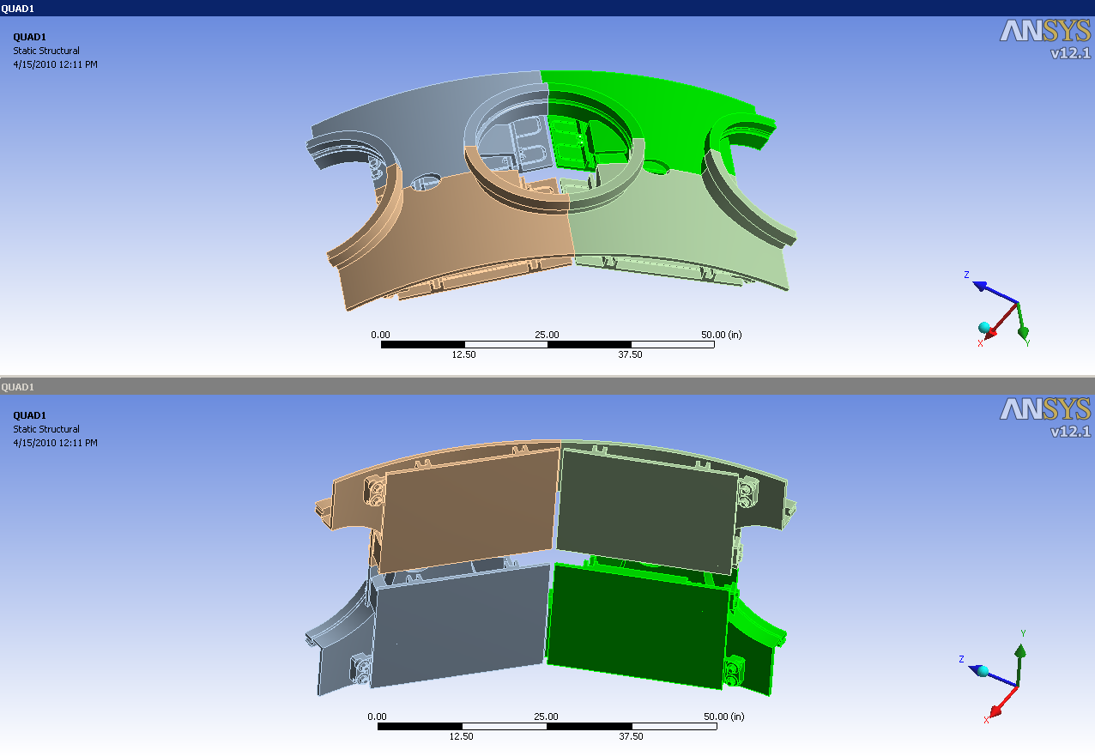
Neutral Beam Armor Solid Model
The Solid Model is Symmetric about 2 planes
Only ¼ of Armor model will be included in the FE analysis

Slide 15
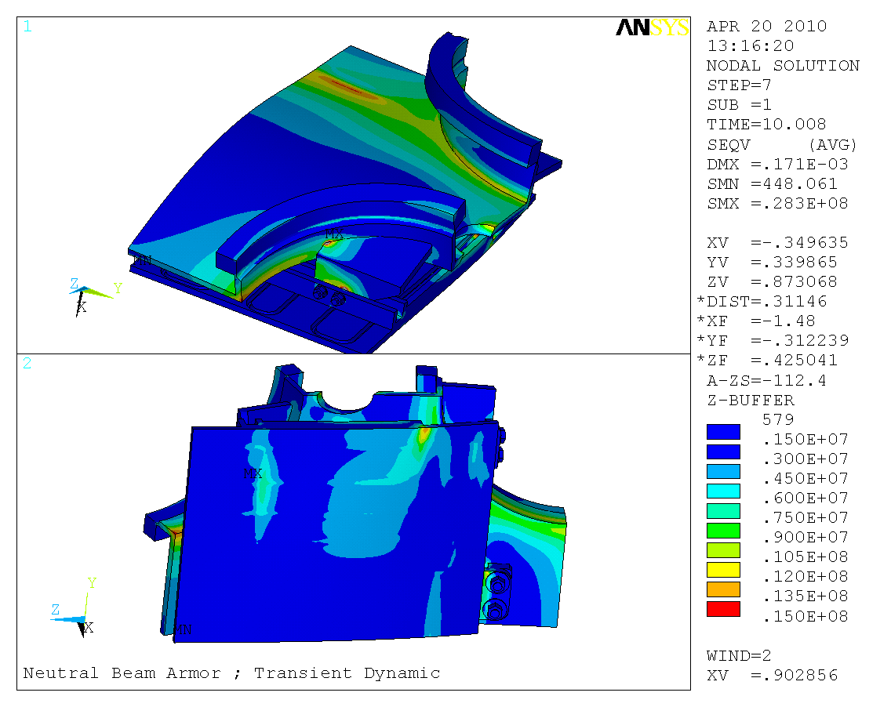
Transient Dynamic Von Mises Stress (Outboard Displacement Disruption)
Plate Support
Vessel Interface
Weld Interface
Vessel Edge 1
Bolt Stress
Flange 1
Vessel Edge 2
Max Stress = 1.6e7 Pa = 2,320 psi
Flange 2
The Transient Equivalent Stress at Max Current is less than 10 Ksi
and well within the material strength capacity (Based on Merged Solids)

Slide 16
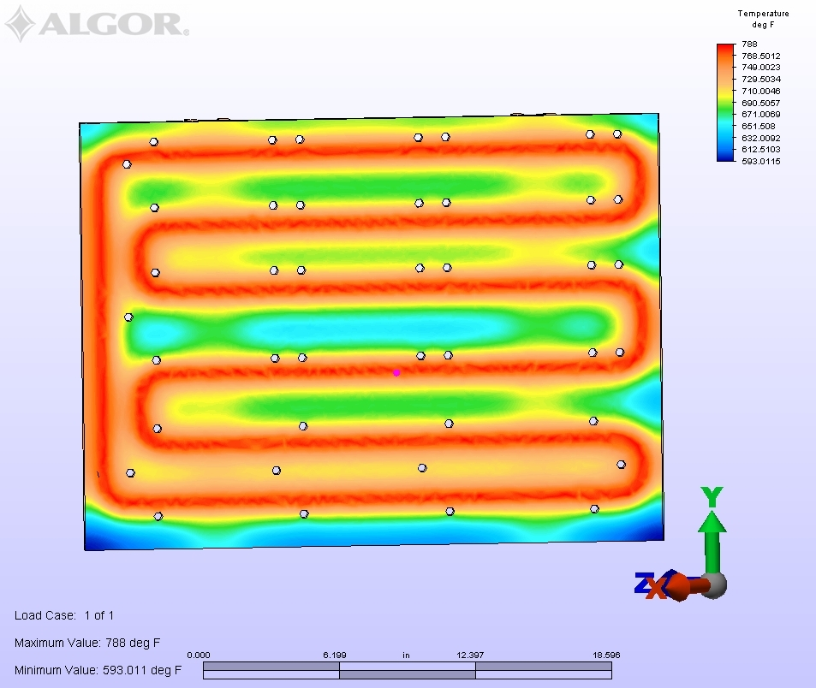
Thermal Growth
Addressed potential thermal growth issues with the new armor constraints
Used bake-out temps as an example
Shows that SS plates grow “up and out”
Do not cause tile interference

Slide 17
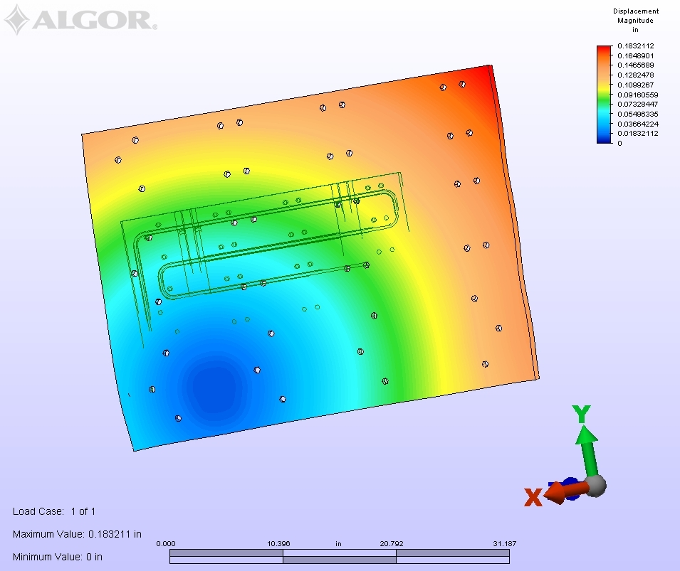
Thermal Growth
Addressed potential thermal growth issues with the new armor constraints
Used bake-out temps as an example
Shows that SS plates grow “up and out”
Do not cause tile interference
Direction of Thermal Growth

Slide 18
Conclusions
Armor Relocation: Thermal
6 sources fit adequately upon armor face
In areas of high heat flux (source overlaps), tile material will be replaced with 4D CFC
CFC has multi-plane high k, thermal shock resistance, good mechanical properties
Armor will sufficiently protect the VV from NB exposure, even with increased heat flux from source overlap
Cooling lines will be adequate for heat removal between shots
Armor Relocation: Mechanical
New mounting scheme improvement to accessibility
Employing bay H and G as access points
Disruption analyses show that forces in the mounts are low, material and fasteners are adequate for loading
Consider final analysis with updated load scenarios and non-merged model
Thermal growth in plates will not cause issues with tiles
Installation procedure is being created
Armor drawings are complete (barring any other changes to design).

