Slide 1
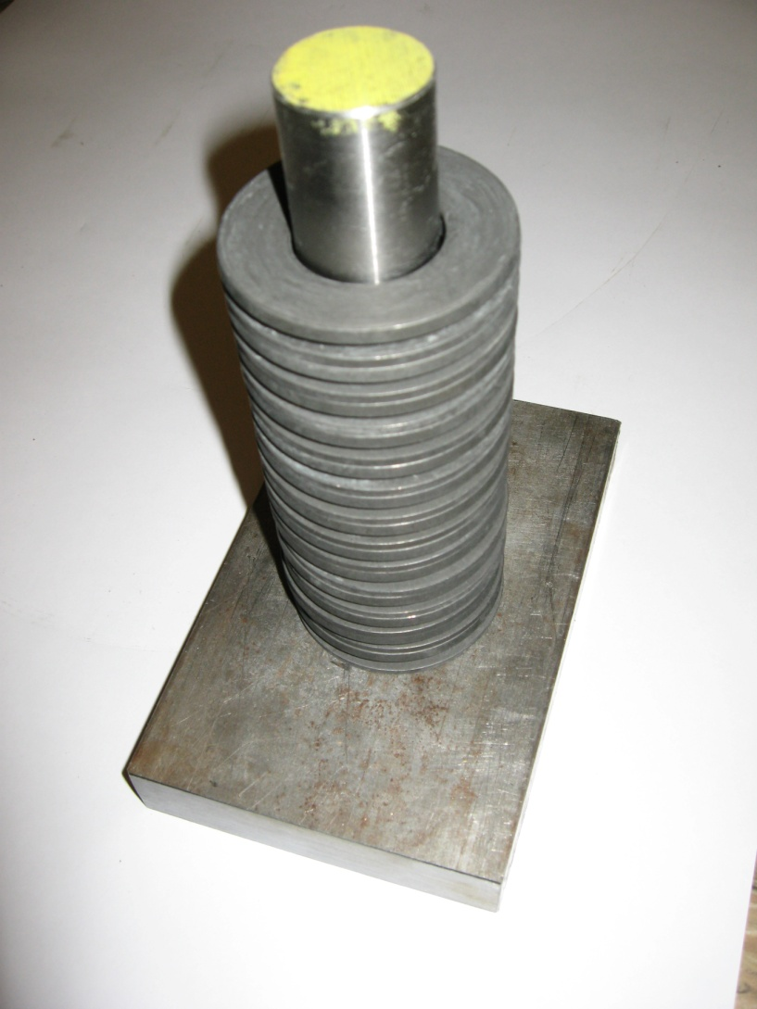
Bellville Washer Stack
(Verification by Testing)

Slide 2
Bellville Washer Stack

Slide 3
Comparison of the Calculated to Test data for a single washer stack
Test data Spring Rate = 3,922. lb/in
Calculated from the required minimum load on the OH coil,
Total Load = 20,157.0 lbs. at 9.47 mm displacement or = .373 in.
There are 14 Stacks, with 26 Bellville spring each.
Therefore: 20,157/14 = 2,128.5 lbs/mm,
2,128.5 X 25.4 mm/in =54,064 lbs/in for 14 stacks,
Than K = 54,064/14 = 3,862. lb/in
Calculated K = 3,862 lb/in
Spring rate check, at .373 in disp. is: 3,862. X .373 = 1,440 lb per stack
therefore, total load for 14 stacks = 1,440. X 14 = 20160. lb

