Slide 1
Vessel Support Leg Calculations
Enclosed are all the so far available calculations covering the above subject.
Please note that this is preliminary presentation format and it may change
as completion of the analyses progresses? I think, so far it is self explanatory.
I am following a logical analyses progression from linear to non linear methods.
I hope that this will answer all necessary questions.
Also, I have not fully completed RUN #4 analyses (Non Linear static Sol 106
with GAP elements). As you can see from the enclosed slides, many GAPs
are involved. But, I think it will be done soon?
Please examine the included slides!

Slide 2
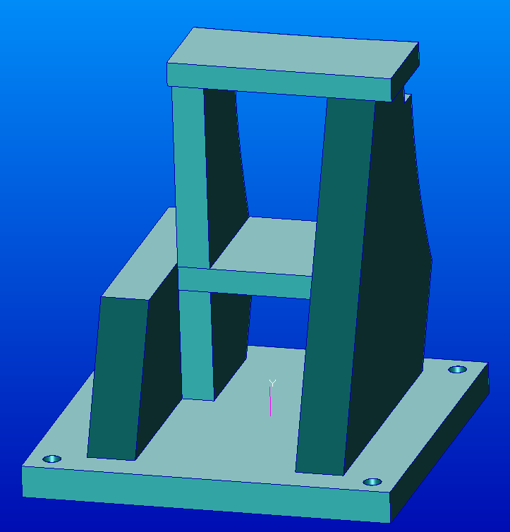
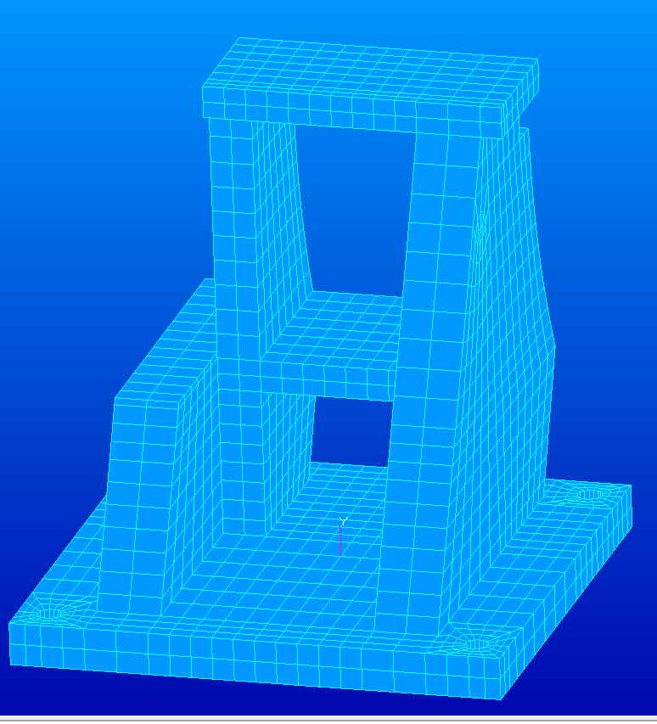
VV-support-attach-011812.igs
Nastran FEA all Hex8 elements
Question: How is this welded, assume weld size = 3/8 inch?
Redesigned VV support chair

Slide 3
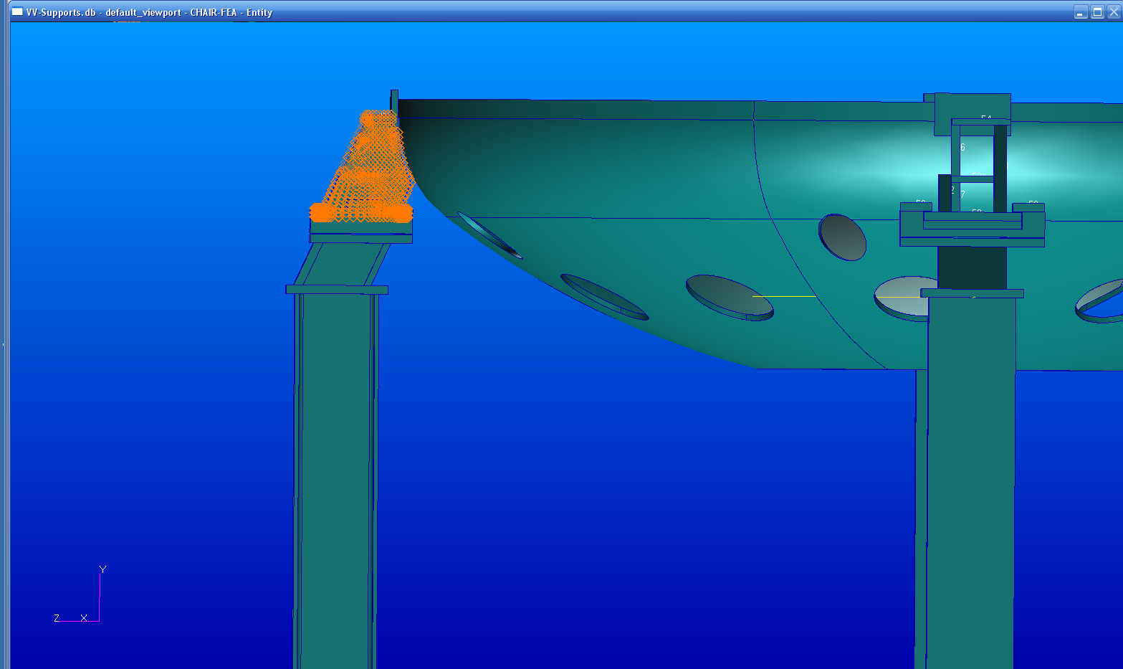
Force form VV weight. Also creates Moment about point A?
A
Moment arm
General design

Slide 4
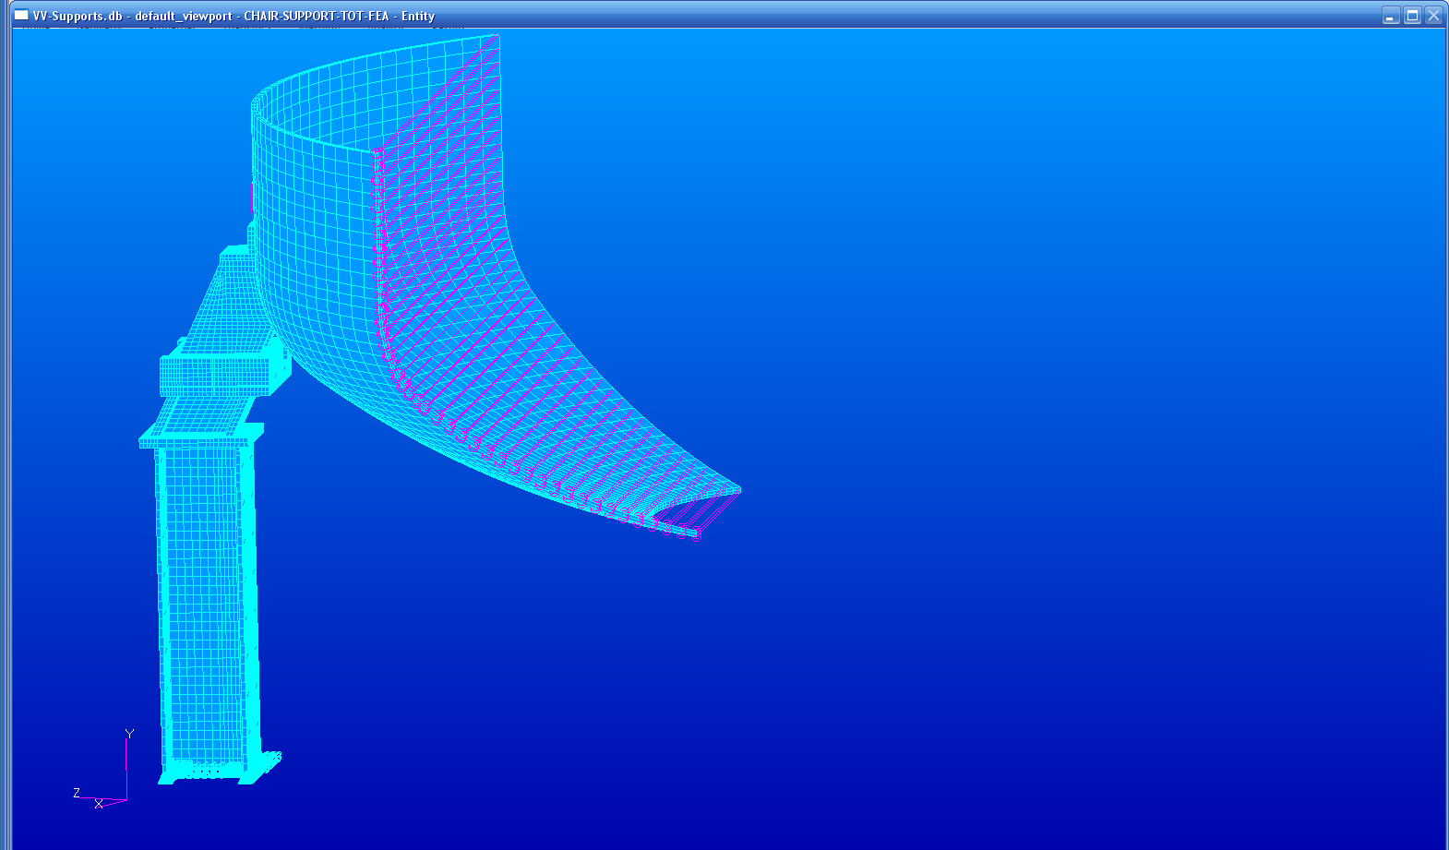
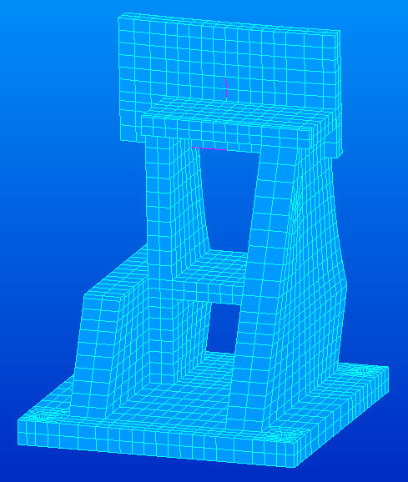
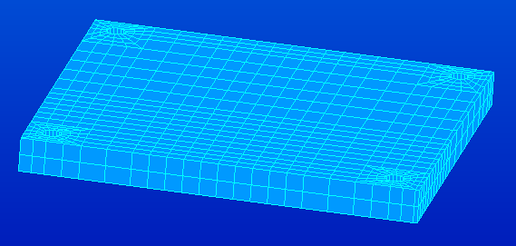
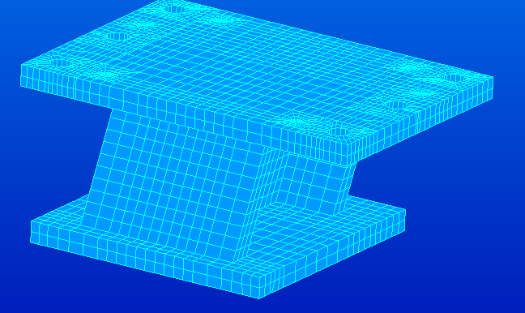
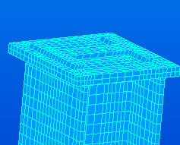
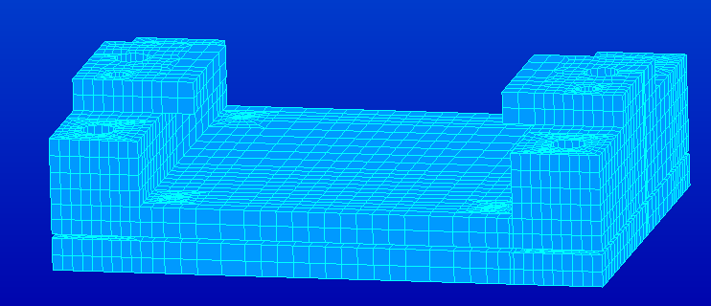
VV Support configuration
FEA simulation
MPCs simulate
Cyclic Symmetry
3 – dof (1,2,3)
Hexa 8- elements
Redesigned Chair
SPCs (1,2,3)
Fixity where
Braces are
located
Slide plate
Cradle

Slide 5
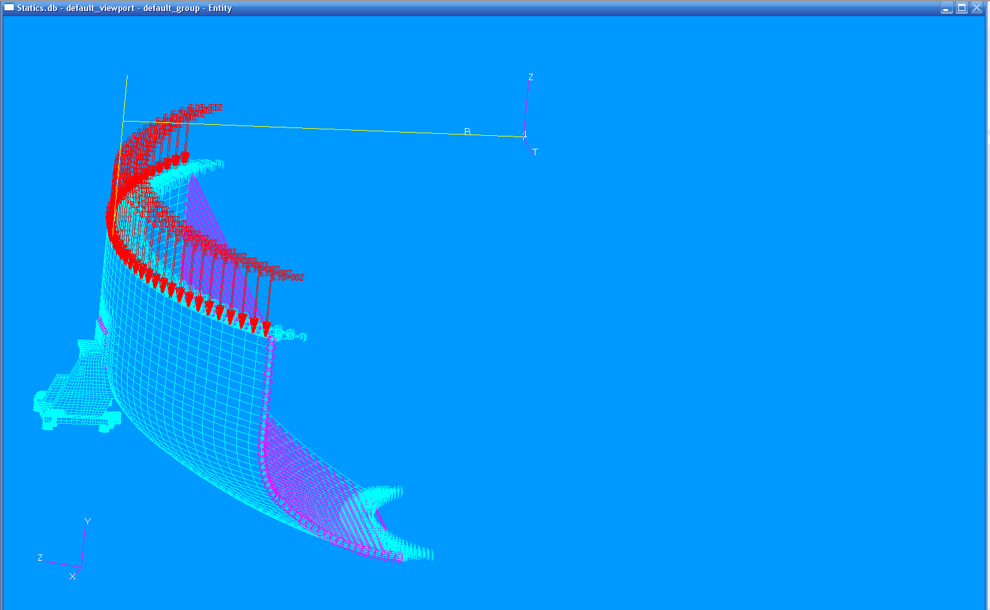
Static Test run #1 and Simulation general loads and fixities
RUN # 1
Db --- Statics
File -- ChairVVStatics.bdf
This is a test run to check
Connections to the VV
40,000. lbs distributed over the VV thickness and 45 degree sector.
This value was taken from the previous analyses estimates, It is
Applied as the distributed pressure.
SPCs in R-direction only
SPCs at four bolts
In 1,2,3 direction
Results are in ChairVVStatics.xdb

Slide 6
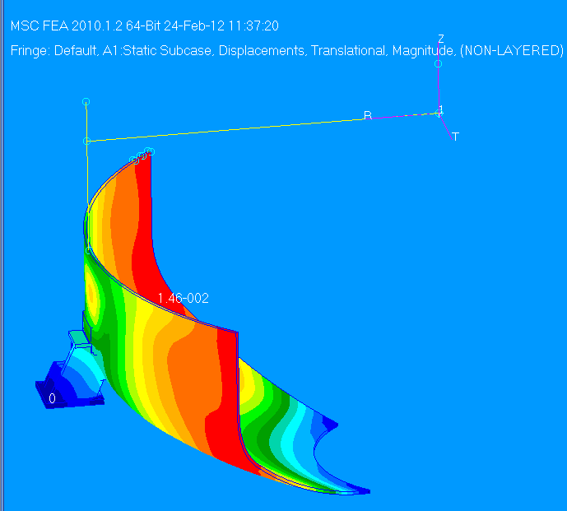
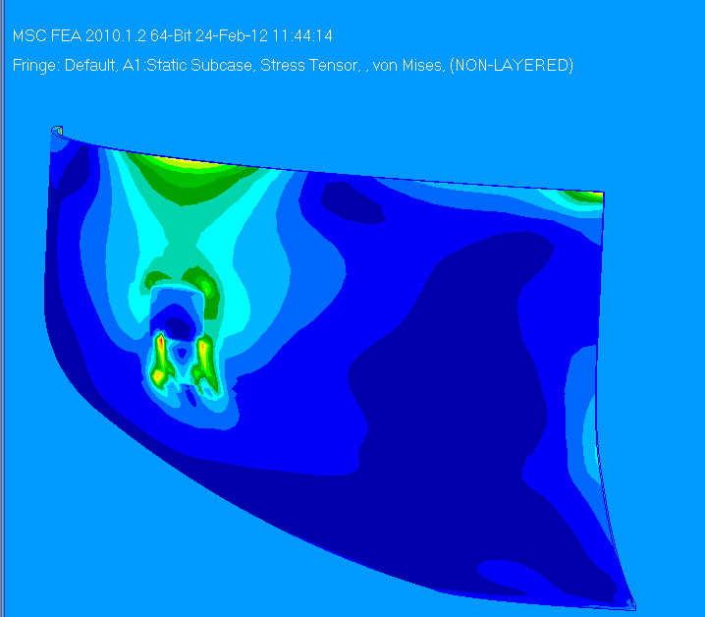
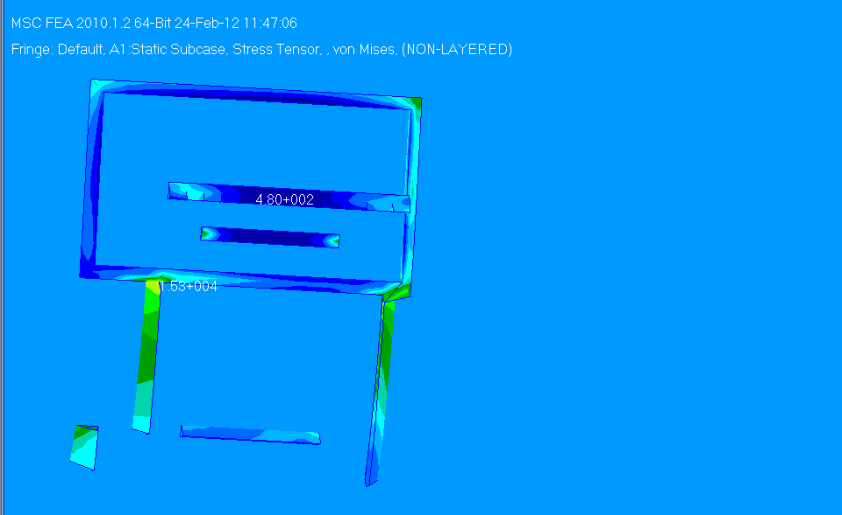
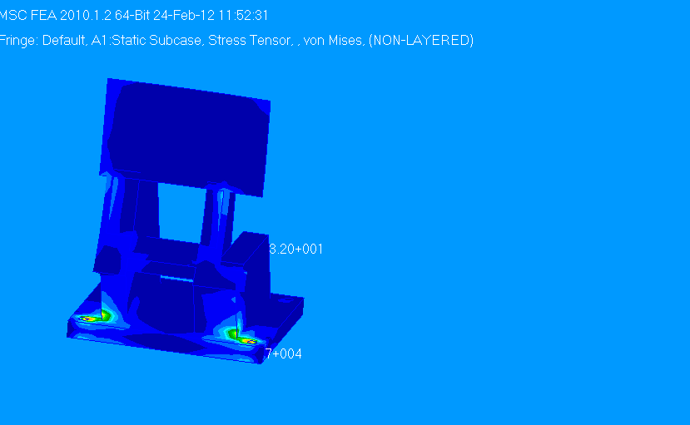
RUN # 1 Results
Max Displacement = .015 inch.
Max Stress = 10,800.psi
Max Stress = 56,700.psi
Note:(not real)
Max stress = 15,300.psi

Slide 7
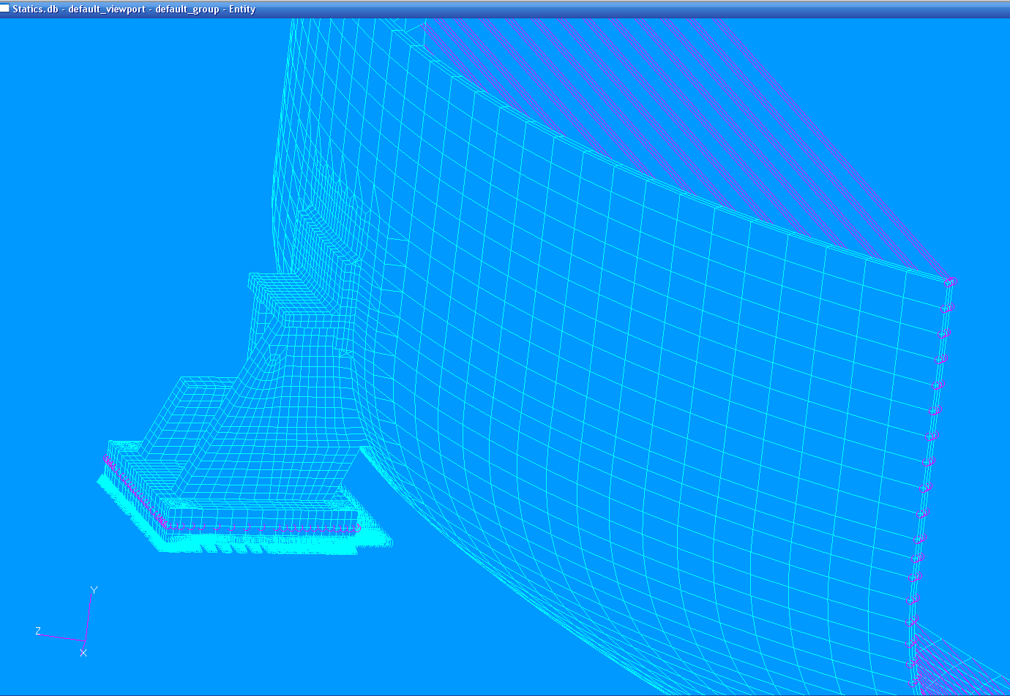
RUN #2
Added the slide plate and connected it via RBE2s
to the chair with B.C. as shown. Sliding in the R- direction
nodes at the center of the slide plate. (Y in coord1=0.)

Slide 8
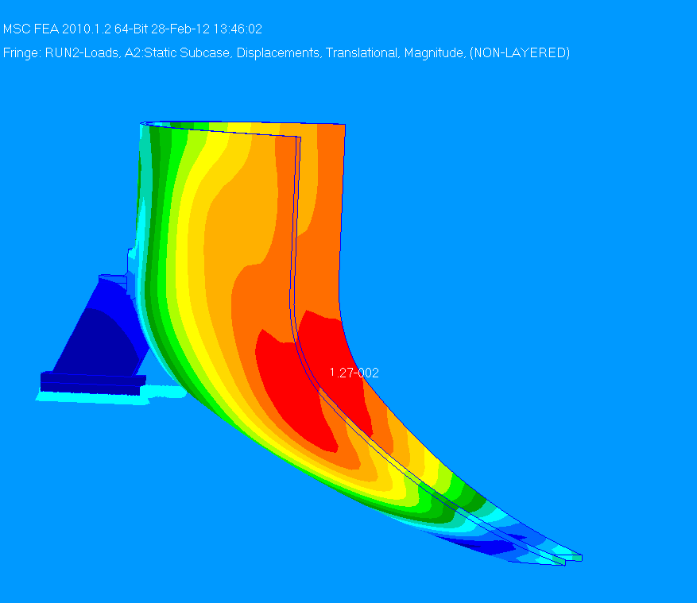
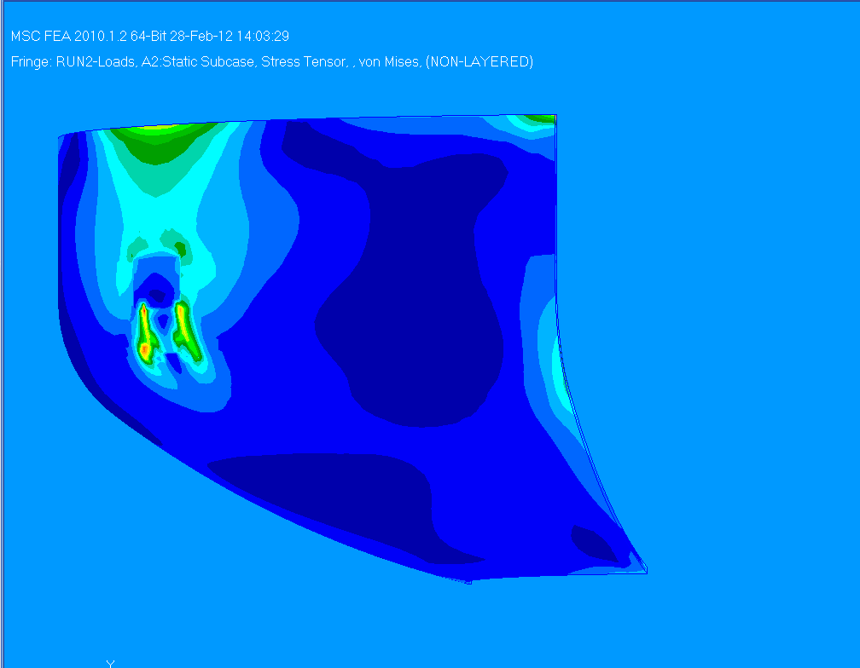
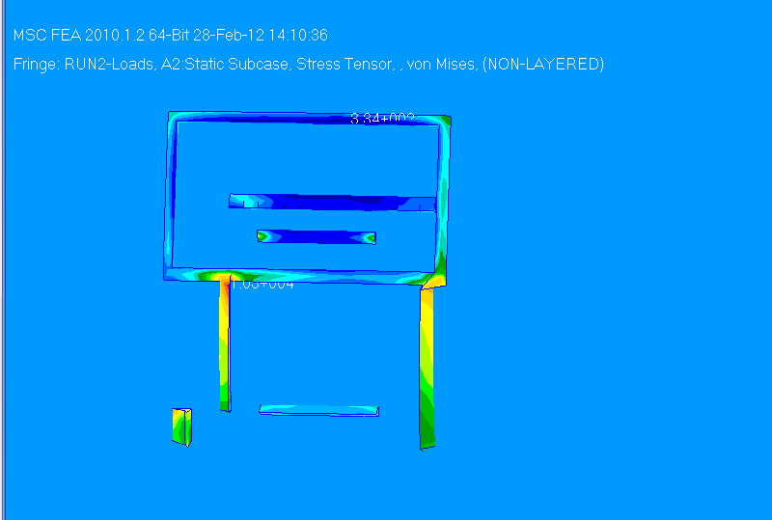
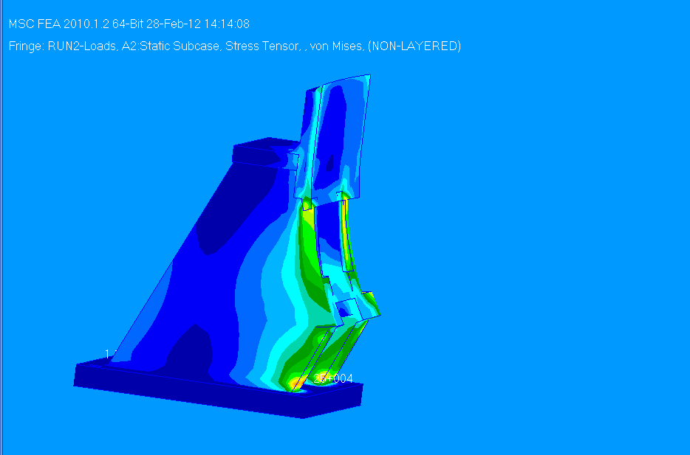
RUN #2 Results
Max displacement = .013 inch
Max Stress = 10,200.psi
Weld area
Max Stress = 12,500.psi
Welds between the Chair and the VV

Slide 9
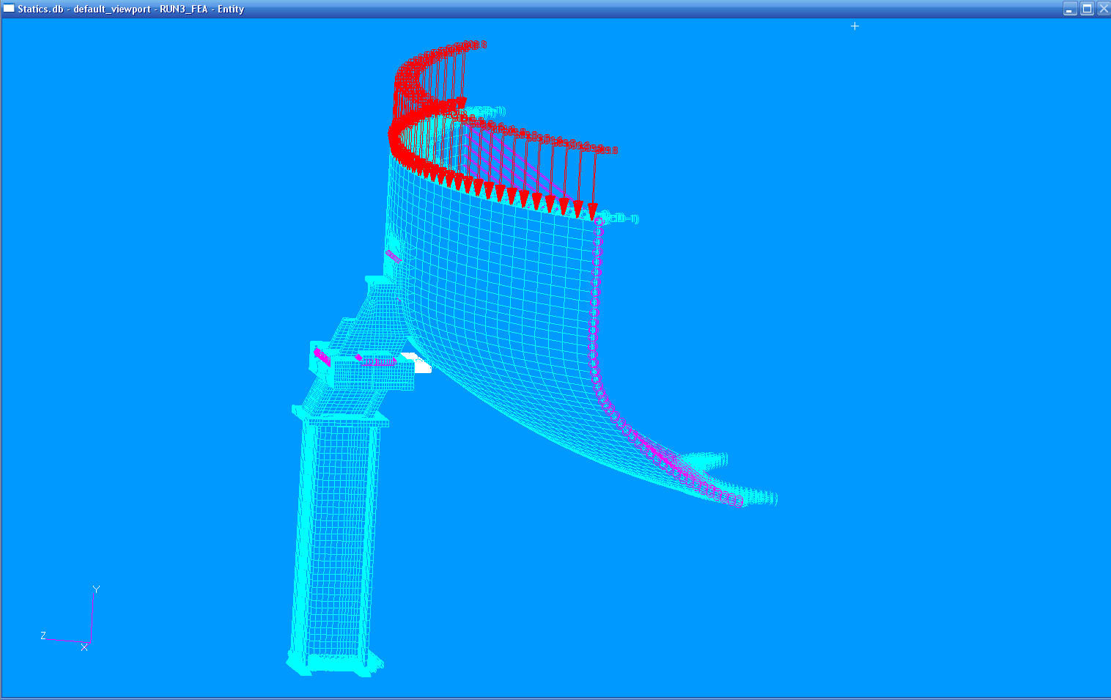
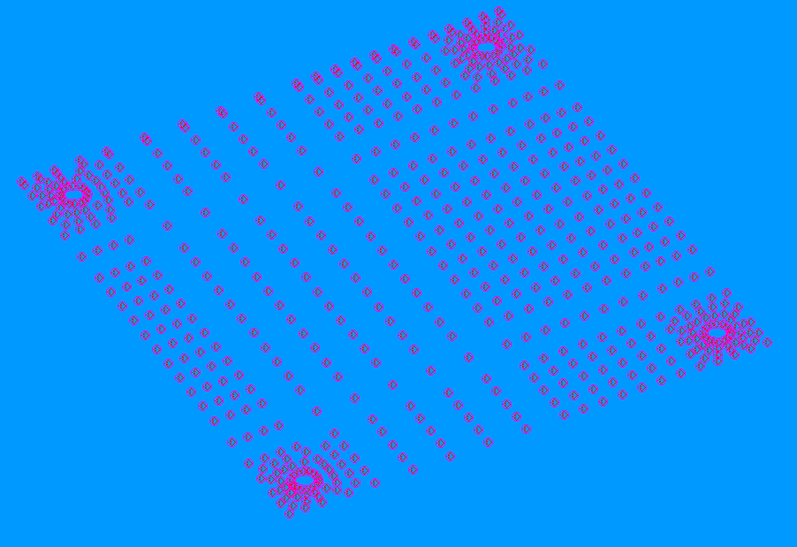

RUN #3
Sol 101 – Linear static run
With GAPs that become rigid
in this solution.
RBE2s replacing the GAPs
For the Sol 101 linear run
Note: zero length RBEs
GAPs for sliding in Solution 106
Static Non-Linear.

Slide 10
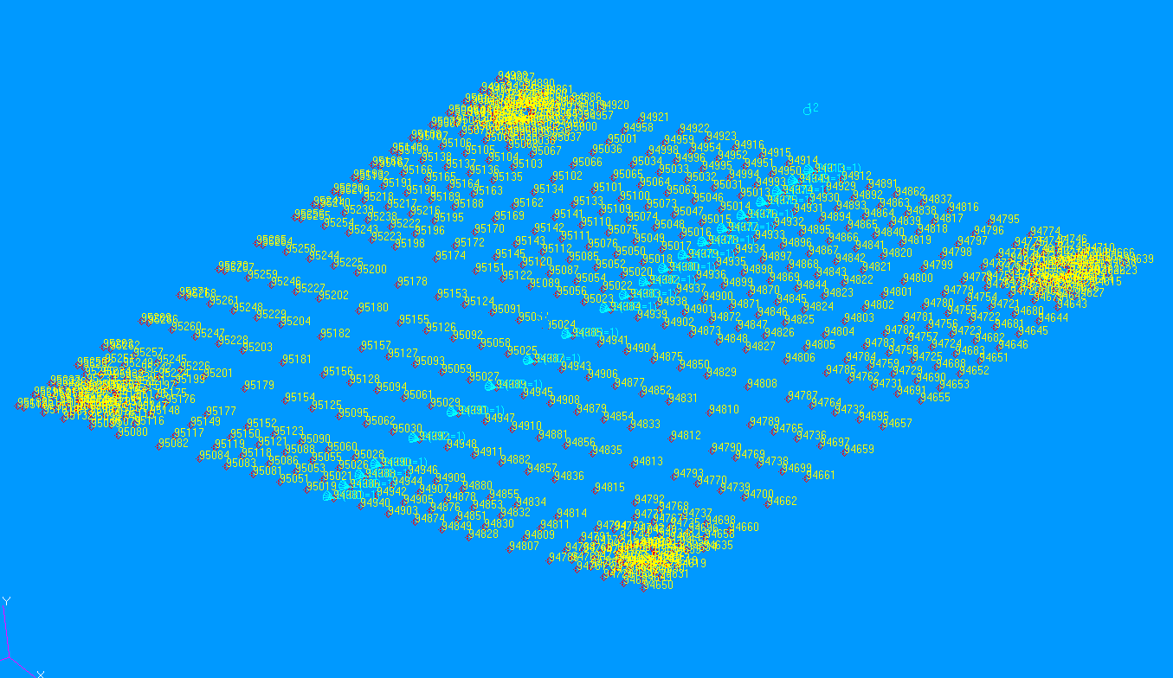
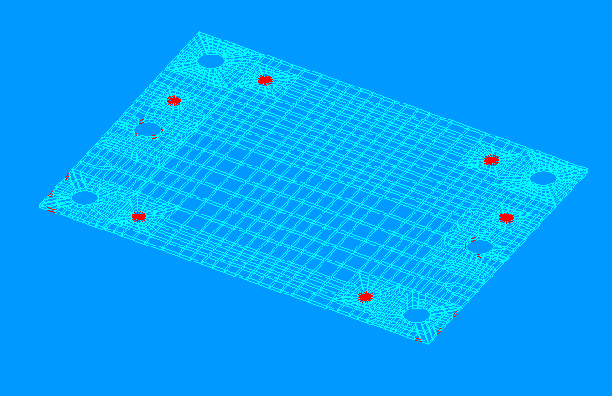
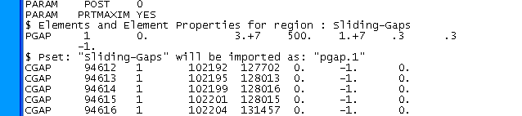
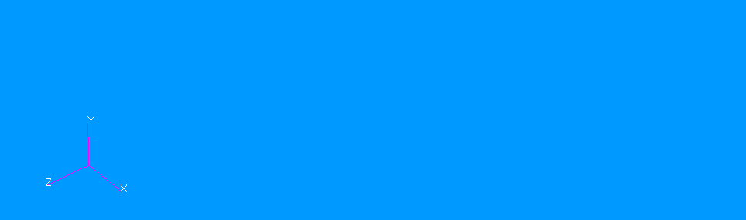
G-10 dielectric break
t = 1/8 inch
Included in RUNs #3
Between the cradle and Vertical support

Slide 11
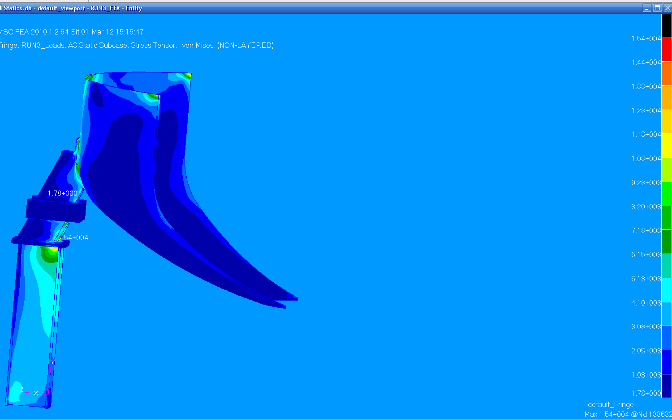
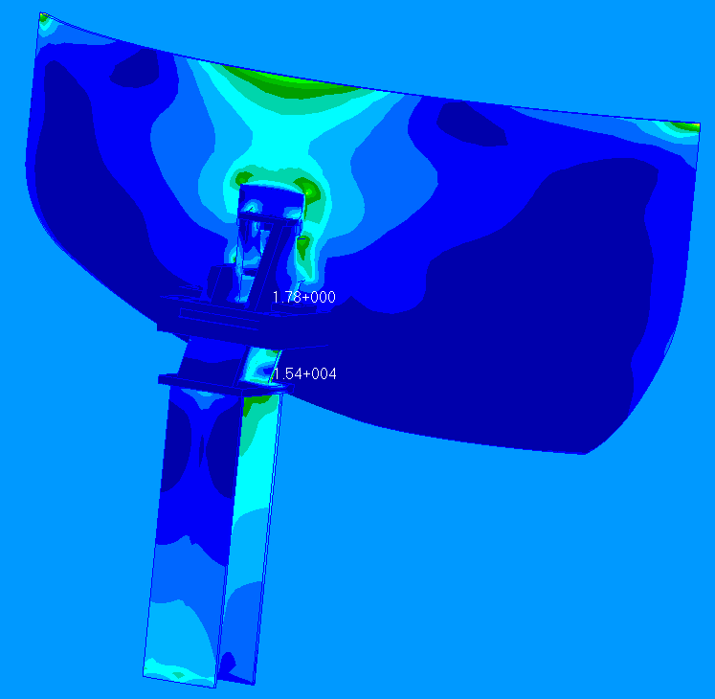
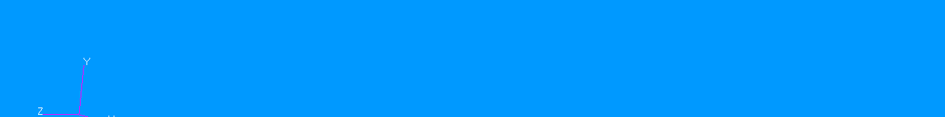
RUN #3 Results
Maximum stress on the total system for this run = 15,400. psi.

Slide 12
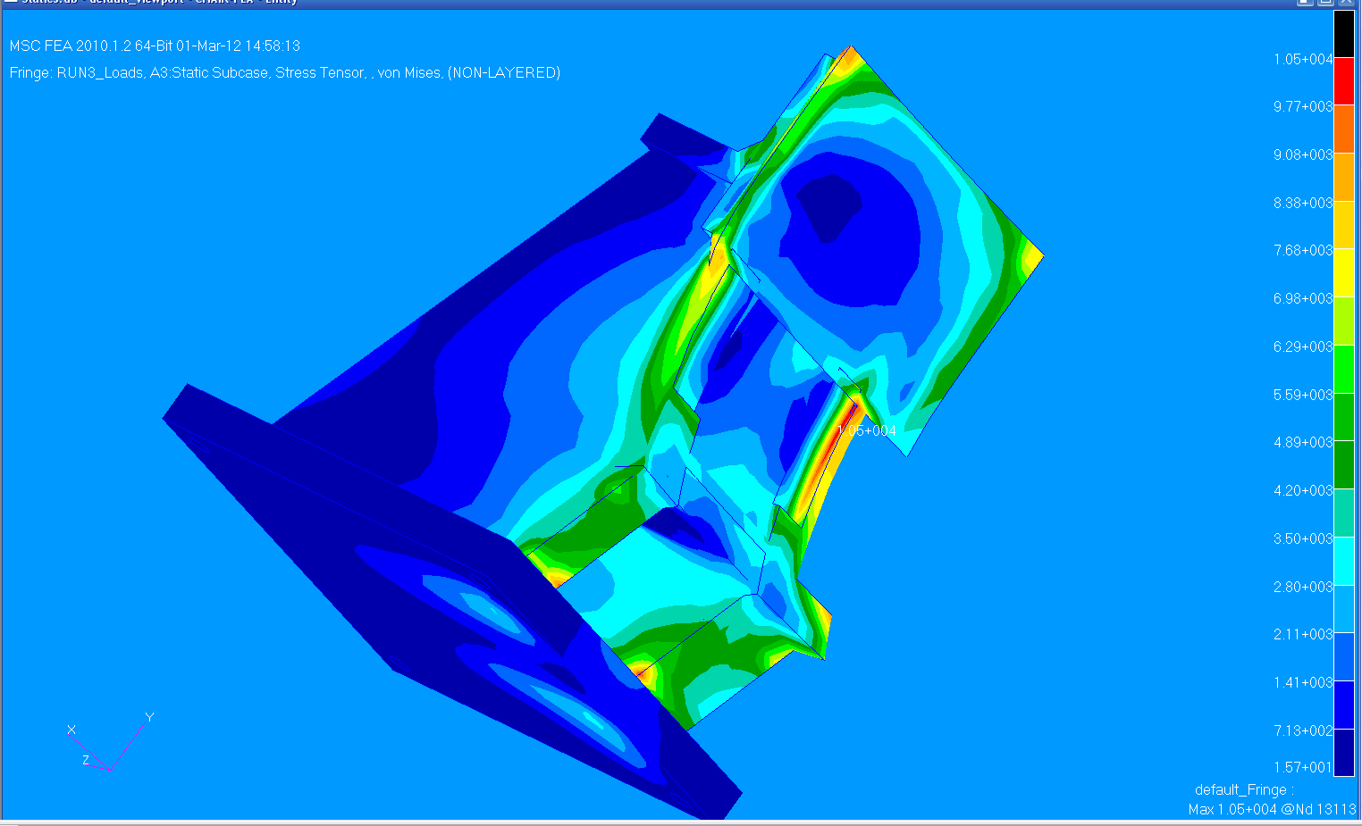
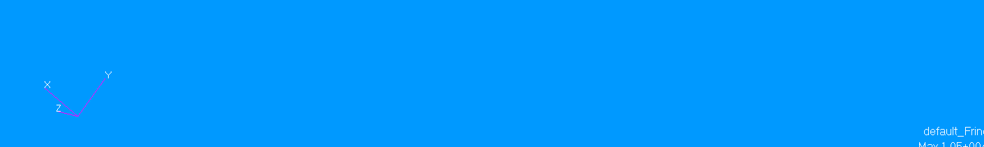
RUN #3 Results
Plate welded to the VV
VV Chair with welds, Maximum Stress = 10,500.psi

Slide 13
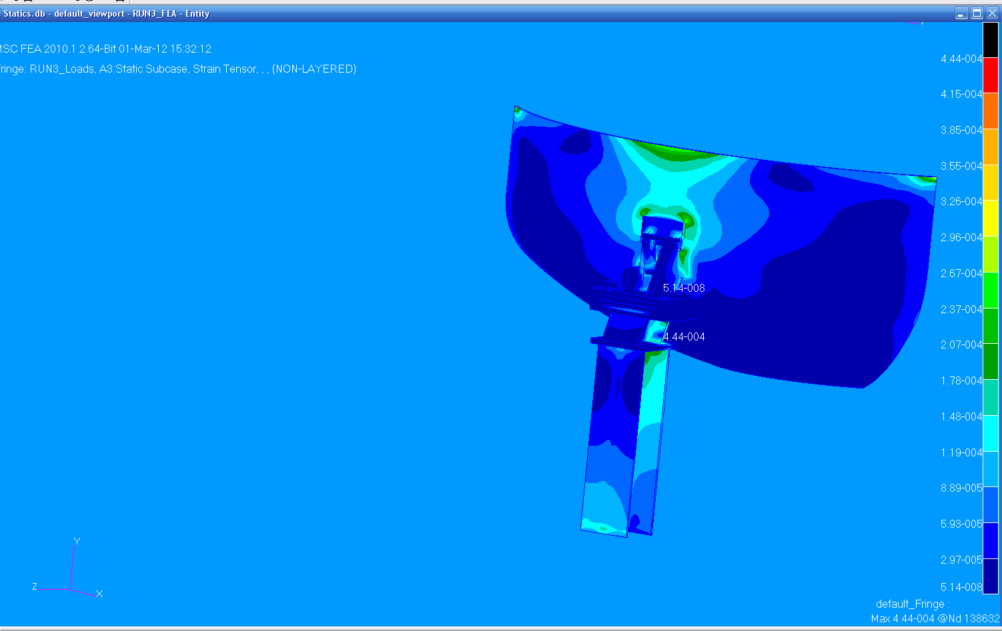
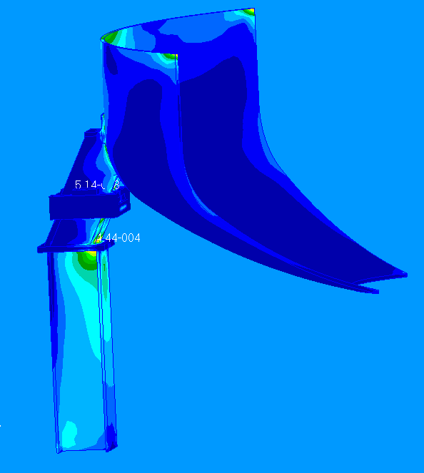
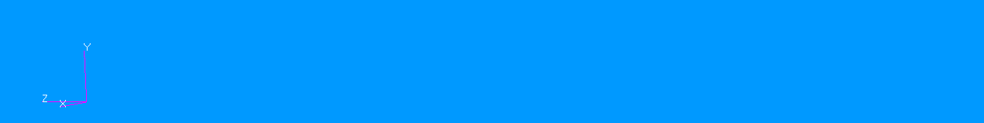
RUN #3 Results
Maximum strain on the total system for this run = .00044

Slide 14
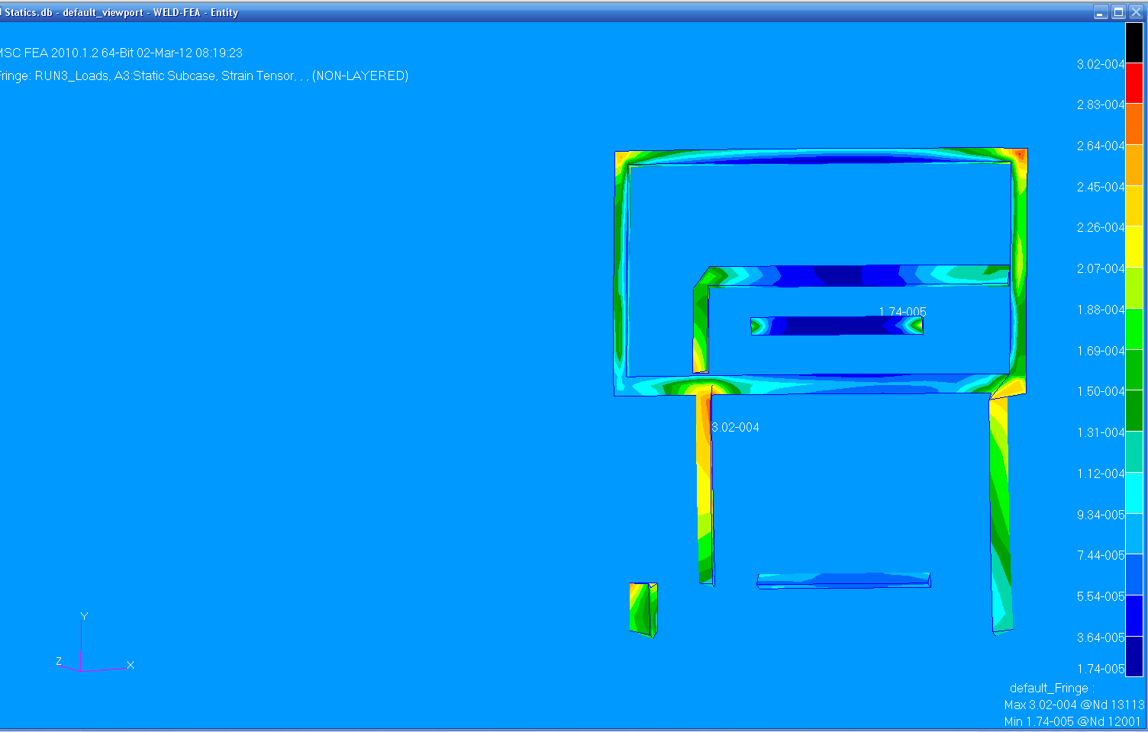
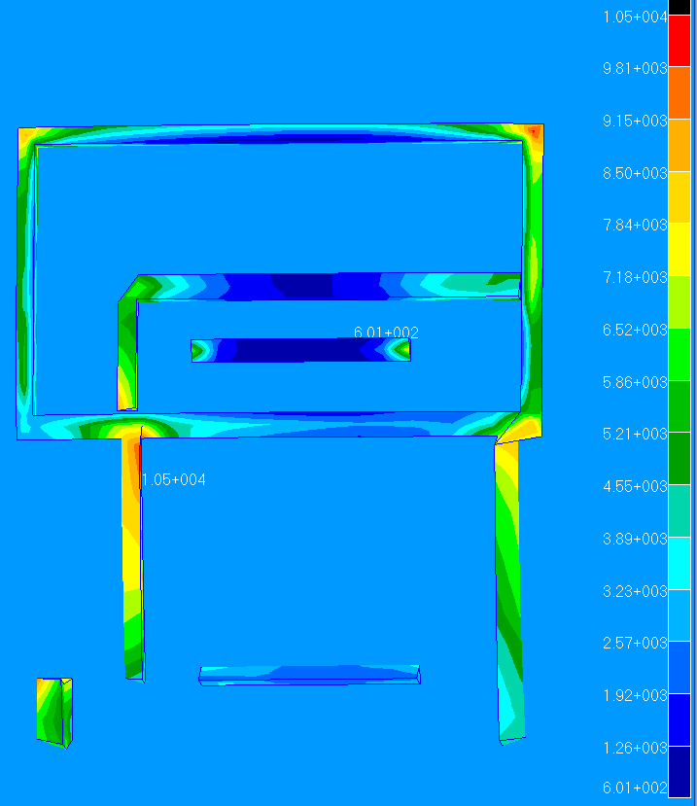
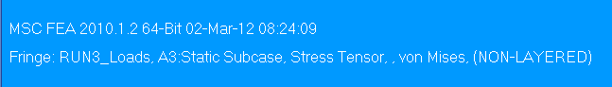
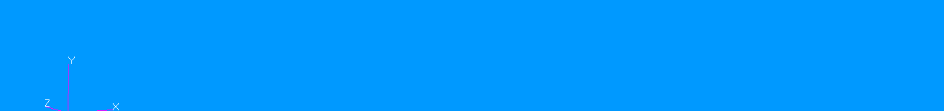
RUN #3 Results
VV – Plate weld frame
Chair to VV welds
Max Strain = .0003
Max Stress = 10,500.psi

Slide 15
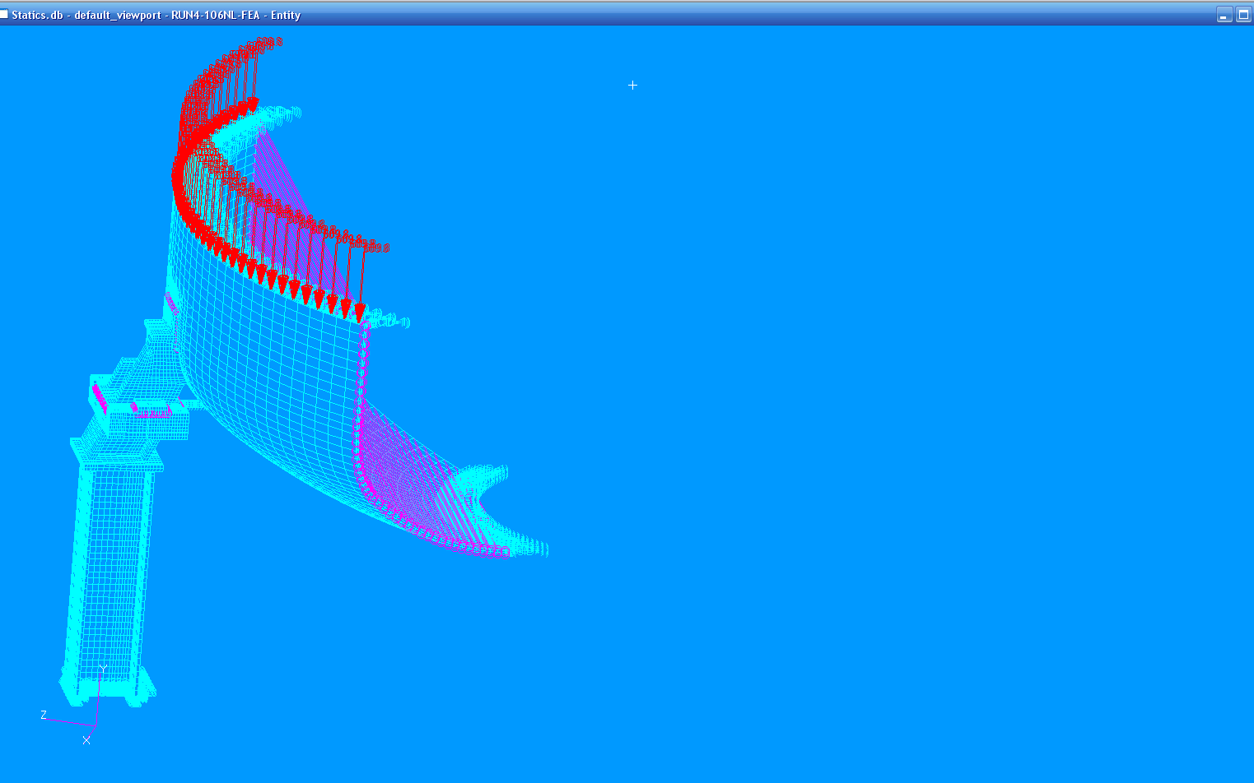
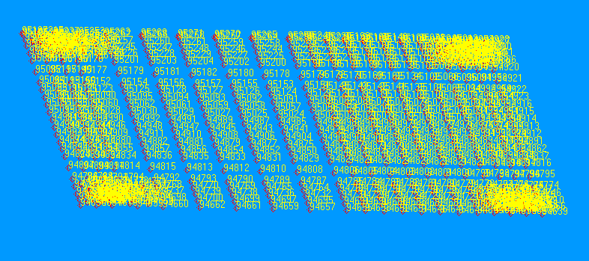
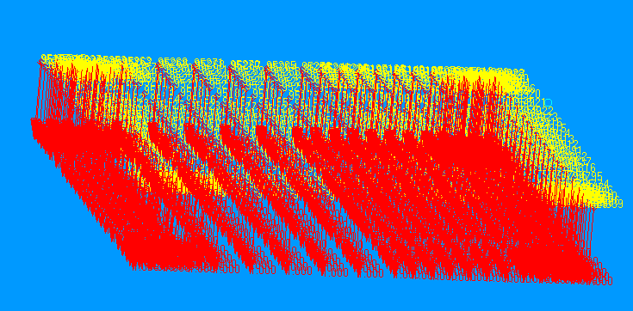
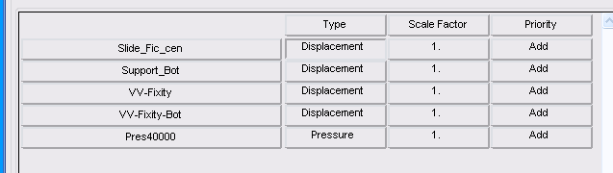

RUN #4 Non Linear static Sol 106
GAPs sliding between
the Chair and the Cradle
GAPs orientation in the -Y direction
Load Case “RUN4-Loads”

Slide 16
This is continuing with the non linear evaluation ?
P.R. 03/02/2012

