Slide 1
Inboard Diverter Tile Concepts Comparison
Design
Baseline with crossing T-Bars
Single Larger T-Bar
Single Larger T-Bar Split and Pinned (ala TFTR)
Three Point Rotating Supports
Smaller Tiles – 7.5 vs 15 deg – with Single Larger T-Bar
Smaller Tiles – 7.5 vs 15 deg – with Single Larger T-Bar – GRAFOIL under Base with 10 kN Preload on T-bar
All concepts subjected to the following:
Thermal - 5 MW/m2 for 5 sec
Eddy Currents – Br_dot= 520 T/s, Bz_dot=460 T/s for 1 ms
Halo Currents – 35 kA per 15 deg Tile
Results driven by Tensile Stress at Supports in ATJ

Slide 2
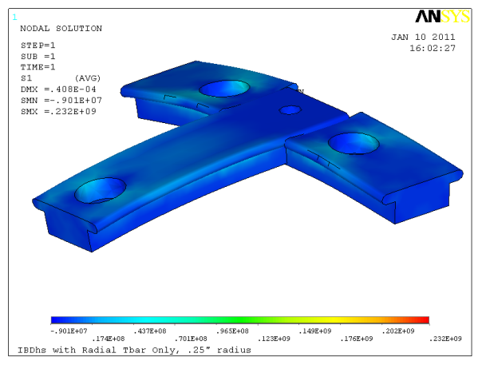
Baseline
Ibdhs102810/Ibdhs001_struct

Slide 3
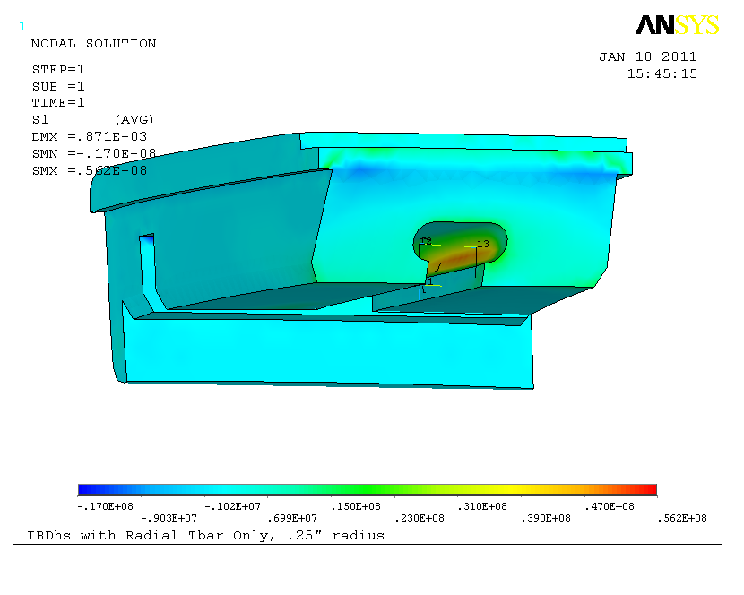
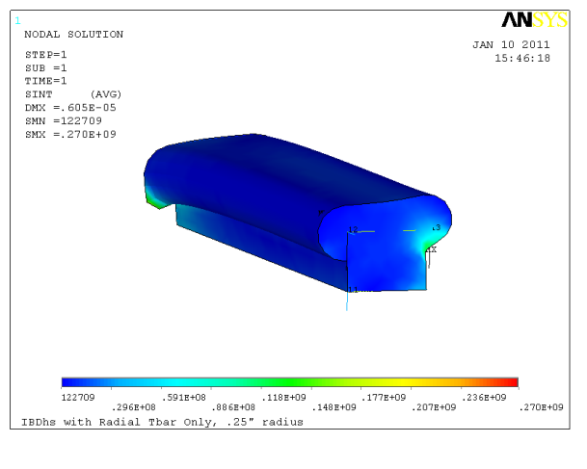
Larger T-Bar
Ibdhs112410/Ibdhs009_structx

Slide 4
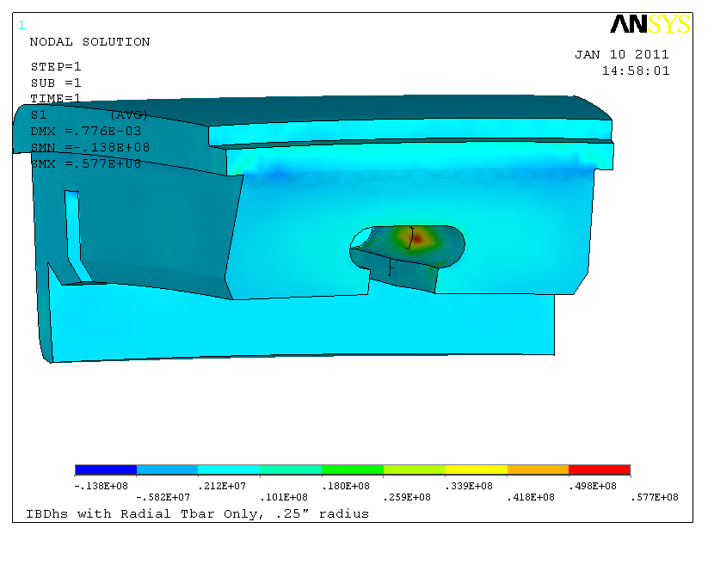
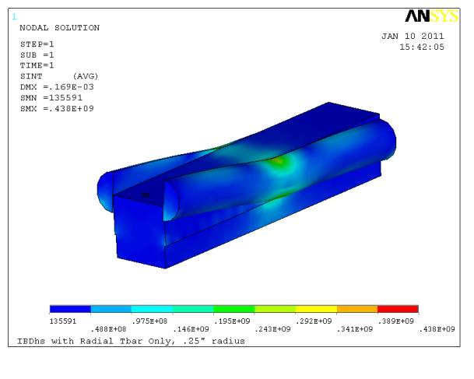
Split and Pinned
T-Bar
Ibdhs011011/Ibdhs804_struct

Slide 5
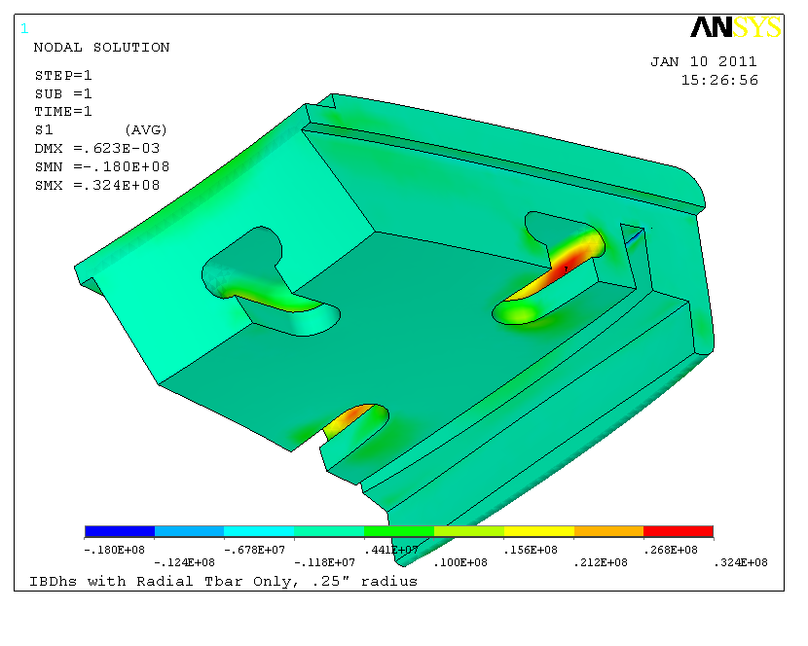
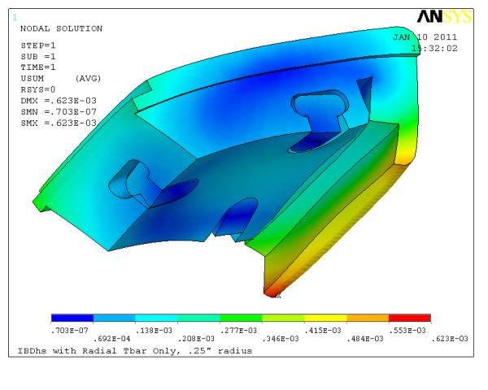
Three point pivoting supports
Ibdhs010511/Ibdhs703_struct

Slide 6
Pivoting Supports Details
Bolt
T-Bar
Spherical Washers
Retaining Clips
Not to scale

Slide 7
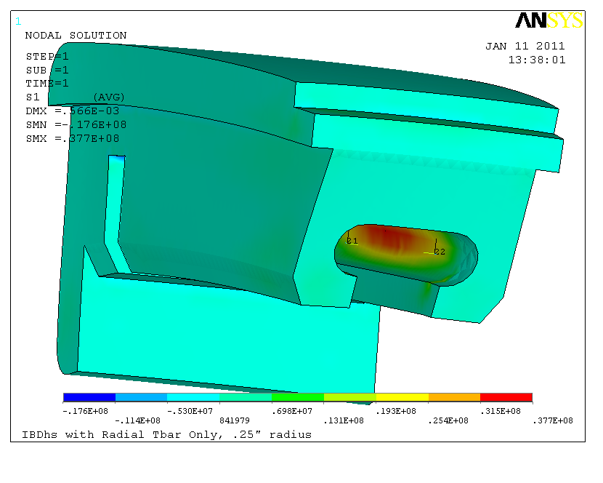
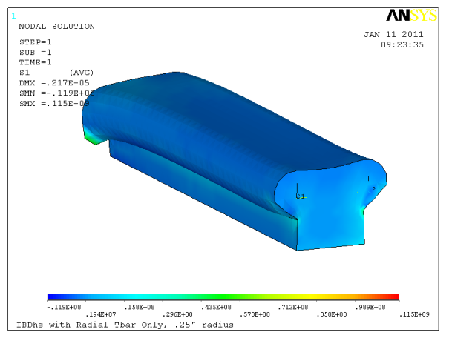
Smaller 7.5deg Tile
Ibdhs120810/Ibdhs101_struct
Ibdhs120810/Ibdhs101_struct19

Slide 8
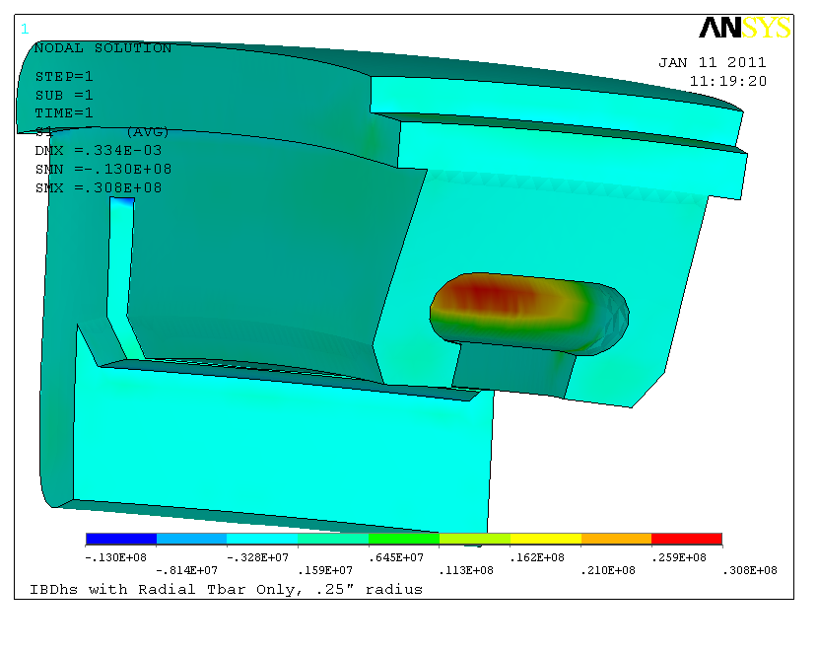
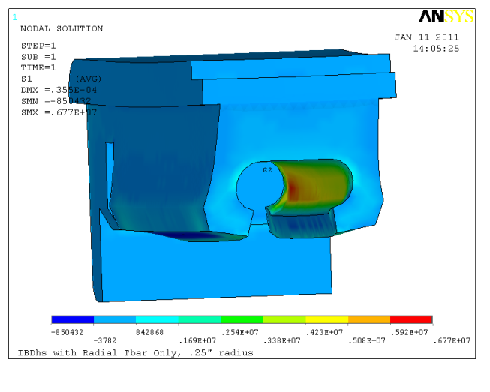
Grafoil under base of Tile and T-bar
T-bar Preloaded to 10 kN
Preload only much lower
Smaller 7.5deg Tile
Ibdhs120810/Ibdhs101_struct21

Slide 9
Summary
Design Concept | Peak Principal Tensile Stress, MPa, Th+EM | Peak Principal Tensile Stress, MPa, Th Only
Baseline with crossing T-Bars | 85.8
Single* Larger T-Bar | 56.2 | 19.4
Single Larger T-Bar Split and Pinned (ala TFTR) | 57.7
Three Point Pivoting Supports | 32.4 | 7.44
Smaller Tiles – 7.5 vs 15 deg – with Single Larger T-Bar | 37.7 | 14.1
Smaller Tiles – 7.5 vs 15 deg – with Single Larger T-Bar – GRAFOIL under Base with 10 kN Preload on T-bar | 30.8 | 23.6
*Single T-Bar Concepts need to provide radial constraint not explicitly modeled

Slide 10
Conclusions
Baseline with crossing T-Bars
T-slot to small to carry launching force and over turning moments from EM loads. Over constrains tile from thermal load
Single Larger T-Bar
Show improvement over baseline (above) but still over constrains tile from thermal along T-bar axis
Single Larger T-Bar Split and Pinned (ala TFTR)
Attempt to relieve thermal stress along axis – While flexible for thermal, unable to distribute launching load
Three Point Rotating Supports
Allows fairly free thermal expansion. Stress dominated by EM launching forces
Smaller Tiles – 7.5 vs 15 deg – with Single Larger T-Bar
Significant reduction compared to larger tile with Single Larger T-Bar
Gain in thermal stress for smaller tile less than expected due Tile/Tbar relative stiffness
Smaller Tiles – 7.5 vs 15 deg – with Single Larger T-Bar – GRAFOIL under Base with 10 kN Preload on T-bar
Reduces impact of EM loads (ie behaves like preloaded joint) but increases constraint from thermal load

Slide 11
Conclusions
Recommend design that shows better performance for thermal loads, while still performing adequately with EM loads
Thermal loads are more predictable. Better thermal margin may allow for higher heat fluxes if EM loads prove to be less severe
EM loads are less certain and analysis has assumed the worse

