Slide 1
Proposed Update to Force Calculation Method in DP Spreadsheet
C Neumeyer
Jan 13, 2011

Slide 2
Introduction
Prior versions of DP spreadsheet present forces based on 96 sets of OH/PF currents, multiplied by a 1.1 “headroom” factor, without plasma and without consideration of post-disruption current distribution
The headroom factor was intended to cover uncertainties which were not defined
More comprehensive force calculations are appropriate to ensure that design basis brackets nominal conditions:
Coil currents only
Coil currents with plasma
Post-disruption coil currents
Headroom should be retained in all three cases to provide margin over equilibria calculations which have some error bar
Error bar is unknown (to writer)
Various physics assumptions are inherent in equilibria calculations
10% margin is chosen lacking other guidance

Slide 3
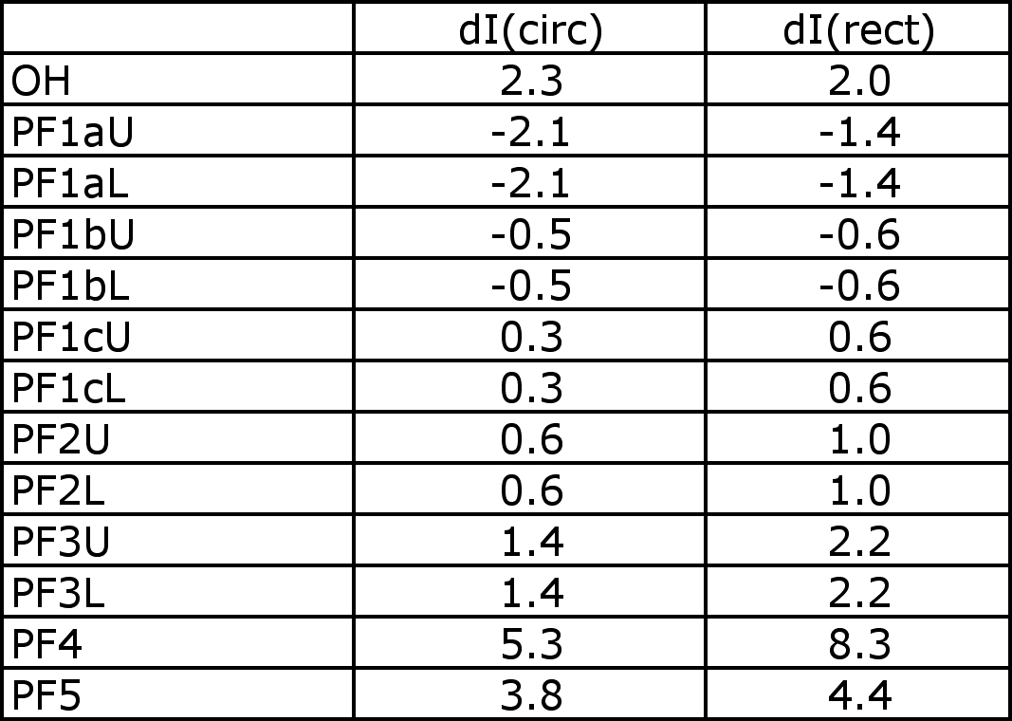
Plasma Modeling (1)
Two versions of influence matrices have been computed
R Hatcher using circular plasma (r=0.934m a=0.570m, same as nominal NSTX CSU plasma) with constant current density
R Woolley using rectangular plasma (r=1.07m dr=1.1m dz=2.0m) with constant current density (same area as inside last closed flux surface of actual plasma)
Comparison of effect of PF5U, e.g., on the plasma indicates -2.6lb/kA^2 for circular and -2.2lb/k^2 for rectangular (~20% discrepancy)
Differences probably differ on various coils
Mutual inductance matrix (on which flux-conserving post-disruption current shifts are based) also differs depending on the plasma model
Comparison of current shifts due to 2MA disruption is as follows
Large discrepancies
are noted

Slide 4
Plasma Modeling (2)
Comparison of results for three cases is recommended to guide choice of model and calculation of influence matrix and current shifts
Circular model as used by R Hatcher
Rectangular model as used by R Woolley
Typical plasma equilibria from J Menard with non-uniform current density
Force influence matrices should probably be based on 3. above, but it would be interesting to understand how 1. and 2. compare to 3.
Models 1. and 2. are easy to implement for various purposes, 3. is not
Same for mutual between plasma and each coil
The result from 3. probably falls between 1. and 2. because actual plasma current density is closer to 1. but plasma geometry is closer to 2.

Slide 5
Current Shifts (1)
Flux-conserving calculation (developed by R. Woolley) can be used to estimate current shifts
Conservative because it ignores energy dissipation in passive structures and coils as flux disappearing from plasma is replaced by flux from coils with shifted currents
Difference between flux-conservation vs. complex behavior should be investigated and understood
Calculation is based on mutual inductance matrix
However, mutual inductance matrix depends on which coil circuits are active
Some coil circuits are often left open when not needed for plasma shaping
PF4, PF1bU/L, PF1cU/L
How to deal with mutual inductance matrix which may vary depending on experiment underway?

Slide 6
Current Shifts (2)
J. Menard’s 96 cases include some where PF4, PF1bU/L, PF1cU/L have zero current
In practice, zero current is achieved by configuring for open circuit conditions
Using bus links in the “Safety Disconnect Switches” (SDS)
Leaving the SDS line switches in the open position
Zero current is not reliably achieved with circuit closed and power supply feedback control set to a zero reference
Induced voltages can transiently overpower the power supply
If zero current operation is attempted with closed circuit then mutual inductance matrix is preserved
Current shifts are less if inductance matrix is preserved

Slide 7
Current Shifts (3)
Inconvenient to use different set of current shifts for each combo of PF4, PF1bU/L and PF1cU/L for 96 cases in DP spreadsheet
Alternate method is used and is conservative
Compute worst case current shift for each coil based on all combos of PF4, PF1bU/L, PF1cU/L open and use that value for all 96 cases (based on 2MA disruption)
Worst case values

Slide 8
Current Shifts (4)
Various DCPS options exist to deal with open circuited coils
Use worst case values per DP spreadsheet method
Monitor SDS link and switch positions
Nuances
Uni-polar circuits (PF1b, PF1c, PF4, and PF5) can effectively transition from closed to open when induction tries to drive current backwards through thyristors
If SDS monitoring is not used then may need to prohibit plasma operations when circuits other than PF1b, PF1c, and PF4 are open. Such situations would be highly unusual and in most cases impossible.
Perhaps DCPS could (conservatively) modify mutual matrix (exclude appropriate row and column) in real time whenever a coil current is zero (which could be due to open circuit or happenstance with closed circuit)

Slide 9
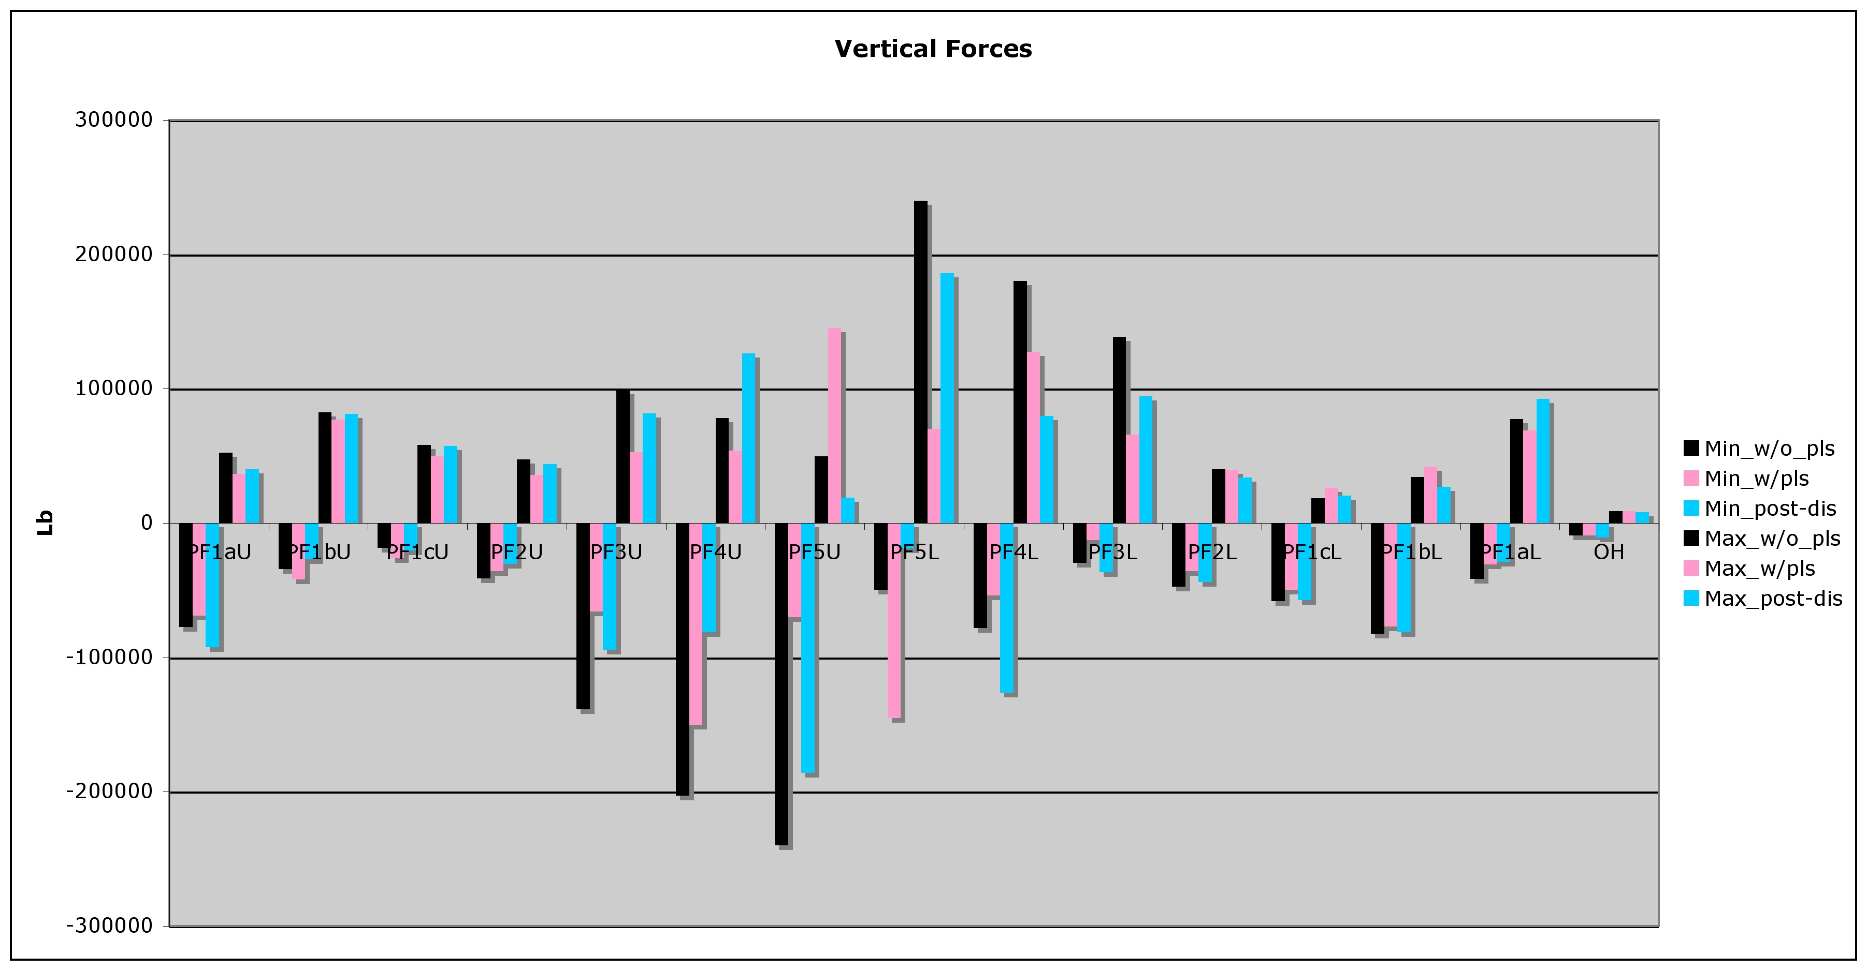
Preliminary DP Findings (1)
New results will dominate over prior criteria in several cases

Slide 10
Preliminary DP Findings (2)
New results will dominate over prior criteria in several cases

Slide 11
DP Spreadsheet Revision
Worst of the three cases will be reported on the web page for
the nominal condition
Will continue to publish worst case PS combo cases (saved current
sets from prior revision avoids need to re-run XL solver for all cases)
Will utilize circular plasma model for now (may require later revision)
Will incorporate minor changes in PF1a conductor cross section as requested by J Chrz

Slide 12
Summary/Conclusions
Method is proposed for improved force calculations
Plasma model needs refinement
Might be prudent to put a safety margin on the forces and/or the allowables considering limitations on calculation accuracy
Difference between flux-conserving current shift and more complex actual behavior should be investigated to determine level of conservatism

